Slide 2
What the videos and what do you think about it?

Slide 4
WRITING
LESSON 7
READING

Slide 5
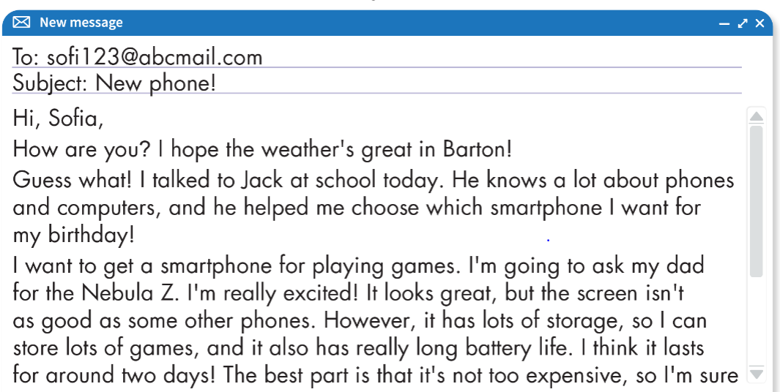

Slide 6
Playing games

Slide 7
2. She feels _________about getting her new smart phones.
excited

Slide 8
battery life

Slide 9
too expensive

Slide 10
5. Kate is having a _________________next Sunday.
birthday party

Slide 13
ONLINE GAME

Slide 15
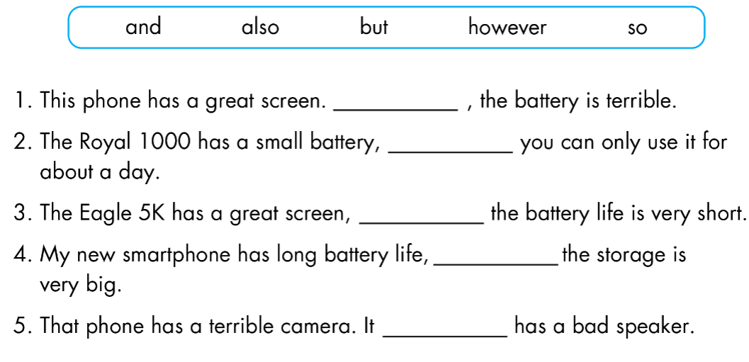
However
so
but
and
also

Slide 16
WARP-UP
Unit 5
SCIENCE AND TECHNOLOGY
Lesson 7: READING & WRITING
Ms Phương
Zalo: 0966765064
Reading about an email about a new smartphone.
- Learning about using conjunctions to make longer, more interesting sentences.

Slide 17
Homework
- Do the exercises in WB: Listening and Reading (page 36).
- Do the vocabulary exercise in Tiếng Anh 8 i-Learn Smart World Notebook (page 44).
- Prepare: Unit 6 - Lesson 3 – Speaking and Writing (page 63 – SB).

