Slide 1


Slide 2
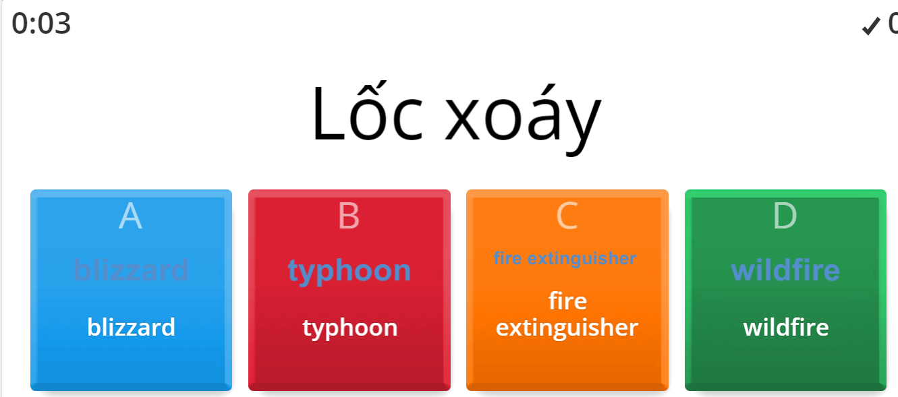

ONLINE GAME

Slide 3




LESSON 5
Ms Phương
Zalo: 0966765064
GRAMMAR

Slide 4

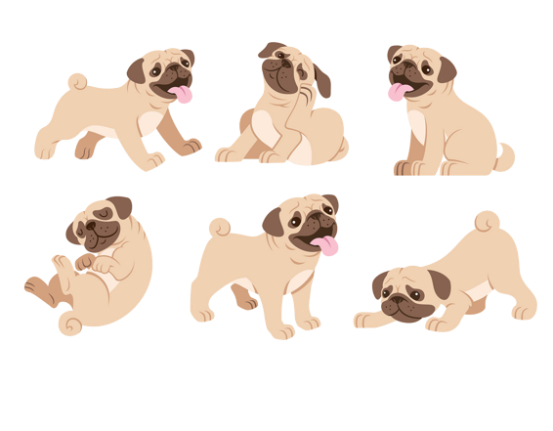




Prepositions of place
(Giới từ chỉ vị trí)
MsPham
0936082789
in
/ɪn/
on
/ɒn/
under
/ˈʌndər/
next to
/ˈnekst tu/
above
/əˈbʌv/
behind
/bɪˈhaɪnd/
in front of
/ɪn frʌnt əv/
between
/bɪˈtwiːn/
among
/əˈmʌŋ/

Slide 5
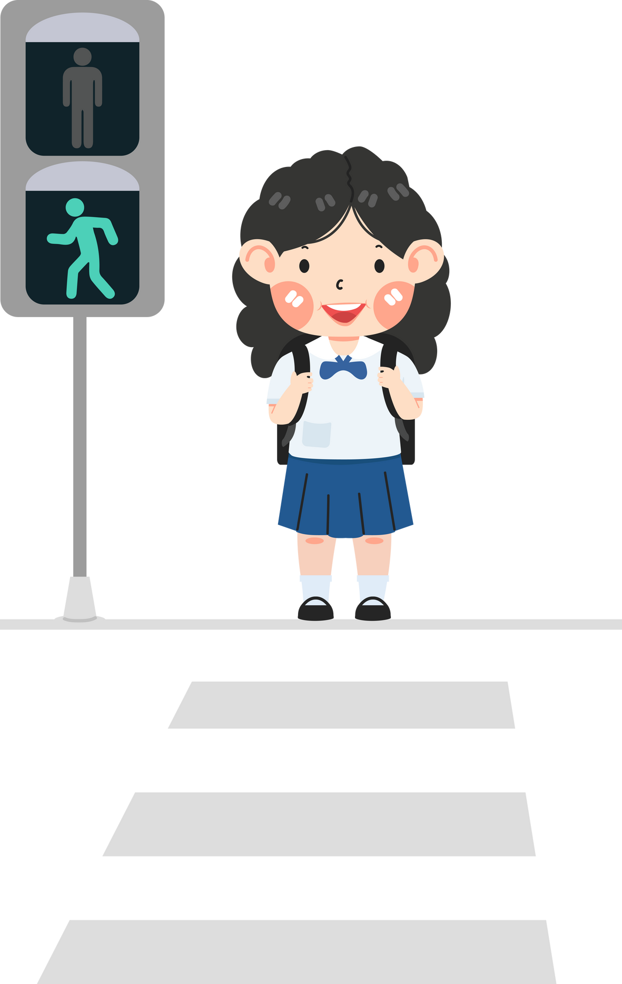
across
Prepositions of movement
(Giới từ chỉ sự chuyển động)

Slide 6


along
Prepositions of movement
(Giới từ chỉ sự chuyển động)

Slide 7

through
Prepositions of movement
(Giới từ chỉ sự chuyển động)

Slide 8

over
Prepositions of movement
(Giới từ chỉ sự chuyển động)

Slide 9

into
Prepositions of movement
(Giới từ chỉ sự chuyển động)

Slide 10
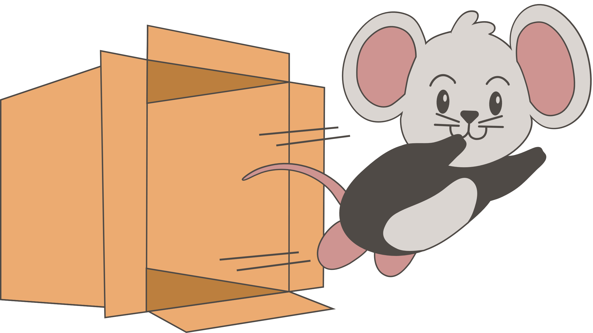
out of
Prepositions of movement
(Giới từ chỉ sự chuyển động)

Slide 11

around
Prepositions of movement
(Giới từ chỉ sự chuyển động)

Slide 12

Prepositions of movement
(Giới từ chỉ sự chuyển động)
inside

Slide 13

Prepositions of movement
(Giới từ chỉ sự chuyển động)
outside

Slide 14
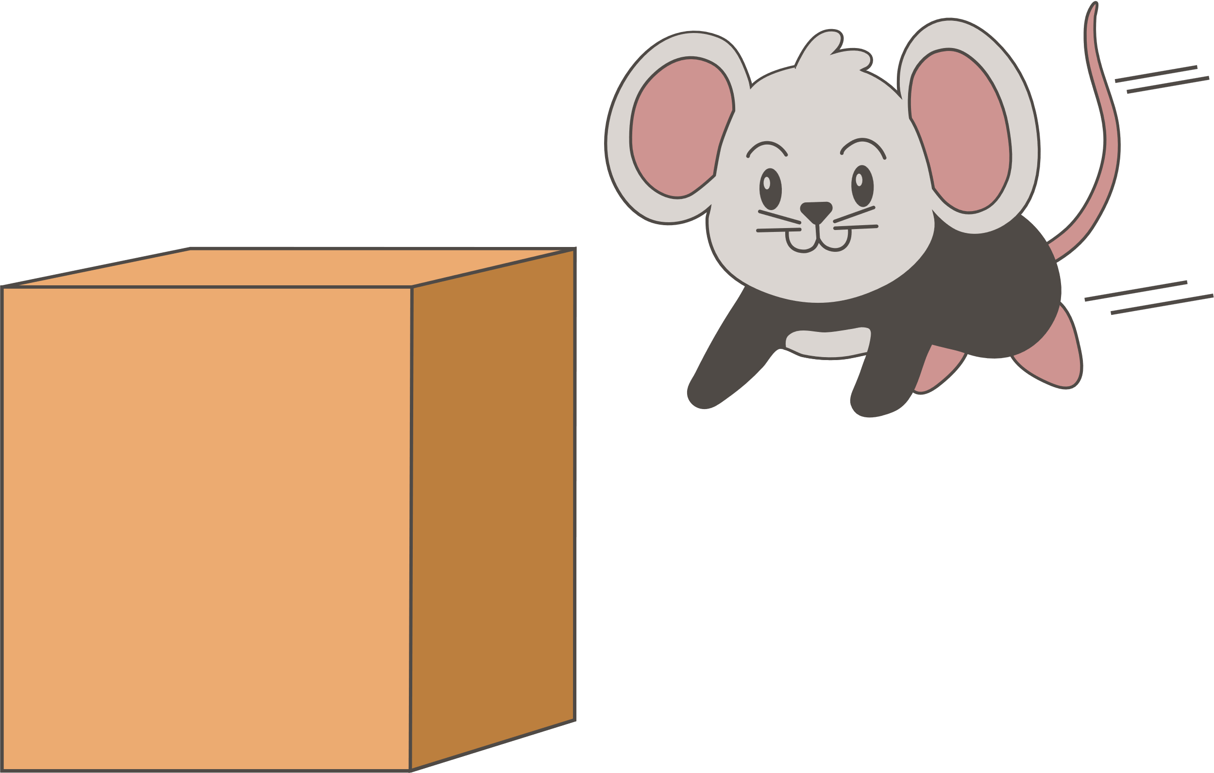
Prepositions of movement
(Giới từ chỉ sự chuyển động)
to/toward

Slide 15

Prepositions of movement
(Giới từ chỉ sự chuyển động)
up

Slide 16

Prepositions of movement
(Giới từ chỉ sự chuyển động)
down

Slide 17
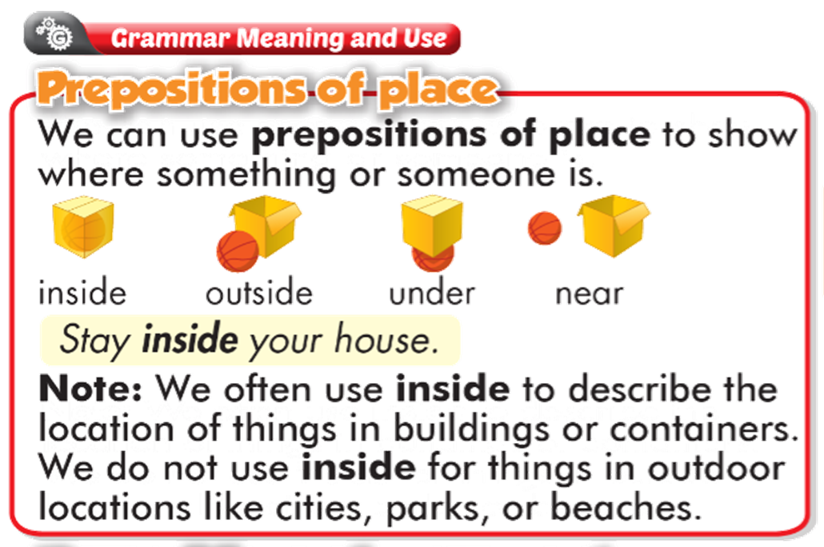

Slide 18
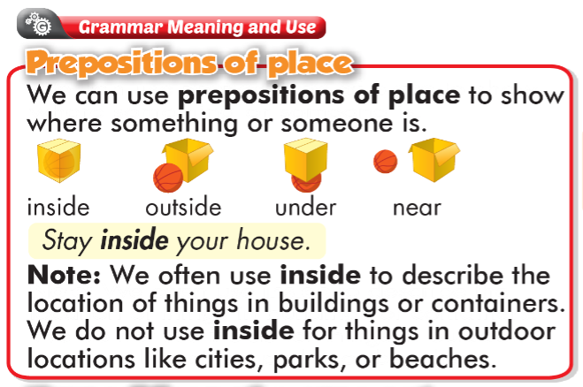
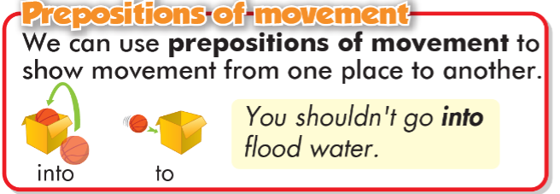

Slide 19
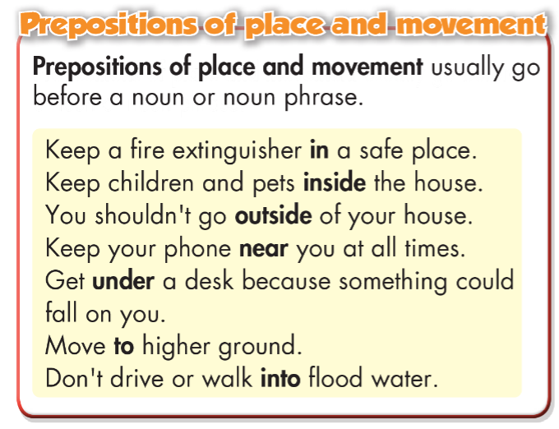

Slide 20
a. Read the sentences, then circle the correct words.
Stock up on supplies and stay inside/under your home.
In a flood, don't go outside/into the water.
Keep a phone near/to you and call emergency services if you are in danger.
If there's a tsunami, move into/to higher ground.
If there's an earthquake, get outside/under a table.
Board up doors and windows, and don't go near/outside of your house.

Slide 21

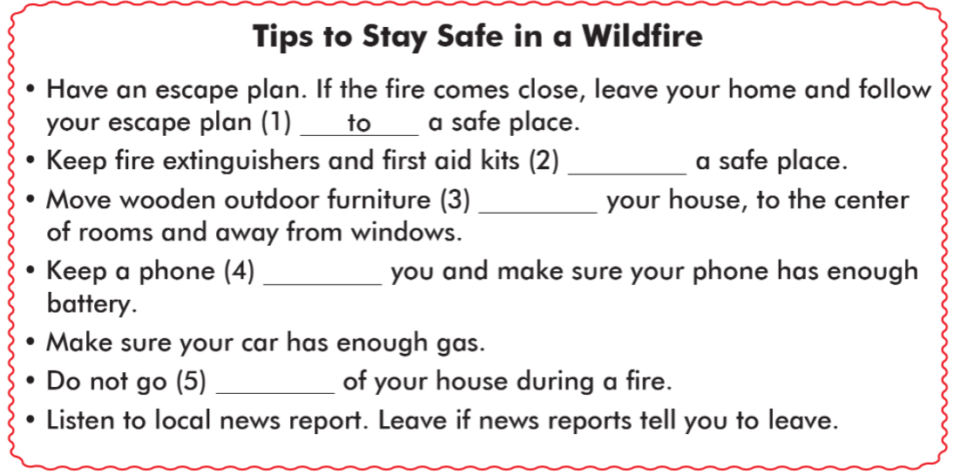
in
inside
near
outside

Slide 22
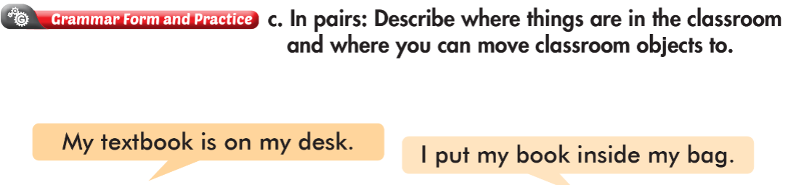


Slide 23
WARP-UP
Unit 4
DISASTERS
Lesson 6: GRAMMAR
Ms Phương
Zalo: 0966765064
To practice and use Preposition of place and movements correctly

Slide 24

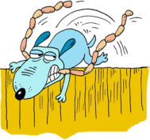
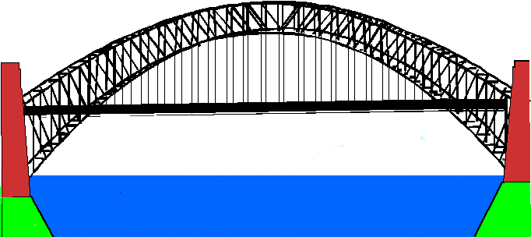
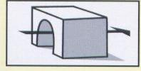

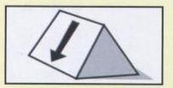
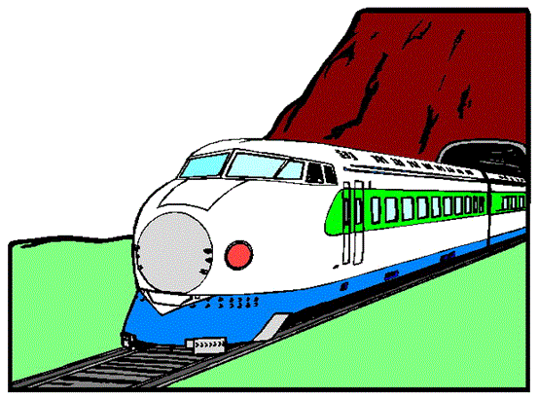
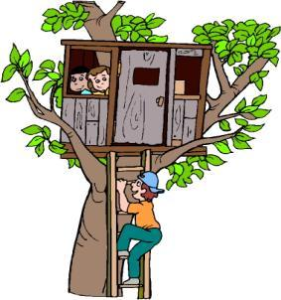





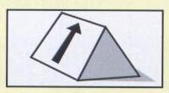
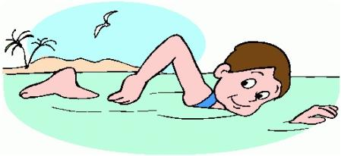
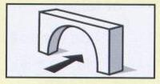
PREPOSITIONS OF MOVEMENT
through
DOWN
over
ACROSS
UP
UNDER
Notes:
PREPOSITIONS OF MOVEMENT

Slide 25
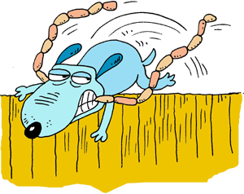

PREPOSITIONS OF MOVEMENT
up
under
over
across
The dog stole the sausage and quickly jumped…………… the wall.
OVER

Slide 26
PREPOSITIONS OF MOVEMENT
across
up
over
through
THROUGH
The train went …………….… a very long tunnel.

Slide 27
PREPOSITIONS OF MOVEMENT
up
under
over
down
The ship sailed ………… the bridge and then disappeared over the horizon.
UNDER

Slide 28
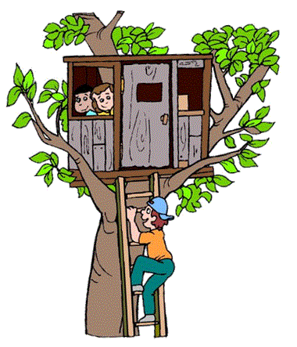
PREPOSITIONS OF MOVEMENT
up
through
across
over
John climbed ……… the ladder to play with the boys in the tree house.
UP

Slide 29

PREPOSITIONS OF MOVEMENT
across
down
over
under
DOWN
Santa went ……….. the chimney and
left the presents next to the Christmas tree.

Slide 30

PREPOSITIONS OF MOVEMENT
through
over
up
across
ACROSS
Paul swam ………… the lake to the other side.

Slide 31
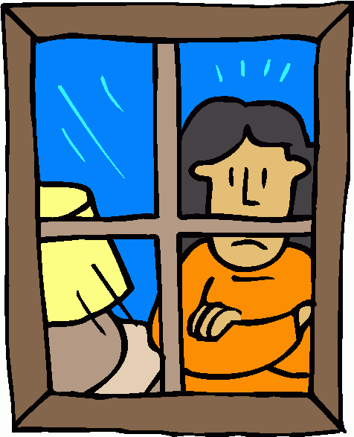
PREPOSITIONS OF MOVEMENT
up
through
over
down
THROUGH
Mum was looking ……..… …..the window when we arrived. She was worried.

Slide 32
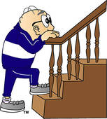
R
PREPOSITIONS OF MOVEMENT
through
across
down
up
UP
Mr. Roberts went ……… the stairs to his bedroom.
THE END

Slide 33

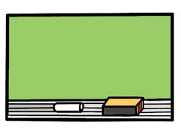




off
up
down
around
over
through
under
onto
into
past
away from
across
towards
out of
along

Slide 34


up
round
over
out of
Sally was very happy and she started dancing …….……. and …………….
round
round

Slide 35
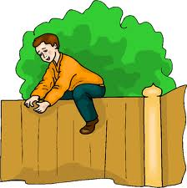
down
up
over
past
Adam jumped ………. the fence and escaped .
over

Slide 36
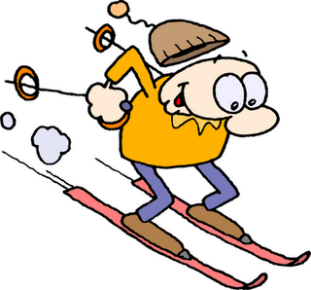

down
across
towards
through
Paul was skiing ………. the hill really fast!
down

Slide 37

down
into
onto
out of
The workers took the objects ……..… a brown box .
out of

Slide 38
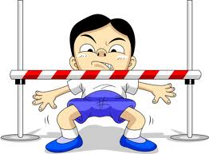
under
up
over
past
Max tried to walk ….……. the pole. It was really difficult!
under

Slide 39
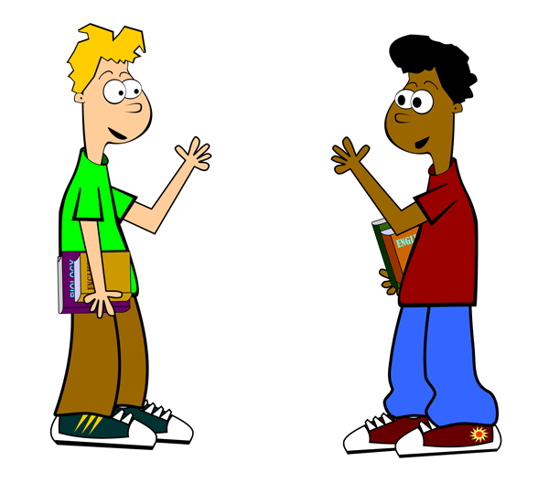
over
towards
up
along
The new student walked ……….
me smiling and said: Hello!.
towards

Slide 40
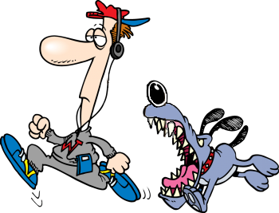
along
towards
past
away from
The postman ran ……….………the angry dog.
away from

Slide 41
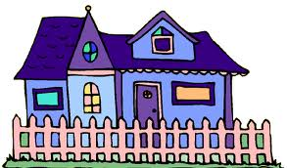
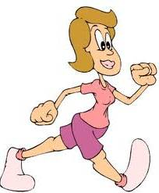
past
up
across
down
Anna’s mum walks ……….…. my house every day.
past

Slide 42
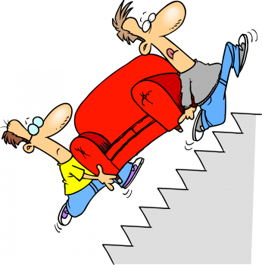
down
up
off
towards
Uncle Jim and Dad carried the sofa ……….. the stairs.
up

Slide 43
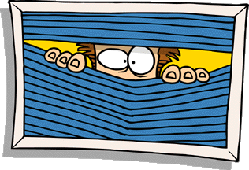
onto
along
through
into
We saw the nosy neighbour looking ……………..…. the window blinds.
through

Slide 44
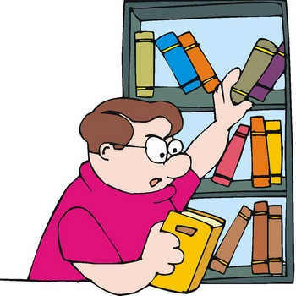
off
away from
over
onto
Joe took the book that was on the table and put it ………. the top shelf.
onto

Slide 45

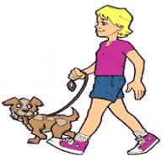
onto
along
up
into
Peter walked his dog ……….….
the beach early this morning.
along

Slide 46
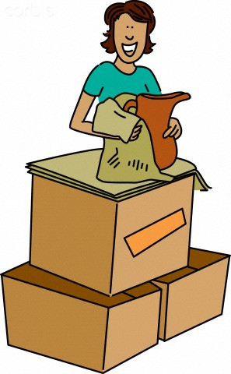

into
down
over
along
Emma collected all her things and put them ………. big boxes.
into

Slide 47
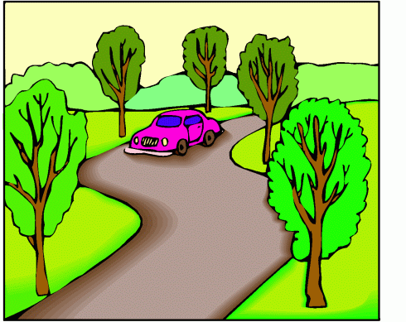
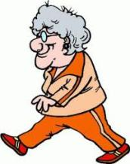
along
through
over
across
An old woman was walking
………. the road.
across

Slide 48

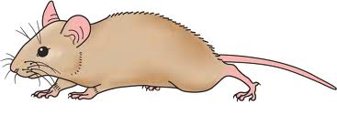

into
off
across
onto
My schoolbag fell ………. the
chair.
off

Slide 49

Homework
1. Review Prepositions of place and movement.
2. Do the exercises on page 23 WB.
3. Do the exercises in Tiếng Anh 8 i-Learn Smart World Notebook on pages 33.
4. Prepare the next lesson (page 40-41, SB)

Slide 50


