Slide 2
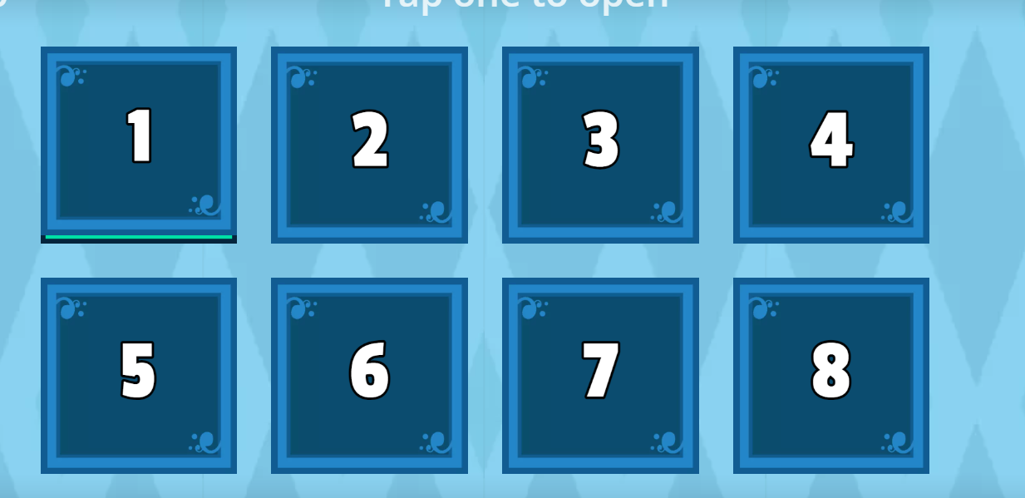
ONLINE GAME

Slide 3
Watch the video and see the project of the grade 7 for their school.

Slide 4
LESSON 8
WRITING
SPEAKING

Slide 5
Discuss with your partner how to make your school greener.
Recycling Program
GREENER SCHOOL
Positive Impact on Environment
Waste Reduction
Environmental Education

Slide 6
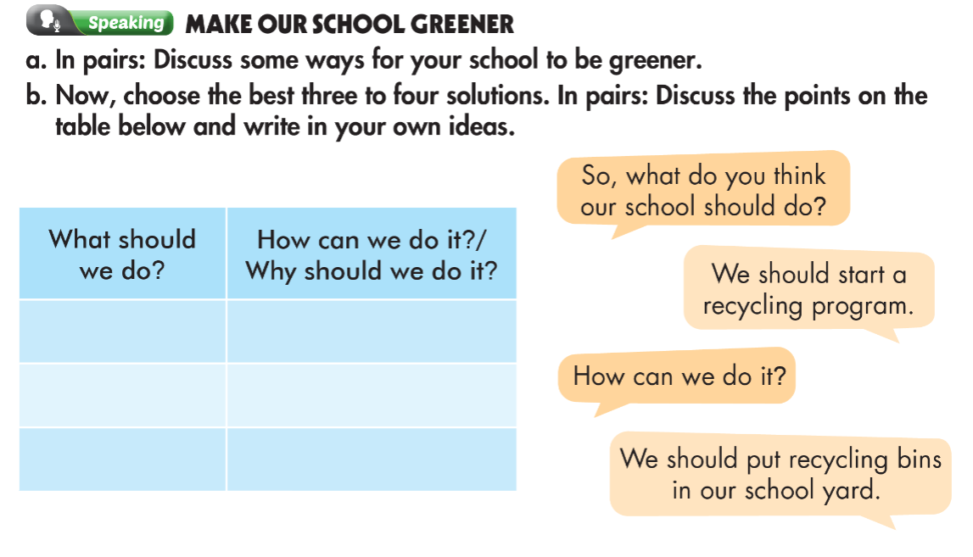

Slide 7
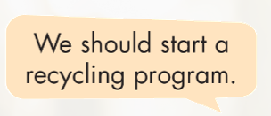

Slide 9
What is a structure of a guide?
How many sections are there in a guide?
Which part do we have to use imperatives?
What do you write in a title and introduction?

Slide 10
How to write a guide?
Title
What is a guide for.
Introduction
What the topic is.
Use the imperatives.
Headings
What to tell about.
Should be clear and easy to understand.
Explain
Should be clear, short.

Slide 12
How to Make Our School Greener
Our school has many environmental problems. Here are some simple things we can do to help our school's environment. Recycle everything. We should get more recycling bins and start a recycling program. This will help improve land pollution. Plant more trees. We should plant more trees around the playground. This will help reduce air pollution. Use less plastic. We should sell less plastic in our school cafeteria to reduce trash. This will help reduce plastic pollution on land and in the sea.
Sample writing

Slide 13
WARP-UP
Unit 3
PROTECTING THE ENVIRONMENT
Lesson 8: Writing & Speaking
Speaking: discuss some ways for your school to be greener.
Writing: How to write a guide.
Ms Phương
Zalo: 0966765064

Slide 14
Homework
1. Do the exercises on page 19 WB.
2. Prepare the next lesson (page 33 SB)
3. Do the exercises in TA 8 i-Learn Smart World Notebook, page 26

Slide 15
Homework
Review how to write a guide.
- Finish the writing part.
- Do the exercises in WB: Writing (page 19).
- Play consolidation games in Tiếng Anh 8 i-Learn Smart World DHA App on www.eduhome.com.vn
- Prepare: Unit 3 – Review – page 90.

