Slide 2
LESSON 10
REVIEW 2

Slide 3
Vocabulary review
No | Word | Meaning
1
amount (n)
Số lượng
2
entertainment(v)
Giải trí
3
facility (v)
Thiết bị
4
fresh (v)
Tươi mới
5
nature (n)
Thiên nhiên
6
noise (n)
Tiếng ồn
7
peace (n)
Hoà bình
8
quiet(n)
Yên bình
9
room
Phòng/ căn phòng

Slide 4
Vocabulary review
No | Word | Meaning
10
vehicle (n)
Xe cộ
11
spinning top (n)
Con quay
12
folk (n)
Dân gian
13
herb (n)
Chăn (gia súc)
14
hometown (n)
Quê hương
15
jump rope (n)
Nhảy dây
16
pick (n)
Thu hoạch
17
tug of war (n)
Kéo co
18
people’s committee (n)
Hội đồng nhân dân

Slide 5
Vocabulary review
No | Word | Meaning
19
candied (n)
Tẩm đường
20
eve (v)
Đêm trước
21
take place (v)
Xảy ra, diễn ra

Slide 6
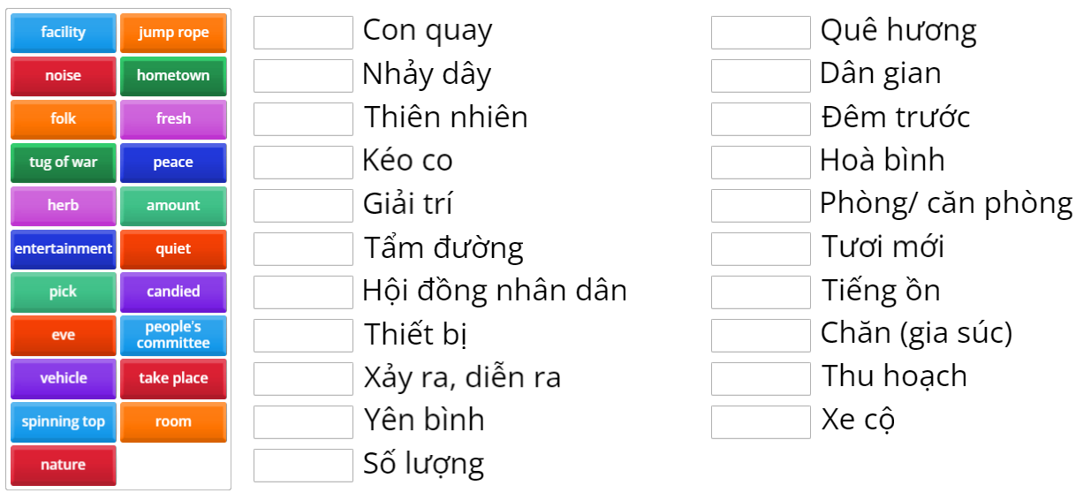
ONLINE GAME

Slide 7
Động từ ( Diễn tả Thích/Ghét + Danh Động Từ ( V-ing)
Like ( Thích) | Dislike ( Không thích)
Like : thích Enjoy : thích Prefer : Thích ( thường mang tính lựa chọn thích làm gì hơn) | Hate : Ghét Don’t like : Không thích = dislike

Slide 8
Qui tắc thêm “ing” vào động từ
V | Qui tắc | Ví dụ
 |  | V | Ving
- kết thúc là:
ng - p - e
Bỏ e
thêm “ing”
come
take
make
coming
taking
making
1
- kết thúc là:
p - ng – p
Và có trọng âm vào âm tiết này
Nhân 2 phụ âm cuối và thêm “ing”
run
sit
permit
running
sitting
permitting
2

Slide 9
Qui tắc thêm “ing” vào động từ
V | Qui tắc | Ví dụ
 |  | V | Ving
- kết thúc là:
“ie”
Đổi ie → y
thêm “ing”
lie
die
lying
dying
3
- Còn lại
Thêm “ing”
cook
go
see
begin
cooking
going
seeing
begining
4

Slide 10
Qui tắc thêm “ing” vào động từ
V kết thúc là: n.p.e → Bỏ e, thêm “ing”
V kết thúc là: p.n.p và có trọng âm → nhân 2 phụ âm cuối, thêm “ing”.
V kết thúc là: ie → Bỏ ie, thêm “ing”.
Các V còn lại: thêm “ing”.

Slide 11
PRESENT SIMPLE FOR FUTURE USE
Chúng ta sử dụng thì hiện tai đơn mang nghĩa tương lai khi nói về những lịch trình đã được sắp xếp ví dụ như : Lịch chiếu phim, chiếu bóng, tàu chạy, thời khoá biểu, thời gian biểu.

Slide 12
GIỚI TỪ CHỈ THỜI GIAN
IN
ON
at
Part of the day ( buổi)
Days ( thứ)
Time ( giờ)
In the morning , in the afternoon, in the evening
At 6 o’clock , at 10:30 p.m
Ms Phương
Zalo: 0966765064
Months ( tháng)
On Monday , on Sundays
In January , in May , in December…..
Date ( ngày)
Meals ( bữa ăn)
Seasons ( mùa)
at breakfast , at lunch , at dinner
On 15th Monday , on Tuesday 2nd
In summer, in spring, in winter, in autumn /fall.
Holidays ( kỳ nghỉ)
Parts of special day
Year ( năm)
at Christmas , at Easter , ….
In 2021 , in 2000
on Monday morning, on Tuesday afternoon.
Phrases ( cụm từ)
Decade, century( thế kỷ, thập kỷ)
At night , at midnight , at the moment, at the weekend, at the same time, at present…
In the 80s, in the 20 century.

Slide 13
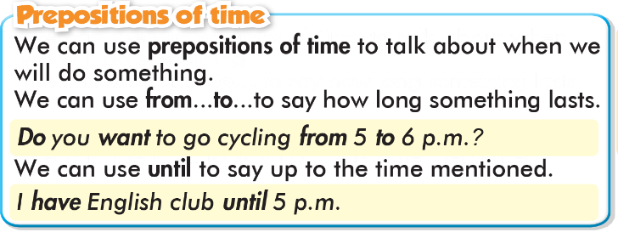
GIỚI TỪ CHỈ THỜI GIAN
From….to: Từ…..đến
Until = Till : Cho tới khi

Slide 14
Circle the correct answers.
1. It's going to take a long time to get home. There are lots of ________ on the street.
a. spinning tops b. vehicles c. noises
2. I'm going back to my ___________ this weekend. My parents still live there.
a. hometown b. vehicle c. room
3. My brother is really strong. His team always wins __________.
a. tug of war b. jump rope c. spinning tops
4. There's so much __________ in my village. There are lots of beautiful birds and flowers.
a. noise b. fresh air c. nature
5. There isn't any __________ in the country. There's nothing to do for fun.
a. entertainment b. peace c. room
6. I prefer to live in the city because there are more public _______ such as sports centers and libraries.
a. room b. facilities c. nature
7. Many kids in the country ________ cows or water buffalo to help their parents.
a. pick b. herd c. jump

Slide 15
Underline the mistakes and write the correct words on the lines.
1. There are too much vehicles in the city. _____________
2. There are more nature and fresh air in the country. _____________
3. I don't like tug of war. I prefer pick flowers. _____________
4. Where do they like hang out? _____________
5. There aren't many hospital or schools in the country._____________
6. Who usually do you play spinning tops with? _____________
7. There aren't enough entertainment in the country. _____________
many
is
to pick
to hang
hospitals
Who do you usually
isn’t

Slide 16
Circle the word that has the underlined part pronounced differently from the others.
A. kids B. like C. pick D. visit
/kɪd/ /laɪk/ /pɪk/ /ˈvɪzɪt/
2. A. hang B. play C. games D. space
/hæŋ/ /pleɪ/ /ɡeɪmz/ /speɪs/
3. A. nature B. beach C. school D. much
/ˈneɪtʃər/ /biːtʃ/ /skuːl/ /mʌtʃ/

Slide 17
In pair: list advantages and disadvantages in the country and the city.
Country | City
A lot of nature Fresh air Not enough entertainment Quiet | Lots of pollution Modern facilities Too many vehicles Noisy

Slide 18
Write about the differences between country life and city life. Write 80 to 100 words.

Slide 19
Sample answer
Some people like living in the country, but others prefer the city life. There are lots of nature and fresh air in the country. You can enjoy the quiet and peace there. However, there are not many things to do for fun. Life in the city is different. There are lots of modern facilities. However, there are not many vehicles, so it’s noisy and crowded. In conclusion, life in the country and city have both good and bad points.

Slide 20
WARP-UP
Unit 2
LIFE IN THE COUNTRY
Lesson 10: REVIEW 2
Writing
Write about the differences between life in the country and the city.
Ms Phương
Zalo: 0966765064
Vocabulary
Review vocabulary about the city and country.
Grammar
- Review verbs expressing preferences + to_V
- Adverbs of frequency
- Quantifiers lots of, many, much
Pronunciation
- Pronunciation of “tʃ” sound.

Slide 21
HOMEWORK
1. Review the vocab and grammar in the unit. Practice using them by making sentences.
2. Prepare the next lesson Unit 3, lesson 1.1 – Vocab. & Listening, pages 24 & 25.
3. Play the consolidation games on www.eduhome.com.vn

