Slide 2
WRITING
LESSON 7
READING

Slide 3
Watch the video and see the festival around the world.

Slide 5
take place
eve
People’s committee
fruit

Slide 7
1. The announcement is for the 2020 Tết festival in Hiền Lương Village.
FALSE

Slide 8
2. The festival will be on Lê Duẩn Street.
TRUE

Slide 9
3.The festival is only free for children.
FALSE

Slide 10
4.You can enjoy music performances from famous Vietnamese singers.
FALSE

Slide 11
5.The festival will have some types of traditional Tết food like candied fruit and bánh chưng
TRUE

Slide 15
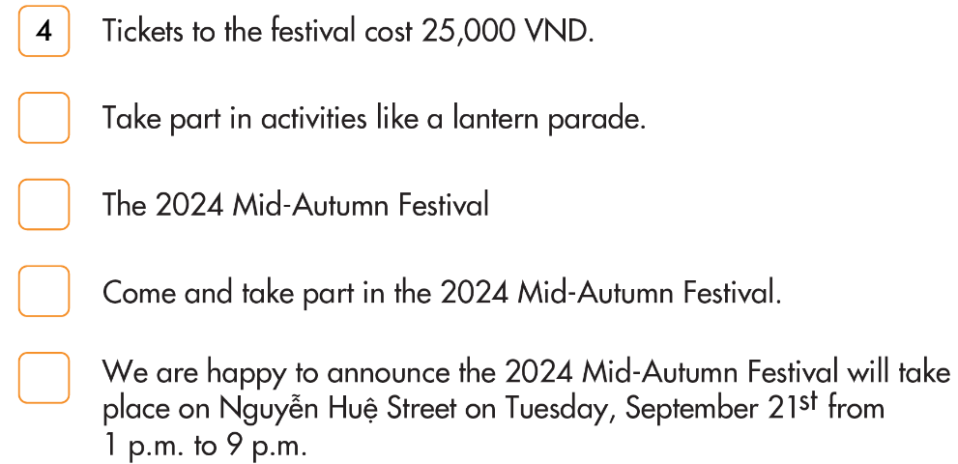
5
1
3
2

Slide 16
WARP-UP
Unit 2
LIFE IN THE COUNTRY
Lesson 7: READING & WRITING
Ms Phương
Zalo: 0966765064
Reading
Reading an announcement about a festival.
Writing
Writing a long-form announcement.

Slide 17
HOMEWORK
1. Do the exercises on page 12 WB.
2. Do the exercises in Tiếng Anh 8 i-Learn Smart World Notebook on page 18.
3. Prepare the next lesson (pages 23 SB)
4. Play the consolidation games on www.eduhome.com.vn

