Slide 2
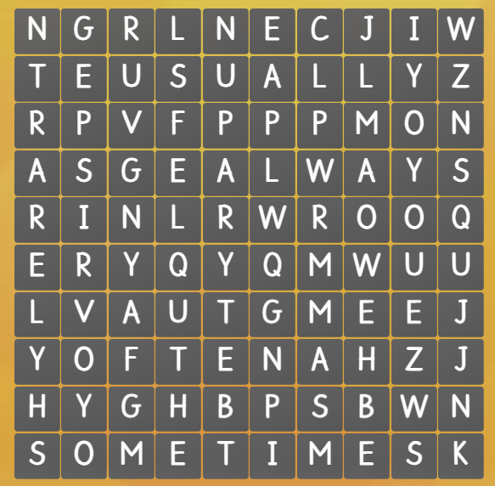
Find adverbs of frequency in the crossword.

Slide 3
PRONUNCIATION
LESSON 6
SPEAKING

Slide 6
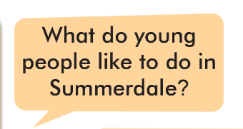
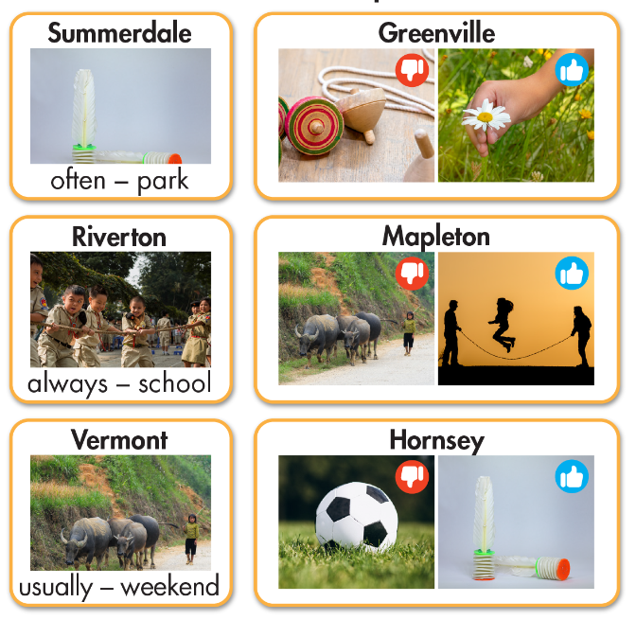
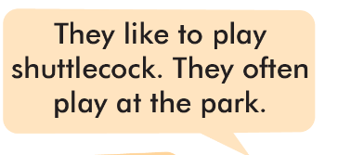
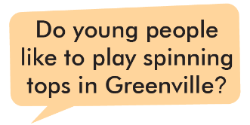
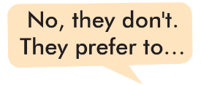

Slide 7
What do young
people like to do in Summerdale?
They like to play
shuttlecock. They often play at the park.

Slide 8
Do young people
like to play spinning tops in Greenville?
No, they don't.
They prefer to pick flowers.

Slide 9
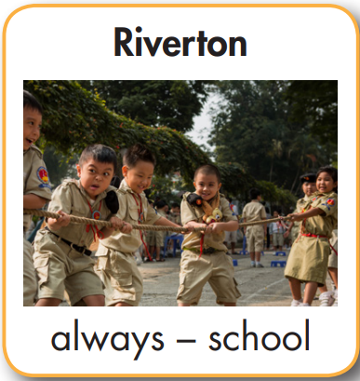
What do young
people like to do
in Riverton?
They like to play
Tug of war. They always play at school.

Slide 10
Do young people
like to herd buffalo in Mapleton?
No, they don’t.
They prefer to jump rope.

Slide 11
What do young
people like to do in Vermont?
They like to herd buffalo. They usually do it at the weekend.

Slide 12
1. Look at the people and what are they doing?
2. Can you guess where are they?

Slide 14
What do young people
like to do in the country?
They like to jump rope. They usually jump rope after school.
Do they like to play
tug of war?
Yes, they do, but I
think they prefer to...

Slide 15
WARP-UP
Unit 2
LIFE IN THE COUNTRY
Lesson 6: PRONUNCIATION AND SPEAKING
Ms Phương
Zalo: 0966765064
Pronunciation
Intonation of Yes/No questions.
Speaking
Talking about folk games that you like/don’t like

Slide 16
HOMEWORK
1. Practice saying Yes/No questions
2. Prepare the next lesson (pages 22 SB)
3. Play the consolidation games on www.eduhome.com.vn

