Slide 2
Correct the mistake.
There were too much people at the party.
I don't have many money to buy a new car.
There are too many informations on the website.
She eats a lot of sugars.
They have lots of works to do.
He drank too many coffees in the morning.
There is not enough chairs in the meeting room.
The students have too many homework to finish.
There are any cars on the street.
We don't have enough times to complete the project.
many
enough
much information
sugar
work
much coffee
are
much
some/ a lot of/ a few
time

Slide 3
PRONUNCIATION
LESSON 3
SPEAKING

Slide 4
chair
child
nature
kitchen

Slide 5
/tʃaɪld/
/tʃeə(r)/
/tʃ/ sound
/ˈneɪtʃə(r)/
/ˈkɪtʃɪn/

Slide 7
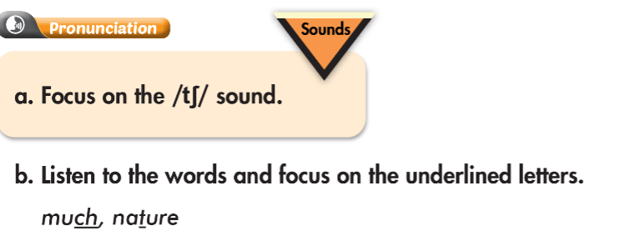
/sʌtʃ/
/tʃiːz/
/tʃer/
/ˈstʌmək/

Slide 8
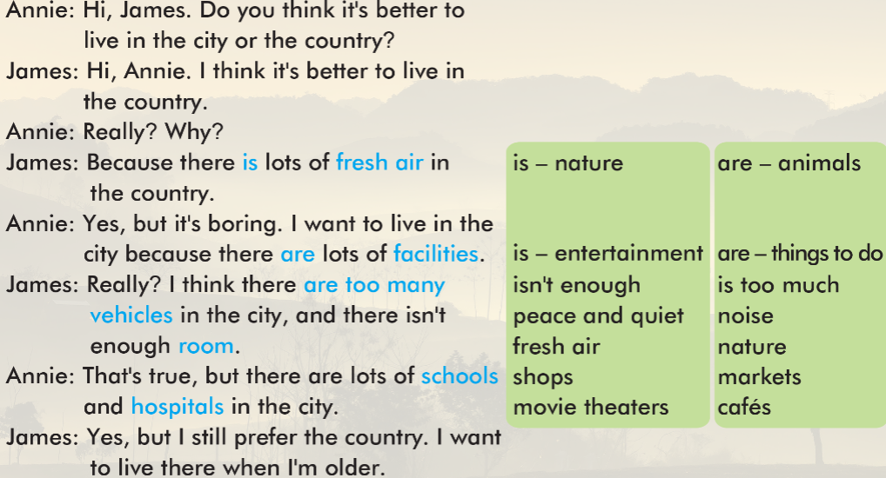

Slide 11
WARP-UP
Unit 2
LIFE IN THE COUNTRY
Lesson 3: Pronunciation & Speaking
Ms Phương
Zalo: 0966765064
Pronunciation
Pronouncing the /tʃ/ sound.
Speaking
Talking about living in the country and the city

Slide 12
Choose the word whose underlined part is pronounced differently form that of the others.
A. school B. child C. chair D. chore
/skuːl/ /tʃaɪld/ /tʃer/ /tʃɔːr/
2. A. peace B. bread C. meat D. beach
/piːs/ /bred/ /miːt/ /biːtʃ/
3. A. nature B. nation C. fashion D. bacon
/ˈneɪtʃər/ /ˈneɪʃən/ /ˈfæʃən/ /ˈbeɪkən/

Slide 13
Choose the words whose main stress is placed differently from the others.
A. vehicle B. library C. pollution D. hospital
/ˈviːəkəl/ /ˈlaɪbreri/ /pəˈluːʃən/ /ˈhɑːspɪtəl/ 2. A. theater B. animal C. computer D. vegetable
/ˈθɪətər/ /ˈænɪməl/ /kəmˈpjuːtər/ /ˈvedʒtəbəl/
3. A. facility B. activity C. environment D. transportation
/fəˈsɪləti/ /ækˈtɪvəti/ /ɪnˈvaɪrənmənt/ /trænspɔːˈteɪʃən/

Slide 14
HOMEWORK
1. Practice saying the /tʃ/ sound.
2. Prepare the next lesson (pages 18 & 19 SB)
3. Play the consolidation games on www.eduhome.com.vn

