Slide 1
Choose the word whose underlined part is pronounced differently form that of the others.
A. chat B. hang C. hand D. ball
2. A. board B. rock C. sport D. shorts
3. A. fishing B. climbing C. knitting D. kicking
/tʃæt/ /hæŋ/ /hænd/ /bɔːl/
/bɔːrd/ /rɑːk/ /spɔːrt/ /ʃɔːrts/
/ˈfɪʃɪŋ/ /ˈklaɪmɪŋ/ /ˈnɪtɪŋ/ /ˈkɪkɪŋ/

Slide 2
Choose the words whose main stress is placed differently from the others.
A. design B. practice C. prefer D. enjoy
2. A. popular B. different C. favorite D. exciting
3. A. karate B. recipe C. jewelry D. shuttlecock
/dɪˈzaɪn/ /ˈpræktɪs/ /prɪˈfɜːr/ /ɪnˈdʒɔɪ/
/ˈpɑːpjələr/ /ˈdɪfərənt/ /ˈfeɪvərət/ /ɪkˈsaɪtɪŋ/
/kəˈrɑːti/ /ˈresəpi/ /ˈdʒuːəlri/ /ˈʃʌtlkɑːk/

Slide 4
VOCABULARY
LESSON 4
LISTENING

Slide 6
knitting
(n) /ˈnɪtɪŋ/
Việc đan len
The activity of making things like clothes from wool

Slide 7
karate
(n) /kəˈrɑːti/
Môn võ ka ra te.
A martial art from Japan

Slide 8
roller skating
(n) /ˈrəʊlə skeɪtɪŋ/
Môn trượt ba tin.
The sport of moving over the ground wearing shoes with wheels

Slide 9
sewing
(n) /ˈsəʊɪŋ/
Việc khâu vá
The activity of making or fixing things made of cloth.

Slide 10
practice
(n) /ˈpræktɪs/
Sự tập luyện
A way of doing something again and again to help you become better.

Slide 11
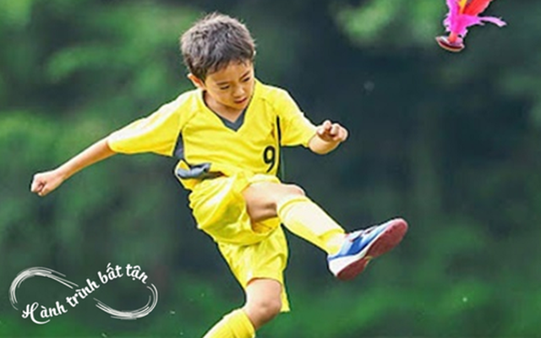
shuttlecock
(n)/ˈʃʌtlkɒk/
Môn đá cầu
A sport played by kicking a plastic object with feathers to keep it up in the air OR the object players hit in a game of badminton

Slide 12
cycling
(n) /ˈsaɪklɪŋ/
Môn đạp xe đạp
The sport of riding a bicycle

Slide 13
table tennis
(n) /ˈteɪbl tenɪs/
Môn bóng bàn
A sport that two or more players hit a ball over the net on a large table

Slide 14
Read the definitions of the following words match the words with the pictures.

Slide 15
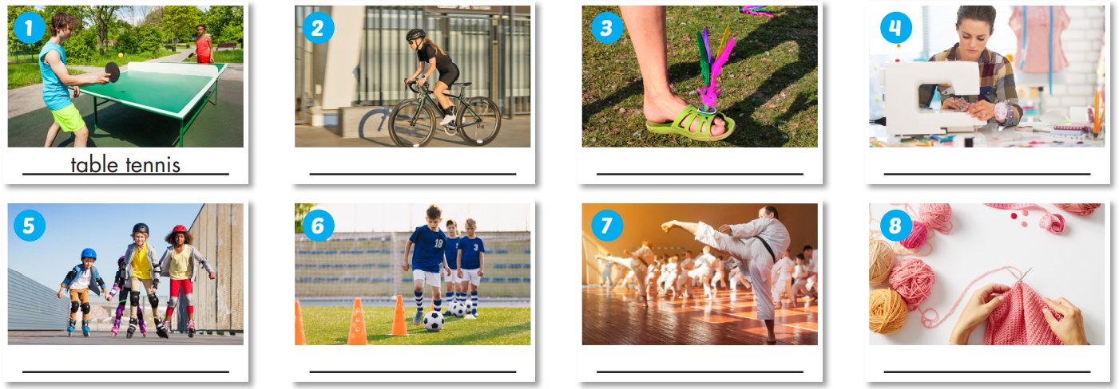
Read the definitions of the following words match the words with the pictures. Listen and repeat.
cycling
shuttlecock
sewing
roller skating
practice
karate
knitting

Slide 18
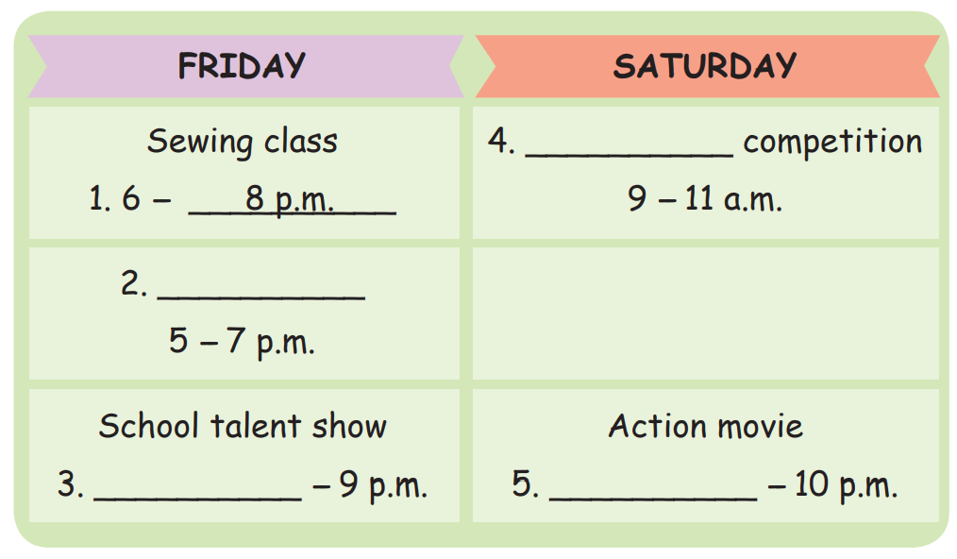
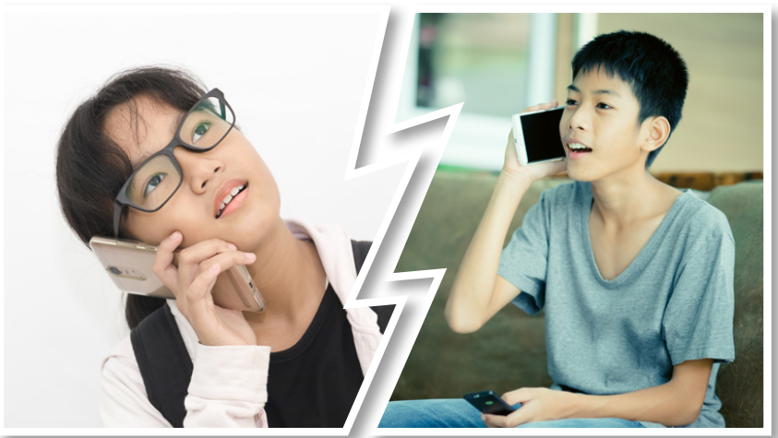
activity
activity
time
time

Slide 19
Cycling
English Club
7:30
8:30

Slide 20
Listen and fill in the blanks.
I think it starts at (3)___________. Ethan: I don't think so. I told you before that I don't like talent shows. Mary: It would be fun together, though. Ethan: Sorry, I'm too busy on Friday. What about Saturday? Mary: OK. Ethan: How about the cycling (4) _____________ in the morning? Mary: No. You know I don't like cycling, either. Ethan: That's true. You didn't enjoy it last time. Well, how about the new (5) __________on at the movie theater? Mary: What time is it? Ethan: It's on at 8:30 p.m. Mary: Great. I'm free then. Ethan: OK. I'll see you at the theater at 8:00. Mary: Sure. I can't wait.
Mary: Hi, Ethan. How's it going? Ethan: Oh, hey, Mary. How are you? Mary: I'm good, thanks. Do you want to go to the (1) _______. class on Friday evening? Ethan: What time is it? Mary: It's from 6 to 8 p.m. Ethan: Ah, I'm sorry, I can't. Mary: Oh, OK. Ethan: Sorry, I have English club until 7 p.m. Maybe another time. Mary: That's OK. What about the school _________(2)

Slide 21
Listen again and check the answer.
7:30
I think it starts at (3)___________. Ethan: I don't think so. I told you before that I don't like talent shows. Mary: It would be fun together, though. Ethan: Sorry, I'm too busy on Friday. What about Saturday? Mary: OK. Ethan: How about the cycling (4) _____________ in the morning? Mary: No. You know I don't like cycling, either. Ethan: That's true. You didn't enjoy it last time. Well, how about the new (5) ___________________on at the movie theater? Mary: What time is it? Ethan: It's on at 8:30 p.m. Mary: Great. I'm free then. Ethan: OK. I'll see you at the theater at 8:00. Mary: Sure. I can't wait.
Mary: Hi, Ethan. How's it going? Ethan: Oh, hey, Mary. How are you? Mary: I'm good, thanks. Do you want to go to the (1) _______. class on Friday evening? Ethan: What time is it? Mary: It's from 6 to 8 p.m. Ethan: Ah, I'm sorry, I can't. Mary: Oh, OK. Ethan: Sorry, I have English club until 7 p.m. Maybe another time. Mary: That's OK. What about the school _________________(2)
sewing
competition
action movie
talent show

Slide 22
Listen to the audio script and practice with your partner.
I think it starts at 7:30. Ethan: I don't think so. I told you before that I don't like talent shows. Mary: It would be fun together, though. Ethan: Sorry, I'm too busy on Friday. What about Saturday? Mary: OK. Ethan: How about the cycling competition in the morning? Mary: No. You know I don't like cycling, either. Ethan: That's true. You didn't enjoy it last time. Well, how about the new action movie on at the movie theater? Mary: What time is it? Ethan: It's on at 8:30 p.m. Mary: Great. I'm free then. Ethan: OK. I'll see you at the theater at 8:00. Mary: Sure. I can't wait.
Mary: Hi, Ethan. How's it going? Ethan: Oh, hey, Mary. How are you? Mary: I'm good, thanks. Do you want to go to the sewing class on Friday evening? Ethan: What time is it? Mary: It's from 6 to 8 p.m. Ethan: Ah, I'm sorry, I can't. Mary: Oh, OK. Ethan: Sorry, I have English club until 7 p.m. Maybe another time. Mary: That's OK. What about the school talent show?

Slide 23
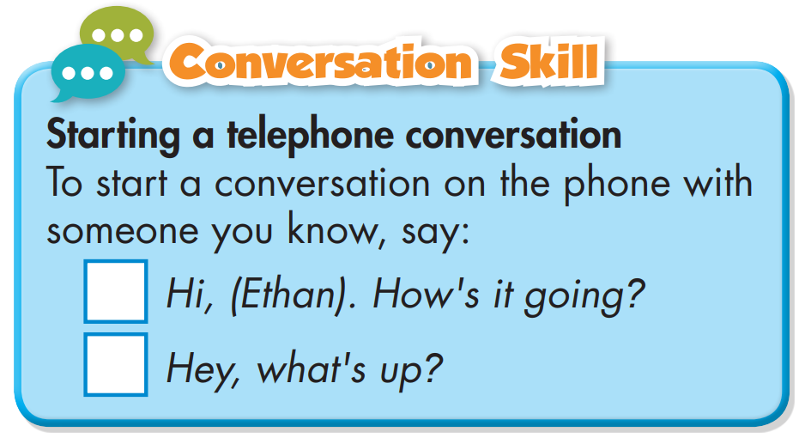
Listen and repeat.
Listen to the conversation again and tick the phrases or sentences you hear
Ảnh Này của Tác giả Không xác định được cấp phép theo CC BY-NC

Slide 25
Vocabulary Review
No | Word | Meaning
1
knitting
Việc đan len
2
karate
Môn võ ka ra te.
3
roller skating
Môn trượt ba tin.
4
sewing
Việc khâu vá
5
practice
Sự tập luyện
6
shuttlecock
Môn đá cầu
7
Môn đạp xe đạp
cycling
8
table tennis
Môn bóng bàn

Slide 26
Unit 1
Free time
Lesson 4: New words + Listening
Ms Phương
Zalo: 0966765064
Vocabulary: table tennis, cycling, shuttlecock, sewing, roller skating, practice, karate, knitting
Practice listening for specific information and know how to start a conversation on the phone.

Slide 27
HOMEWORK
1. Do exercises in workbook on page 4.
2. Prepare the next lesson: Lesson 2.2 - Grammar, pages 9 & 10
3. Do the exercises in Tiếng Anh 8 i-Learn Smart World notebook (pages 7 & 8).

