Slide 1
LUONG VAN CHANH SECONDARY SCHOOL
ENGLISH 7
TEACHER: TRAN MAI THAO

Slide 2

Unit 4: Community Services
Lesson 3.1: Listening & Reading
Page 34

Slide 3



LESSSON OUTLINE
Consolidation

Slide 4

By the end of this lesson, students will be able to…
practice listening and reading for main ideas and specific information.
be well-prepared for the writing activity in the next lesson.

Slide 5

WARM-UP

Slide 6

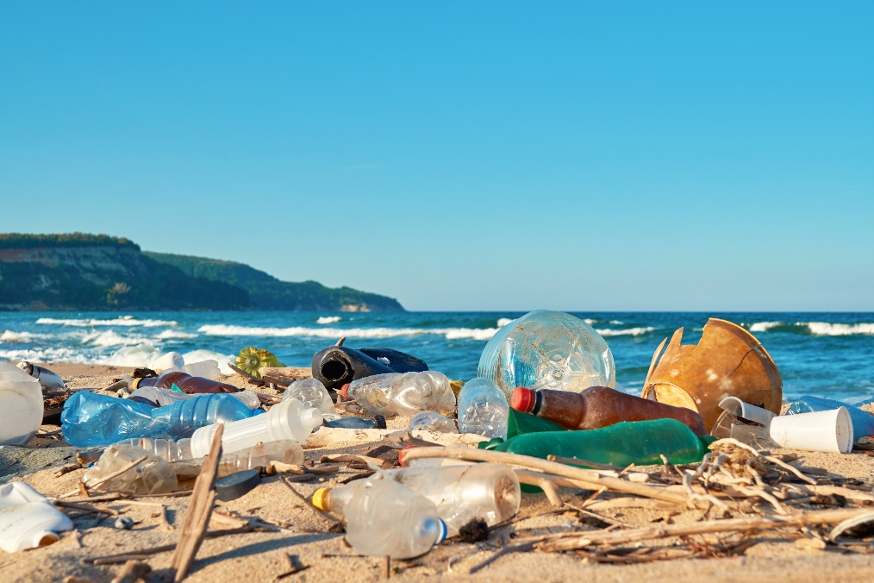
Work in pairs.
Look at the picture and discuss.
1. Do you know any beaches that look like this?
2. How does it make you feel?
3. What can we do to stop this from happening?
Suggested answers:
1. Vung Tau, Long Hai, …
2. It makes me feel terrible.
3. We can put some trash bins along the beaches.

Slide 7


It’s listening time….

Slide 8
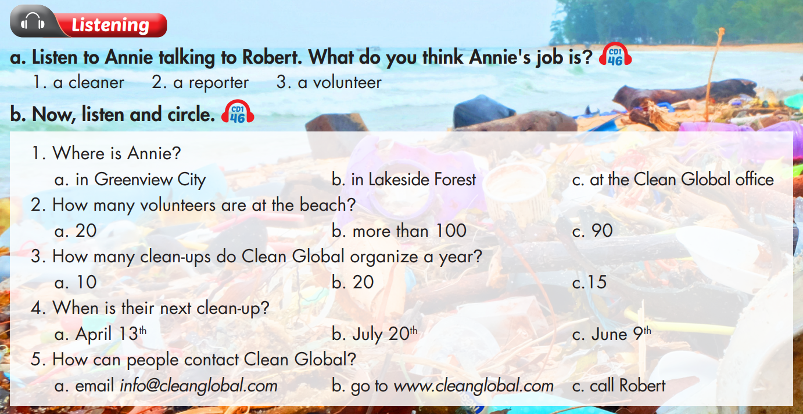

Slide 9
Pre – listening
Before listening
a. Underline the key words and guess what Annie’s job is.
a person who cleans houses, offices, public places, etc.
a person who collects and reports news for newspapers, radio, or television.
a person who does a job without being paid for it.

Slide 10

While - listening
Listen the first time to recognize what Annie’s job is.
Hello. I'm Annie Jones and I'm here at Shell Beach in Greenview City. Today, Clean Global is here with over one hundred volunteers to clean up the beach. Here I have Robert Owen, the organizer of today's event. Hi Robert! Tell us about your organization.
Annie is a reporter.

Slide 11
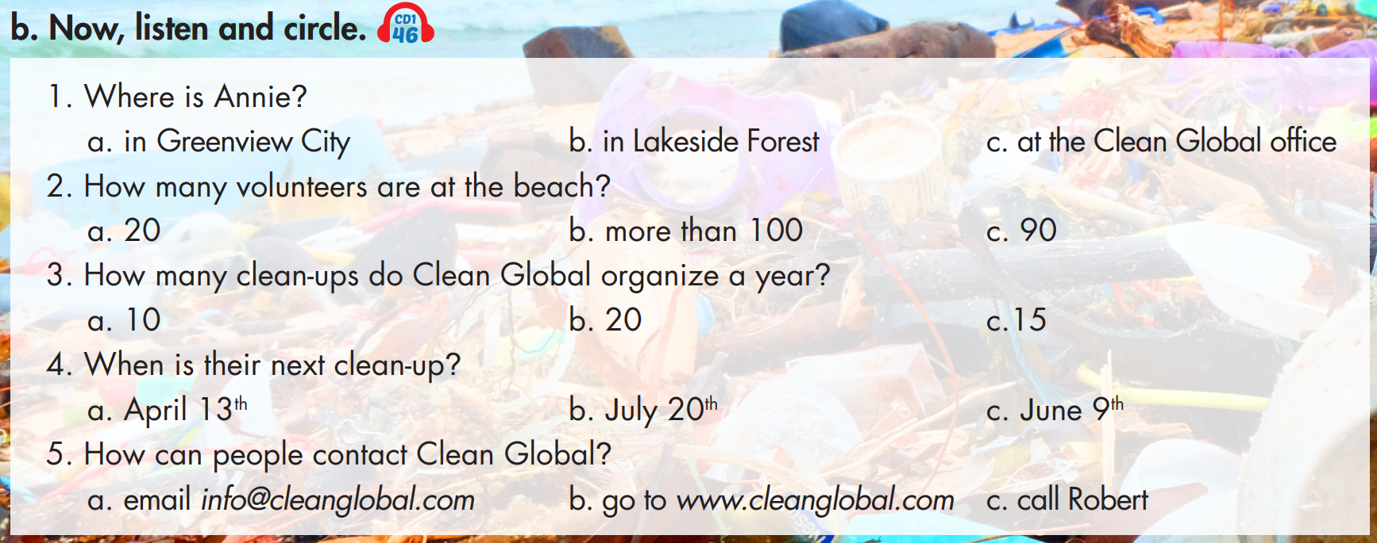
b. Underline the key words in each question and predict the answer.

Slide 12
b. Now, listen and circle.
1. Where is Annie?
in Greenview City
in Lakeside Forest
at the Clean Global office
2. How many volunteers are at the beach?
20
more than 100
90
Hello. I’m Annie Jones and I’m here at Shell Beach in Greenview City.
Today, Clean Global is here with over one hundred volunteers to clean up the beach.

Slide 13
3. How many clean-ups do Clean Global organize a year?
10
20
15
4. When is their next clean-up?
April 13th
July 20th
June 9th
We're Clean Global. We organize fifteen clean-ups every year all over the country.
On Saturday, July twentieth, we are meeting at Lakeside Forest.

Slide 14
5. How can people contact Clean Global?
email info@cleanglobal.com
go to www.cleanglobal.com
call Robert
If you want to contact us, get more information, or join in, please visit us at www.cleanglobal.com.

Slide 15

Post - listening
Work in pairs
Do you think their activity is good for the community? Why (not)?

Slide 16
Audio Scripts
Practice the conversation with a partner.
W: Hello. I'm Annie Jones and I'm here at Shell Beach in Greenview City. Today, Clean Global is here with over one hundred volunteers to clean up the beach.
Here I have Robert Owen, the organizer of today's event. Hi Robert!
M: Hello.
W: Tell us about your organization.
M: We're Clean Global. We organize fifteen clean-ups every year all over the country. We help keep beaches, parks, and forests clean.
W: That's great.
M: Thanks. But we need more volunteers. On Saturday, July twentieth, we are meeting at Lakeside Forest. If you want to contact us, get more information, or
join in, please visit us at www.cleanglobal.com. For every clean-up we provide trash bags, gloves, and a small lunch for all volunteers. Just remember to bring water and sunscreen!

Slide 17
Pre - reading
Underline the key words and guess whether Jane would like to take part in future clean-ups.

Slide 18
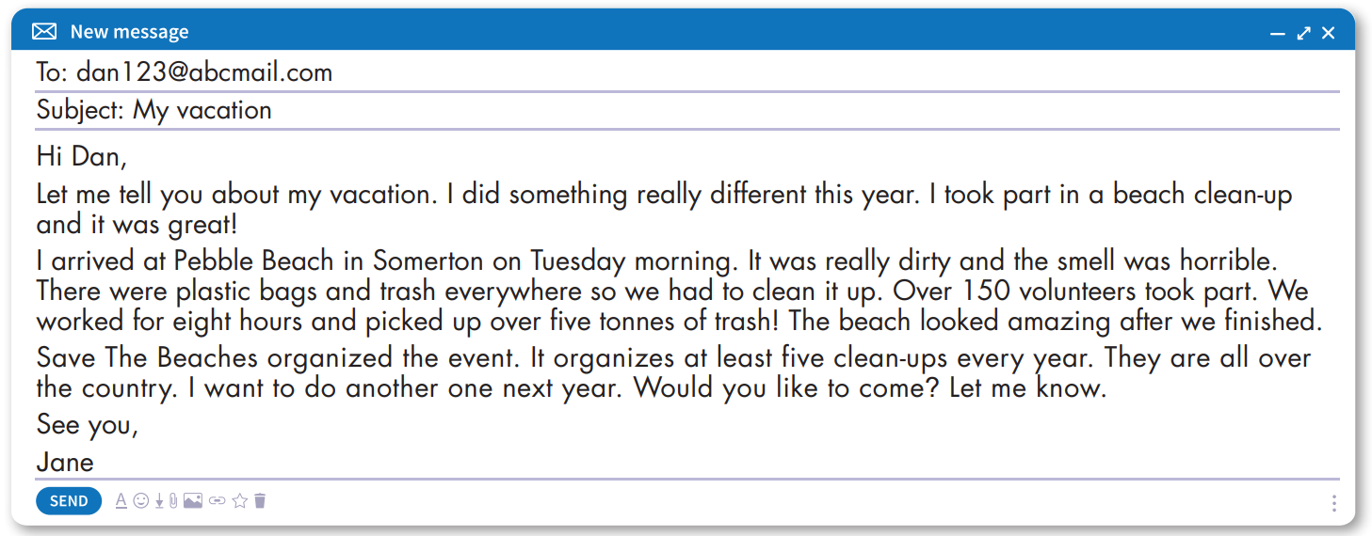
While - reading
Skim the email and underline the key words.
Answer: a. Yes

Slide 19
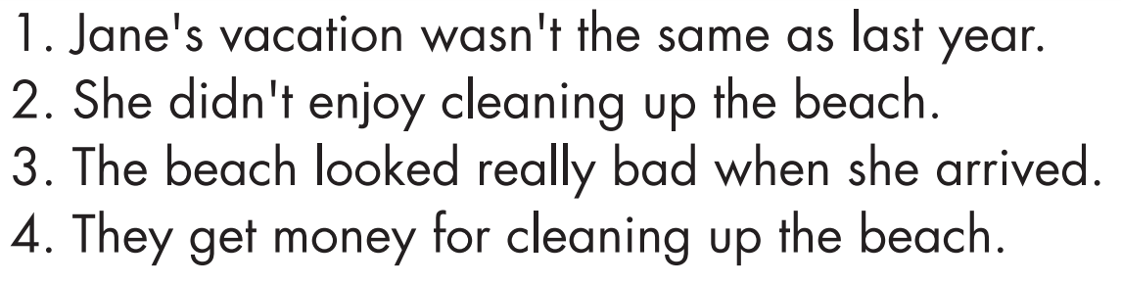
Pre - reading
Read the sentences and underline the key words.

Slide 20
While - reading
Now, read and write True or False.
1. Jane's vacation wasn't the same as last year.
True

Slide 21
While - reading
Now, read and write True or False.
False
2. She didn't enjoy cleaning up the beach.

Slide 22
While - reading
Now, read and write True or False.
3. The beach looked really bad when she arrived.
True

Slide 23
While - reading
Now, read and write True or False.
4. They get money for cleaning up the beach.
False

Slide 24

Post - reading
Work in pairs
Would you like to take part in a beach clean-up? Why (not)?

Slide 25
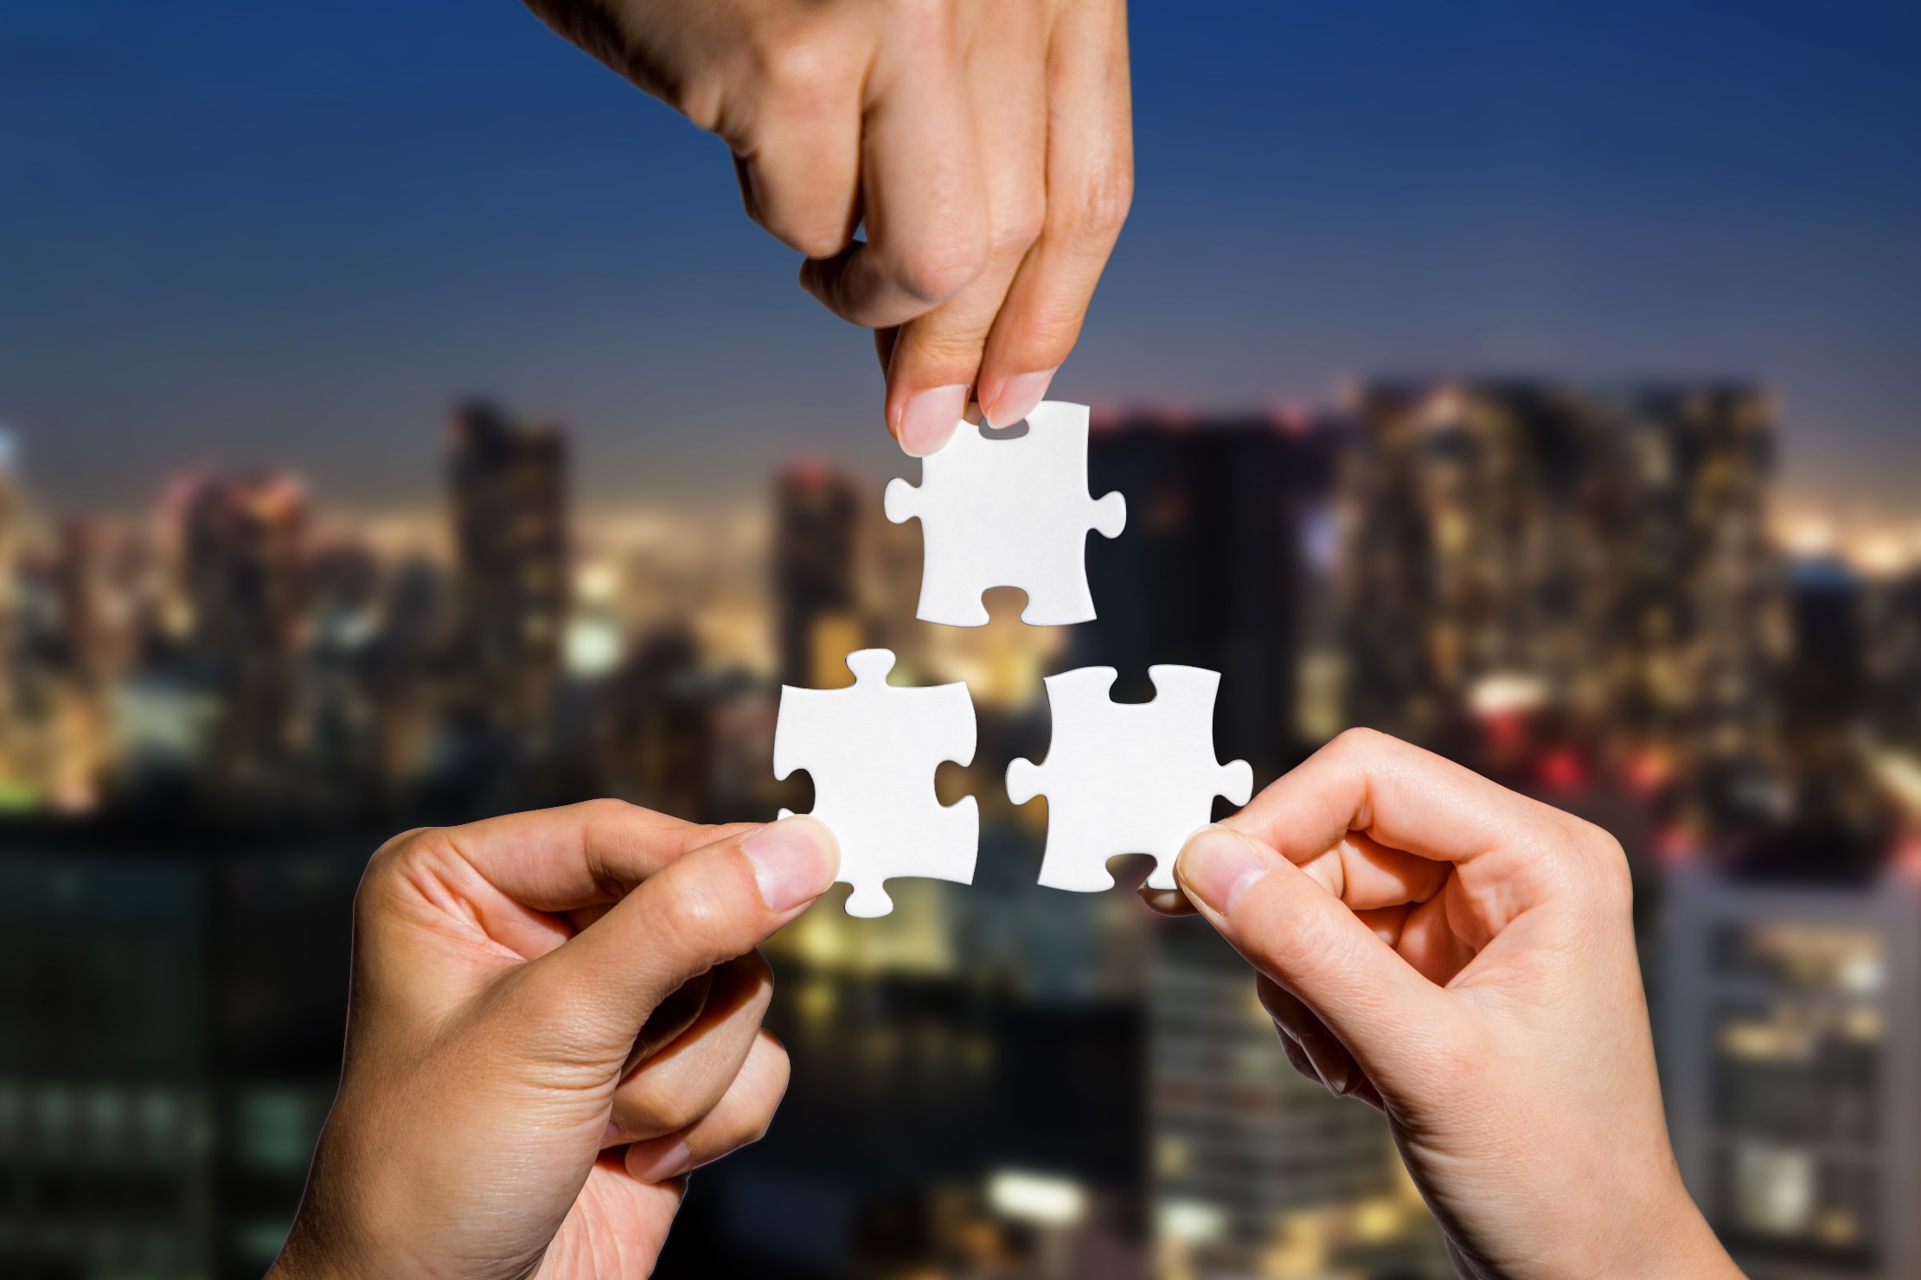
CONSOLIDATION

Slide 26
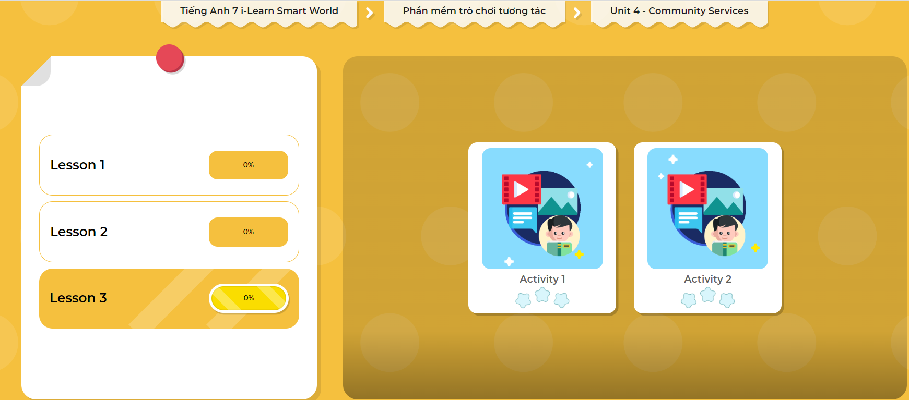
LET’S PLAY!
Click here to play the games

Slide 27

WRAP-UP

Slide 28
Today’s lesson
Listening:
- Listen for gist and choose the correct information.
Reading:
- Skim and scan for general and specific information.

Slide 29
Homework
Do the Listening and Reading exercises on page 24 WB.
Do the exercises in Tiếng Anh 7 i-Learn Smart World Notebook on page 26.
Prepare the next lesson (page 35 SB).
Play the consolidation games in Tiếng Anh 7 i-Learn Smart World DHA App on www.eduhome.com.vn

Slide 30

Lesson 3
Stay positive and have a nice day!

