Slide 1
LUONG VAN CHANH SECONDARY SCHOOL
ENGLISH 7
TEACHER: TRAN MAI THAO

Slide 2

Unit 4: Community Services
Lesson 2.2: Grammar
Page 32

Slide 3


LESSON OUTLINE
Consolidation

Slide 4

By the end of this lesson, students will be able to…
use Past Simple with regular verbs.

Slide 5

Past Simple

Slide 6

WARM-UP

Slide 7

Work in pairs.
Ask your friends about their last weekend.
What did you do last weekend?
Did you have a good time?

Slide 8



Slide 9
PRESENTATION
Past Simple

Slide 10
Lead in
Read three sentences and complete the formation:
1. Last month, we raised money to help the local charity.
2. My friends didn’t donate old clothes. They donated old books.
3. Did you volunteer at the soup kitchen?
Past Simple Tense
Affirmative:
Negative:
Interrogative:
S + V-ed
S + didn’t + V bare infinitive
Did + S + V bare infinitive?

Slide 11
Read the sentences and choose the correct words to complete the rules.
Yesterday, our school organized a fun run for all students.
Three days ago, my family cleaned up the beach while we were on vacation.
Peter raised money to help the children in the orphanage last year.
We use the Past Simple to talk about an action that started and finished in the ………………..
We often use yesterday, .........................., ………………, ... to say when it happened.
We can put the time marker at the …………………… or the end of a sentence.
past
three days ago
last year
beginning

Slide 12

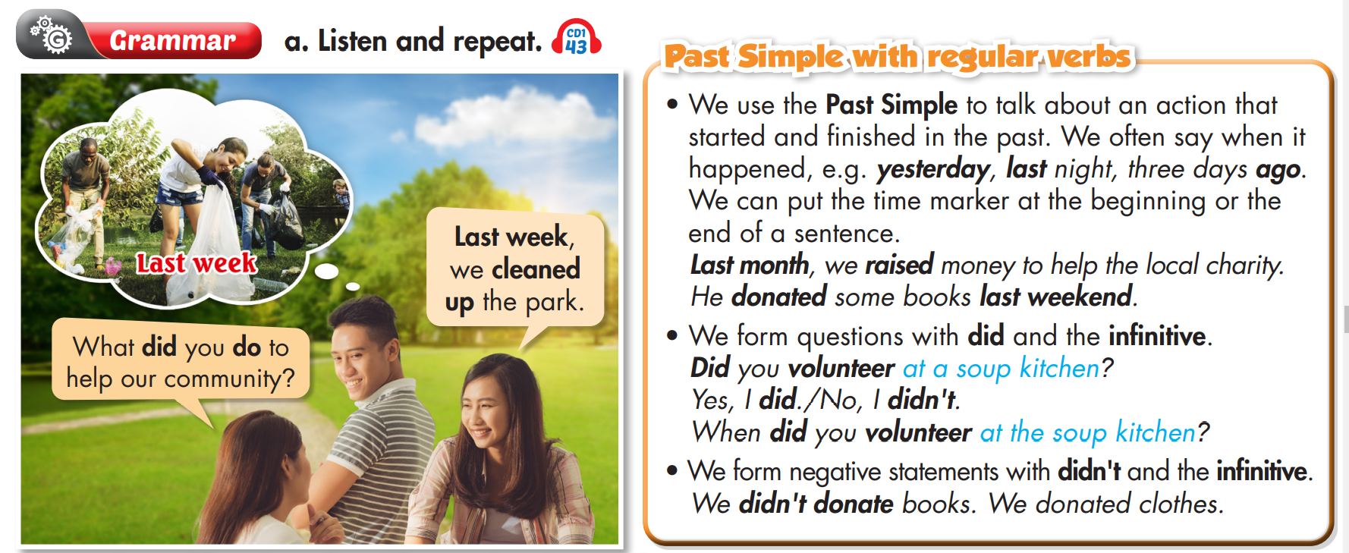

Slide 13


Read the spelling rules for ‘-ed’ in the Past Simple tense and give the past form of the verbs in the box.
• We form the Past Simple of regular verbs by adding ‘-ed’ to the verbs.
clean - cleaned, volunteer - volunteered
• For verbs ending with ‘-e’, we add ‘-d’.
like - liked, live - lived
• For verbs ending with a consonant + ‘y’, we change ‘y’ to ‘i’ and add ‘-ed’.
try - tried, fry - fried
• For one-syllable verbs ending with one consonant, then one vowel and one consonant, we double the last consonant and add ‘-ed’.
plan - planned, stop - stopped
watch
raise
study
listen
visit
prefer
carry
beg
donate
collect
watched
raised
studied
listened
visited
preferred
carried
begged
donated
collected

Slide 14

PRACTICE

Slide 15
1. Last Sunday, Andy and his friends _______________ (volunteer) at the soup kitchen.
2. We _______________ (clean up) the park near our school last weekend.
3. My parents _______________ (raise) money to help the local children's hospital two months ago.
4. Last Monday, lots of students _______________ (donate) books and clothes they _______________ (not use) any more to poor children in their town.
5. Our school _______________ (collect) all of the donations and sent them to poor people.
6. They _______________ (plant) trees in the streets to make their town cleaner.
volunteered
cleaned up
raised
donated
didn’t use
collected
planted

Slide 16
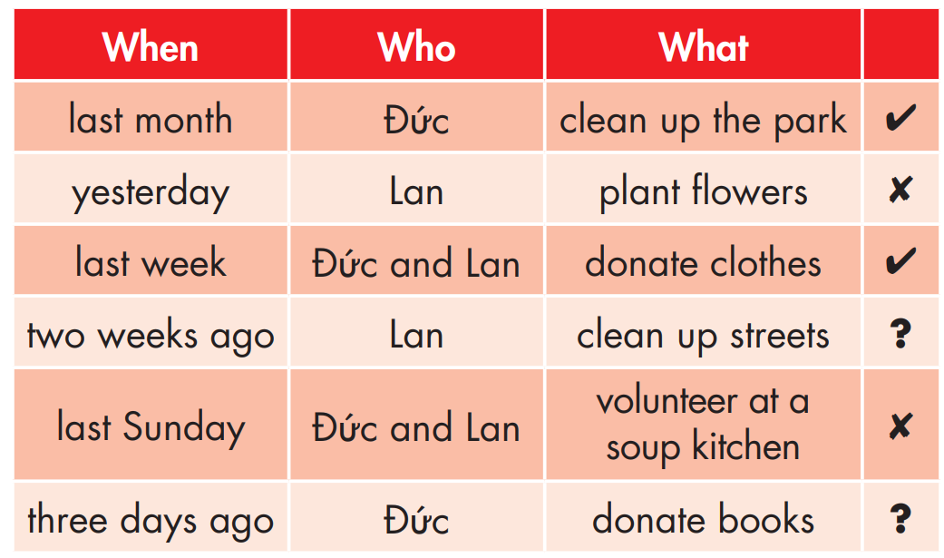

Slide 17
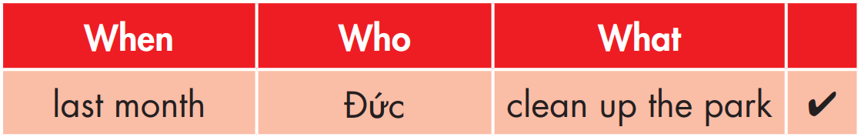
1. Đức cleaned up the park last month.
2. Lan didn’t plant flowers yesterday.
3. Đức and Lan donated clothes last week.

Slide 18

4. Did Lan clean up streets two weeks ago?
5. Đức and Lan didn’t volunteer at a soup kitchen last Sunday.
6. Did Đức donate books three days ago?

Slide 19
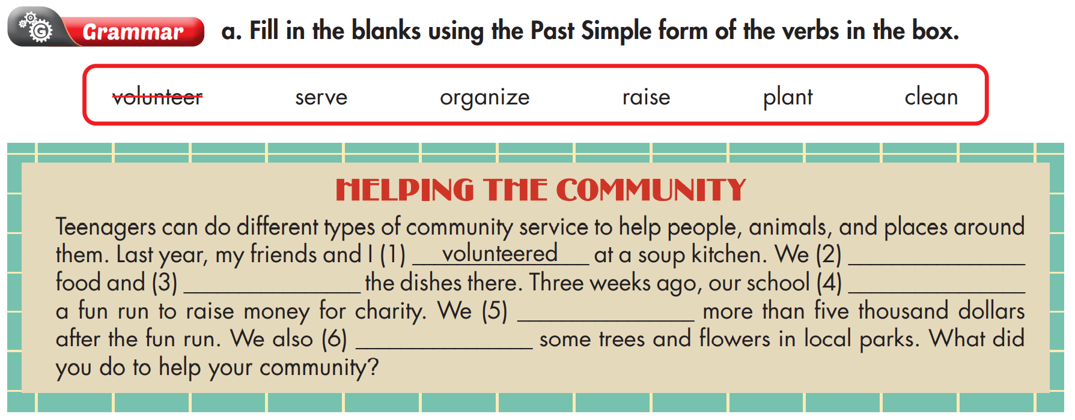
Extra Practice
WB, page 23
served
cleaned
organized
raised
planted

Slide 20
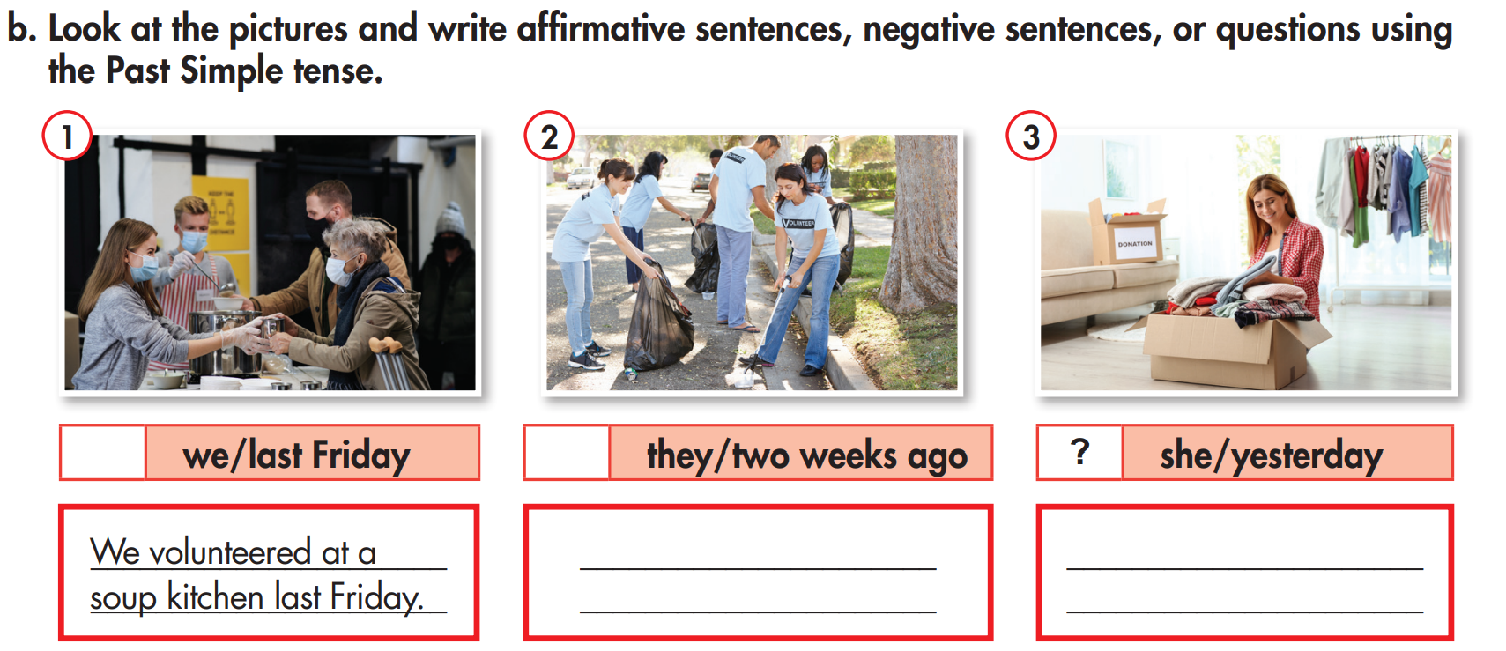
Extra Practice
WB, page 23
✓
✗
They didn’t clean up streets two weeks ago.
Did she donate old clothes yesterday?

Slide 21
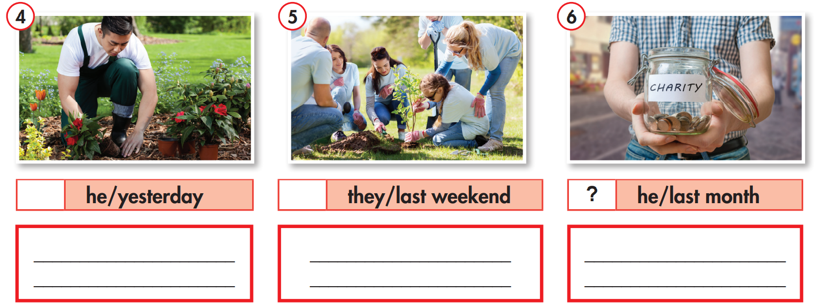
✓
✗
He planted flowers yesterday.
They didn’t plant trees last weekend.
Did he raise money last month?

Slide 22

PRODUCTION

Slide 23
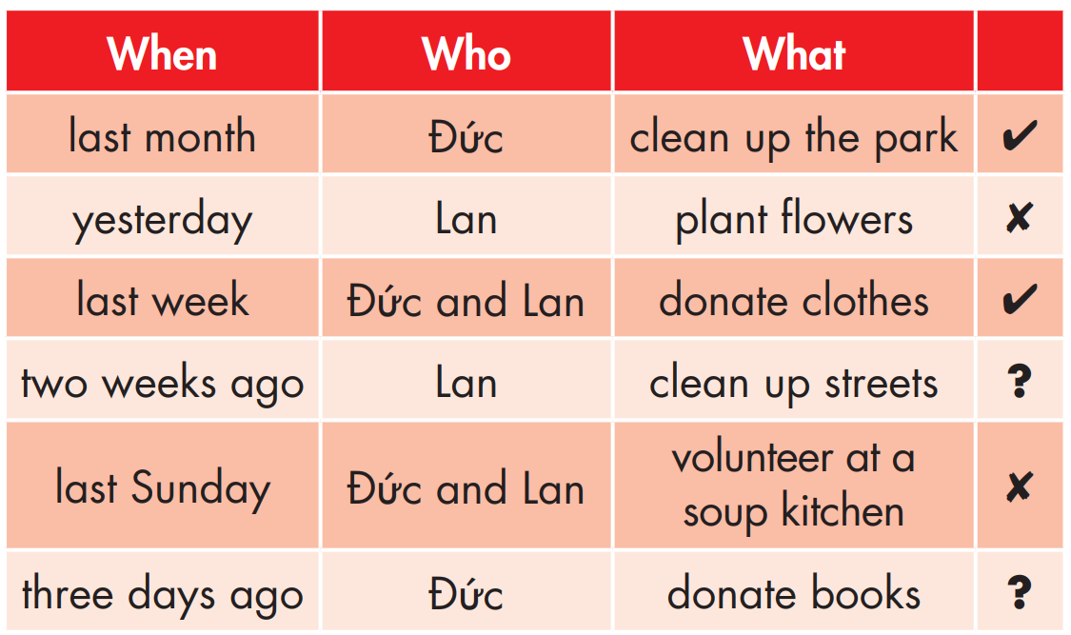
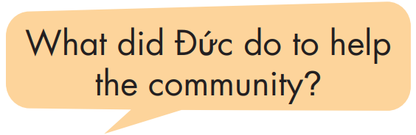
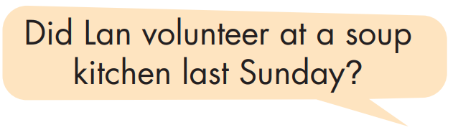
d. In pairs: Ask and answer using the information in Task c.
He cleaned up the park last month.
Yes, she did.

Slide 24

CONSOLIDATION

Slide 25

Write five sentences about what you did to help the community. Write 50 to 70 words.

Slide 26
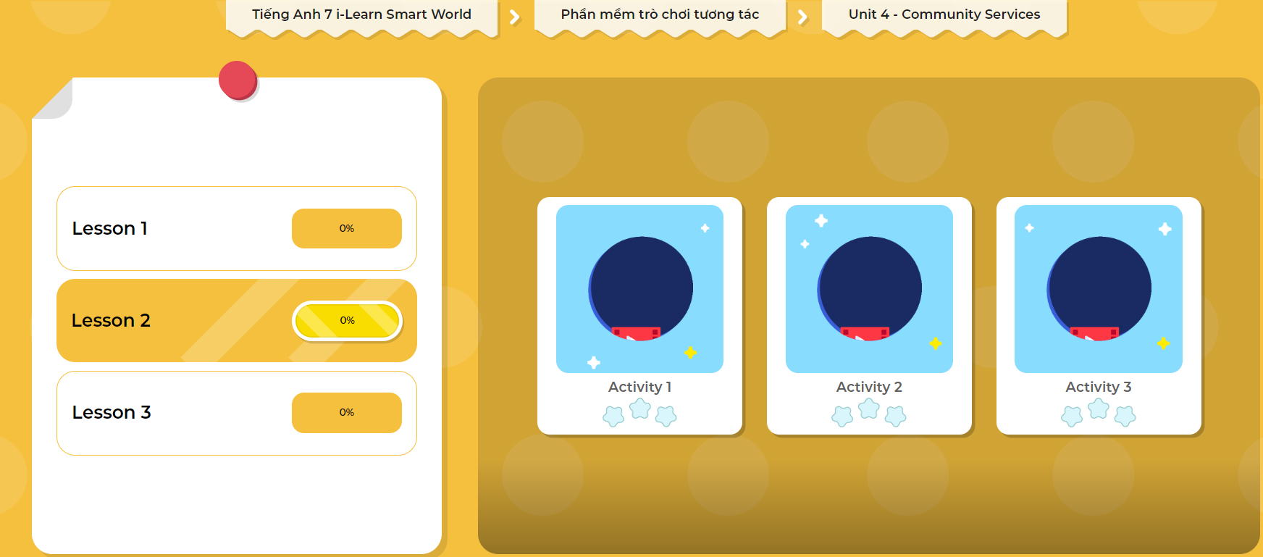
LET’S PLAY!
Click here to play the games

Slide 27

WRAP-UP

Slide 28
Today’s lesson
Grammar:
- Use Past Simple to talk about actions that started and finished in the past.
Speaking & Writing:
- Talk and write about what you did to help our community.

Slide 29
Homework
Practice making sentences, using Past Simple tense.
Do the writing exercise in workbook page 23.
Complete the grammar notes in Tiếng Anh 7 i-Learn Smart World Notebook on page 25.
Prepare the next lesson (page 33 SB).
Play the consolidation games in Tiếng Anh 7 i-Learn Smart World DHA App on www.eduhome.com.vn

Slide 30

Lesson 3
Stay positive and have a nice day!

