Slide 1
LUONG VAN CHANH SECONDARY SCHOOL
ENGLISH 7
TEACHER: TRAN MAI THAO

Slide 2

Unit 3: Music and Arts
Lesson 3.1: Listening & Reading
Page 26

Slide 3



Lesson 3.1
LESSSON OUTLINE
Consolidation

Slide 4

By the end of this lesson, students will be able to…
- talk about favorite movies.
practice listening and reading for main ideas and specific information.
be well-prepared for the writing section in the next lesson.

Slide 5

WARM-UP

Slide 6


Work in pairs.
What are different types of movies you like to watch? Why?

Slide 7
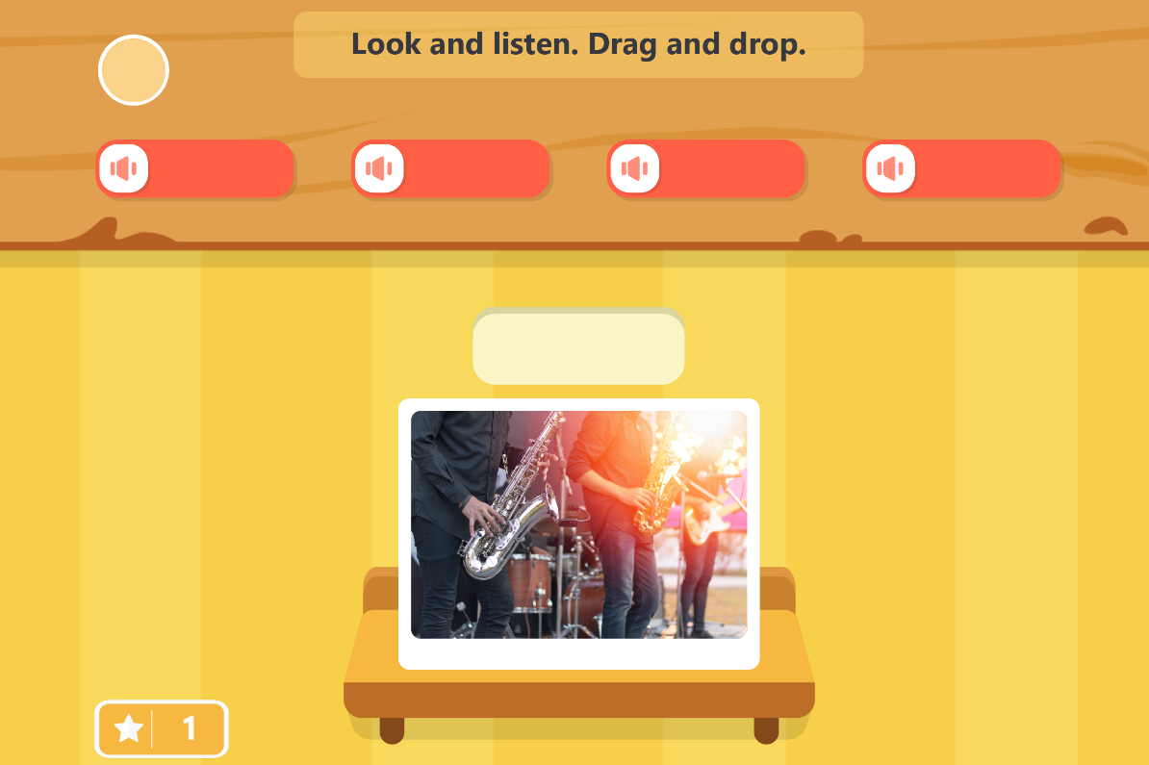
Play the games. Click the picture below.

Slide 8


It’s listening time….

Slide 9
Pre – listening
a. Match the vocabulary to the meaning.
VOCABULARY | MEANING
conclusion | A very famous, successful, and important person, especially a performer such as a musician, an actor, or a sport player
plot | The place a film is recorded or performed
star | The last part of something
setting | The story of a book, film, play, etc.

Slide 10
Pre - listening
b. Underline the key words and fill in the blanks using the words below.
conclusion plot star setting
1. The main character or actor is called the ______________.
2. The ______________ is the place/time the movie happens.
3. The story the movie tells is called the ______________.
4. The ______________ gives your overall feelings.

Slide 11

While - listening
Listen to an English teacher and check your answers.
☞ FIRST TIME
1. The main character or actor is called the _____________.
2. The ______________ is the place/time the movie happens.
3. The story the movie tells is called the ______________.
4. The ______________ gives your overall feelings.
star
setting
plot
conclusion

Slide 12
While - listening
Now listen again and check.  SECOND TIME
Next, write about the main character or star of the movie. For example, the star is Brad Pitt.
After that, write where the movie takes place. This is the setting. For example, you can say, the movie is set in America.
setting
1. The main character or actor is called the ______________.
2. The ______________ is the place/time the movie happens.
star
After that, tell the main parts of the story. This is called the plot. Say what the movie is about, but don’t tell the ending.
At the end, you should give your overall feelings and who would enjoy the movie. This is called the conclusion.
3. The story the movie tells is called the ______________.
conclusion
4. The ______________ gives your overall feelings.
plot

Slide 13
Pre - listening
Read the instruction quickly. Underline the key words in the questions and options. What are we going to do?
Listen and circle the correct answers
b. Now, listen and circle the correct answers.
1. When should you say what kind of movie it is?
at the start/in the middle
2. What does the teacher say you shouldn’t tell?
the ending/the surprise
3. What else does the teacher say to write about?
music and costumes/who would like the movie

Slide 14
While - listening
Now listen and circle the correct answers.  FIRST TIME
1. When should you say what kind of movie it is?
at the start/in the middle
2. What does the teacher say you shouldn’t tell?
the ending/the surprise
3. What else does the teacher say to write about?
music and costumes/who would like the movie

Slide 15
While - listening
Now listen again and check.  SECOND TIME
1. When should you say what kind of movie it is?
at the start/in the middle
2. What does the teacher say you shouldn’t tell?
the ending/the surprise
3. What else does the teacher say to write about?
music and costumes/who would like the movie

Slide 16
While - listening
Now listen again and check.  THIRD TIME
First, start with the movie name, and what type of movie it is.
At the end, you should give your overall feelings and who would enjoy the movie.
1. When should you say what kind of movie it is?
at the start/in the middle
3. What else does the teacher say to write about?
music and costumes /
who would like the movie
Say what the movie is about, but don’t tell the ending.
2. What does the teacher say you shouldn’t tell?
the ending/the surprise

Slide 17

Post - listening
Work in pairs.
Talk about a movie you like.

Slide 18
Track 34
Teacher: OK, class, today we are going to write about movies we like. First, start with the movie name, and what type of movie it is. Next, write about the main character or star of the movie. For example, the star is Brad Pitt. After that, write where the movie takes place. This is the setting. For example, you can say, the movie is set in America. After that, tell the main parts of the story. This is called the plot. Say what the movie is about, but don’t tell the ending. Then, you should describe some good or bad parts of the movie. At the end, you should give your overall feelings and who would enjoy the movie. This is called the conclusion.
Scripts

Slide 19


It’s reading time….

Slide 20

Pre - reading
Read the instruction quickly. Underline the key words. What are we going to do?
Read and choose the best title.

Slide 21
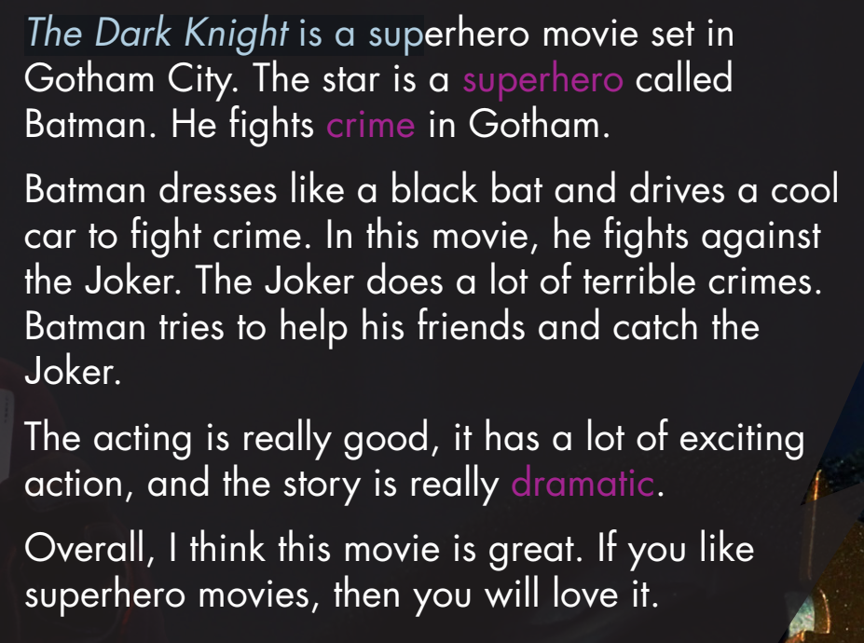
Pre - reading
Look at the topic sentence and guess.

Slide 22
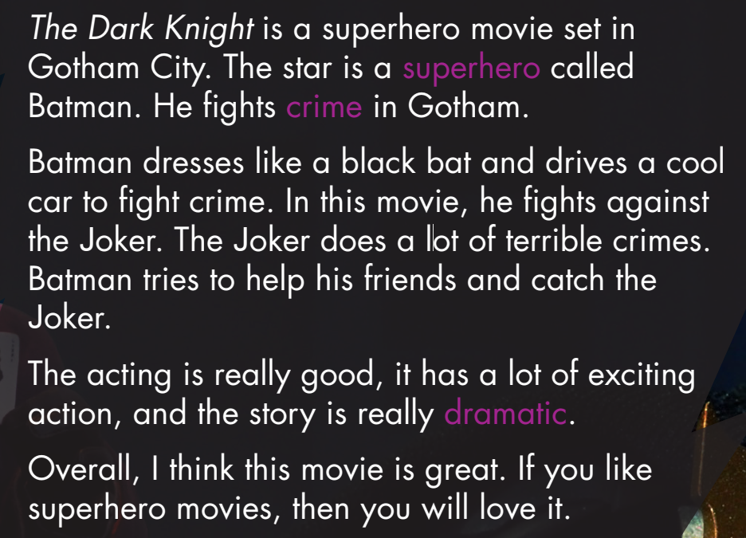
Skim the text. Underline the key words/phrases. Choose the best title.
While - reading
1. The Dark Knight – an action-packed crime drama

Slide 23
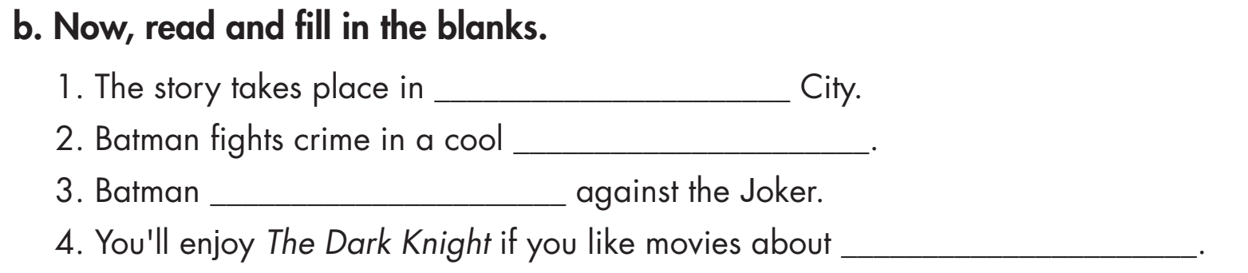
Pre - reading
Read the instruction quickly. Underline the key words. What are we going to do?
Read and fill in the blanks.

Slide 24
Pre - reading
Read the sentences. Underline the key words. Scan the text and answer the questions.

Slide 25
Pre - reading
Read the sentences. Guess the type of words (a verb, a noun, an adjectives, an adverb, etc.) missing in each statement.
a name of a city
a noun
a verb
a noun

Slide 26
1. The story takes place in ______________________ City.
Gotham
While - reading

Slide 27
car
2. Batman fights crime in a cool __________.
While - reading

Slide 28
fights
While - reading
3. Batman _______________ against the Joker.

Slide 29
While - reading
superheroes
4. You'll enjoy The Dark Knight if you like movies about ______________.

Slide 30

Post - reading
Work in pairs.
Would you like to watch this movie? Why (not)?

Slide 31

CONSOLIDATION

Slide 32

Work in pairs.
Talk about a movie star you like. Say why you like him / her!

Slide 33

WRAP-UP

Slide 34
Today’s lesson
Listening:
- Listen for gist and comprehension.
Reading:
- Skim and scan for general and specific information.

Slide 35
Homework
Do the exercises on page 18 WB
Do the exercises in Tiếng Anh 7 i-Learn Smart World Notebook on page 18
Prepare the next lesson (page 27 SB)
Play the consolidation games in Tiếng Anh 7 i-Learn Smart World DHA App on www.eduhome.com.vn

Slide 36

Lesson 3
Stay positive and have a nice day!

