Slide 1
LUONG VAN CHANH SECONDARY SCHOOL
ENGLISH 7
TEACHER: TRAN MAI THAO

Slide 2

Unit 3: Music and Arts
Lesson 2.2: Grammar
Page 24

Slide 3


LESSON OUTLINE
Consolidation

Slide 4

By the end of this lesson, students will be able to…
use prepositions of time and possessive adjectives
make plans to go to a music event

Slide 5

Preposition of time / Possessive adjectives

Slide 6

WARM-UP

Slide 7
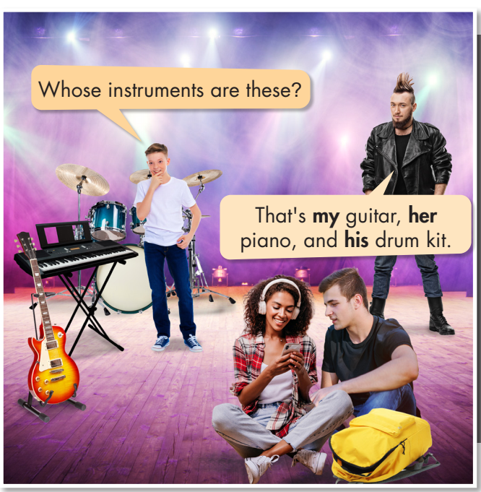
Work in pairs. What instruments can you see in the picture?
Do you like them?

Slide 8
PRESENTATION
Preposition of time / Possessive adjectives

Slide 9


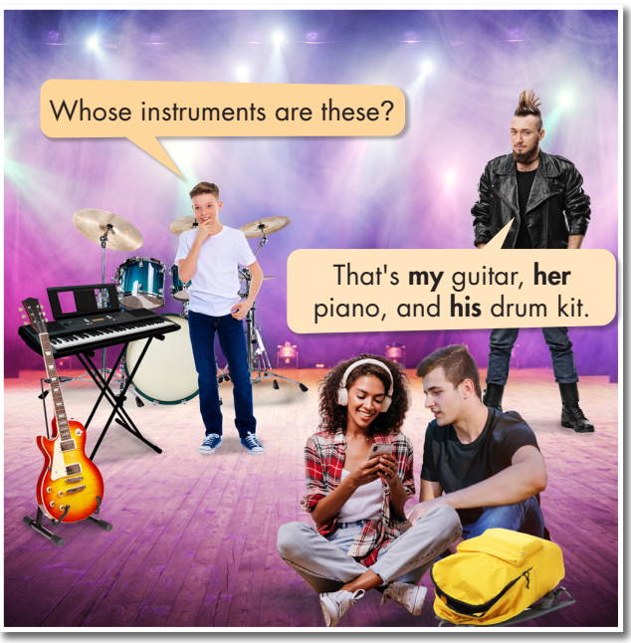
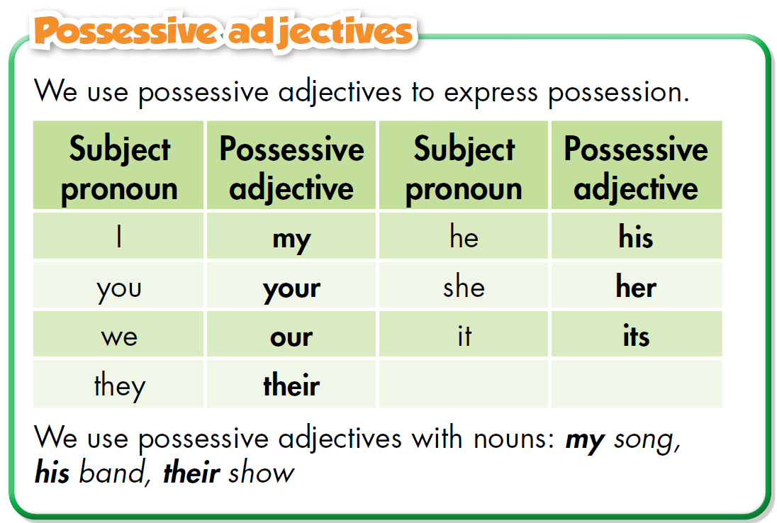

Slide 10
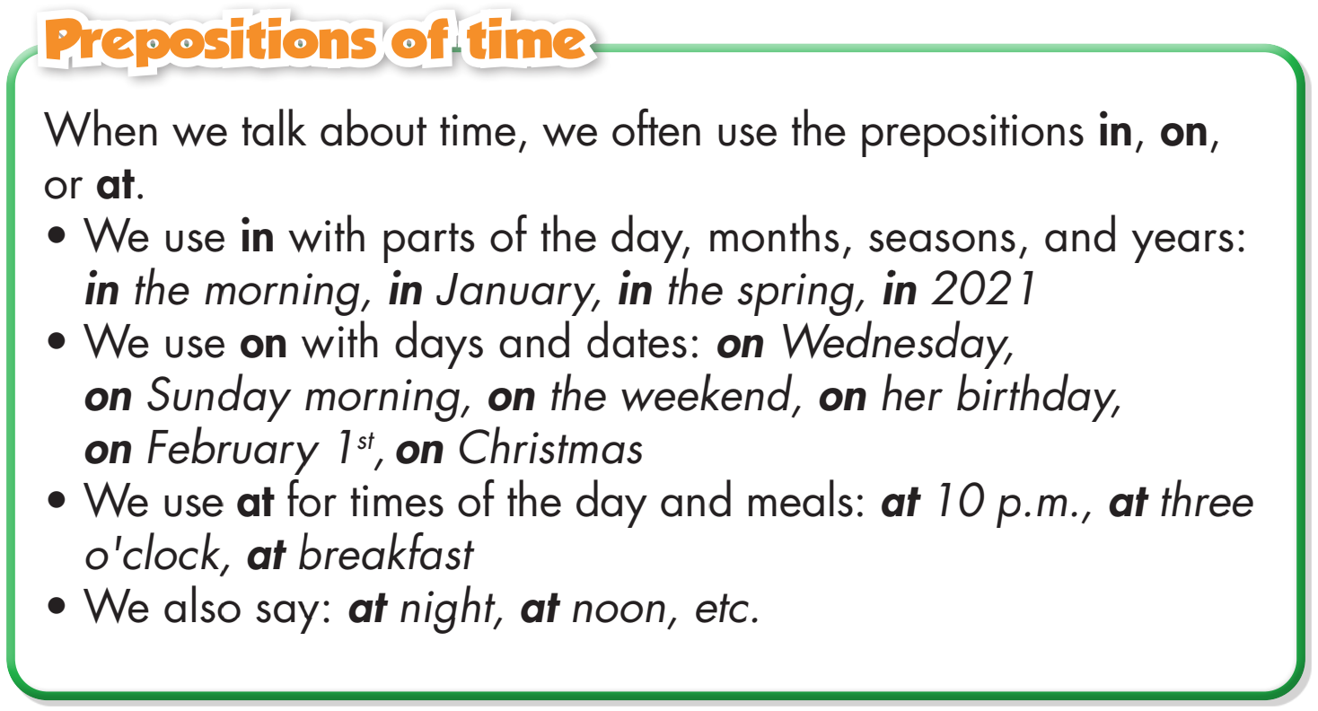

Slide 11
PRACTICE
Preposition of time / Possessive adjectives

Slide 12

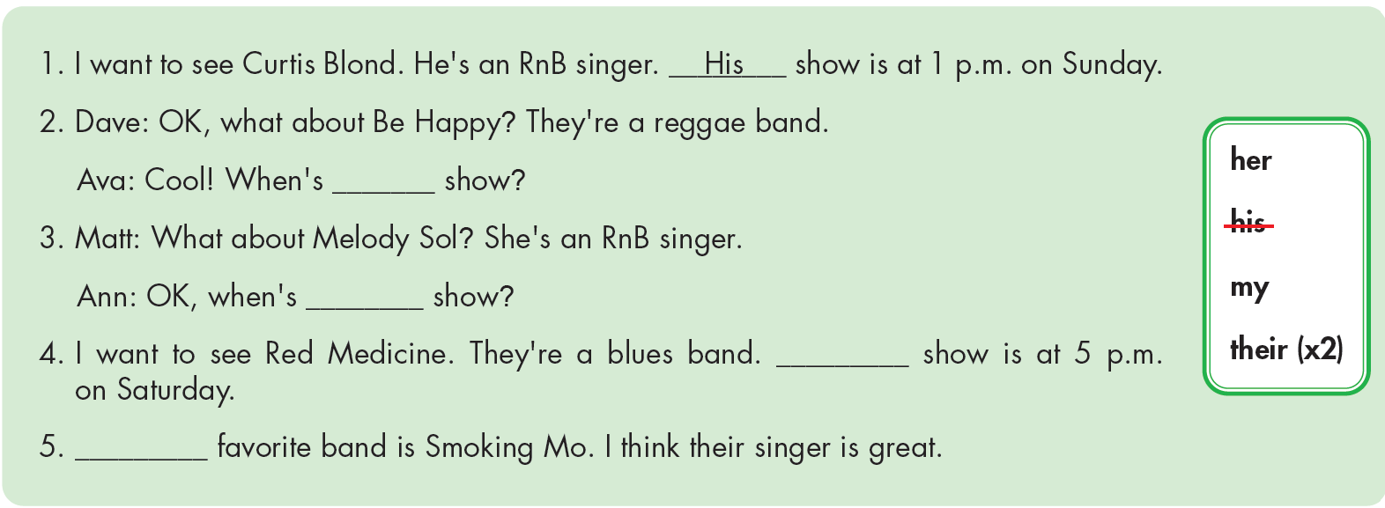
Extra Practice
WB, page 17
their
her
their
My

Slide 13
b. Fill in the blanks with in, on, or at, and the correct possessive adjectives.
1. Mary and I are having a CD listening party at our (we) house on Friday night.
2. I know Tom Barley is _____ (you) favorite reggae artist. Did you buy his new CD? He released it _____ March.
3. John loves going to outdoor concerts _____ the fall. It's _____ (he) favorite season.
4. Are you going to watch Jane Jackson's performance? _____ (she) concert is on TV _____ 5 p.m.
5. I love the Big Blues Traveling Band. _____ (they) music festival _____ 2019 was incredible.
your
in
in
his
Her
at
Their
in

Slide 14
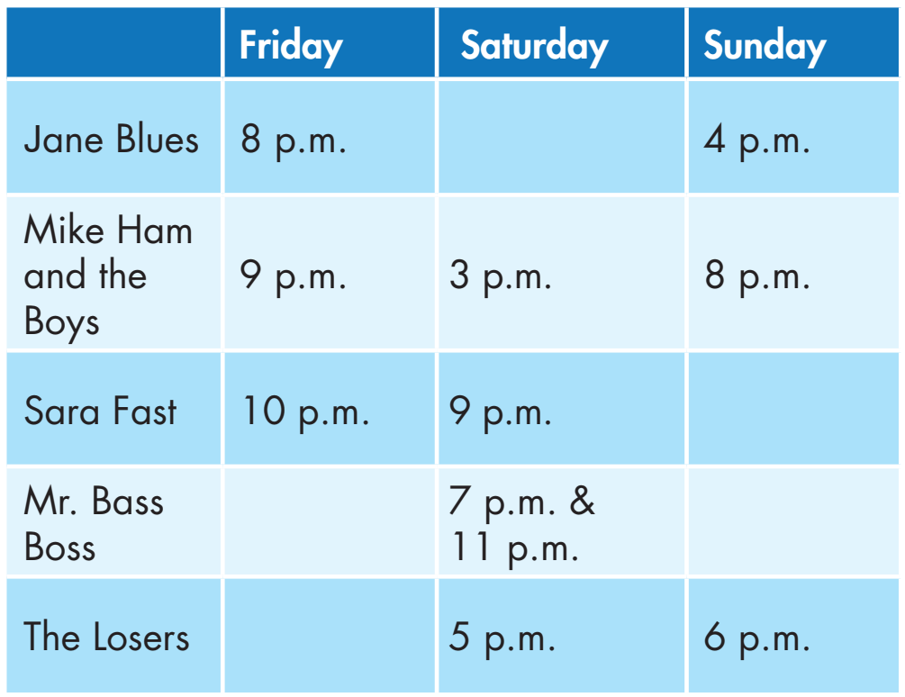
c. Look at the table and write the answers.
1. When can you watch Jane Blues' concert at night?
__________________________________
2. When can you see Mike Ham and the Boys' afternoon show?
___________________________________
3. When can you hear Sara Fast's songs on Friday?
__________________________________
4. When can you see Mr. Bass Boss' late night concert?
___________________________________
5. When can you see The Losers’ final show?
___________________________________
You can watch her concert at 8 p.m. on Friday.
You can see their afternoon show at 3 p.m. on Saturday.
You can hear her songs at 10 p.m. on Friday.
You can see his late night concert at 11 p.m. on Saturday.
You can see their final show at 6 p.m. on Sunday.

Slide 15
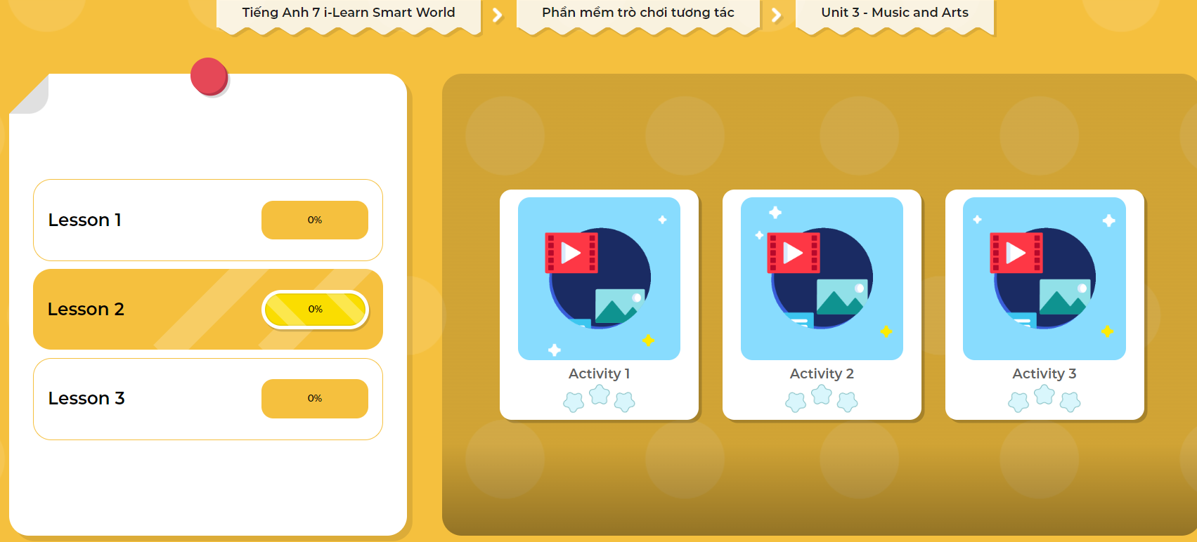
Extra Practice
DHA
Play the games in DHA App. Click the picture below.

Slide 16
PRODUCTION
Preposition of time / Possessive adjectives

Slide 17
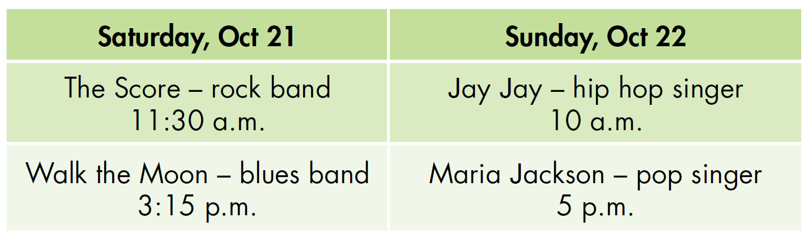
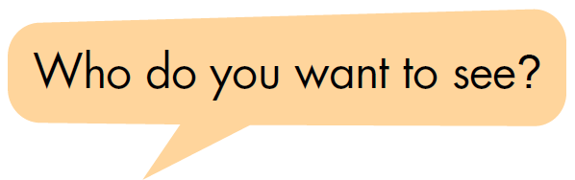
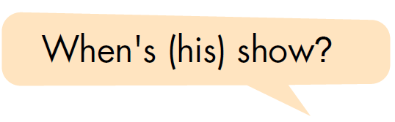
d. In pairs: Ask and answer using the information in the table.

Slide 18

CONSOLIDATION

Slide 19
Extra Practice
WB, page 17
Circle the correct answers.
1. We're going to a music show in/on Saturday afternoon. Would you like to come?
2. When's his show? Is it at/in 6 p.m.?
3. Is there a music festival in our town in/at October?
4. My parents always listen to music on/at night before they go to bed.
5. Are you going to do anything special in/on your birthday?
6. There's a great music show in/at the evening.
7. Jay Jay's show is next weekend, in/on January 14th.
8. Lily's show is in/on Saturday. It's at/on 9 o'clock in/at the morning.

Slide 20

WRAP-UP

Slide 21
Today’s lesson
use prepositions of time and possessive adjectives.
make plans to go to a music event.

Slide 22
Homework
- Do the exercises on page 17 WB.
Complete the grammar notes in Tiếng Anh 7 i-Learn Smart World Notebook on page 17.
Prepare the next lesson (page 25 SB).
Play the consolidation games in Tiếng Anh 7 i-Learn Smart World DHA App on www.eduhome.com.vn

Slide 23

Lesson 3
Stay positive and have a nice day!

