Slide 1
LUONG VAN CHANH SECONDARY SCHOOL
ENGLISH 7
TEACHER: TRAN MAI THAO

Slide 2

Unit 3: Music and Arts
Lesson 1.3: Pronunciation & Speaking
Page 22

Slide 3



Lesson 1.3
LESSON OUTLINE
Consolidation

Slide 4

By the end of this lesson, students will be able to…
talk about the music you like/ don’t like.
practice pronouncing different sounds /s/, /z/ of "s" at the end of verbs.

Slide 5

WARM-UP

Slide 6

Work in pairs.
Choose the word whose main stress is placed
differently from the others.
1. A. terrible B. favorite C. exciting D. classical
2. A. helpful B. selfish C. friendly D. amazed
3. A. glasses B. party C. swimming D. tonight
/ˈterəbl/
/ˈfeɪvərɪt/
/ɪkˈsaɪtɪŋ/
/ˈklæsɪkl/
/ˈhelpﬂ/
/ˈselfɪʃ/
/ˈfrendli/
/əˈmeɪzd/
/ˈɡlæsəz/
/ˈpɑ:rti/
/ˈswɪmɪŋ/
/təˈnaɪt/

Slide 7
Work in pairs.
Choose the word whose underlined part is
pronounced differently from that of the other words.
A. long B. short C. blond D. bored
2. A. love B. pop C. fond D. rock
3. A. listening B. hospital C. evening D. designer
/lɔ:ŋ/
/ʃɔ:rt/
/blɑːnd/
/bɔːrd/
/lʌv/
/pɑ:p/
/fɑːnd/
/rɑːk/
/ˈlɪsnɪŋ/
/ˈhɑːspɪtl/
/ˈi:vnɪŋ/
/dɪˈzaɪnər/

Slide 8

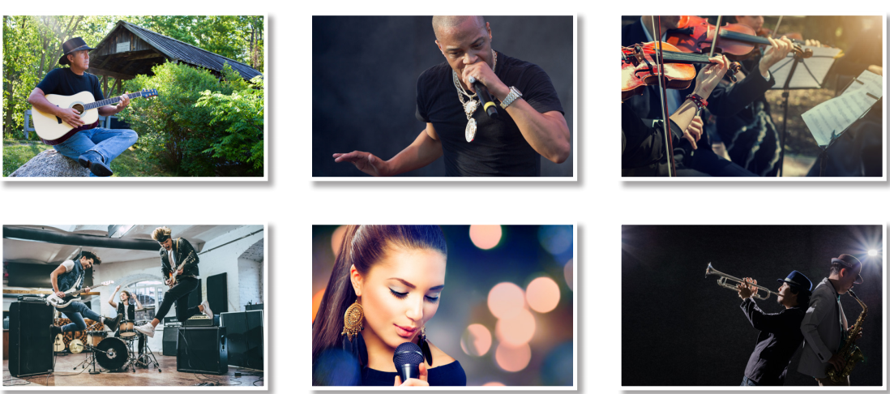
Work in pairs.
What can you see in each picture?

Slide 9



Slide 10
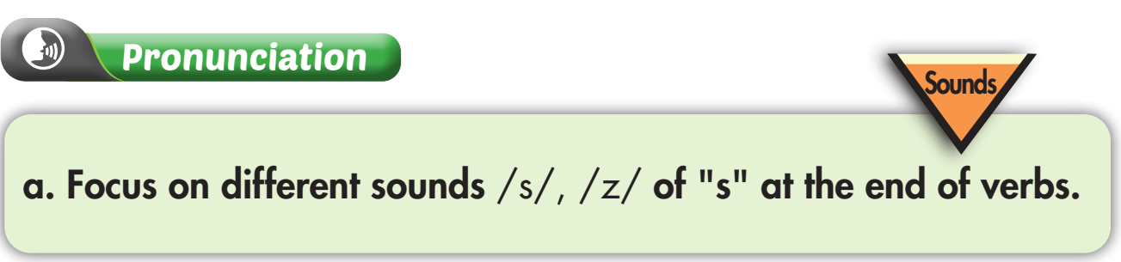
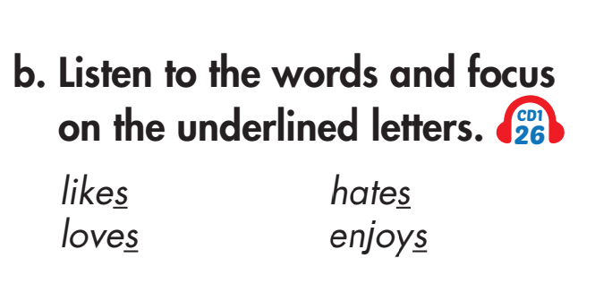


Slide 11
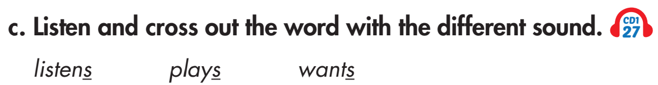

Slide 12
Extra Practice
Find 10 verbs related to the topic Music and Arts, add ‘s’ to each, then practice saying them with a partner.

Slide 13

Speaking

Slide 14

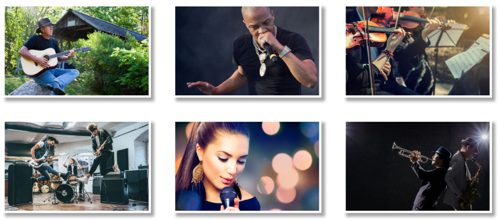
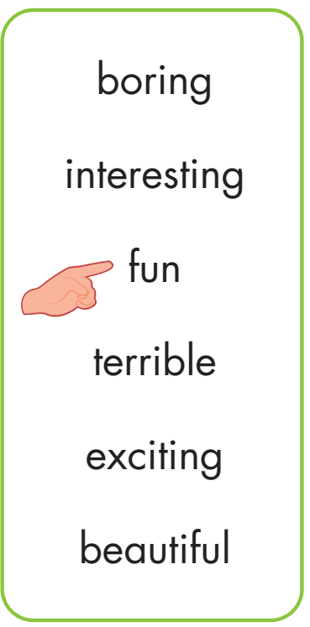
Point, ask, and answer. Then practice with your own idea.
Do you like country music?
Yes, I do. It's fun.

Slide 15
Extra Practice
Try to extend your answers.
Do you like country music?
Yes, I do. I listen to country music when I have free time, especially in the evening or when I’m sad. It's fun and I feel relaxed. What about you?

Slide 16
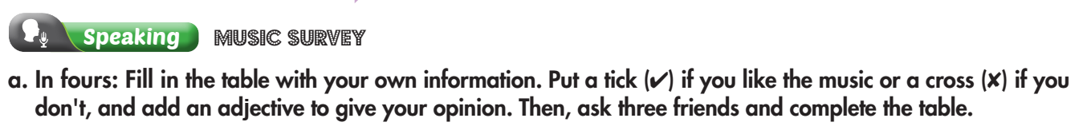

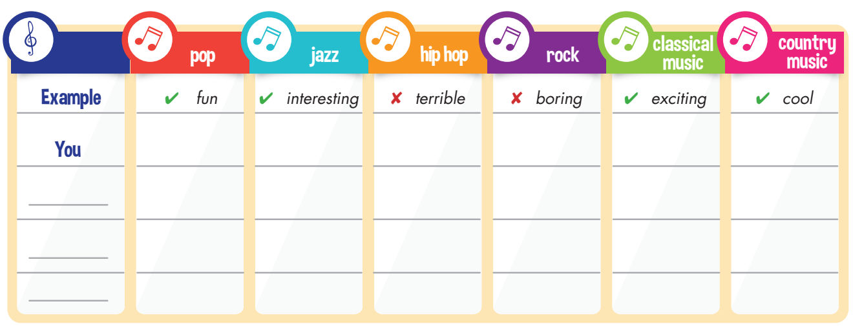
Work in groups

Slide 17
Teacher: What’s the most popular kind of music in your group?
Student: In our group, the most popular kind of music is pop.

Slide 18

CONSOLIDATION

Slide 19
Write a short paragraph about the kind of music you like and list the reason(s). Write about 50 words.

Slide 20

WRAP-UP

Slide 21
Today’s lesson
talk about the music you like/ don’t like.
practice pronouncing different sounds /s/, /z/ of "s" at the end of verbs.

Slide 22
Homework
Practice pronouncing sounds /s/, /z/ of "s" at the end of the verbs.
Do the writing exercise on page 57 WB.
Review the vocabulary and grammar notes in Tiếng Anh 7 i-Learn Smart World Notebook (pages 14 & 15).
Play the consolidation games in Tiếng Anh 7 i-Learn Smart World DHA App on www.eduhome.com.vn.
Prepare the next lesson (page 23 SB).

Slide 23

Lesson 3
Stay positive and have a nice day!

