Slide 1
LUONG VAN CHANH SECONDARY SCHOOL
ENGLISH 7
TEACHER: TRAN MAI THAO

Slide 2

Unit 3: Music and Arts
Lesson 1.2: Grammar
Page 21

Slide 3


LESSON OUTLINE
Consolidation

Slide 4
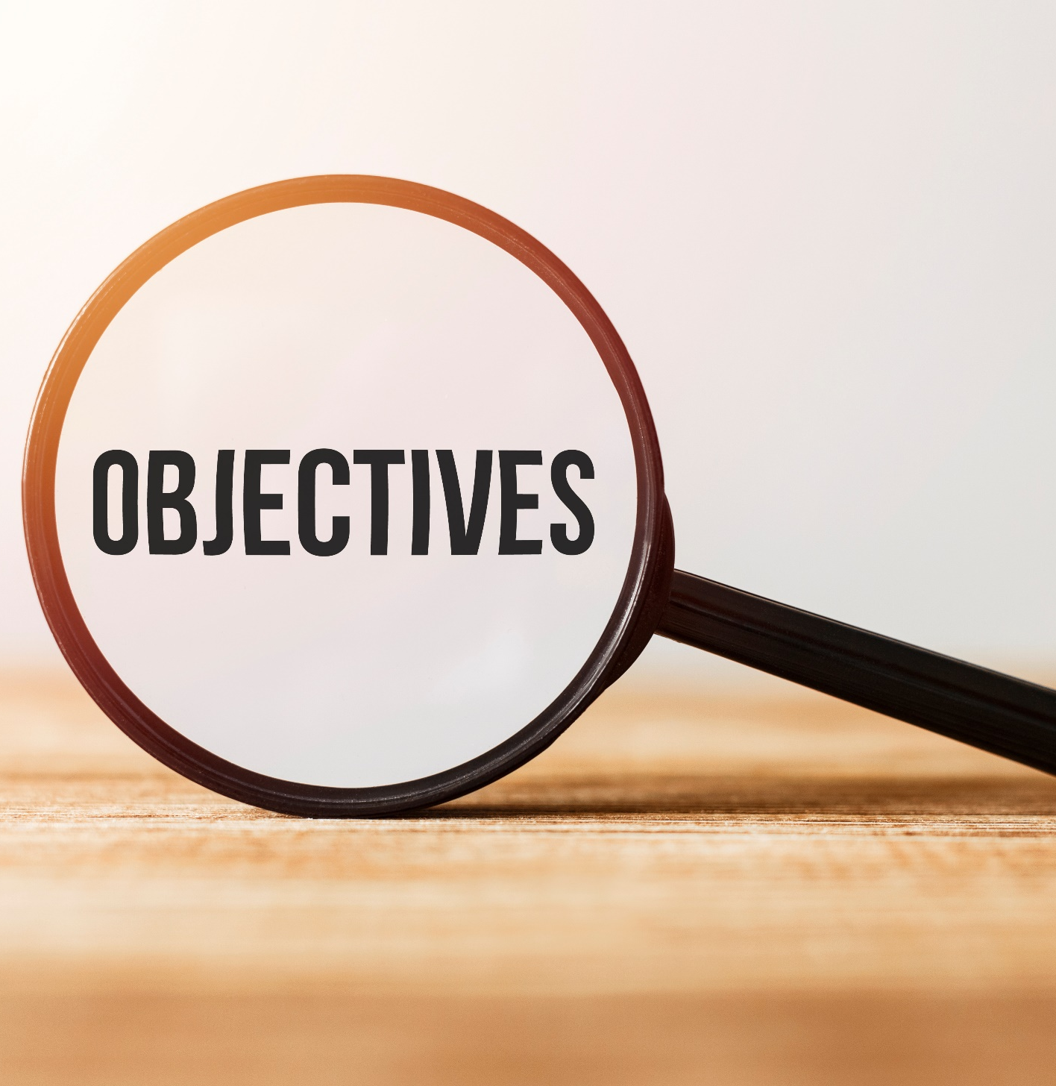
By the end of this lesson, students will be able to…
use Present Simple to talk about facts.
talk about things that we consider as facts (such as likes and dislikes) or are true for a long time.
Notes:
Change information

Slide 5

Present Simple

Slide 6

WARM-UP

Slide 7

Work in pairs
Talk about what you do every day in the correct order.
I wake up at 6:30 a.m./ I have a shower./ I have breakfast./ I brush my teeth./ I put on my clothes./ I leave my house at 7:30./ I walk to the bus stop./…
Notes:
- Teacher talks about what he/she does everyday in an order. Then ask students to speak to their partners about their daily routine and let some of them talk about their partners' routine.

Slide 8

PRESENTATION

Slide 9
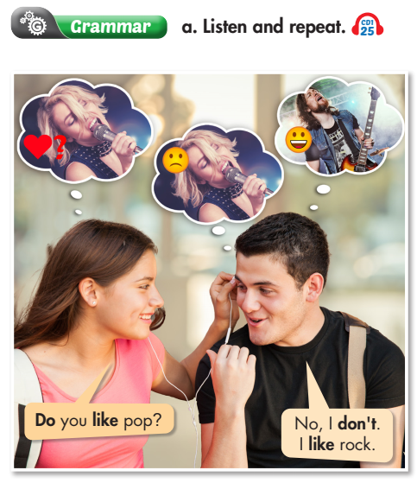

Present Simple for facts
We can use the Present Simple to talk about things that we consider as facts (such as likes and dislikes) or are true for a long time.
We form the Present Simple with regular verbs like this:
• Positive: S + Verb (-s/-es) + (object).
• Negative: S + don't/doesn't + Verb + (object).
• Question: Do/Does + S + Verb + (object)?
Does … like …?

Slide 10
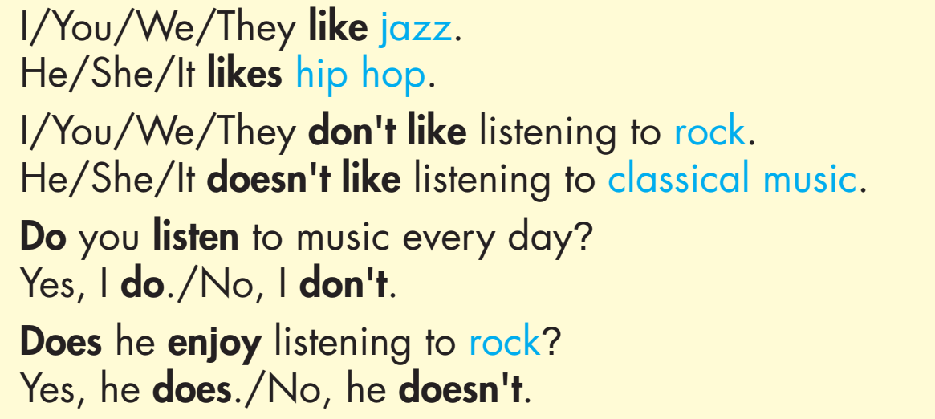
Present Simple for facts
EXAMPLES

Slide 11
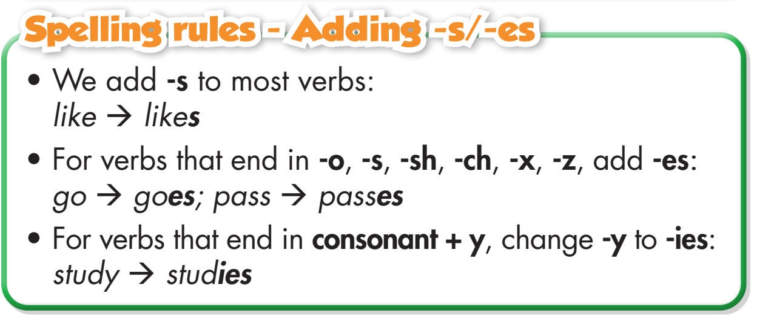

Slide 12
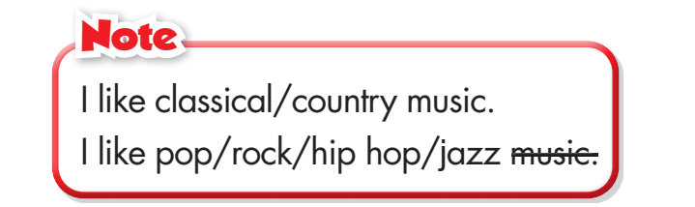
b. Circle the correct words.
1. Sarah love/loves jazz.
She don't/doesn't like rock music.
2. Matt often listen/listens to his favorite rock songs
when he do/does his homework.
3. I don't/doesn't like listening to classical music. It is/are boring.

Slide 13
PRACTICE

Slide 14
b. Circle the correct words.
4. - Do/Does your parents listen/listens to country music?
- Yes, they love/loves it.
5. My sister and I play/plays the piano every day. We practice/practices in the evening.
6. - When do/does the music show finish/finishes?
- It finish/finishes at 11 p.m.

Slide 15
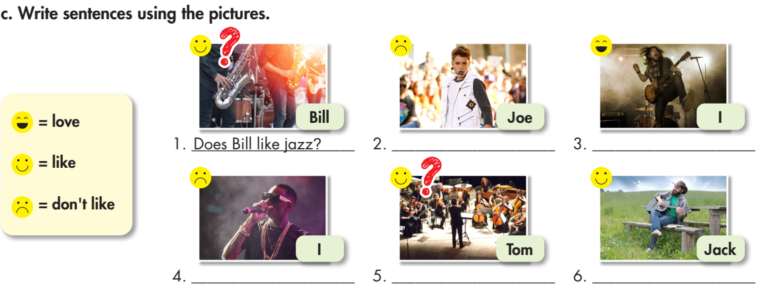
Joe doesn’t like pop.
I love rock.
I don’t like
hip hop.
Does Tom like
classical music?
Jack likes country music.

Slide 16
Extra Practice
WB, page 15
Underline the mistakes. Write the correct answers on the lines.
do not
1. I am not like listening to rock music. _____________
2. I loves listening to pop music. ______________
3. Are you like listening to jazz? - No, I don't.______________
4. I likes playing classical music on the piano. ______________
love
Do
like

Slide 17
Extra Practice
WB, page 15
Underline the mistakes. Write the correct answers on the lines.
likes
5. She like singing country music. ____________
6. Is he like listening to country music? - Yes, he does._____________
7. Does you like listening to classical music? - Yes, I am. ____________
8. My dad don't like rock. He think it's noisy._______________
Does
Do - do
doesn’t - thinks

Slide 18
Complete the text with the affirmative or negative form of the verbs.
come work cook eat go have live stay study swim
have got
ABOUT ME
My name’s Laura. I’m thirteen and I come from Seville. I two brothers. My eldest brother, Javier, is nineteen and he at the Univeristy of Seville. My other brother, Hugo, is only four, so he to school. My grandma with us in our flat, and my parents of course!
My favorite time of year is the summer. My parents during August, so we in our house in the moutains. There’s a pool, but we
in the afternoon because it’s really hot. In the evening, my dad some amazing meals and we dinner together outside.
have
studies
doesn’t go
lives
don’t work
stay
don’t swim
cooks
eat

Slide 19
PRODUCTION

Slide 20

Ask and answer.
What kind of music do you like?
I like hip hop. It’s exciting.
I like pop. It’s interesting.

Slide 21

CONSOLIDATION

Slide 22
QUESTION GAME - PING PONG
I work at an international school. And you?
I am a student.
I like rock music. And you?
I like jazz.
Notes:
-Teacher will use a kind of ‘PING PONG ’process of making statement about herself/himself and then will elicit the answers from the students.

Slide 23
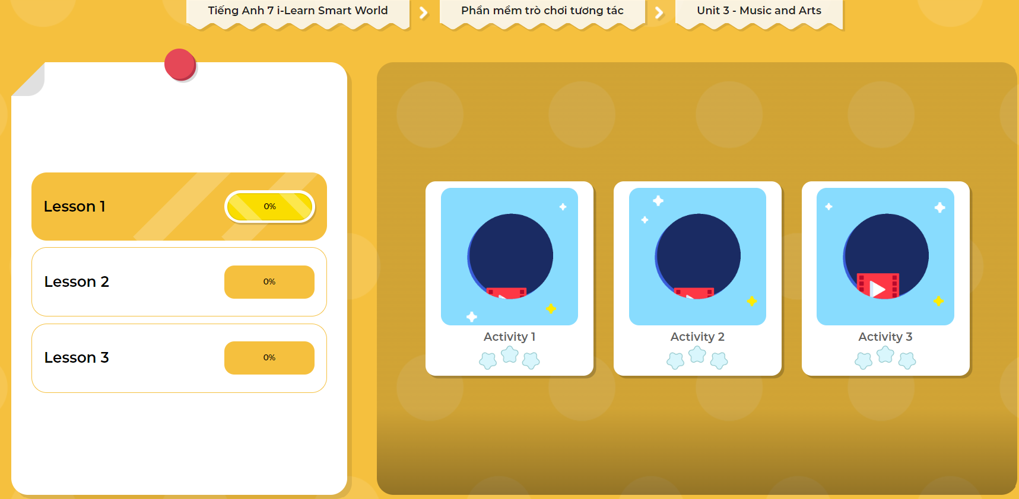
Extra Practice
DHA
Play the games in DHA App. Click the picture below.

Slide 24

WRAP-UP

Slide 25
Today’s lesson
Grammar:
Using Present Simple for facts.
Talking about things that we consider as facts (such as likes and dislikes), or things that are true for a long time.

Slide 26
Homework
Practice making sentences using the Present Simple.
Complete the grammar notes in Tiếng Anh 7 i-Learn Smart World Notebook on page 15.
Prepare the next lesson (page 22 SB).
Play the consolidation games in Tiếng Anh 7 i-Learn Smart World DHA App on www.eduhome.com.vn

Slide 27

Lesson 3
Stay positive and have a nice day!

