Slide 1
LUONG VAN CHANH SECONDARY SCHOOL
ENGLISH 7
TEACHER: TRAN MAI THAO

Slide 2

Unit 3: Music and Arts
Lesson 1.1: Vocabulary & Reading
Page 20

Slide 3



LESSSON OUTLINE
Consolidation

Slide 4
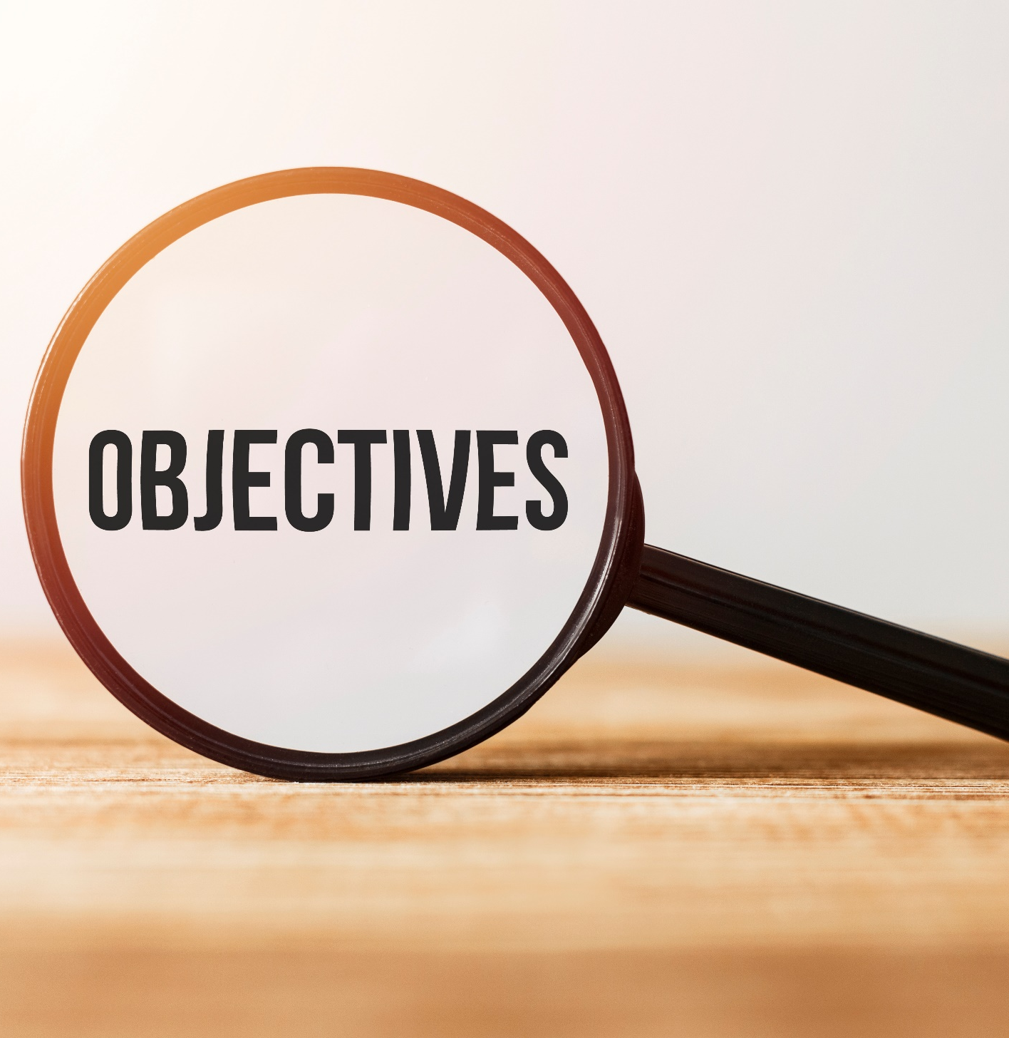
By the end of this lesson, students will be able to…
talk about types of music.
practice reading and understanding specific information about a teen’s favorite kind of music.
Notes:
Change information

Slide 5

New words
jazz
pop
hip hop
classical music
rock
country (music)
Notes:
Change information

Slide 6

WARM-UP

Slide 7

Work in pairs
1. What is your favorite type of music?
2. Do you learn music at school?
3. Do you find music important to our life?

Slide 8



Slide 9
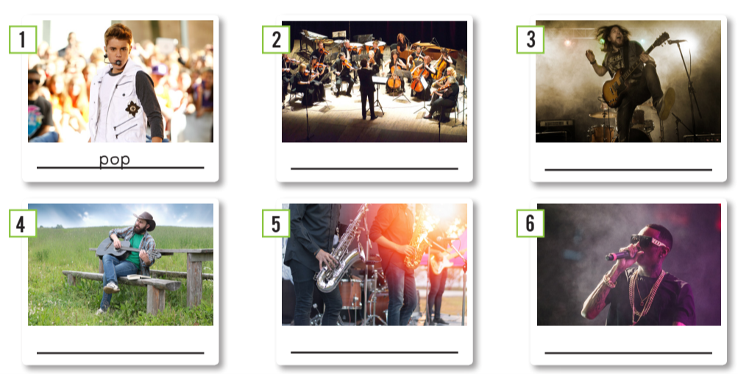
Work in pairs. What can you see in each picture?

Slide 10
Work in pairs. a. Match each phrase to each picture.
1. pop
2. jazz
3. hip hop
4. classical music
5. rock
6. country (music)
classical music
rock
country (music)
jazz
hip hop

Slide 11

Listen and repeat. (Click each word/phrase to hear the sound)
jazz (n) /dʒæz/ nhạc jazz
hip hop (n) /ˈhɪp hɑːp/ nhạc hip-hop
classical music (n) /ˌklæsɪkl ˈmjuːzɪk/ nhạc cổ điển
rock (n) /rɑːk/ nhạc rốc
country (music) (n) /ˈkʌntri mjuːzɪk/ nhạc đồng quê
Notes:
GV click vào từng cụm nghe âm thanh

Slide 12
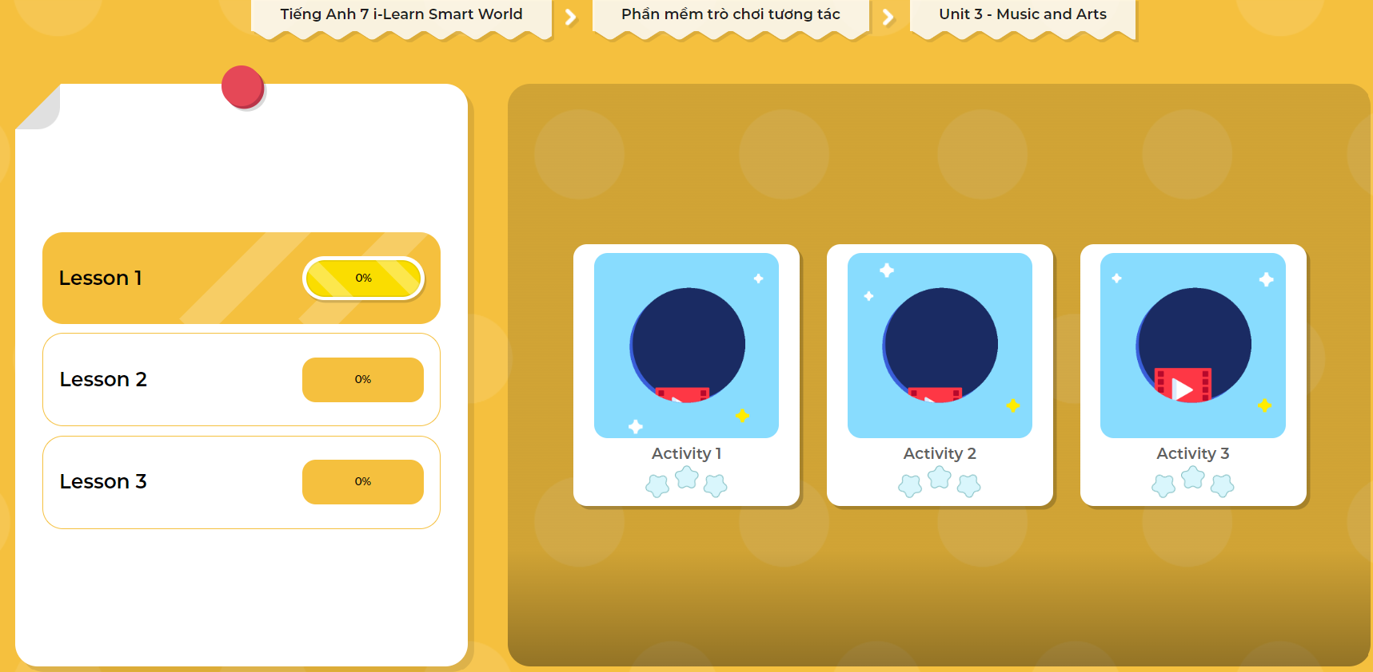
Extra Practice
DHA
Play the games in DHA App. Click the picture below.

Slide 13
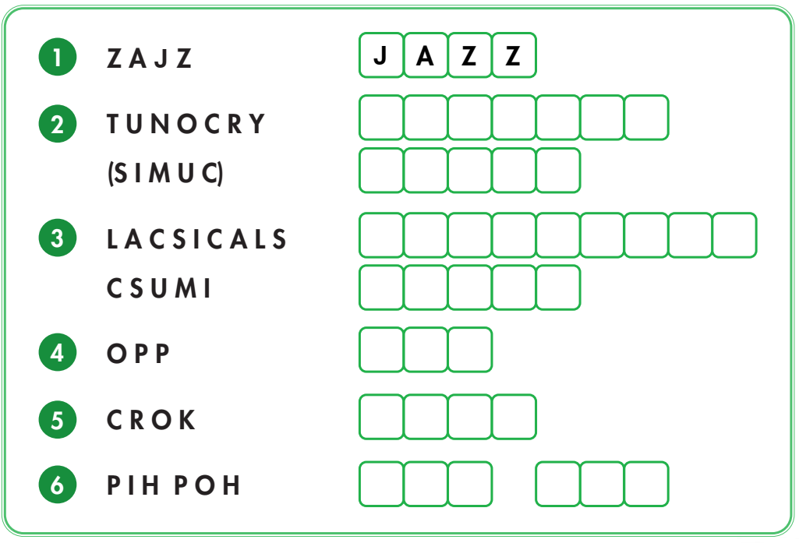
Extra Practice
WB, page 14
Work in pairs
Unscramble the words
C O U N T R Y
M U S I C
C L A S S I C A L
M U S I C
P O P
R O C K
H I P H O P

Slide 14


Work in pairs.
b. Talk about which types of music you like and dislike, using the adjectives below.
boring interesting fun terrible exciting beautiful

Slide 15

It’s reading time….

Slide 16
Pre - reading
Read the instruction quickly. Underline the key words. What are we going to do?
Read and answer the question.
a. Read the blog posts. Do Bình and Linh both like rock music?

Slide 17
Look at the blog posts. Skim the text and underline the information related to the question.
a. Read the blog posts. Do Bình and Linh both like rock music?
WHAT'S YOUR FAVORITE KIND OF MUSIC?
December 4
I like listening to all kinds of music, but my favorites are rock and hip hop. Rock is great to listen to when I feel sad because it's so exciting. I always feel much better after I listen to my favorite rock songs. I think I like hip hop most. I like to listen to music on the weekends and in the evenings after school. I can sing and dance to it all day long.

Slide 18
February 10
I love listening to pop music. It's my favorite. I think the songs are so beautiful. My favorite pop singer is Taylor Swift. I usually listen to her songs in my free time. I don't like listening to rock. It's terrible!

Slide 19
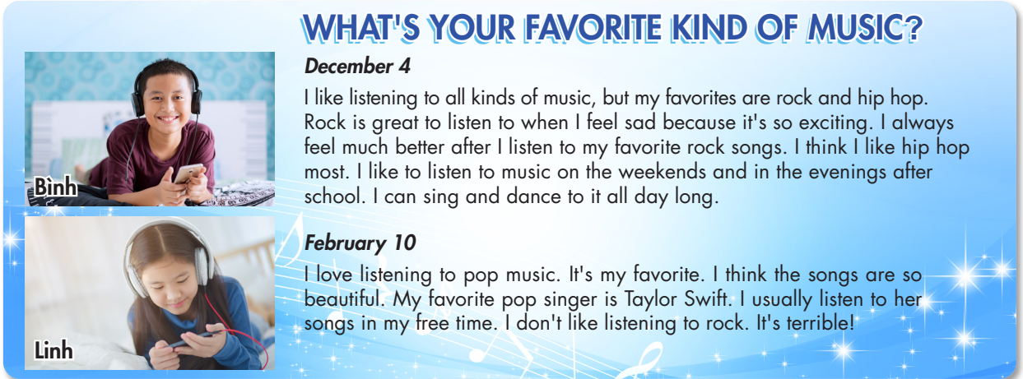
Scan the underlined sentences. Answer the questions.
What’s Bình’s favorite kind of music? What’s Linh’s favorite kind of music?
Do they both like rock music?
While - reading
No, they don’t.

Slide 20
Pre - reading
Read the instruction quickly. What are we going to do?
Read and circle the correct answer.

Slide 21
Read the statements. Underline the key words.
Pre - reading
1. Bình’s favorite music is…
a) jazz. b) hip hop. c) pop.
2. Listening to rock makes Bình feel…
a) better. b) bored. c) excited.
3. Linh thinks pop music is…
a) terrible. b) beautiful. c) sad.
4. Linh listens to Taylor Swift…
a) at school. b) in the evenings. c) in her free time.
5. Linh doesn’t like…
a) hip hop. b) rock. c) pop.

Slide 22
While - reading
Scan the text. Circle the answer.
1. Bình’s favorite music is… a) jazz. b) hip hop. c) pop.
WHAT'S YOUR FAVORITE KIND OF MUSIC?
Bình, December 4
I like listening to all kinds of music, but my favorites are rock and hip hop. Rock is great to listen to when I feel sad because it's so exciting. I always feel much better after I listen to my favorite rock songs. I think I like hip hop most. I like to listen to music on the weekends and in the evenings after school. I can sing and dance to it all day long.
Linh, February 10
I love listening to pop music. It's my favorite. I think the songs are so beautiful. My favorite pop singer is Taylor Swift. I usually listen to her songs in my free time. I don't like listening to rock. It's terrible!

Slide 23
Scan the text. Circle the answer.
While - reading
2. Listening to rock makes Bình feel… a) better. b) bored. c) excited.
WHAT'S YOUR FAVORITE KIND OF MUSIC?
Bình, December 4
I like listening to all kinds of music, but my favorites are rock and hip hop. Rock is great to listen to when I feel sad because it's so exciting. I always feel much better after I listen to my favorite rock songs. I think I like hip hop most. I like to listen to music on the weekends and in the evenings after school. I can sing and dance to it all day long.
Linh, February 10
I love listening to pop music. It's my favorite. I think the songs are so beautiful. My favorite pop singer is Taylor Swift. I usually listen to her songs in my free time. I don't like listening to rock. It's terrible!

Slide 24
While - reading
Scan the text. Circle the answer.
3. Linh thinks pop music is… a) terrible. b) beautiful. c) sad.
WHAT'S YOUR FAVORITE KIND OF MUSIC?
Bình, December 4
I like listening to all kinds of music, but my favorites are rock and hip hop. Rock is great to listen to when I feel sad because it's so exciting. I always feel much better after I listen to my favorite rock songs. I think I like hip hop most. I like to listen to music on the weekends and in the evenings after school. I can sing and dance to it all day long.
Linh, February 10
I love listening to pop music. It's my favorite. I think the songs are so beautiful. My favorite pop singer is Taylor Swift. I usually listen to her songs in my free time. I don't like listening to rock. It's terrible!

Slide 25
While - reading
Scan the text. Circle the answer.
4. Linh listens to Taylor Swift… a) at school. b) in the evenings. c) in her free time.
WHAT'S YOUR FAVORITE KIND OF MUSIC?
Bình, December 4
I like listening to all kinds of music, but my favorites are rock and hip hop. Rock is great to listen to when I feel sad because it's so exciting. I always feel much better after I listen to my favorite rock songs. I think I like hip hop most. I like to listen to music on the weekends and in the evenings after school. I can sing and dance to it all day long.
Linh, February 10
I love listening to pop music. It's my favorite. I think the songs are so beautiful. My favorite pop singer is Taylor Swift. I usually listen to her songs in my free time. I don't like listening to rock. It's terrible!

Slide 26
While - reading
Scan the text. Circle the answer.
5. Linh doesn’t like… a) hip hop. b) rock. c) pop.
WHAT'S YOUR FAVORITE KIND OF MUSIC?
Bình, December 4
I like listening to all kinds of music, but my favorites are rock and hip hop. Rock is great to listen to when I feel sad because it's so exciting. I always feel much better after I listen to my favorite rock songs. I think I like hip hop most. I like to listen to music on the weekends and in the evenings after school. I can sing and dance to it all day long.
Linh, February 10
I love listening to pop music. It's my favorite. I think the songs are so beautiful. My favorite pop singer is Taylor Swift. I usually listen to her songs in my free time. I don't like listening to rock. It's terrible!

Slide 27

Post - reading
Work in pairs.
When do you like to listen to music?
I like to listen music in my free time.
.
I listen to music when I am home alone.
I listen to my favorite music after school.
I listen to my favorite music when I'm sad.

Slide 28

CONSOLIDATION

Slide 29
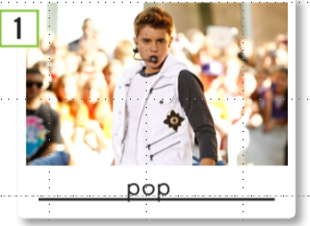
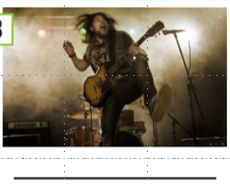
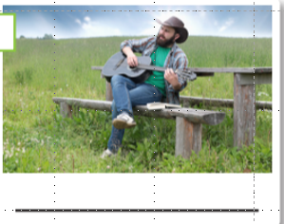
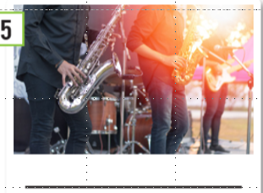

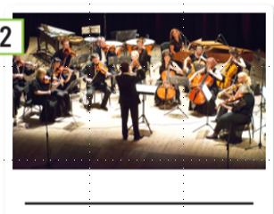
Look at the pictures, write the words.
rock
country (music)
jazz
hip hop
classical music

Slide 30

WRAP-UP

Slide 31
Today’s lesson
Vocabularies
pop
jazz
hip hop
classical music
rock
country (music)

Slide 32
Today’s lesson
Reading:
- Understanding instructions.
Skimming and scanning for specific information.
Speaking:
- Talking about types of music.

Slide 33
Homework
Learn by hearts the vocabularies and make sentences using them.
Do the Reading exercise on page 15 WB.
Do the exercises in Tiếng Anh 7 i-Learn Smart World Notebook on page 14.
Prepare the next lesson (page 21 SB).
Play the consolidation games in Tiếng Anh 7 i-Learn Smart World DHA App on www.eduhome.com.vn .

Slide 34

Lesson 3
Stay positive and have a nice day!

