Slide 2


Slide 3



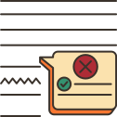
LESSON 5
Ms Phương
Zalo: 0966765064
GRAMMAR

Slide 4
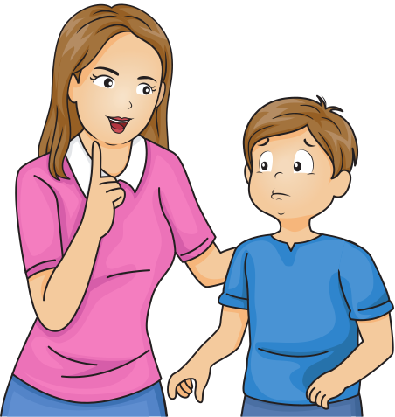
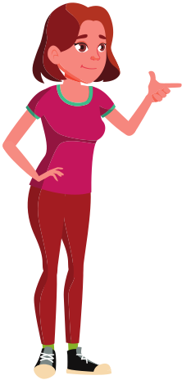
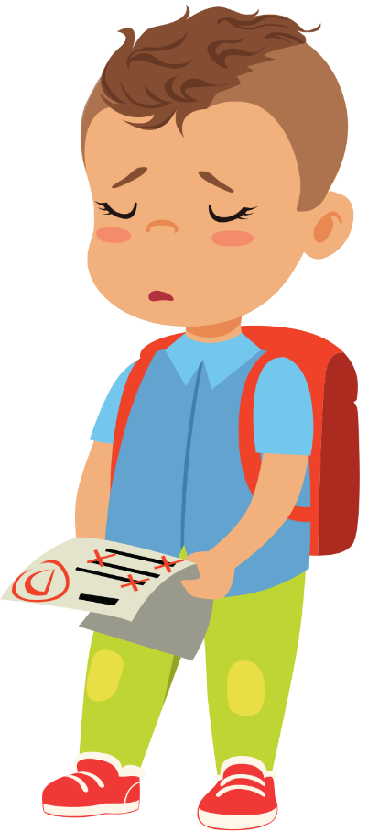

Ms Phương
Zalo: 0966765064
- I’m so sad because I’ve got a D for the maths test.
The water is so deep. You shouldn’t swim here.
- Don’t worry! You should study harder.

Slide 5

Modals
Động từ khuyết thiếu
should:
Nên
You should study harder.
shouldn’t :
Không nên
You shouldn’t swim here.
Should/shouldn’t + V(o)

Slide 6
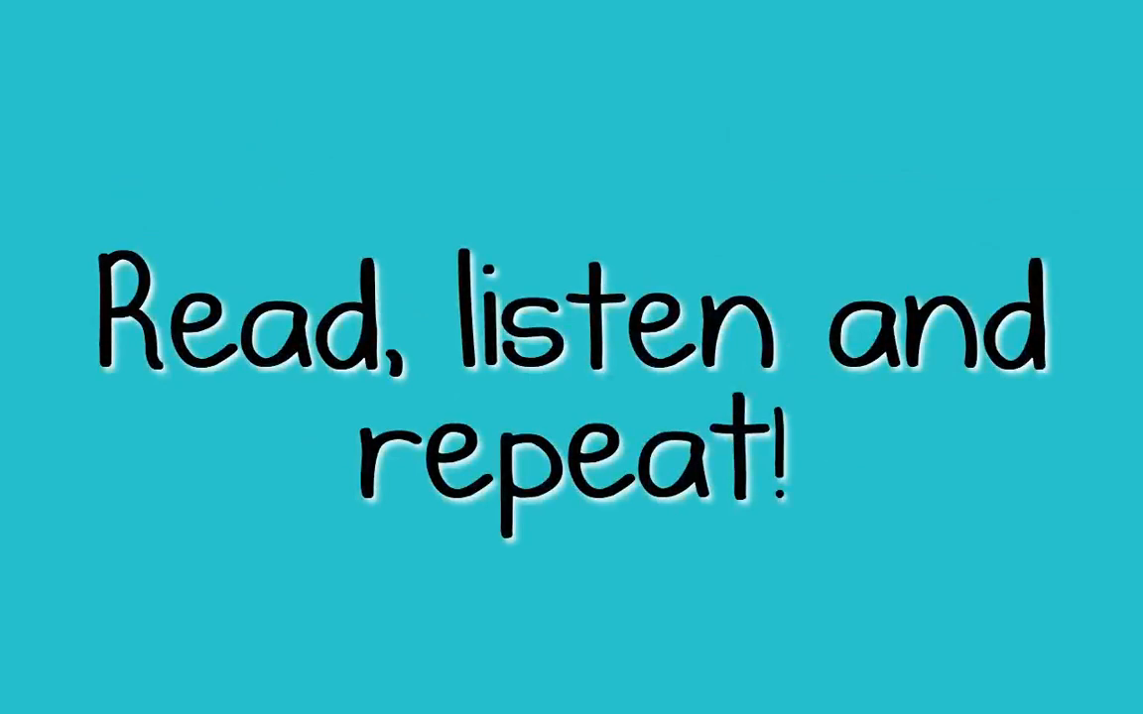

Slide 7


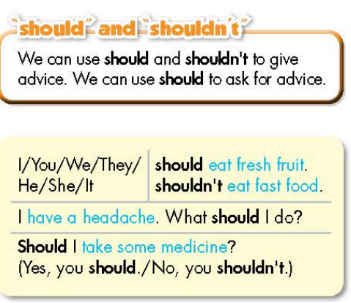
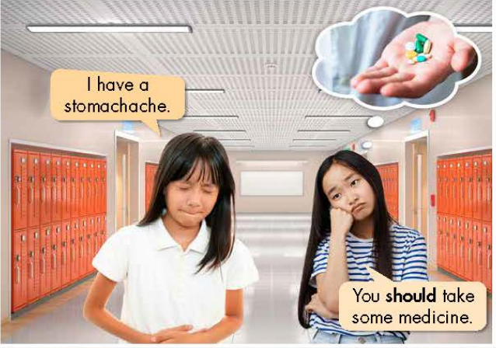

Slide 8
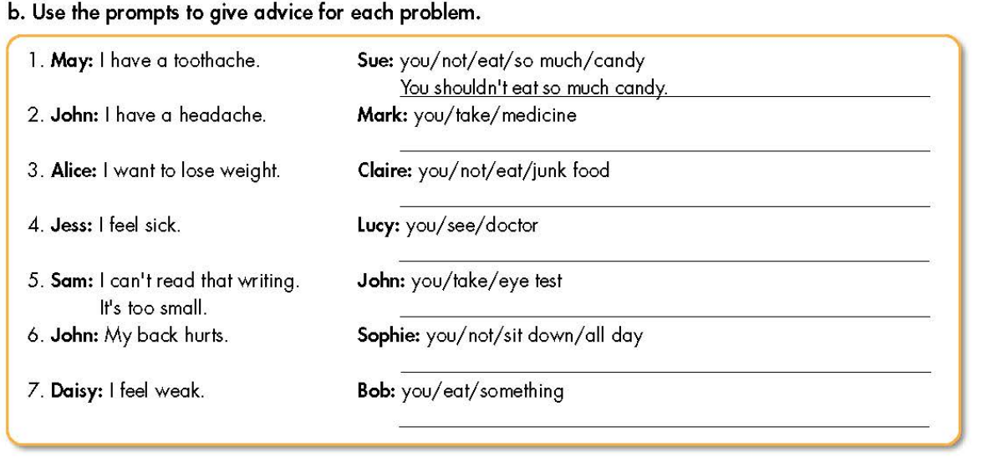
You should take medicine.
You shouldn’t eat junk food.
You should see a doctor.
You should take an eye test.
You should not sit down all day.
You should eat something.

Slide 9
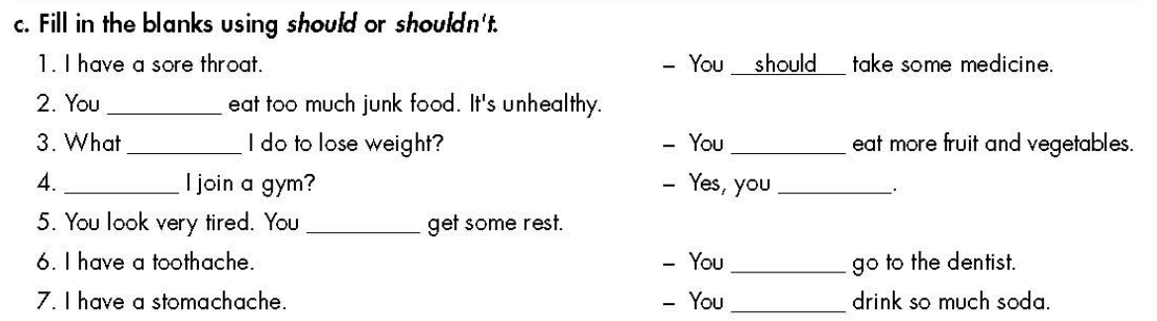
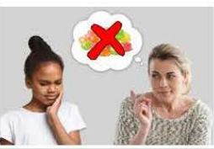
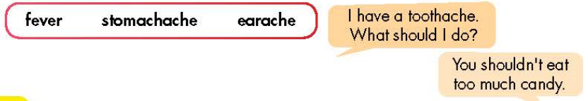
should
should
shouldn’t
should
Should
should
should
shouldn’t

Slide 10

SHOULD OR SHOULDN’T!?

Slide 11
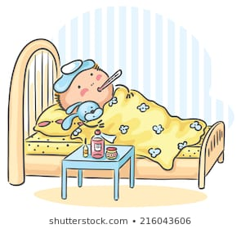

He has flu.
He ________ stay at home.
SHOULD

Slide 12
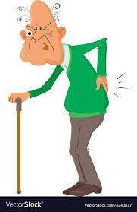

He has backache.
He ________carry heavy things.
SHOULDN’T

Slide 13
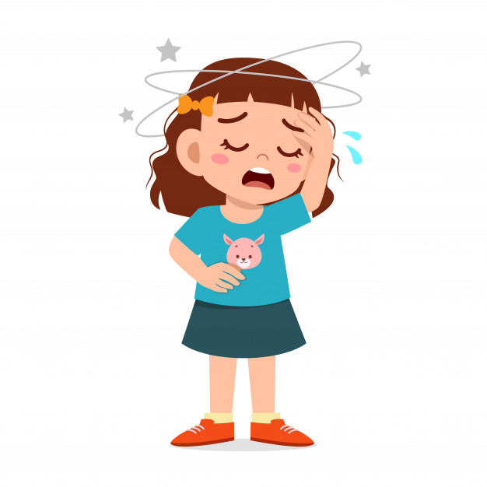
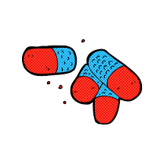
She has a headache.
She ________ take painkiller.
SHOULD

Slide 14
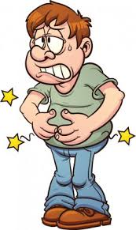

Steve has stomachache.
He ________ drink lemon and mint tea.
SHOULD

Slide 15
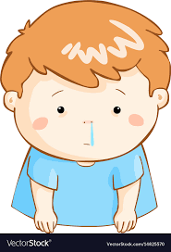
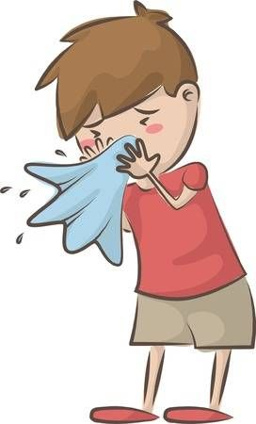
You have runny nose.
You ________ blow your nose.
SHOULD

Slide 16
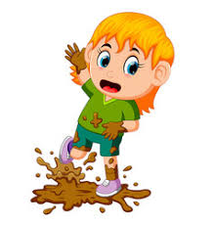
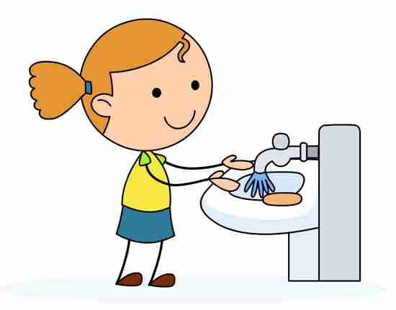
Daisy has dirty hands.
She ________ wash her hands.
SHOULD

Slide 17
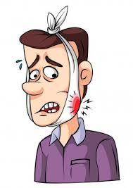
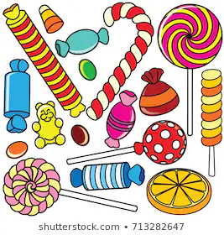
My brother has toothache.
He ________ eat candies.
SHOULDN’T

Slide 18
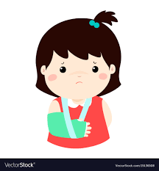
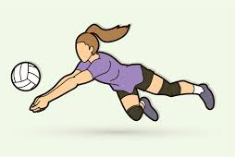
Jennifer has a broken arm.
She ________ play volleyball.
SHOULDN’T

Slide 19
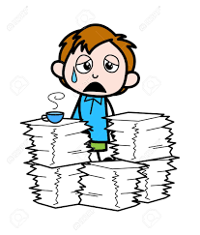
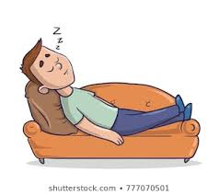
He feels tired.
He ________ have a rest.
SHOULD

Slide 20
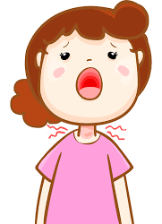
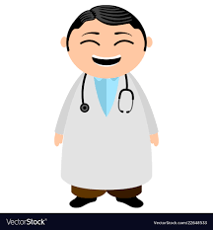
Caroline has a sore throat.
She ________ go to a doctor.
SHOULD

Slide 21
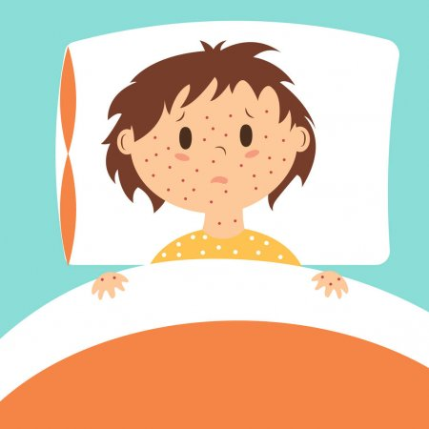

She has measles.
She ________ go to school.
SHOULDN’T

Slide 22
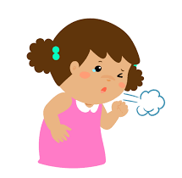

She has a cough.
She ________ drink cold drinks.
SHOULDN’T

Slide 23
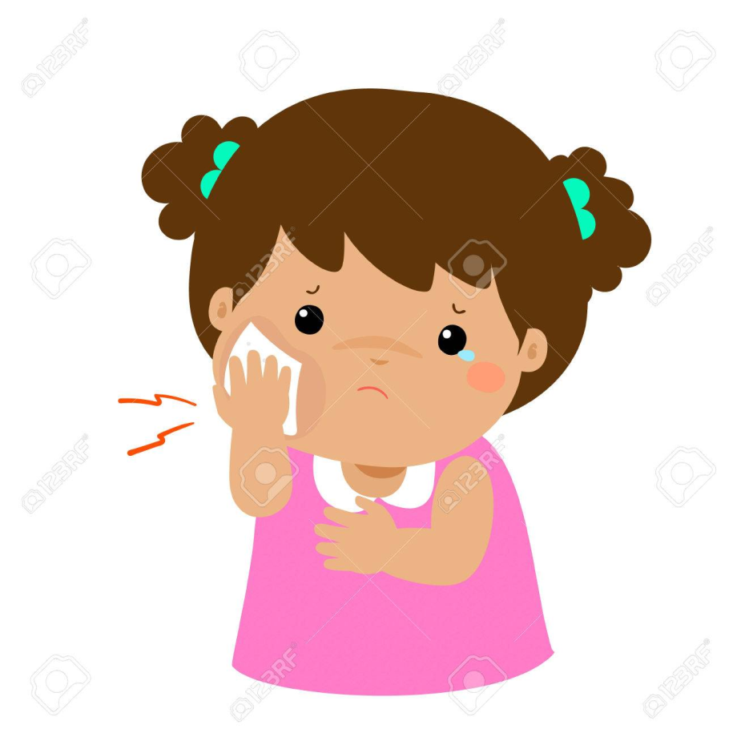
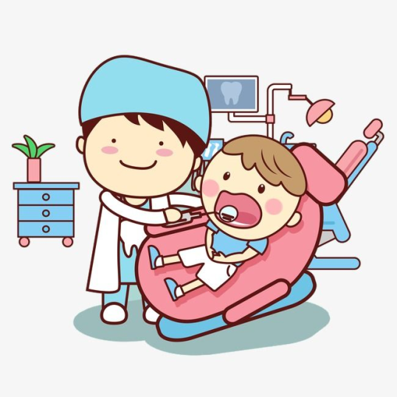
She has toothache.
She ________ go to a dentist.
SHOULD

Slide 24
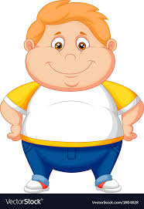

Matt is fat.
He ________ eat junk food.
SHOULDN’T

Slide 25
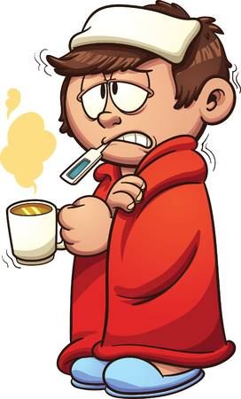

Peter has cold.
He ________ have a rest.
SHOULD

Slide 26
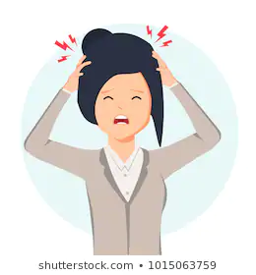

She has headache.
She ________ take medicine.
SHOULD

Slide 27
Unit 2: HEALTH
Lesson 5: Grammar
- “should” and “shouldn’t”
Form:
Form:
(+) S + should + V_{B.I} …
(-)S + shouldn’t + V_{B.I} …
(?)Should + S+ V_{B.I} …
Usage: to ask for / give advice
Ms Phương
Zalo: 0966765064

Slide 28

HOMEWORK
Make
- Make 2 sentences, use “should” and “shouldn’t to ask for / give advice.
Do
- Do the exercises in WB: Grammar (page 11).
Complete
- Complete the grammar notes in Tiếng Anh 7 i-Learn Smart World Notebook (page 13).
Prepare
- Prepare: Lesson 2 – Pronunciation and Speaking (page 17 – SB).

