Slide 1
LUONG VAN CHANH SECONDARY SCHOOL
ENGLISH 7
TEACHER: TRAN MAI THAO

Slide 3
LESSON 9
REVIEW

Slide 4
VOCABULARY REVIEW
v
Uống
1. drink
v
2.eat
ăn
n
3. fast food
Đồ ăn nhanh
Ms Phương
Zalo: 0966765064
n
4. fruit
Trái cây
n
Đồ ăn vặt
5. junk food
adj
6.healthy
Lành mạnh
adj
Không lành mạnh
7. unhealthy
n
8. lifestyle
Lối sống
n.ph
Ngủ đủ
9. get enough sleep
n
10. soda
Nước uống có ga
n
11. vegetables
Rau

Slide 5
v
Cảm thấy
12.feel
Phrase
Sốt
13. have a fever
Phrase
Đau họng
14. have a sore throat
Ms Phương
Zalo: 0966765064
phrase
Nghỉ ngơi
15. have a rest
phrase
Uống thuốc
16.take medicine
phrase
Uống vitamin
17. take vitamins
adj
18.lazy
lười biếng
v
19.keep
giữ gìn
v
20.stay up late
Thức khuya
v
21.feel weak
Cảm thấy ốm yếu

Slide 6
v
Cảm thấy buồn ngủ
22.feel asleep
23. Keep warm
v
Giữ ấm
n
Căng tin
24. cafeteria
n
Ms Phương
Zalo: 0966765064
25. principal
Hiệu trưởng
adj
Một cách hiệu quả
26.effectively

Slide 7
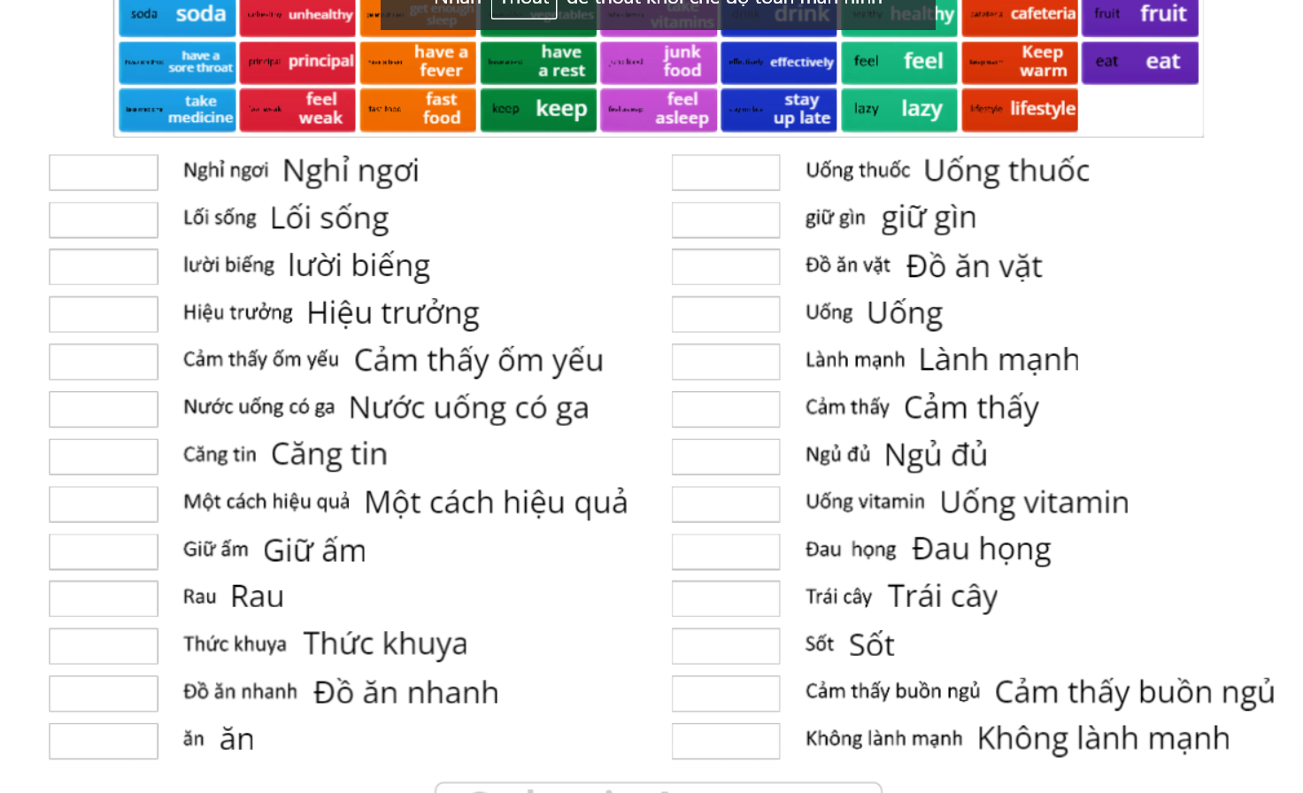
PRACTICE ONLINE VOCABULARY
Ms Phương
Zalo: 0966765064

Slide 8
GRAMMAR REVIEW
Quantifiers ( Từ chỉ định lượng)
Countable and Uncountable nouns ( Danh từ đếm được và không đếm được) ( Hiện tại đơn)
Ms Phương
Zalo: 0966765064

Slide 9
COMMON UNCOUNTABLE NOUNS
food
liquid
others
butter
orange juice
money
cheese
coffee
homework
meat
milk
advice
rice
water
information
sugar
oil
bread
lemondade

Slide 10
a little/not much
a lot of, lots of
some
any
Một ít
Nhiều
một vài, một chút
một vài, một chút
Đứng trước danh từ không đếm được
Đứng trước danh từ số nhiều cả đếm được và không đếm được, câu khẳng định
Đứng trước danh từ số nhiều đếm được.
Đứng trước danh từ số nhiều đếm được.
a little water
some apples,
any tables
I have lots of friends.
Đứng trước danh từ không đếm được.
Đứng trước danh từ không đếm được.
some milk
any water
Dùng trong câu khẳng định.
Dùng trong câu hỏi và câu phủ định.
There isn’t any water left.
We have some food in the fridge
Are there any books here?

Slide 11
3. Should /Shouldn’t
should” and “shouldn’t”
Form:
Form:
(+) S + should + V_{B.I} …
(-)S + shouldn’t + V_{B.I} …
(?)Should + S+ V_{B.I} …
Usage: to ask for / give advice
Ms Phương
Zalo: 0966765064

Slide 12
You will hear a doctor talking to a group of students about staying healthy. Listen and fill in the blanks. You hear the information twice.
Listening
Name of doctors: (0)_________________.
Important to get: (1)________hours of sleep
Difficult to sleep before (2)________ p.m
Teenagers getting enough sleep (3)_________%
Shouldn’t eat or (4)_____________
Relax before bed by (5) ______________
8 / eight
11
11
15
exercise
reading (a book)

Slide 13
THE AUDIO SCRIPT
Doctor: Hello, everyone. I'm Doctor Brown and today I want to talk to you about how to prepare yourself for a good night's sleep. It's important
to get at least eight hours of sleep each night, but lots of teenagers and it difficult to fall asleep before eleven o'clock at night.
One study found that only fifteen percent of teenagers get enough sleep. So, what can you do to get more sleep? Well, you shouldn't eat or
exercise for a few hours before bed. You should also do something to relax before you go to bed, like reading a book. If you read a book before going to sleep, then you will sleep better than if you watch TV or play online games.

Slide 14
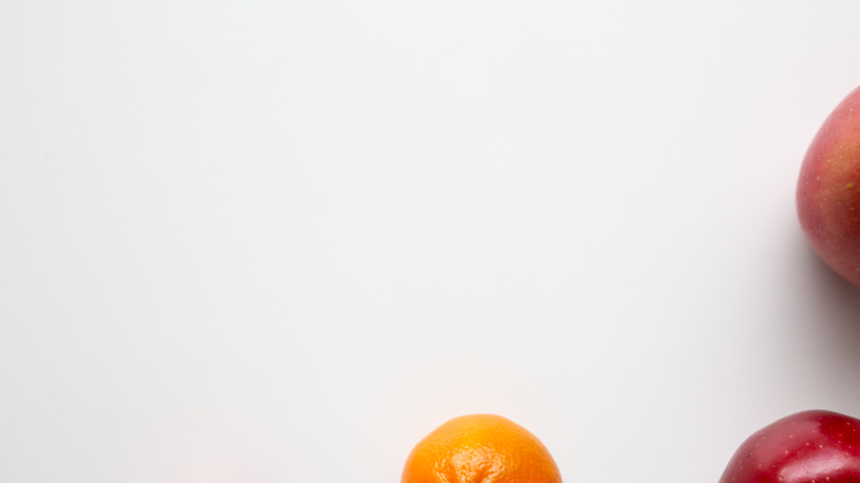
Read the article about how to stay healthy. Choose the correct answer A,B or C.
Teenagers: How to say healthy
Having a healthy lifestyle is very important. Unhealthy habits will make you feel tired and increase your chance of becoming overweigh. Here are somethings you need to pay attention to:
Eat many types of food and try to eat more fruit and vegetables. Many teens like fast food and soda, but they’re really bad for you. You don’t have to stop eating your favorite burgers completely, but try to eat them less.
Exercise regularly. You should get an hour of exercise a day. If you can’t try to be active for at lease half an hour three times a week.
Get enough sleep, you shouldn’t stay up late too often. Your body needs about nine hours of sleep every night, but most teens have only about seven hours of sleep. Having enough sleep will help you focus and remember things more easily.

Slide 15
1. What does the article say about healthy eating?
A. Never eat fast food
B. Eat many different kinds of food
C. Eat more fruit and vegetables than meat
2. What's the least amount of exercise teens should get?
A. 30 minutes three times a week
B. 60 minutes three times a week
C. 60 minutes every day
3. How much sleep do most teens get each night?
A. seven hours B. eight hours C. nine hours
4. What isn't a benefit of having enough sleep?
A. Your body will be stronger.
B. You can focus better.
C. Your memory will be better.

Slide 16
Fill in the blanks with the words from the box.
stay up late eat fruit and vegetables get some sleep
take your medicine has a sore throat unhealthy take vitamins keep warm
1. It's 11 p.m., Mandy! You shouldn't ________________.
2. Most people don't need to ________________ because they can get enough vitamins from their food already.
3. It's very important to ________________ during winters.
4. We'll need to wake up at 4 a.m. tomorrow. Try to ________________ now.
5. Matt's lifestyle is really _____________________. He doesn't exercise and eats lots of burgers and pizzas.
6. Don't forget to _____________________ after lunch. The doctor said you should eat some food before taking it.
7. Jane _____________________. It hurts when she eats or talks.
8. A good way to get your kids to _____________________ is to add some to their favorite dishes.
stay up late
take vitamins
keep warm
get some sleep
unhealthy
take your medicine
has a sore throat
eat fruit and vegetables

Slide 17
Grammar: a. Circle the correct answer.
Can you go buy some/much milk, please?
We don’t have some/any left.
2. I eat lots of/any vegetables every day.
3. Ben doesn’t do any/ a little exercise. He’s very lazy.
4. My parents help me watch a little/any TV every day.
5. You should drink lots of/ any water every day.

Slide 18
b. Unscramble the sentences.
1. shouldn't/TV./You/much/watch/too
_________________________________________________________
2. do/What/should/healthier?/I/to/become
_________________________________________________________ 3. exercise./He/much/do/doesn't
_________________________________________________________
4. get/a/Teens/hours/night./nine/should/sleep/of
_________________________________________________________
5. of/shouldn't/candy./You/eat/lots
_________________________________________________________
You shouldn’t watch too much TV.
What should I do to become healthier?
He doesn’t do much exercise.
Teens should get a nine hours of sleep a night.
You shouldn’t eat lots of candy.

Slide 19
a. Circle the word that has the underlined part pronounced differently
from the others.
1. A. take B. stay C. late D. soda
2. A. fever B. rest C. vegetable D. medicine
3. A. candy B. fast food C. warm D. have
b. Circle the word that differs from the other three in the position of primary stress in each of the following questions.
4. A. medicine B. unhealthy C. vitamin D. vegetable
5. A. lifestyle B. fever C. lazy D. enough
6. A. cafeteria B. stomachache C. restaurant D. exercise

Slide 20
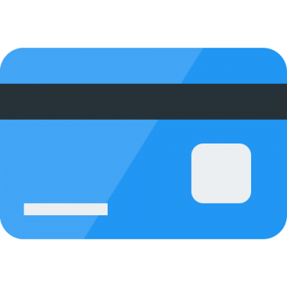
BÀI GIẢNG THUỘC QUYỀN SỞ HỮU TRÍ TUỆ CỦA E-TEACHERS. NGHIÊM CẤM MỌI HÀNH VI SAO CHÉP, PHÁT TÁN CHIA SẺ , MUA ĐI BÁN LẠI KHI CHƯA ĐƯỢC SỰ ĐỒNG Ý CỦA E-TEACHERS
ỦNG HỘ CHẤT XÁM CỦA ĐỒNG NGHIỆP LÀ ĐANG TẠO NHÂN QUẢ TỐT CHO BẢN THÂN VÀ GIA ĐÌNH CỦA CHÍNH MÌNH. E-TEACHERS CẢM ƠN VÌ BẠN ĐÃ ĐỒNG HÀNH.
PHONE /ZALO: 0966765064
https://www.facebook.com/maiphuongdo.dhnn/
SỬ DỤNG TÀI LIỆU CHÍNH CHỦ BẠN SẼ NHẬN ĐƯỢC SỰ TẬN TÂM VÀ CHÚNG TÔI SẼ PHỤC VỤ CÁC BẠN TẬN TÌNH.
TÀI LIỆU ĐƯỢC UPDATE VÀO MAIL CÁ NHÂN NGAY KHI UPDATE VÀ ĐƯỢC GIẢI ĐÁP MỌI THẮC MẮC VỀ KỸ THUẬT HOẶC CHUYÊN MÔN MỘT CÁCH KỊP THỜI NHẤT
TK: 3614689 ĐỖ MAI PHƯƠNG
NGÂN HÀNG VPBAK VIÊT NAM THỊNH VƯỢNG CHI NHÁNH HÀ NỘI.

