Slide 1

Unit 2: Health
Lesson 3.1: Listening & Reading
Page 18

Slide 2
LUONG VAN CHANH SECONDARY SCHOOL
ENGLISH 7
TEACHER: TRAN MAI THAO

Slide 3

LESSSON OUTLINE
Listening
Practice
Speaking
Wrap-up

Slide 4

By the end of this lesson, students will be able to…
- practice listening and reading for specific information/ detaila.
- talk about different kinds of healthy and unhealthy food at the school canteen.

Slide 5

WARM-UP

Slide 6

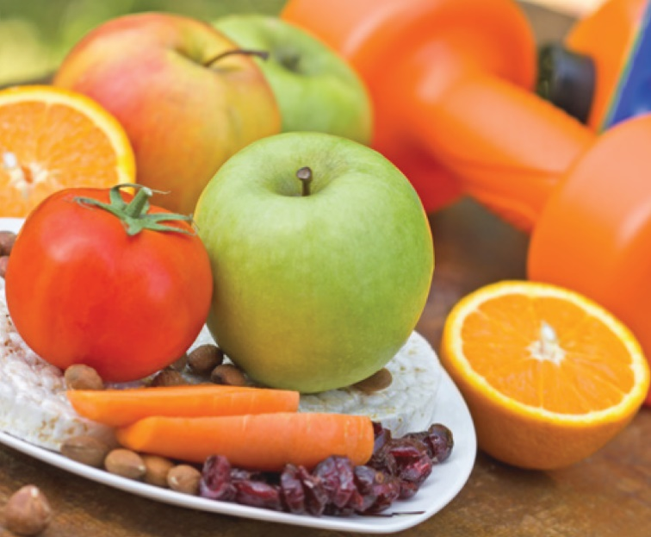
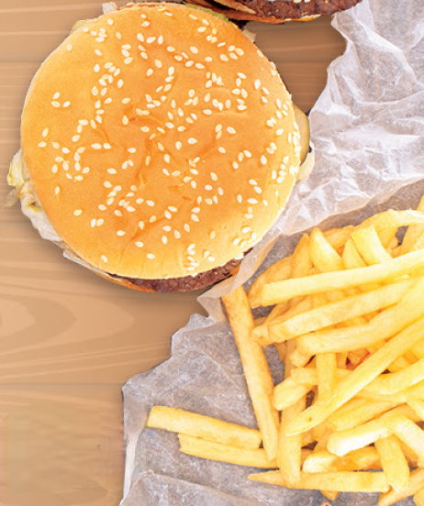

a. Look at the photos of food and name the food.
1
3
6
5
8
9
2
4
7
carrots
5.
pizza
3.
tomato
burger
8.
1.
4.
6.
chocolate
orange
2.
apples
9.
French fries
7.
donut
Click here for the answer.

Slide 7
b. Put the food in the right column.
burger
pizza
carrots
tomato(es)
French fries
chocolate
apples
orange(s)
donut
HEALTHY
UNHEALTHY
carrots
burger
apples
French fries
tomato(es)
pizza
chocolate
orange(s)
Click here for the answers.
donut

Slide 8
c. In pairs:
What food and drinks can you buy at your school?
For example:
I can buy lots of French fries and burgers.
I can buy some bananas in the canteen, too.
Click here for the answer.

Slide 9

LISTENING

Slide 10

a. Listen to an interview with James Olive. Where is the interview taking place?
1. in a school cafeteria
2. on TV
Click here for the answer.

Slide 11
b. Now, listen and circle.
3. According to James, what makes students feel tired?
A. Having fast food and soda.
B. Eating small lunches.
C. Studying at school.
4. What is "brain food"?
A. Food that looks like brains.
B. Food with lots of sugar and salt.
C. Food that helps you study better.
What does James do?
Sells healthy food.
Tells schools to sell healthy food.
Helps adults eat healthier food.
2. What do lots of schools sell?
A. Salad and smoothies.
B. Fast food.
C. Fruits and nuts.
Click here for the answer.

Slide 12
Audio script
W: Welcome back. I'm here talking to James Olive.
M: Hello.
W: Please tell everyone what you do, James.
M: Sure. I go to schools around the country and ask principals to sell healthier food in their cafeterias.
W: Why?
M: Well, lots of schools only sell food and drinks like pizza, burgers, and soda. These are not healthy and really don't help students learn and feel healthy. Fast food and soda have a lot of sugar and salt in them. In just a few hours after eating lunch, they will feel tired, and it will be harder to listen in class.
W: I see.
M: Instead, cafeterias should sell "brain food" like fruits and nuts. These foods help you study better and feel much healthier. So, if your school only sells unhealthy food, you should write a letter to your principal and ask for healthy options.
W: Thanks, James.

Slide 13

Extra Listening PRACTICE

Slide 14
Workbook, page 12
a. Listen to Ben talking about exercise and healthy eating and circle the
correct answer.
Ben is … a. healthy. b. unhealthy.
Click here for the answer.

Slide 15
Workbook, page 12
b. Now, listen and choose the correct answers.
His mom says he should...
a. do more exercise.
b. watch less TV.
c. eat more fruit.
3. He doesn't agree with...
a. his parents.
b. his teachers.
c. both.
2. His teachers say playing sport is...
a. not important.
b. important.
c. healthy.
4. He doesn't like...
a. hamburgers.
b. salad.
c. soda.
Click here for the answer.

Slide 16
Audio script
Ben: People are always telling me that I should be careful about my health. My mom says I should eat more fruit and vegetables, and my dad says I'm too lazy and should do more exercise. My teachers at school are always telling me that playing sport is important. I don't agree with them.
I like to eat a lot of hamburgers and French fries, and I enjoy watching TV and playing video games. I'm not very good at sport and I don't like it.
I don't want to waste time doing things I don't enjoy and eating food
I don't like. I hate salad and fruit. I'll take a burger and fries and a can of soda every time.

Slide 17
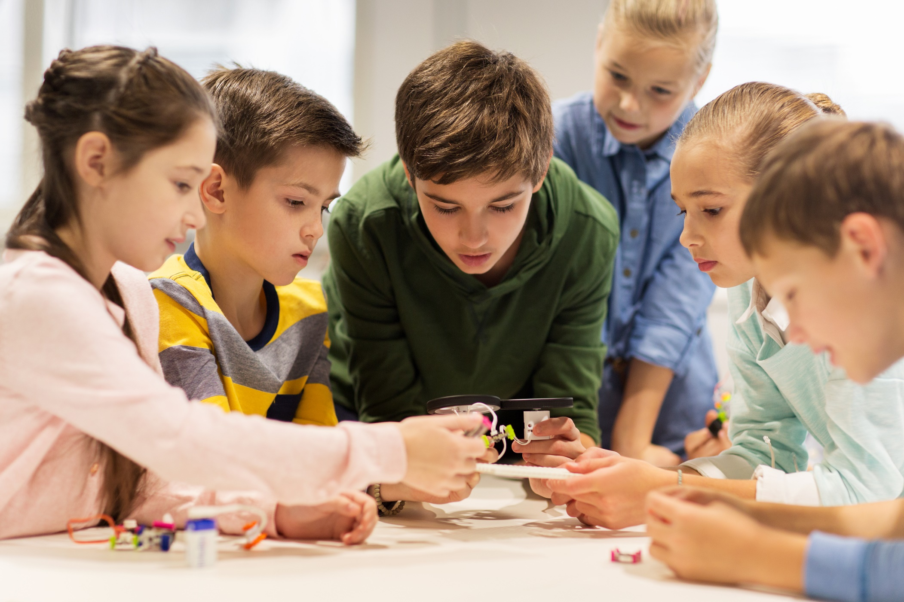
SPEAKING

Slide 18
In pairs: Ask and answer the two following questions.
Suggestions:
What should you eat at the school canteen to be healthy?
I should eat lots of fruits like bananas and watermelons. I should eat more nuts and vegetables like potatoes, tomatoes because they are healthy.
2. What shouldn’t you eat at the school canteen to be healthy?
I shouldn’t eat fast food like burgers or chips. I shouldn’t drink soda or other kinds of soft drinks because they are unhealthy.

Slide 19

READING

Slide 20
Student’s book, page 18
a. Read Tony's letter and circle. Who you think Mrs. Clancy is.?
1. Tony's math teacher
2. Tony's school principal
Dear Mrs. Clancy,
My name is Tony and I am in Class 7D. I am writing to ask you to provide us with healthier food in the cafeteria.
Click here for the answer.

Slide 21
b. Now, read and circle the correct answer.
What street does Tony live on?
a. West Street b. Elk Avenue c. Fort Lauderdale
Tony Jones
1362 Elk Avenue
Fort Lauderdale
Florida
33314
Mrs. J. Clancy
146 West Street
Fort Lauderdale
Florida
33301
Click here for the answer.

Slide 22
b. Now, read and circle the correct answer.
2. What does the cafeteria sell now?
salads b. soda c. fruit
3. How does the food make students feel?
a. good b. unhealthy c. tired
Dear Mrs. Clancy,
My name is Tony and I am in Class 7D. I am writing to ask you to provide us with healthier food in the cafeteria.
At the moment, it only sells things like soda and fast food. It really isn’t good for students. It makes us feel tired after eating lunch. My classmate even fell asleep at his desk in math class and got in lots of trouble. It makes it so difficult for us
to study.
Click here for the answer.

Slide 23
b. Now, read and circle the correct answer.
4. What does Tony want the cafeteria to sell?
a. fruit juice b. fast food c. fresh fruit
I think the cafeteria should sell things like fruit juice and salads. They are so much better for us and will help us study better and feel healthier. I also think it should sell less fast food and soda.
Please help make the cafeteria healthier.
Sincerely,
Tony Jones
Click here for the answer.

Slide 24
Extra Reading PRACTICE

Slide 25
Workbook, page 12
a. Read the letter and answer the question.
What does Roger want to use the youth club for?
1. a football match 2. a sports day
Dear Mr. Johnson,
My name is Roger Jones and I am a member of the youth club. I am writing to ask if you can let our class use the youth club next month for a special sports day. We do not have our own place to hold the sports day. We would like to use the club's playing field for a sponsored football match between our class and our teachers. We would also like to use the table tennis room for a competition. We want our school students to be healthier by playing more sport in their free time. Please help us.
Sincerely,
Roger Jones
Click here for the answer.

Slide 26
b. Now, read and answer the questions.
Brown Street
1. What street does Roger live on? ___________________________
Roger Jones
102 Brown Street,
Arkham, Massachusetts
10004
Mr. Ron Johnson – Manager
Arkham Youth Club, 247 Elm Hill,
Arkham, Massachusetts
10006
Click here for the answer.

Slide 27
b. Now, read and answer the questions.
2. What is the problem?
_____________________________________________________
3. What do Roger and his class want to use?
_____________________________________________________
Click here for the answer.
They do not have their own space to hold the sports day.
They want to use the club’s playing field and the table tennis room.
Dear Mr. Johnson,
My name is Roger Jones and I am a member of the youth club. I am writing to ask if you can let our class use the youth club next month for a special sports day. We do not have our own place to hold the sports day. We would like to use the club's playing field for a sponsored football match between our class and our teachers. We would also like to use the table tennis room for a competition. We want our school students to be healthier by playing more sport in their free time. Please help us.

Slide 28
b. Now, read and answer the questions.
4. Why do they want students to play more sport in their free time?
________________________________________________
They want their students to be healthier.
Dear Mr. Johnson,
My name is Roger Jones and I am a member of the youth club. I am writing to ask if you can let our class use the youth club next month for a special sports day. We do not have our own place to hold the sports day. We would like to use the club's playing field for a sponsored football match between our class and our teachers. We would also like to use the table tennis room for a competition. We want our school students to be healthier by playing more sport in their free time. Please help us.
Click here for the answer.

Slide 29
SPEAKING

Slide 30
c. In pairs:
What can you buy in your school cafeteria?
Are the foods healthy or unhealthy?
Example:
I can buy fast food like burgers and soda, but I don’t want to because they are unhealthy.
I can buy fruit juice like orange juice or lime juice. I should buy those drinks because they are healthy.

Slide 31

CONSOLIDATION

Slide 32
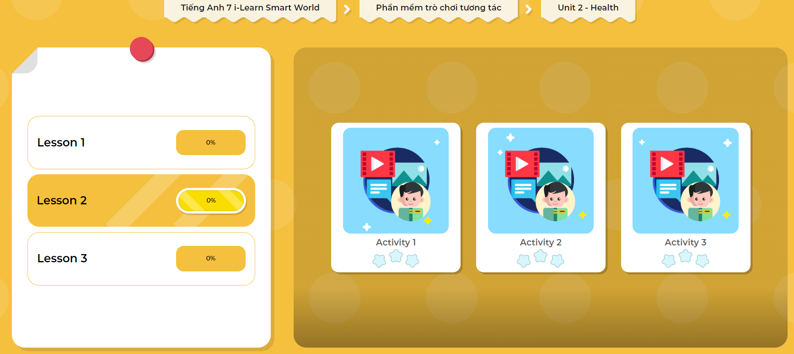
LET’S PLAY!
Click here to play the games.

Slide 33

WRAP-UP

Slide 34
Today’s lesson
- Practice listening and reading for specific information/ details.
- Talk about different kinds of healthy and unhealthy food at the school canteen.

Slide 35
Homework
Practice naming and eating healthy food
Do the exercises in Workbook, page 12
Prepare the next lesson (page 19, SB)
Do the exercise in Tiếng Anh 7 i-Learn Smart World DHA Notebook (page 14)
Play the consolidation games in Tiếng Anh 7 i-Learn Smart World DHA App on www.eduhome.com.vn

Slide 36

Lesson 3
Stay positive and have a nice day!

