Slide 1
LUONG VAN CHANH SECONDARY SCHOOL
ENGLISH 7
TEACHER: TRAN MAI THAO

Slide 2

Unit 2: Health
Lesson 2.3: Pronunciation & Speaking
Page 17

Slide 3

LESSSON OUTLINE
Presentation
Practice
Speaking
Wrap-up

Slide 4

By the end of this lesson, students will be able to…
- practice sound change.
- practice giving advice and persuading someone to have a healthy lifestyle.

Slide 5

WARM-UP

Slide 6

Work in pairs.
Choose the word whose main stress is placed
differently from the others.
A. exercise B. vegetable C. equipment D. balcony
2. A. lazy B. healthy C. windy D. alone
3. A. outdoor B. asleep C. active D. simple
/ˈeksərsaɪz/
/ˈvedʒtəbl/
/ɪˈkwɪpmənt/
/ˈbælkəni/
/ˈleizi/
/ˈhelθi/
/ˈwɪndi/
/əˈləʊn/
/ˈaʊtdɔːr/
/əˈsliːp/
/ˈæktɪv/
/ˈsɪmpl/

Slide 7
Work in pairs.
Choose the word whose underlined part is
pronounced differently from that of the other words.
A. lunch B. junk C. sun D. dude
2. A. kitchen B. teacher C. children D. headache
3. A. salad B. table C. soda D. pizza
/ lʌntʃ /
/dʒʌŋk/
/sʌn/
/duːd/
/ˈkɪtʃɪn/
/ˈti:tʃər/
/ˈtʃɪldrən/
/ˈhedeɪk/
/ˈsæləd/
/ ˈteɪbl/
/ˈsəʊdə/
/ˈpi:tsə/

Slide 8
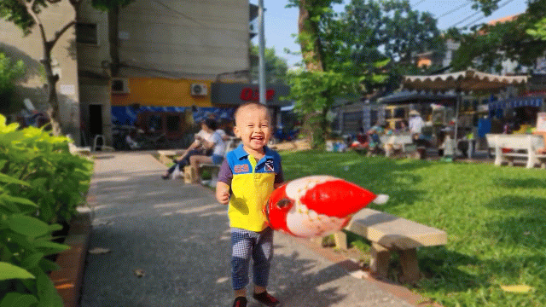
John is having some problems. Read what he says and look at the photos to give him advice with YOU SHOULD or YOU SHOULDN’T.
John: It’s too hot at home.
You: You ___________________. It’s very windy there.
should go to the park
Click here for the answer.

Slide 9
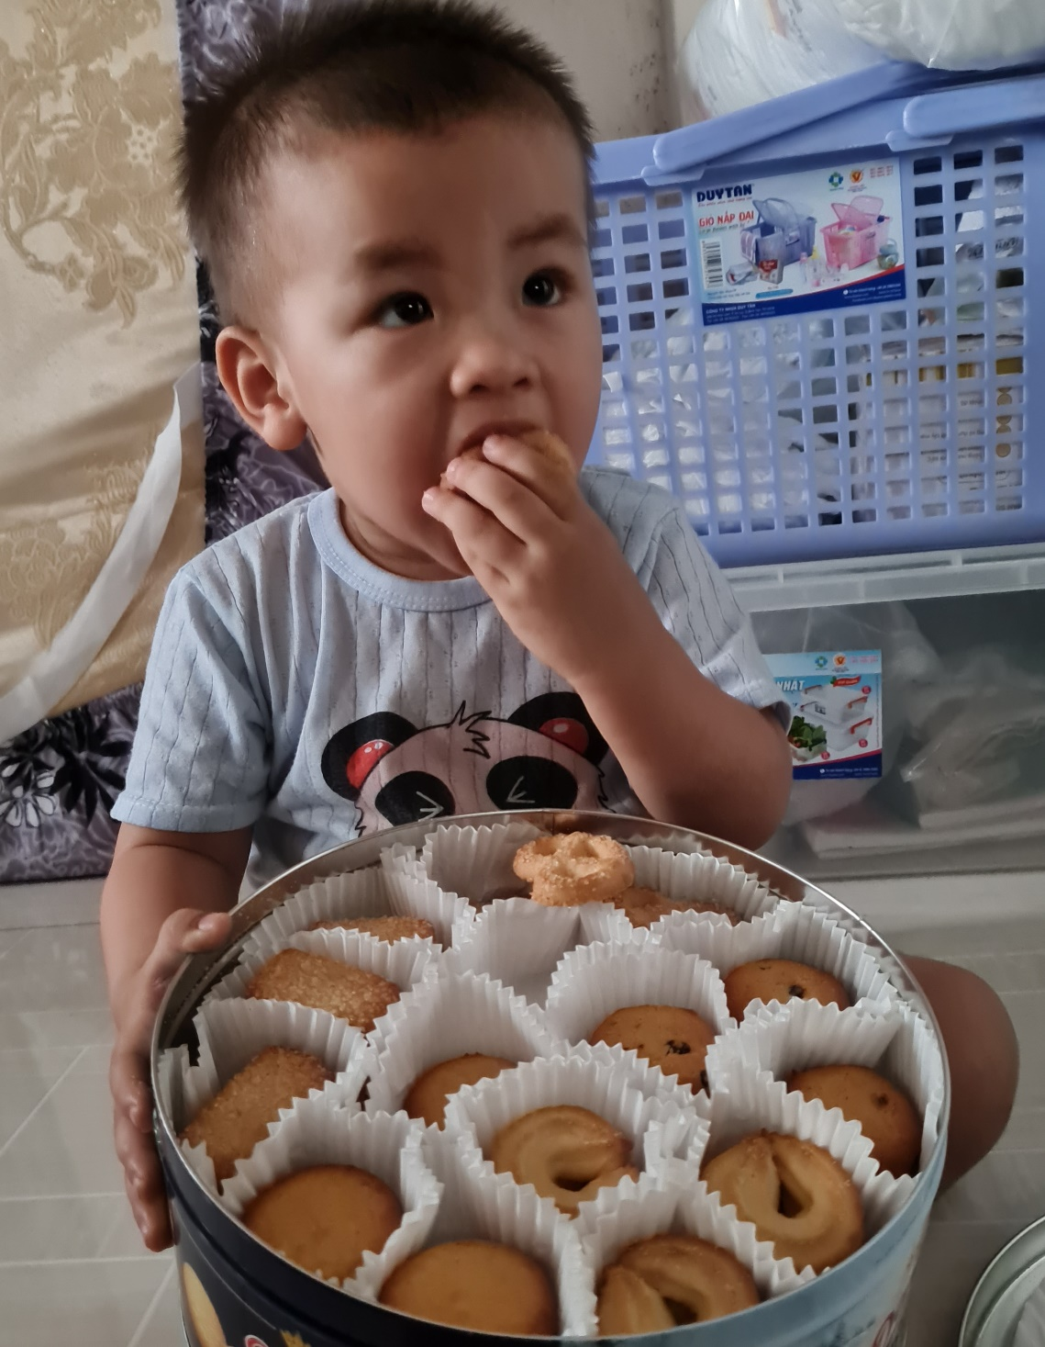
John: I want to eat something sweet.
You: You _________________________. They’re really delicious!
should try / eat some cookies
Click here for the answer.

Slide 10
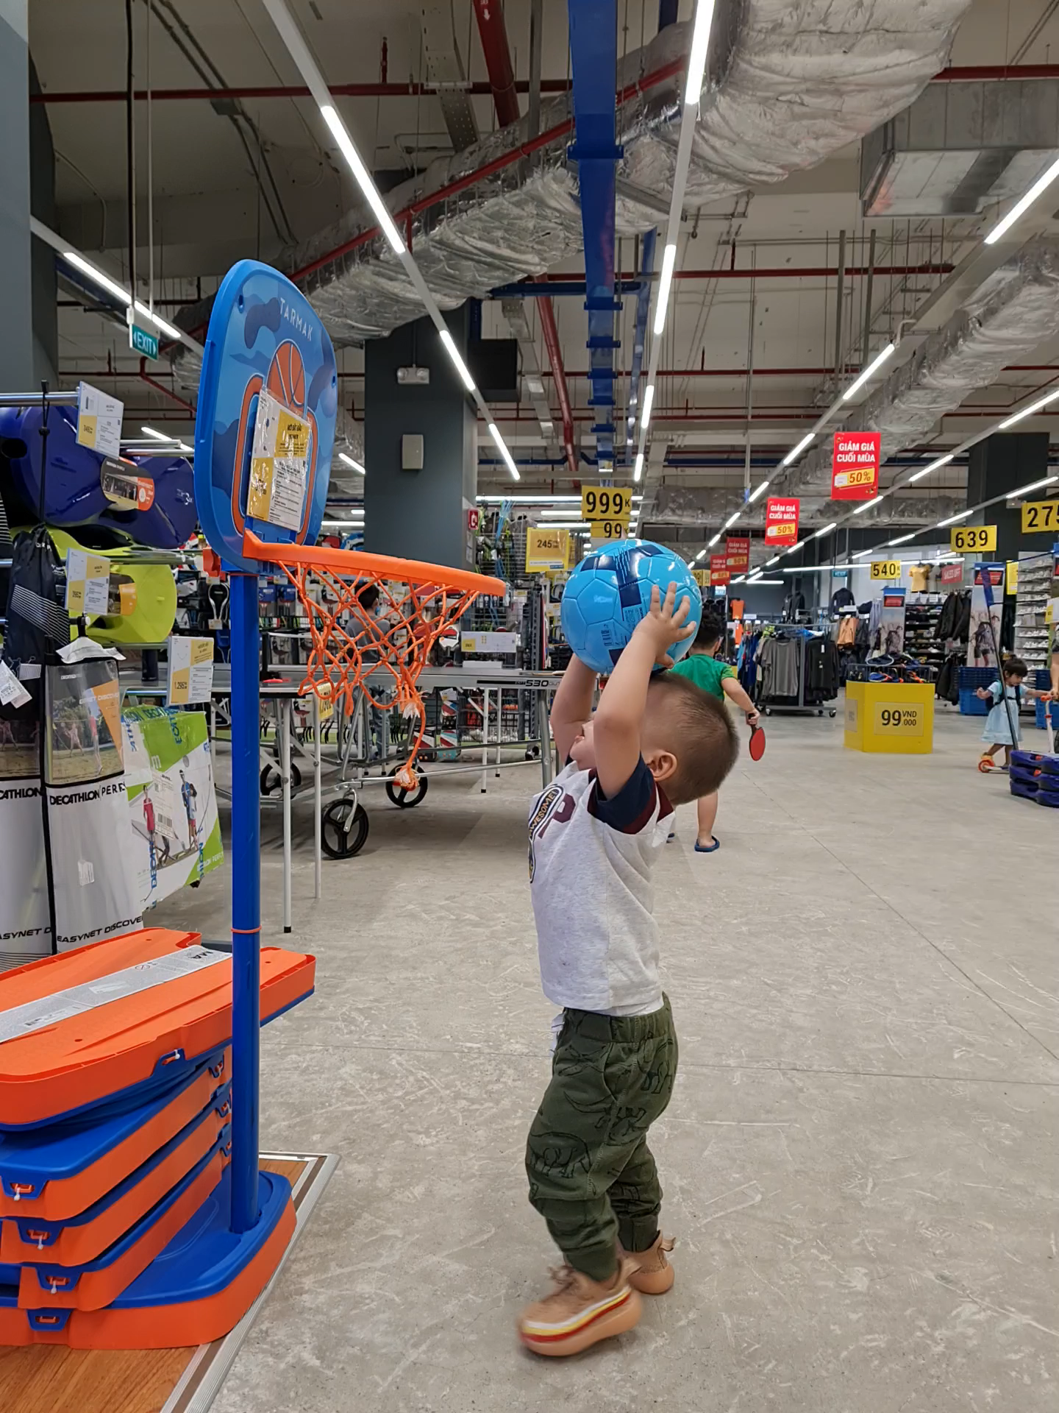
John: I’m unhealthy. Should I play sports?
You: Yes. You _________________________. It’s very exciting.
should try / play basketball
Click here for the answer.

Slide 11

PRESENTATION

Slide 12
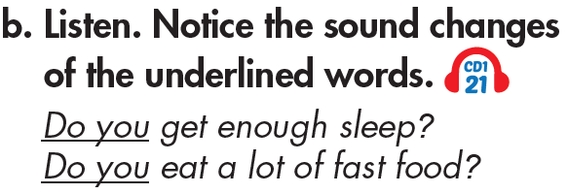

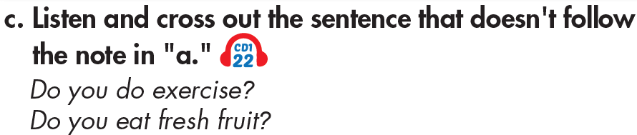
a. “Do you…” often sounds like /dju:/.
Click here for the answer.

Slide 13
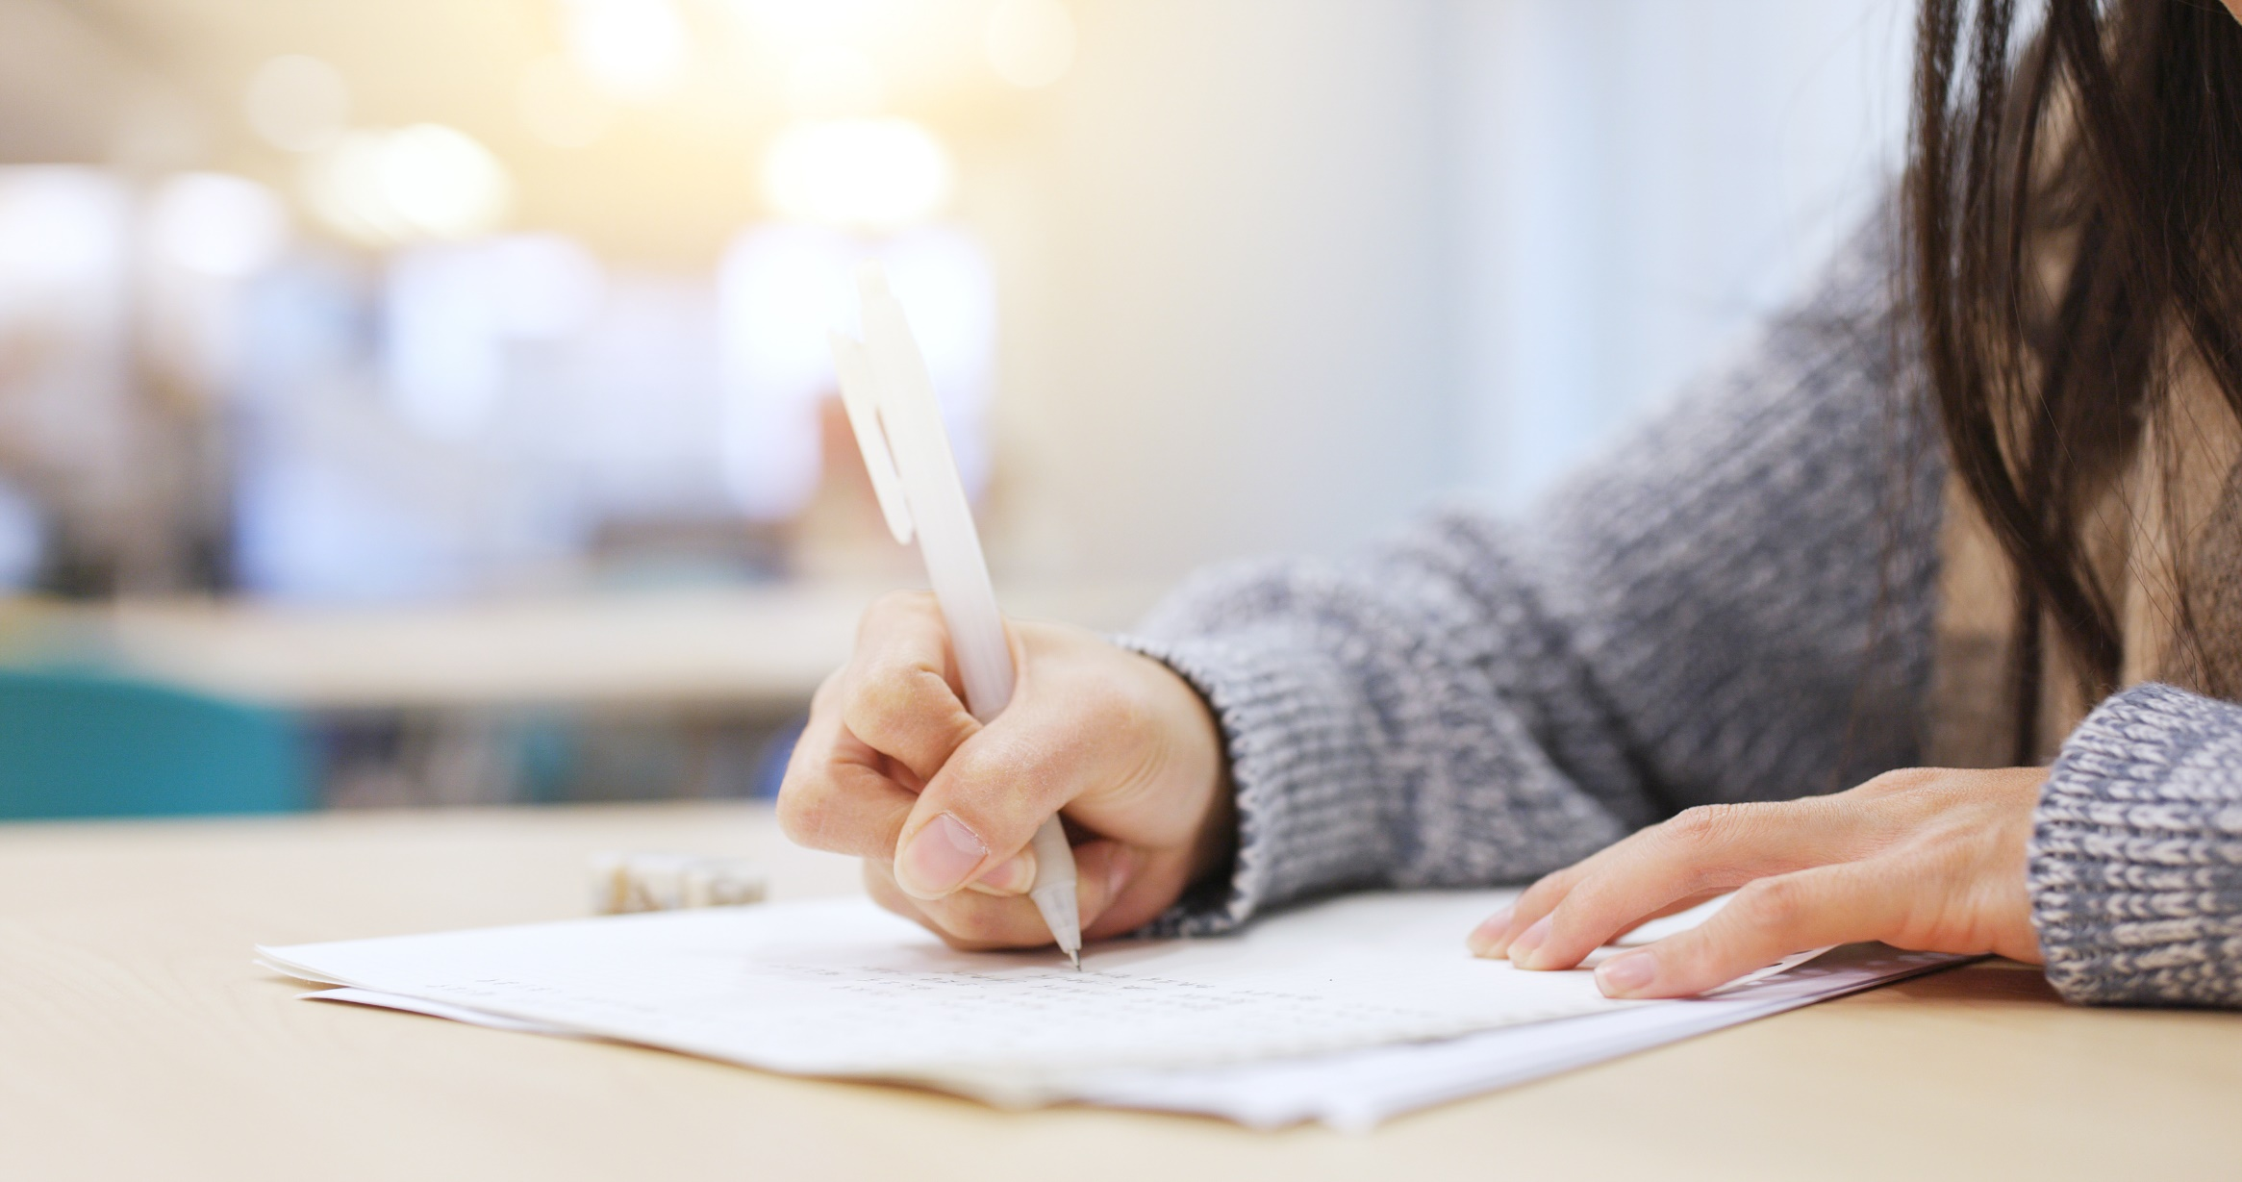
PRACTICE

Slide 14
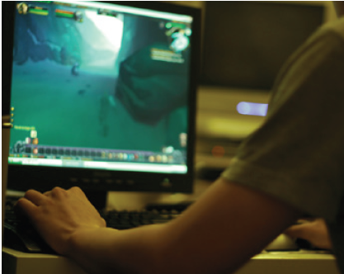
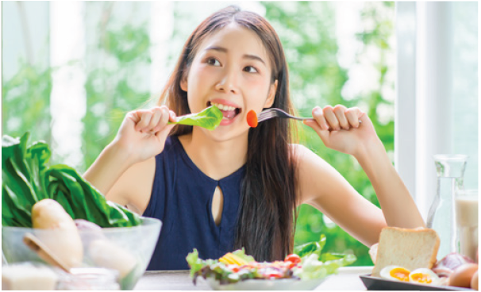

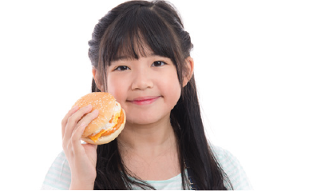
Pair-work: Look at the following photos and make questions with DO YOU /dju:/. Then, take turns to ask and answer.
Do you eat fruit and vegetables every day?
Do you often drink soda?
Do you usually eat fast food?
Do you play games every night?

Slide 15
Practice the conversation. Replace the red phrases with the phrases in the box. Then, swap roles and repeat.
Doctor: Good morning. How can I help you?
Patient: I feel sick. I 1) feel weak and I 2) have a stomachache.
Doctor: I see. Do you 3) eat enough every day?
Patient: No. Sometimes, I 4) don't eat lunch.
Doctor: You should 5) eat properly every day.
Do you eat fruit and vegetables?
Patient: No, not really. I eat a lot of 6) fast food.
Doctor: You shouldn't eat so much 7) junk food.
Patient: OK.
Doctor: And you should 8) get some rest.
Patient: Thank you, Doctor.
Doctor: You're welcome.
1) feel tired / don't sleep well
2) sore throat / fever
3) drink enough water /
exercise enough
4) I drink too much coke /
I'm lazy
5) drink water / play some sports
6) chocolate / French fries
7) sugar / unhealthy food
8) keep warm /
take some medicine

Slide 16
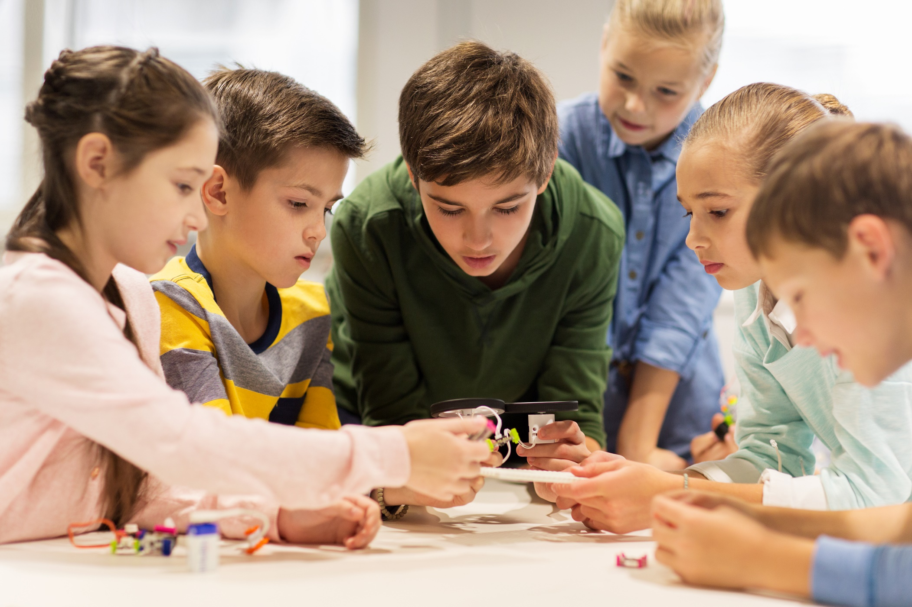
SPEAKING

Slide 17
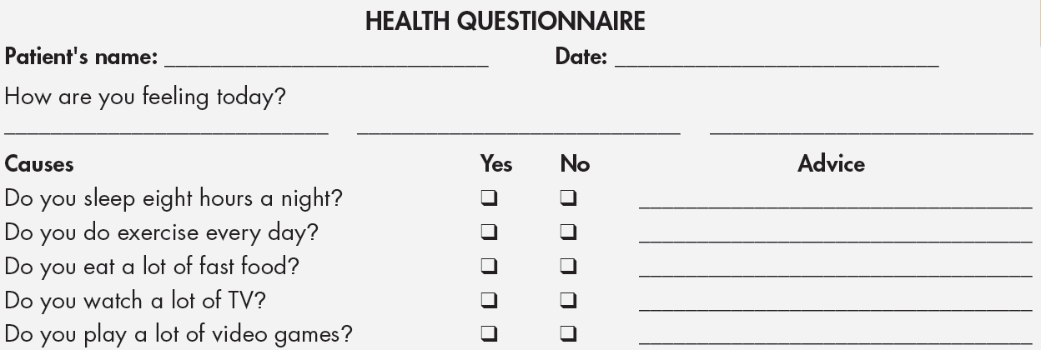
How Are You Feeling Today?
a. In pairs: Student B, p.118 File 2. Student A, you're a doctor giving advice to a sick patient. Ask your patient questions, complete the questionnaire, and give advice if you need to for each question.

Slide 18
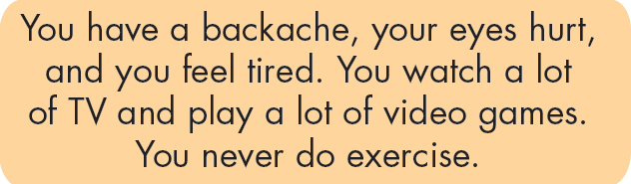
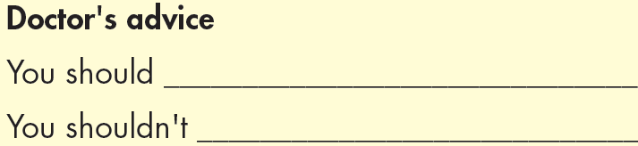
How Are You Feeling Today?
a. In pairs: Student B is the patient. Answer the doctor's questions and write down the doctor's advice.

Slide 19
b. Swap roles. Student A, now you're the patient. Student B, the doctor, changes the questionnaire based on the patient’s problems.
The patient answers the doctor's questions and write down the advice.
You have a cough, a headache, and you feel weak. You eat a lot of fast food and you always watch TV until midnight.
Doctor’s advice
You should __________________.
You shouldn’t _________________.

Slide 20

CONSOLIDATION

Slide 21
Write a short paragraph about what you should / shouldn’t do to stay healthy. Write about 70 words.

Slide 22

WRAP-UP

Slide 23
Today’s lesson
- Practice sound change with DO YOU /dju:/.
- Practice giving advice and persuading someone to have a healthy lifestyle with SHOULD.

Slide 24
Homework
Practice DO YOU /dju:/ and SHOULD
Review the vocabularies in lesson 2.1
Review the grammar point in lesson 2.2
Prepare the next lesson (page 18, SB)
Play the consolidation games in Tiếng Anh 7 i-Learn Smart World DHA App on www.eduhome.com.vn

Slide 25

Lesson 3
Stay positive and have a nice day!

