Slide 1
LUONG VAN CHANH SECONDARY SCHOOL
ENGLISH 7
TEACHER: TRAN MAI THAO

Slide 2

Unit 2: HEALTH
Lesson 2.2: Grammar
Page 16

Slide 3

LESSSON OUTLINE
Presentation
Practice
Production
Wrap-up

Slide 4
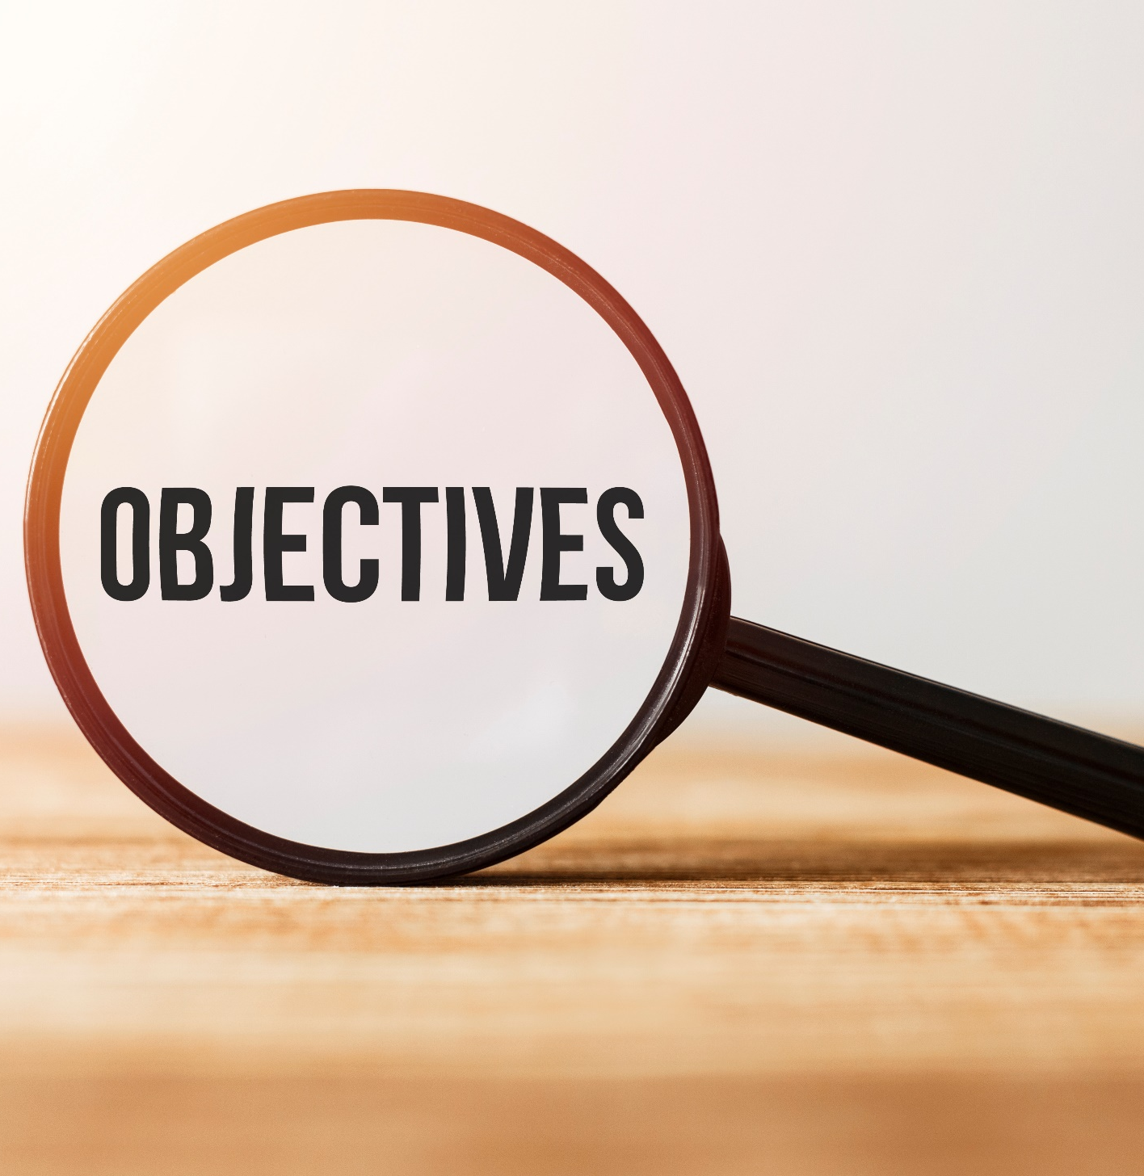
By the end of this lesson, students will be able to…
use SHOULD and SHOULDN’T to ask for and give advice.

Slide 5

WARM-UP

Slide 6
VOCABULARY REVIEW
Complete the sentences.
1. When your body becomes hotter and hotter, you _ _ _ _ _ _ _ _ _ _.
2. When you have a cold, you need to _ _ _ _ _ _ _ _.
3. When you don’t go to bed early, you _ _ _ _ _ _ _ _ _ _.
4. When you can’t do exercise, you feel _ _ _ _.
5. When you have _ _ _ _ _ _ _ _ _ _ _, you can’t speak because your throat hurts.
6. When you are sick, you need to take _ _ _ _ _ _ _ _.
7. You should take _ _ _ _ _ _ _ _ to help your body become healthy.
h a v e a f e v e r
k e e p w a r m
s t a y u p l a t e
w e a k
a s o r e t h r o a t
m e d i c i n e
v i t a m i n s
Click here for the answers.

Slide 7

PRESENTATION

Slide 8
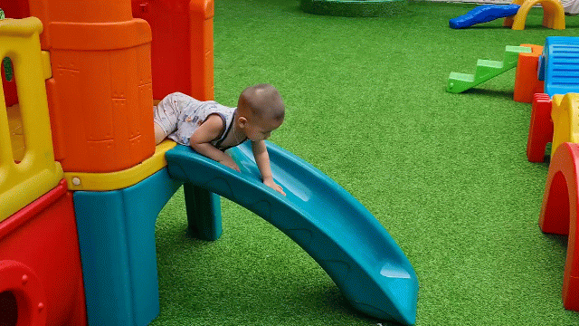
Look, read and answer the question.
The boy looks healthy. Does he do exercise?
The boy looks healthy. Does the boy often do exercise?
Yes, he does. He plays on the playground every day! Do you want to be healthy?
Yes, I do.
That’s easy. You should do exercise every day like him!

Slide 9
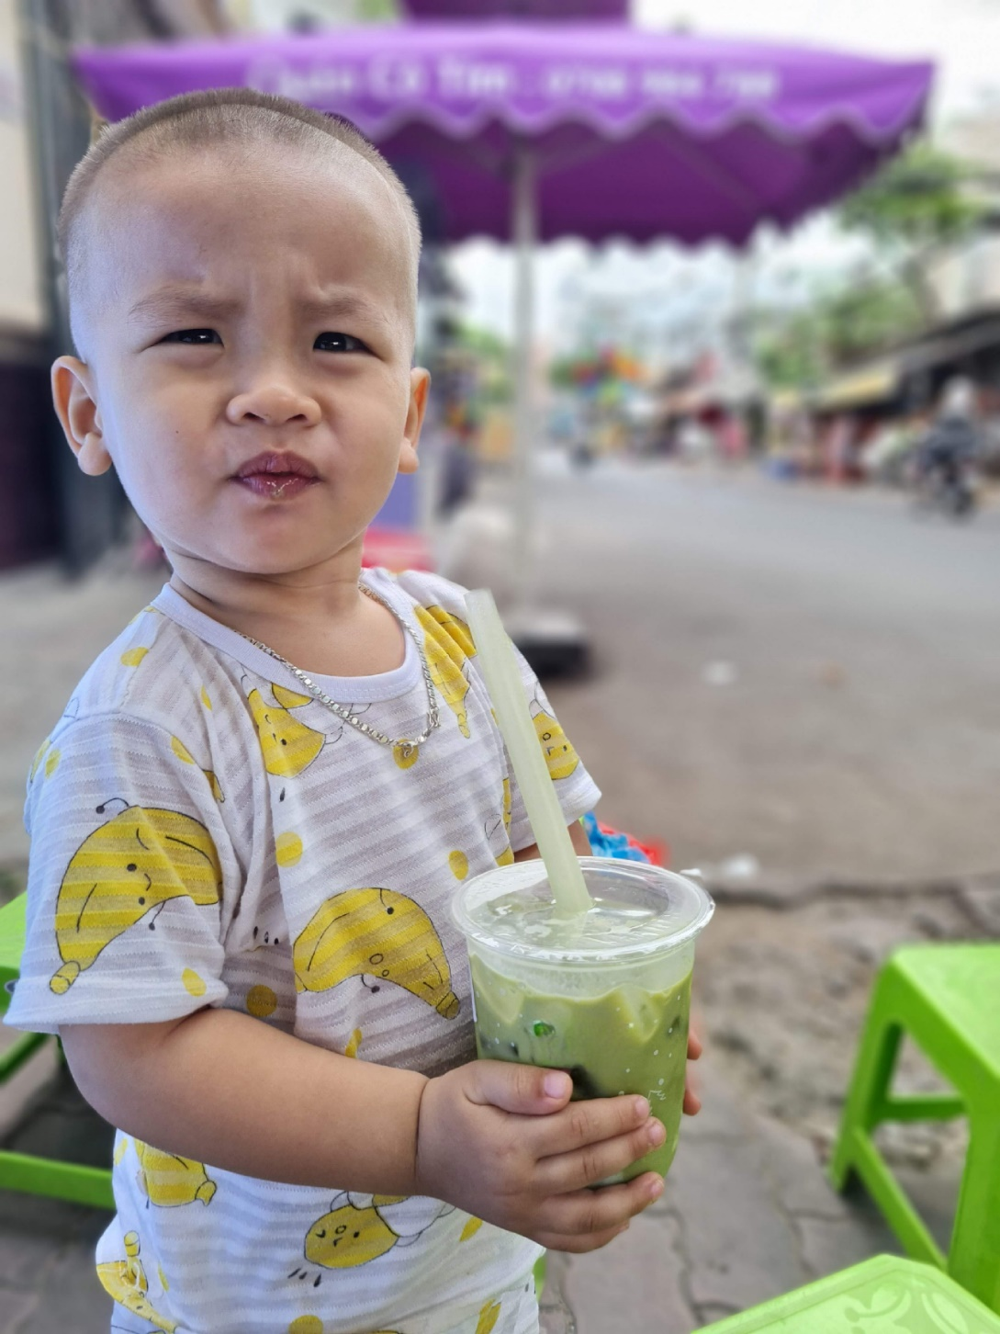
Look, read and answer the question.
Does he drink bubble tea every day?
No, he doesn’t. He drinks juice instead. You shouldn’t drink bubble tea every day!

Slide 10

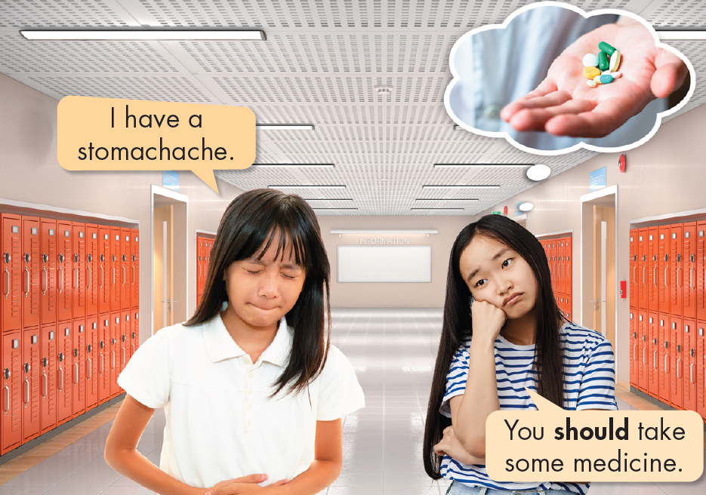
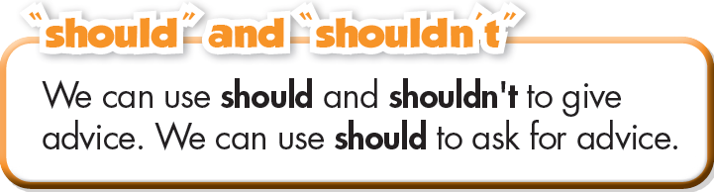
Look, listen and repeat.
(Click here for the audio)
SHOULD + infinitive VERB
I/You/We/They/ should eat fresh fruit.
He/She/It shouldn't eat fast food.
I have a headache. What should I do?
Should I take some medicine?
(Yes, you should./ No, you shouldn't.)

Slide 11
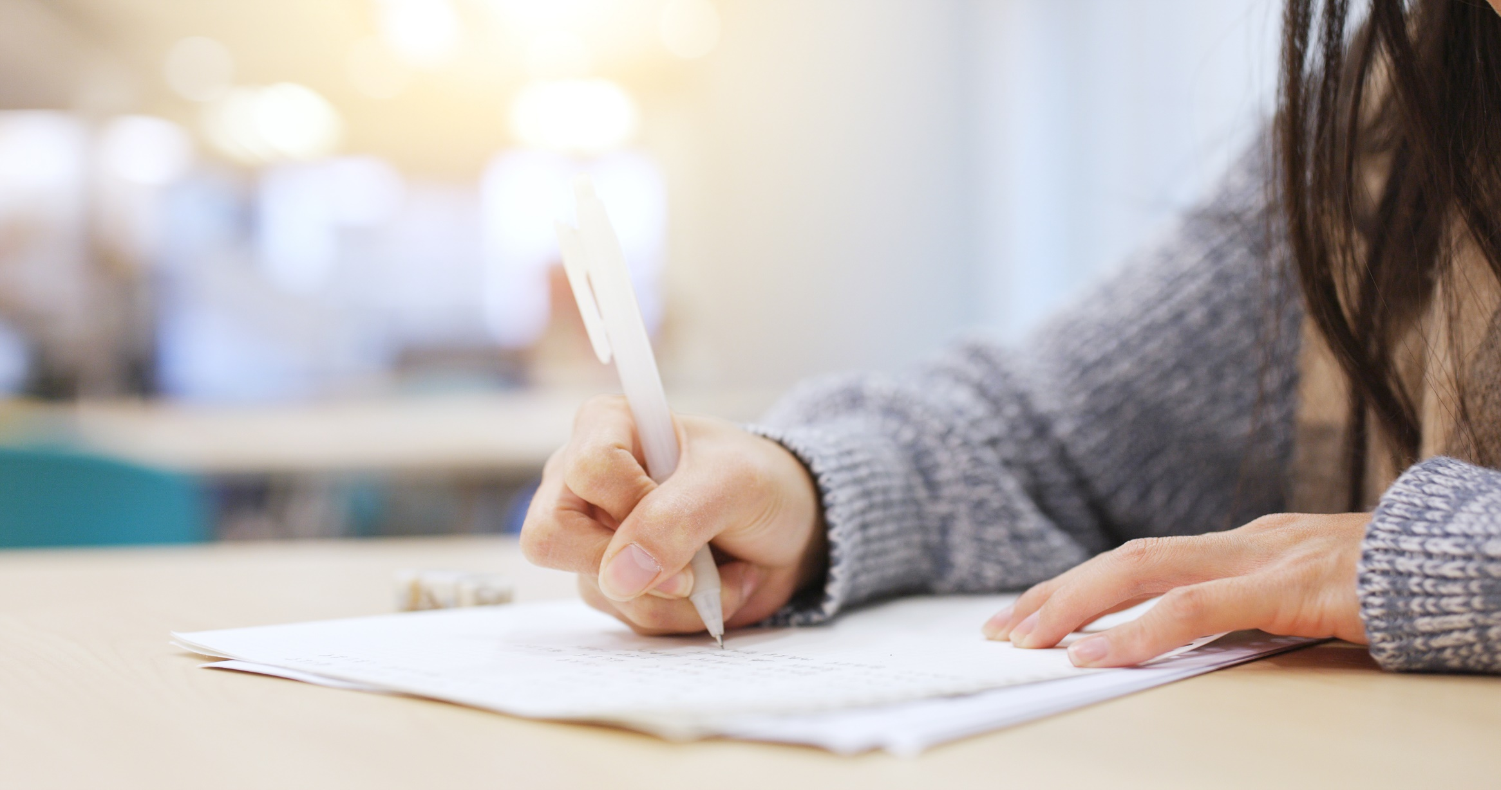
PRACTICE

Slide 12
b. Use the prompts to give advice for each problem.
1. May: I have a toothache.
Sue: you/not/eat/so much/candy ______________________________________________________
2. John: I have a headache.
Mark: you/take/medicine _______________________________________________________
3. Alice: I want to lose weight.
Claire: you/not/eat/junk food
_______________________________________________________
4. Jess: I feel sick.
Lucy: you/see/doctor
_______________________________________________________
You shouldn’t eat so much candy.
You should take medicine.
You shouldn’t eat junk food.
Click here for the answers.
You should see a doctor.

Slide 13
5. Sam: I can't read that writing. It's too small.
John: you/take/eye test _______________________________________________________
6. John: My back hurts.
Sophie: you/not/sit down/all day
_______________________________________________________
7. Daisy: I feel weak.
Bob: you/eat/something
_______________________________________________________
You should take an eye test.
You should not sit down all day.
Click here for the answers.
You should eat something.

Slide 14
c. Fill in the blanks using should or shouldn’t.
1. I have a sore throat. – You ________ take some medicine.
2. You ________ eat too much junk food. It's unhealthy.
3. What _______ I do to lose weight? – You ________ eat more fruit and vegetables.
4. __________ I join a gym? – Yes, you ________.
5. You look very tired. You __________ get some rest.
6. I have a toothache. – You ________ go to the dentist.
7. I have a stomachache. – You ________ drink so much soda.
should
shouldn’t
should
should
Should
should
should
should
shouldn’t
Click here for the answers.

Slide 15
Extra Practice WB, page 11
Unscramble the sentences.
I have a sore throat.
shout/much./You/so/shouldn't
______________________________
2. I feel weak.
take/should/You/vitamins./some
______________________________
You shouldn’t shout so much.
You should take some vitamins.
Click here for the answers.

Slide 16
Extra Practice WB, page 11
Unscramble the sentences.
3. I have a stomachache.
You/medicine./take/should/some
______________________________
4. I have a fever.
a/see/doctor./You/should
______________________________
5. I'm always watching TV.
should/exercise./do/You/more
______________________________
You should take some medicine.
You should see a doctor.
You should do more exercise.
Click here for the answers.

Slide 17
Extra Practice WB, page 11
Read Lily and Jacob's health problems. Use should and shouldn't to give them your advice. Write full sentences.
Lily feels sick today. She has a cough and a sore throat. She eats a little fruit and vegetables every day. She sleeps five hours a night. She watches a lot of TV.
___________________________________________________________
___________________________________________________________
___________________________________________________________
___________________________________________________________
Lily should get some rest.
She should eat more fruit and vegetables.
She should sleep seven hours a night.
She shouldn’t watch much TV.
Click here for the answers.

Slide 18
Extra Practice WB, page 11
Read Lily and Jacob's health problems. Use should and shouldn't to give them your advice. Write full sentences.
Jacob feels weak. He has a stomachache and feels sick. He doesn't eat breakfast. He eats a lot of fast food and drinks soda every day.
___________________________________________________________
___________________________________________________________
___________________________________________________________
___________________________________________________________
Jacob should take some medicine.
He should eat breakfast.
He shouldn’t eat fast food.
He shouldn’t drink soda every day.
Click here for the answers.
You should do more exercise.

Slide 19
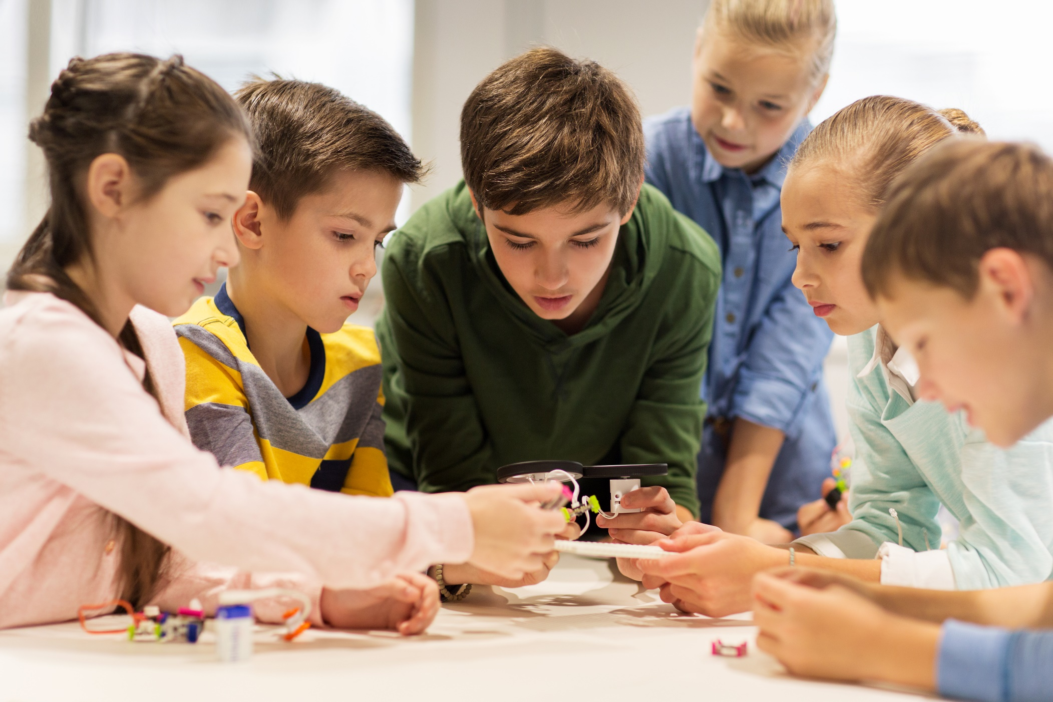
PRODUCTION

Slide 20
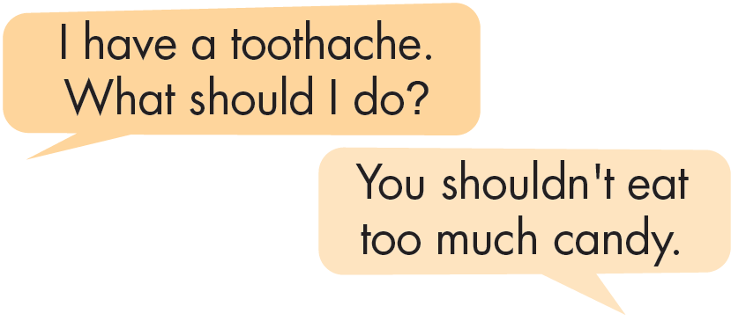
In pairs: Ask for and give your partner advice using the prompts.
fever stomachache earache backache
sore throat headache very tired toothache

Slide 21

CONSOLIDATION

Slide 22
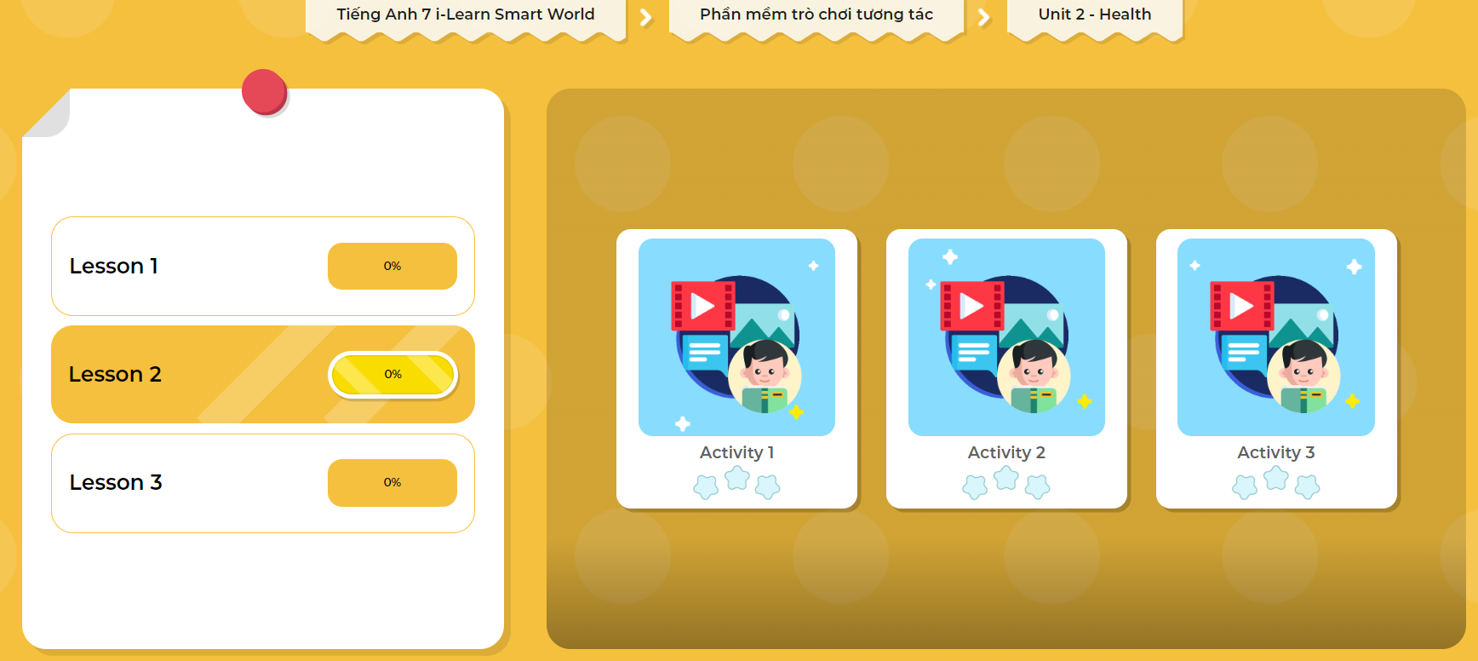
LET’S PLAY!
Click here to play the games.

Slide 23

WRAP-UP

Slide 24
Today’s lesson
We use SHOULD and SHOULDN’T to ask for and give advice.
  SHOULD
  +
infinitive verb
  SHOULDN’T

Slide 25
Homework
Practice the grammar point SHOULD and SHOULDN’T at home by making as many examples as you can.
Complete the grammar notes in Tiếng Anh 7 i-Learn Smart World Notebook on page 11.
Prepare the next lesson (page 17 SB).
Play games in Tiếng Anh 7 i-Learn Smart World DHA App on eduhome.com.vn

Slide 26

Lesson 3
Stay positive and have a nice day!

