Slide 1
LUONG VAN CHANH SECONDARY SCHOOL
ENGLISH 7
TEACHER: TRAN MAI THAO

Slide 2

Unit 1: Free time
Lesson 1.3: Pronunciation
Page 14

Slide 3

LESSSON OUTLINE
Pronuncition
Practice
Speaking
Consolidation
Wrap-up

Slide 4
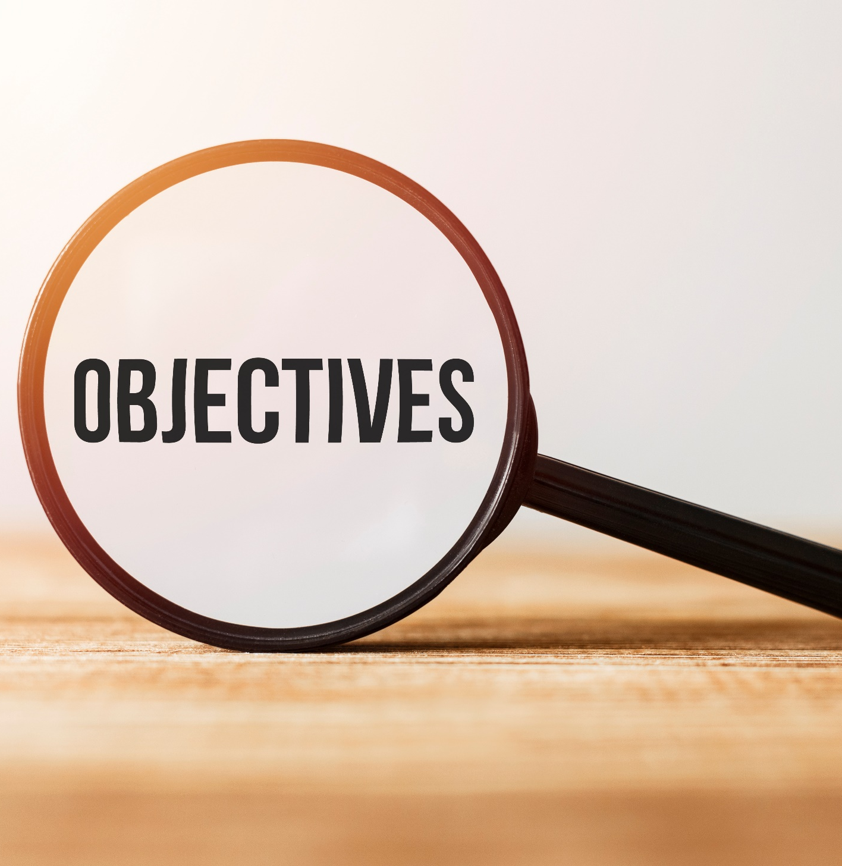
By the end of this lesson, students will be able to…
- practice intonation for Wh-questions.
- talk about what makes a healthy lifestyle.

Slide 5

WARM-UP

Slide 6

Work in pairs.
Choose the word whose main stress is placed
differently from the others.
A. biology B. activity C. invitation D. geography
2. A. climbing B. zorbing C. Thursday D. design
3. A. survey B. mistake C. lifestyle D. classmate
/baɪˈɑːlədʒi/
/ækˈtɪvəti/
/ˌɪnvɪˈteɪʃn/
/dʒiˈɑːɡrəfi/
/ ˈklaɪmɪŋ/
/ˈzɔ:rbɪŋ/
/ˈθɜ:rzdeɪ/
/dɪˈzaɪn/
/ˈsɜːrveɪ/
/mɪˈsteɪk/
/ˈlaɪfstaɪl/
/ˈklæsmeɪt/

Slide 7
Work in pairs.
Choose the word whose underlined part is
pronounced differently from that of the other words.
A. music B. physics C. diamond D. dinner
2. A. car B. game C. plane D. race
3. A. food B. school C. book D. tooth
/ˈmju:zɪk/
/ˈfɪzɪks/
/ˈdaɪmənd/
/ˈdɪnər/
/kɑ:r/
/geɪm/
/pleɪn/
/reɪs/
/fuːd/
/skuːl/
/bʊk/
/tuːθ/

Slide 8

Work in pairs.
Ask 5 questions about your partner’s routine, using some of the 5Ws & 1H.
E.g.:
1. What time do you get up / have breakfast?
2. What do you often have for breakfast / lunch / dinner?
3. How much water / bubble tea / fresh milk do you often drink?
4. How do you go to school?
5. Where do you often have fun / go shopping / eat out?

Slide 9

PRONUNCIATION

Slide 10

To ask a WH-question, we lower our intonation at the end of the question.
a. Listen and repeat. (Click here to hear the sound)
How much fast food do you eat every week?
b. Listen and cross out the question that doesn’t have the right falling intonation. (Click here to hear the sound)
How much junk food do you eat every week?
How much exercise do you do every day?
Click here for the answer.

Slide 11

PRACTICE

Slide 12
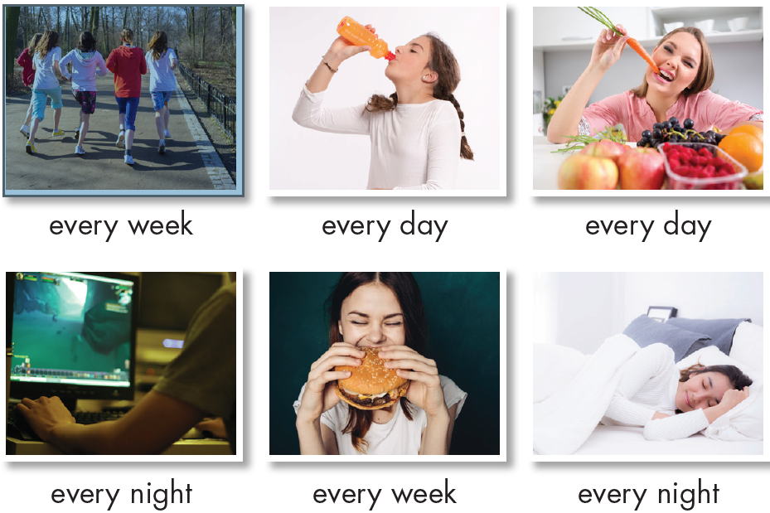
Ask and answer, using the time expressions in the photos and the phrases in the box.
a lot of/lots of
some
only (verb) a little
don't (verb) any / much
How much exercise do you do every week?
I often spend 30 minutes doing exercise every week.
Where do you eat burgers every week?
I often eat them at KFC.

Slide 13

SPEAKING

Slide 14
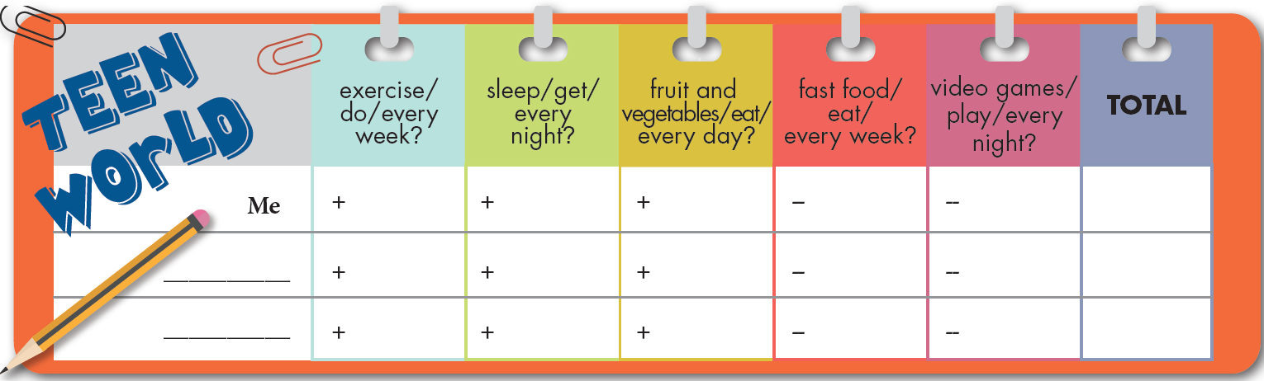
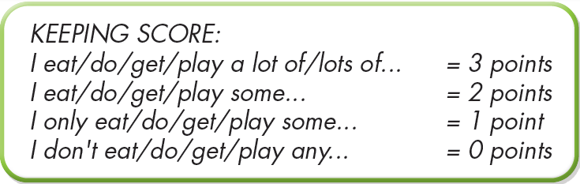
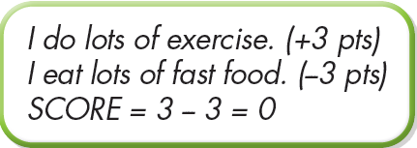
WHO HAS THE HEALTHIEST LIFESTYLE?
a. You're doing a survey about healthy lifestyles. In threes: Fill in the survey for yourself, then ask two friends about their lifestyles, using HOW MUCH / HOW MANY…? For each (+) answer, add points. For each (–) answer, subtract points.
How many video games do you play every night?
I often play some games every night.

Slide 15
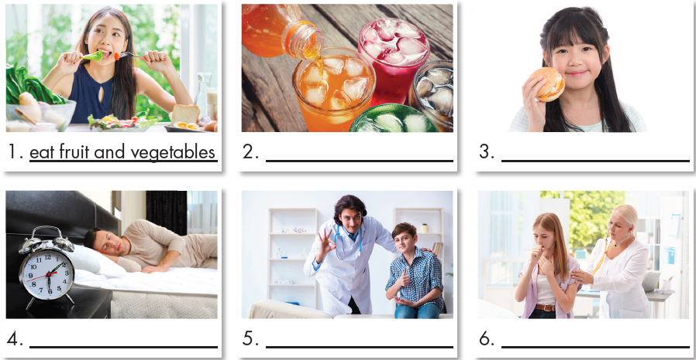
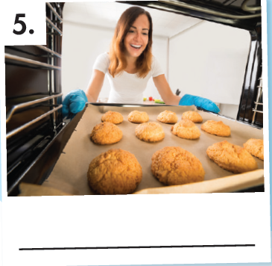
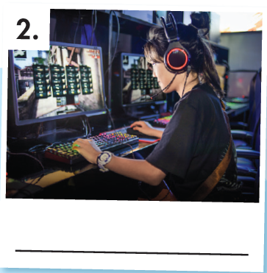
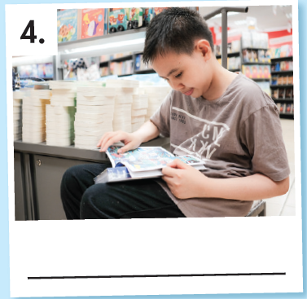
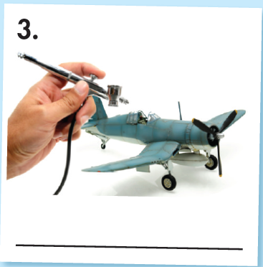
Work in pairs. Ask your partner 10 WH-questions; try to use the words in the photos and the indefinite quantifiers.
a lot of / lots of;
some; a little;
don't (verb) any / much
1.
2.
3.
bake cakes
eat vegetables
drink soda
eat fast food
4.
5.
6.
How often do you eat vegetables?
→ I eat lots of vegetables every weekend.
healthy
unhealthy
play online games
read comics
build models

Slide 16

CONSOLIDATION

Slide 17
Write 5 WH-questions. You can use the vocabulary and the indefinite quantifiers in Unit 2, lesson 1 or your own words. Then, practice reading the questions loudly, trying to lower your intonation at the end of the question.
E.g.:
Where do you often ride a bicycle?
Who do you often play games with?
How long do you often do homework?
Why do you usually wake up early / late?
When do you often go to bed late?

Slide 18

WRAP-UP

Slide 19
Today’s lesson
FALLING INTONATION at the end of WH-questions
Talking about what makes a healthy lifestyle

Slide 20
Homework
Learn vocabularies in lesson 1.1
Review the grammar point in lesson 1.2
Practice the WH-questions with falling intonation
Prepare the next lesson (page 15, SB)
Play the consolidation games in Tiếng Anh 7 i-Learn Smart World DHA App on www.eduhome.com.vn

Slide 21

Lesson 3
Stay positive and have a nice day!

