Slide 1
LUONG VAN CHANH SECONDARY SCHOOL
ENGLISH 7
TEACHER: TRAN MAI THAO

Slide 2

Unit 1: Free time
Review
Pages 84 & 85

Slide 3






LESSON OUTLINE
Consolidation

Slide 4

By the end of this lesson, students will be able to…
- review vocabularies and grammar points.
- talk about
• free time activities
• places of entertainment
- practice listening, reading and speaking.

Slide 5

WARM-UP

Slide 6

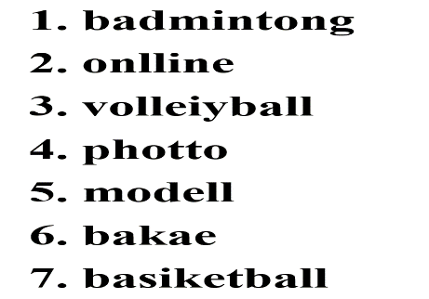
Work in pairs
Game: LEAVE ME OUT

Slide 7
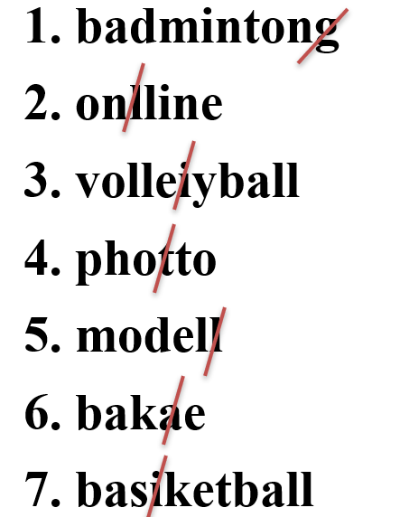
KEY ANSWER

Slide 8


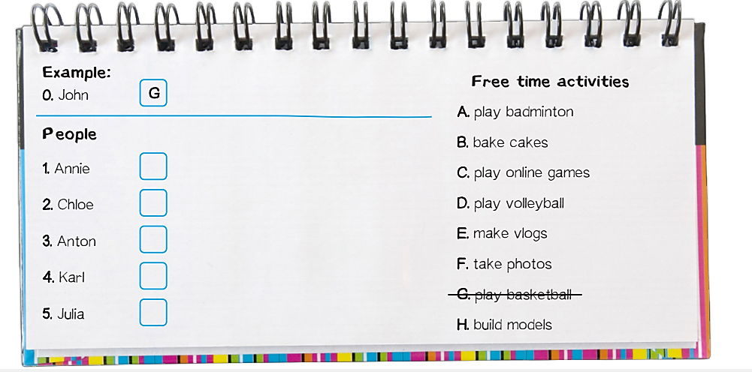
B
A
H
C
E

Slide 9
Audio Scripts
Mrs. Smith: Hello, John. How was school today?
John: It was really good. We all did presentations about what we do in our free time. My presentation was about playing basketball.
Mrs. Smith: Great. What about your friends? What do they like doing?
John: Annie likes baking cakes. She'll bring some to school for us to try.
Mrs. Smith: What about Chloe?
John: She loves sports. Last year she did yoga, but now she plays badminton.
Mrs. Smith: Really?
John: Yeah, and Anton builds models. He showed some great photos of them.
Mrs. Smith: How about Karl?
John: He plays online games. His mom says he should do more exercise and play sport.
Mrs. Smith: Yes, he should!
John: Oh, Julia has a great hobby.
Mrs. Smith: Yeah?
John: She makes vlogs about the clothes she buys. She likes shopping.
Mrs. Smith: Fantastic!

Slide 10

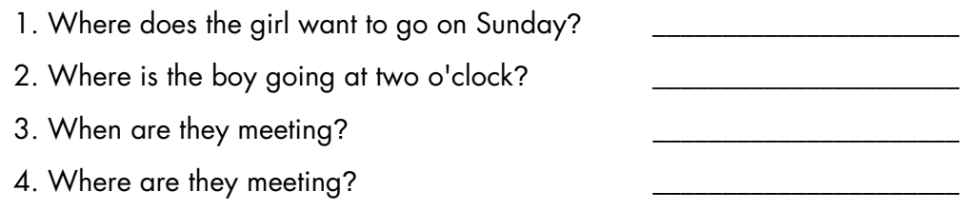
Extra Practice
WB, page 5
Listen to a phone call between two teenagers and answer the questions.
The bowling alley.
The market.
4 o’clock.
The bowling alley.

Slide 11
Audio Scripts
Tom: Oh no, sorry. I'm going to the market with my mom at two o' clock. It's my dad's birthday next week, so I need to buy a present.
Beth: Hmm. How about we meet at four o'clock?
Tom: Four? Yeah. We'll be finished at half past three, so I think four o'clock will be OK for me.
Beth: Let's meet at the mall.
Tom: Hmm, actually it's easier for me if I meet you and Andy at the bowling alley. Is that OK?
Beth: OK. See you there!
Beth: Hi Tom. How are you?
Tom: Good, thanks. You?
Beth: Yeah, I'm OK. Are you busy?
Tom: No. I was doing my homework, but I’ve finished it now.
Beth: I'm meeting Andy at the bowling alley on Sunday. Do you want to come?
Tom: That sounds great. What time?
Beth: How about three o' clock?

Slide 12
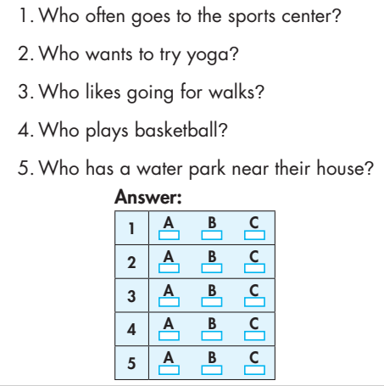
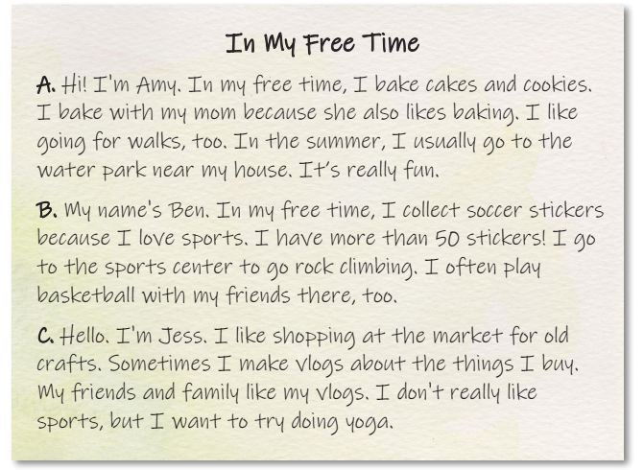
Underline the key words and guess the answer to each question.
1
2
3
4
5

Slide 13
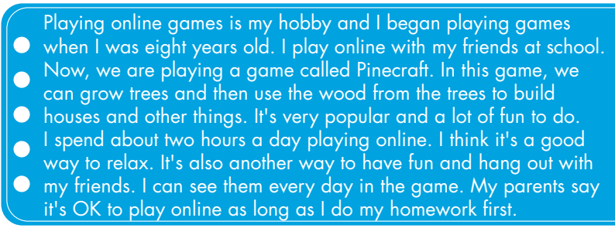
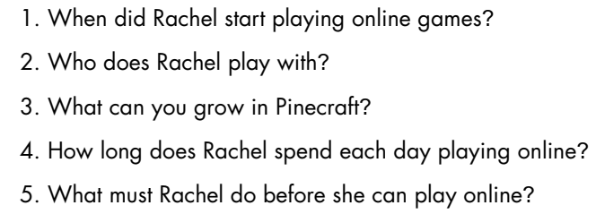
Extra Practice
WB, page 3
Skim and scan the text to answer the questions.
When she was eight years old.
Her friends.
Trees.
About two hours.
Finish her homework.

Slide 14
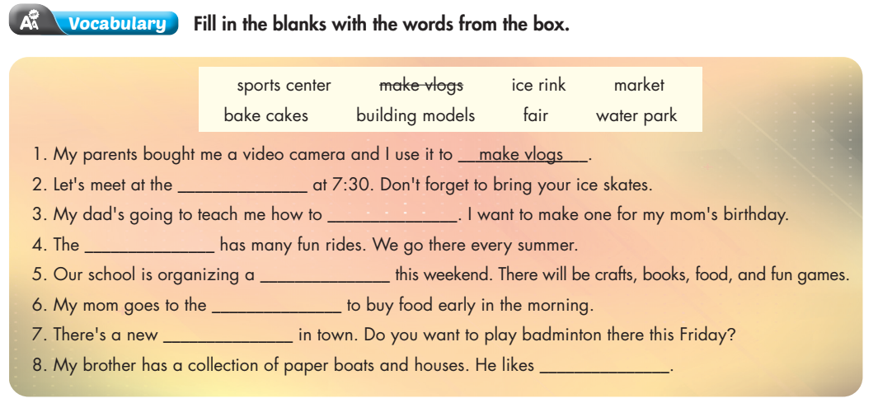
Underline the key words.
ice rink
bake cakes
water park
fair
market
sports center
building models

Slide 15
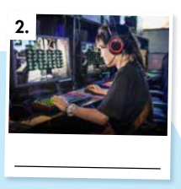
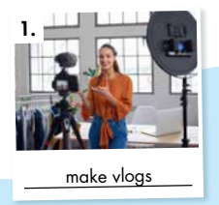
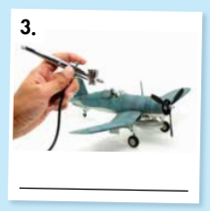
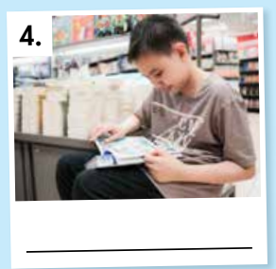
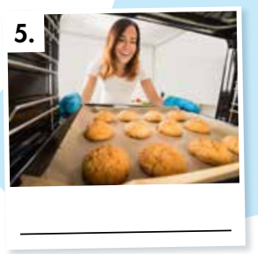
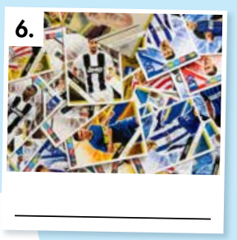
Extra Practice
WB, page 2
Work in pairs
Look at the pictures and write the words.
play online games
make vlogs
build models
read comics
bake cakes
collect soccer stickers

Slide 16

1.cousins/theater/and/to/going/his/Jason/on/the/are/Saturday.
2. alley/bowling/opens/10 a.m./at/The
3. tomorrow?/What/Sofia/we/time/are/meeting
Jason and his cousins are going to the theater on Saturday.
The bowling alley opens at 10 a.m.
What time are we meeting Sofia tomorrow?

Slide 17
4. brother/a/has/soccer/collection/My/of/stickers.
5. evening./this/are/friends/basketball/playing/My
My brother has a collection of soccer stickers.
My friends are playing basketball this evening.

Slide 18
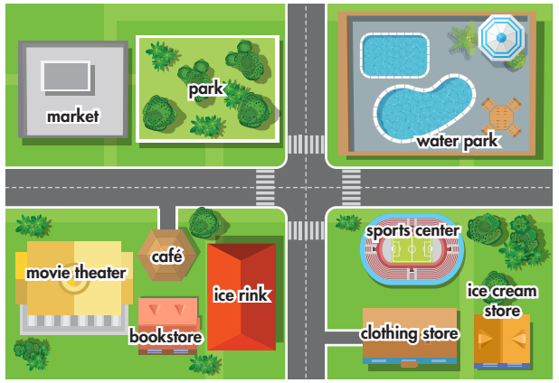
Look at the map and circle the correct words.
1. Let's meet at the café opposite/next to the movie theater.
2. The bookstore is in front of/behind the café.
3. Do you want to meet at the market opposite/behind the movie theater?
4. The clothing store is in front of/ behind the ice cream store.
5. I often go running in the park
next to/behind the market.

Slide 19
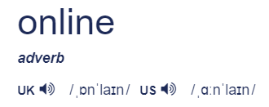
1. A. vlog B. model C. soccer D. sport
2. A. skating B. game C. cake D. market
3. A. online games B. ice rink C. bowling D. sticker
4. A. model B. center C. collect D. sticker
5. A. theater B. equipment C. badminton D. skateboarding
6. A. online B. habit C. soccer D. comic

Slide 20

CONSOLIDATION

Slide 21
* Grammar of Unit 1: Present Continuous and Prepositions of place.
* Vocabulary of Unit 1: Vocabulary about free time activities and places of entertainment.

Slide 22

WRAP-UP

Slide 23
Today’s lesson
Reading & Listening:
- Understand instructions
Practice reading and listening for general and specific information

Slide 24
Homework
Review vocabulary, grammar of unit 1.
Do exercises in Workbook: Review of Unit 1 (page 62).
Prepare: Unit 2 – New words and Reading (page 12 – SB).
Play the consolidation games in Tiếng Anh 7 i-Learn Smart World DHA App on www.eduhome.com.vn

Slide 25

Lesson 3
Stay positive and have a nice day!

