Slide 1
LUONG VAN CHANH SECONDARY SCHOOL
ENGLISH 7
TEACHER: TRAN MAI THAO

Slide 2

Unit 1: Free Time
Lesson 2.2: Grammar
Page 8

Slide 3


LESSON OUTLINE
Consolidation

Slide 4

By the end of this lesson, students will be able to…
- talk about future plans.
- use the Present Continuous tense and prepositions of place correctly.
- Write and answer questions about next week’s plan.

Slide 5
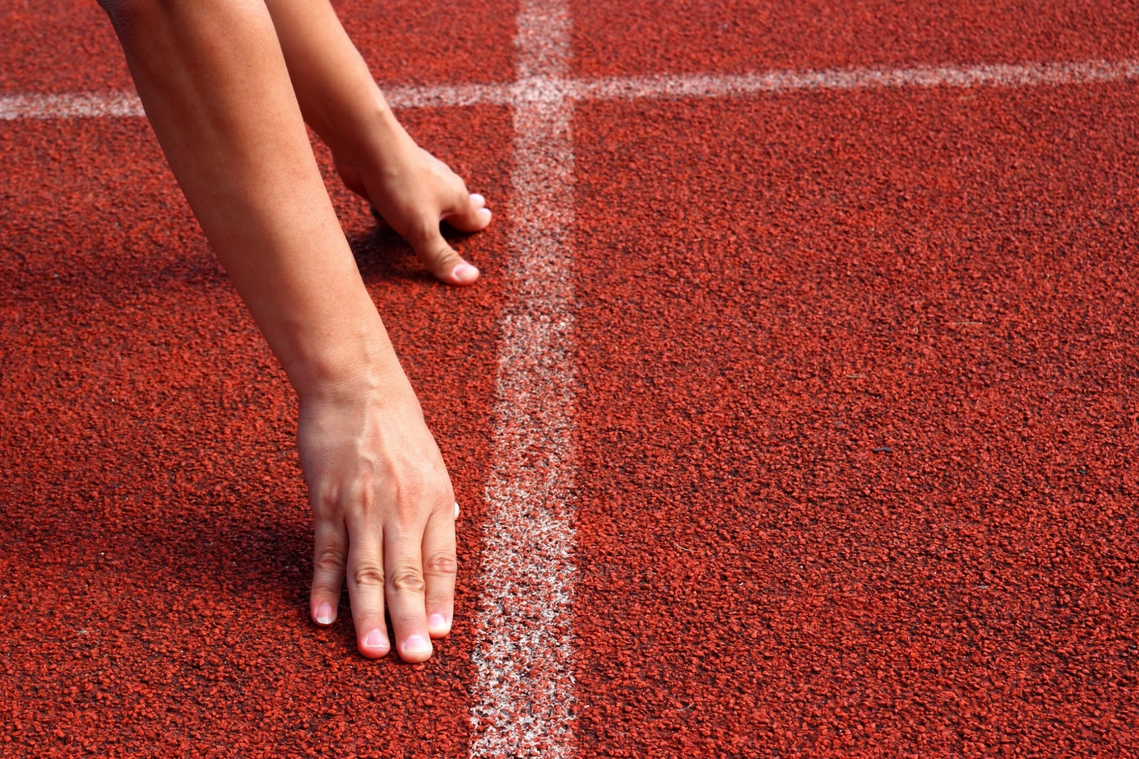
WARM-UP

Slide 6
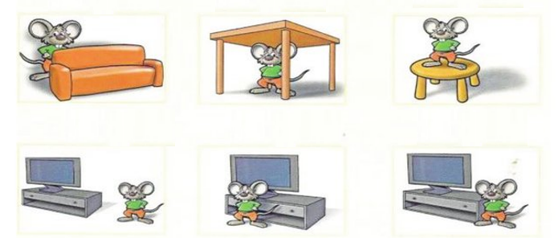
Review: Prepositions of place
1. behind 2. under 3. on
4. near 5. in front of 6. next to

Slide 7



Slide 8
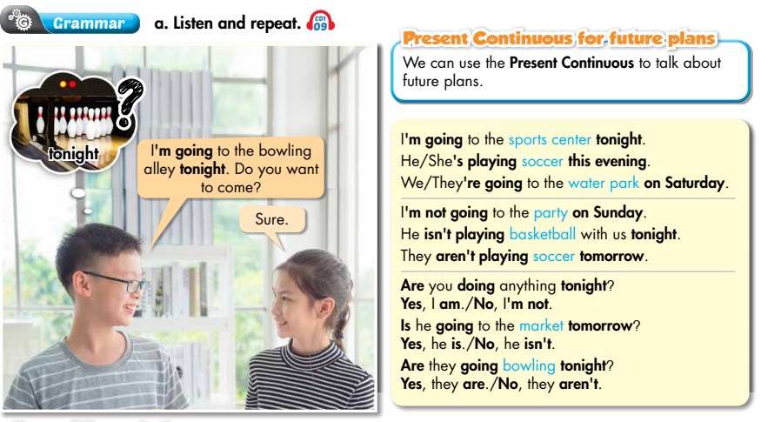


Slide 9
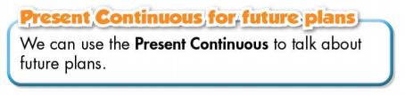
Form:
(+) S + am / is / are + V-ing …
(-) S + am / is / are + not + …
(?) Am / Is / Are + S + V-ing …
Usage: to talk about future plans.

Slide 10
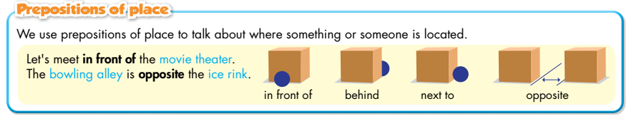

Slide 11
b. Circle the correct words.
1. I'm watch/I'm watching a movie tonight.
2. She is going/going bowling on Sunday night.
3. Let's meet in/on front of the theater.

Slide 12
b. Circle the correct words.
4. I'm meet/meeting Sam at the water park tomorrow.
5. Is/Are you going shopping this evening?
6. We're meeting at the theater next/opposite the restaurant on Wednesday at 6 p.m.

Slide 13
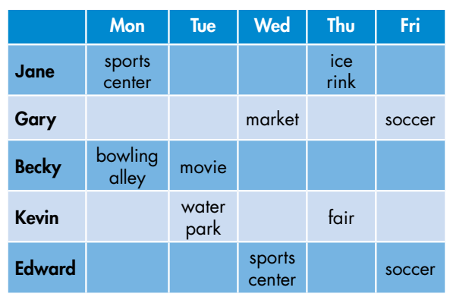
c. Write, then answer the questions.
1. When/Jane/go/ice rink/?
2. What/Becky/do/Tuesday/?
3. When/Gary and Edward/play/soccer/?
4. When/Kevin/go/fair/?
5. What/Gary/do/Wednesday/?
How many questions are there?
There are 5.
What are you going to do?
Write and answer the questions.

Slide 14
c. Write, then answer the questions.
1. When/Jane/go/ice rink/?
2. What/Becky/do/Tuesday/?
3. When/Gary and Edward/play/soccer/?
When is Jane going to the ice rink?
She is going to the ice rink on Thursday.
What is Becky doing on Tuesday?
She is watching a movie.
When are Gary and Edward playing soccer?
They are playing soccer on Friday.

Slide 15
4. When/Kevin/go/fair/?
5. What/Gary/do/Wednesday/?
c. Write, then answer the questions.
When is Kevin going to the fair?
He is going to the fair on Thursday.
What is Gary doing on Wednesday?
He is going to the market.

Slide 16
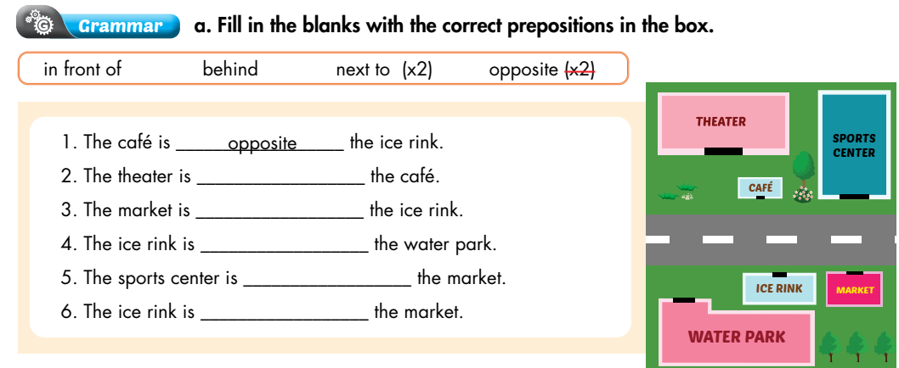
Extra Practice
WB, page 5
1. The café is ________ the ice rink.
2. The theater is ________ the café.
3. The market is ________ the ice rink.
4. The ice rink is _________ the water park.
5. The sports center is ________ the market.
6. The ice rink is ________ the market.
opposite
behind
next to
in front of
opposite
next to

Slide 17
Write sentences using Present Continuous and the
prompts.
Extra Practice
WB, page 5
1. My brother/play/soccer/next Saturday.
2. She/have/party/the weekend.
3. We/going/swimming/Sunday?
4. I/go shopping/friends/shopping mall/tonight.
My brother is playing soccer next Saturday.
She is having a party at the weekend.
Are we going swimming on Sunday?
I am going shopping with my friends at the shopping mall tonight.

Slide 18
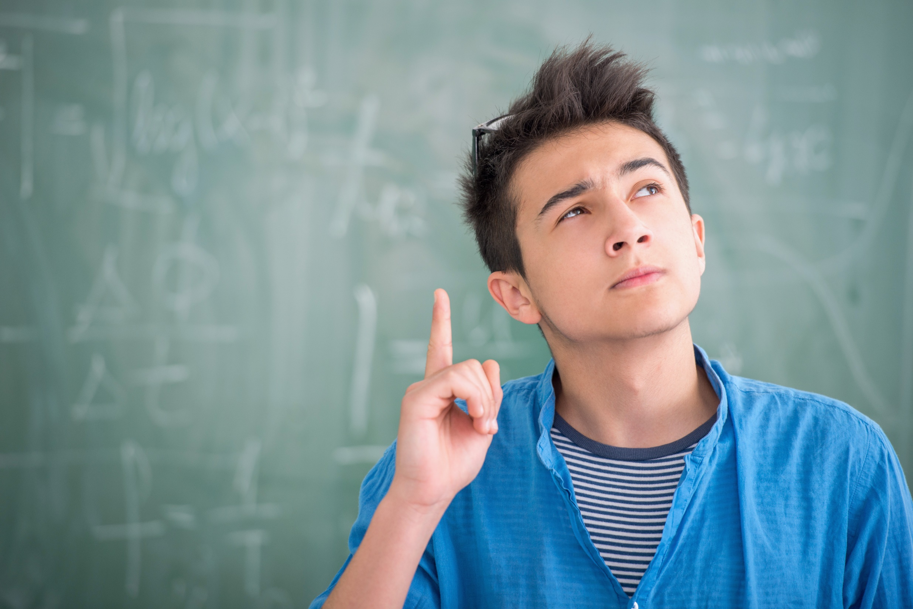
PRODUCTION

Slide 19


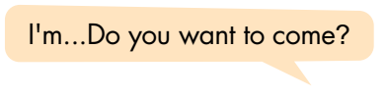
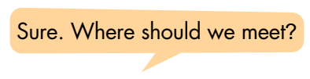

d. In pairs: Make a plan to go out with your friend.

Slide 20

CONSOLIDATION

Slide 21
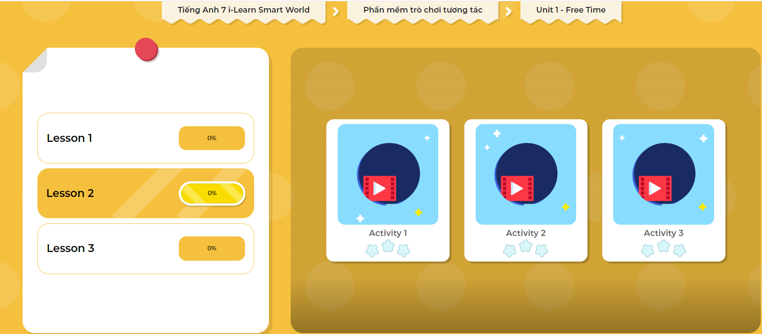
Extra Practice
DHA App
Let’s play!
Click here to play the game

Slide 22

What do you like doing in your free time?
Why do you like doing it?
Write 60 to 80 words.

Slide 23

WRAP-UP

Slide 24
Today’s lesson
Grammar:
Use the Present Continuous tense to talk about future plans.
Prepositions of place: in front of, behind, next to, opposite, on, under, …
Speaking & Writing:
- Talk and write about what you like doing in your free time and why you like doing it.

Slide 25
Homework
Make 2 sentences, using the Present Continuous tense to talk about your future plans.
Make 2 sentences, using prepositions of place.
Complete the grammar notes in Tiếng Anh 7 i-Learn Smart World Notebook (page 7).
Prepare: Lesson 2 – Pronunciation and Speaking (page 9 – SB).
Play the consolidation games in Tiếng Anh 7 i-Learn Smart World DHA App on www.eduhome.com.vn

Slide 26

Lesson 3
Stay positive and have a nice day!

