Slide 1

Unit 1: Free time
Lesson 1.3: Pronunciation & Speaking
Page 6

Slide 2
LUONG VAN CHANH SECONDARY SCHOOL
ENGLISH 7
TEACHER: TRAN MAI THAO

Slide 3



LESSON OUTLINE
Consolidation

Slide 4
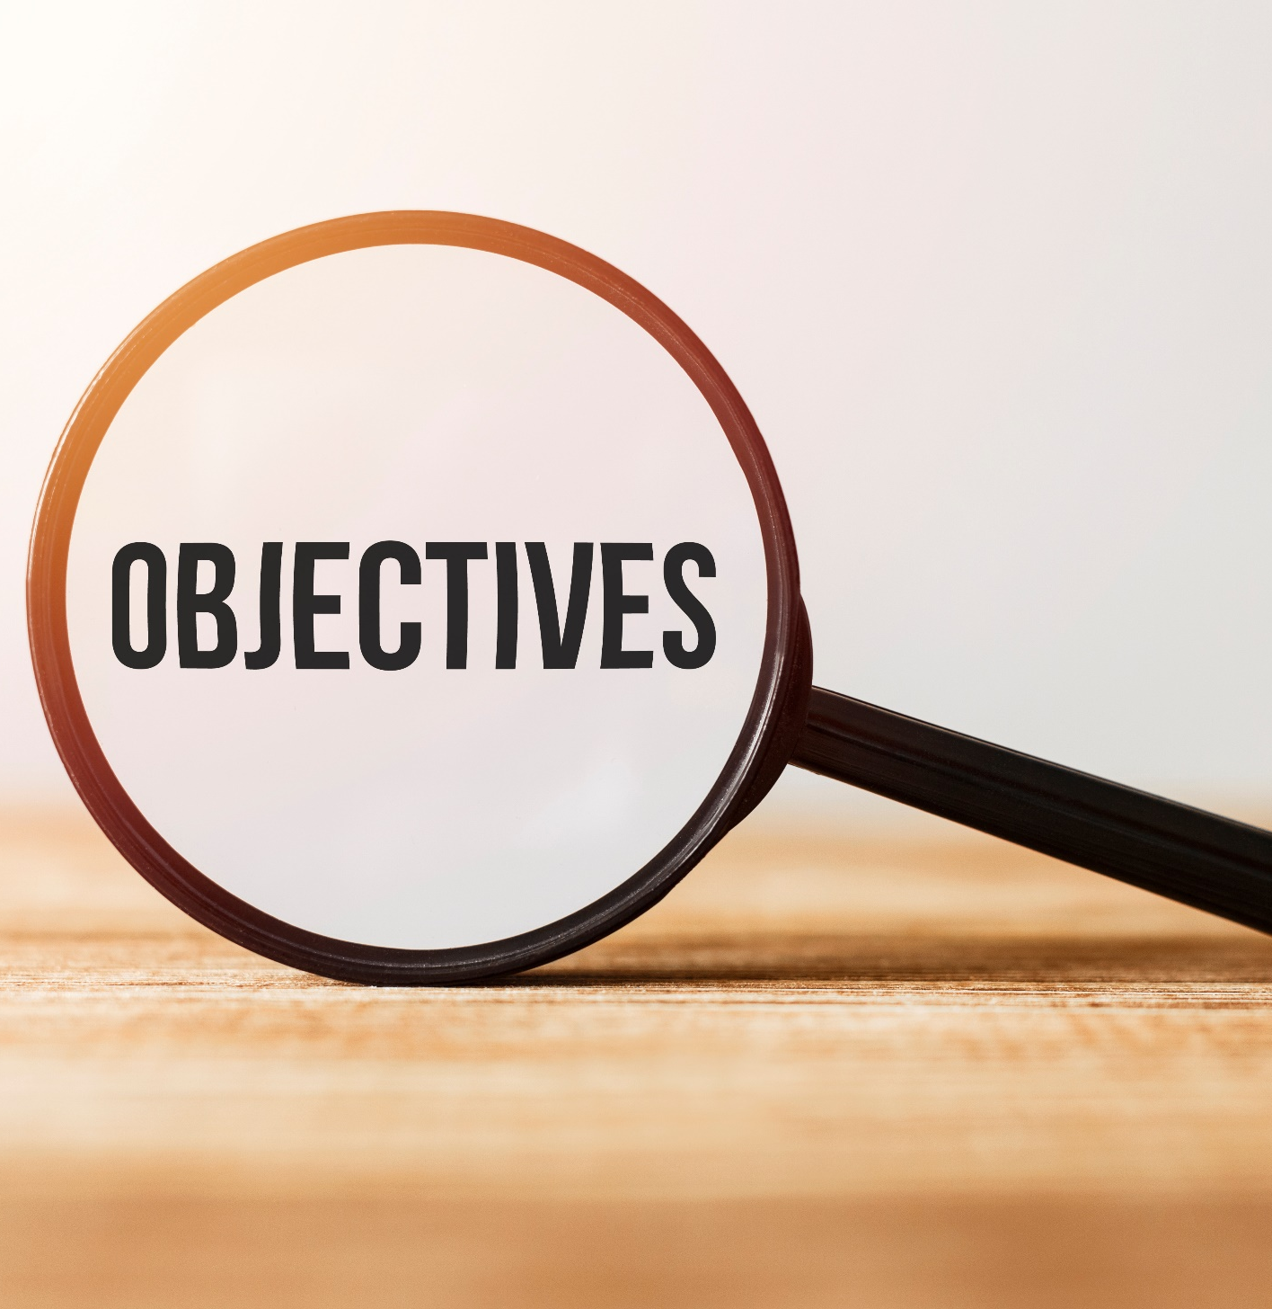
By the end of this lesson, students will be able to…
- pronounce the sound /eɪ/ correctly.
- ask and answer about free time activities, using time expressions of the Present Simple tense.
- conduct a survey about hobbies.

Slide 5
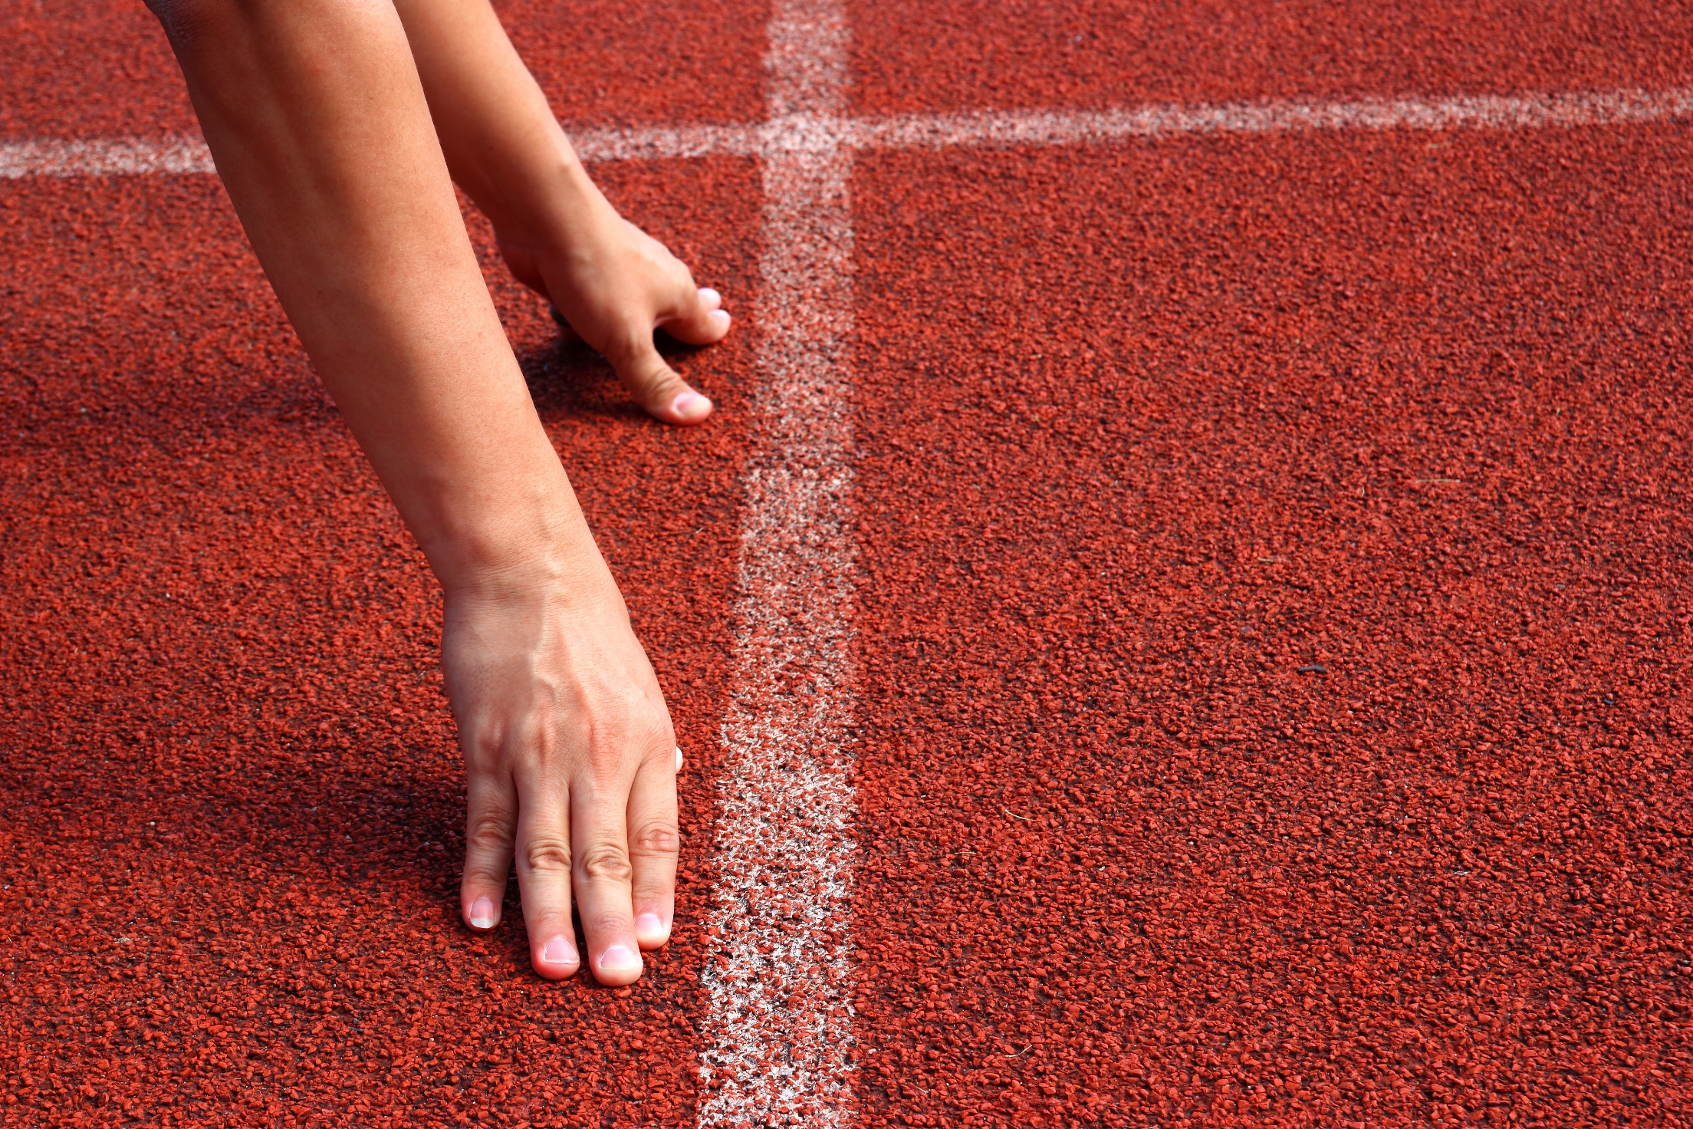
WARM-UP

Slide 6

Work in pairs.
Choose the word whose main stress is placed
differently from the others.
A. mystery B. balcony C. adventure D. fantasy
2. A. dinner B. kitchen C. laundry D. garage
3. A. dangerous B. exciting C. mountainous D. beautiful
/ˈmɪstəri/
/ˈbælkəni/
/ədˈventʃər/
/ˈfæntəsi/
/ˈdɪnər/
/ˈkɪtʃɪn/
/ˈlɔːndri/
/ɡəˈrɑːʒ/
/ˈdeɪndʒərəs/
/ɪkˈsaɪtɪŋ/
/ˈmaʊntənəs/
/ˈbjuːtɪfl/

Slide 7
Work in pairs.
Choose the word whose underlined part is
pronounced differently from that of the other words.
A. center B. city C. soccer D. icing
2. A. bowling B. timing C. tonight D. Friday
3. A. drama B. garage C. villa D. water
/ˈsentər/
/ˈsɪti/
/ˈsɑːkər/
/ˈaɪsɪŋ/
/boʊlɪŋ/
/ˈtaɪmɪŋ/
/təˈnaɪt/
/ˈfraɪdeɪ/
/ˈdrɑːmə/
/ɡəˈrɑːʒ/
/ˈvɪlə/
/ˈwɔːtər/

Slide 8

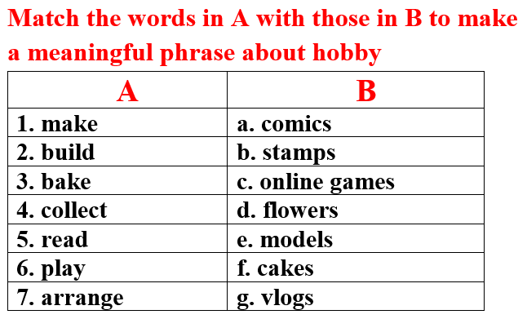
Work in pairs

Slide 9
Key answer

Slide 10



Slide 11
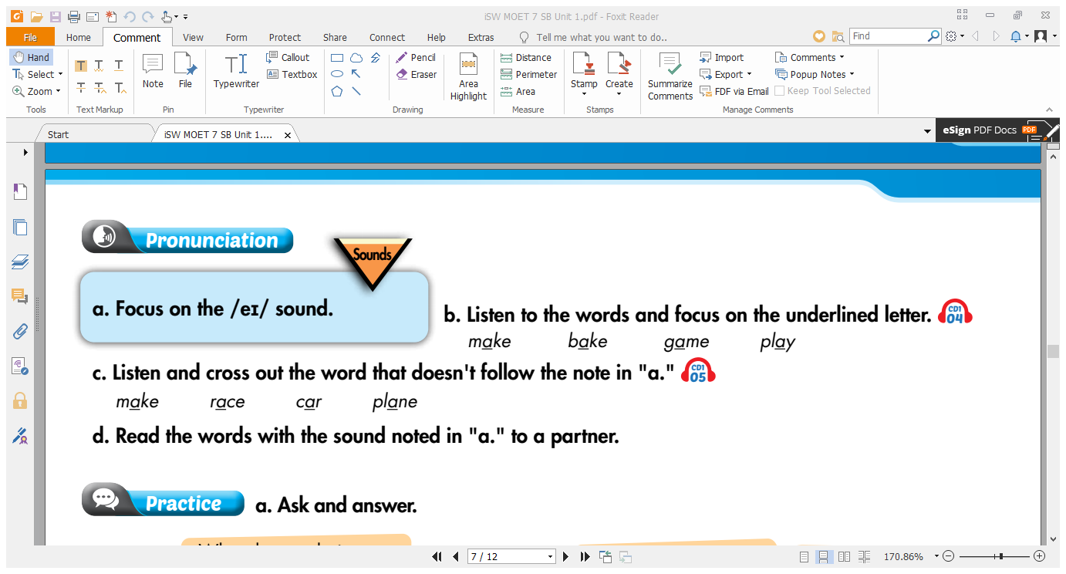


Slide 13
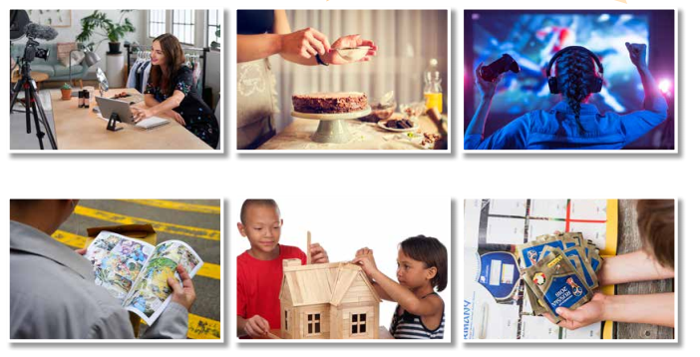
Look and name the pictures
make vlogs
bake cakes
play online games
read comics
build models
collect soccer stickers

Slide 14
A sample conversation
in your free time?
A: What do you do…………………….….…
B: I ………………………….
A: …….……………do you arrange flowers?
B: I arrange flowers ……..……………..
arrange flowers.
How often
once a week.

Slide 15
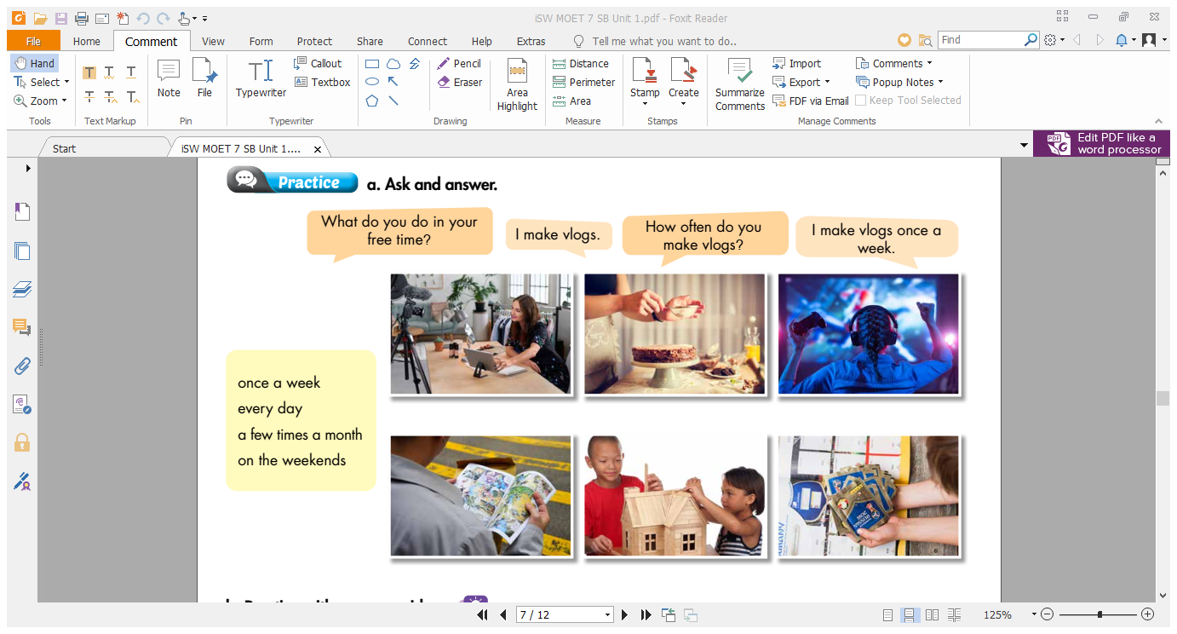
✓
✓
✓
✓
✓

Slide 16
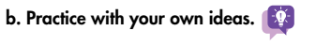
Suggested conversation
in your free time?
A: What do you do………….………….….…
B: I …….…………………..
A: …….……………do you arrange flowers?
B: I arrange flowers ..…….………………..…or…...………..………………………….. such as my family members’ birthdays, Tet holiday, or Christmas.
arrange flowers.
How often
on the weekends
on some special occasions

Slide 17
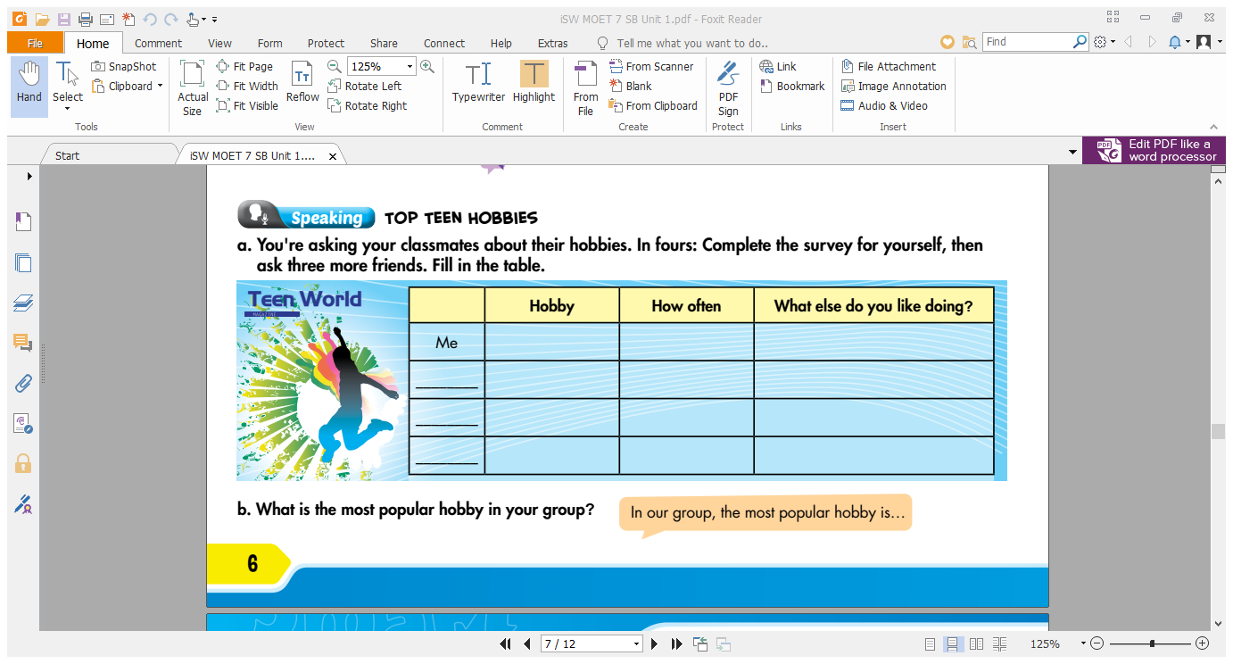
make vlogs
once a week
collect soccer stickers
B
?
?
?
C
?
?
?
D
?
?
?

Slide 18
STUDENT A
STUDENT B
What do you do in your free time?
I make vlogs.
How often do you make vlogs?
I make vlogs once a week.
What else do you like doing?
I also like collecting soccer stickers.

Slide 19
Work in groups
b. What is the most popular hobby in your group?
In our group, the most popular hobby is….

Slide 20

CONSOLIDATION

Slide 21
Write a paragraph about your hobby. You can begin with:
My hobby is/ hobbies are…..

Slide 22
Suggested paragraph
My hobby is baking cakes. I bake cakes when I have free time. I often spend one or two hours baking cakes. My mother is a good baker so she helps me a lot. In addition, I like making vlogs. I make vlogs every week and it helps me make new friends. What about you? What do you do in your free time?

Slide 23
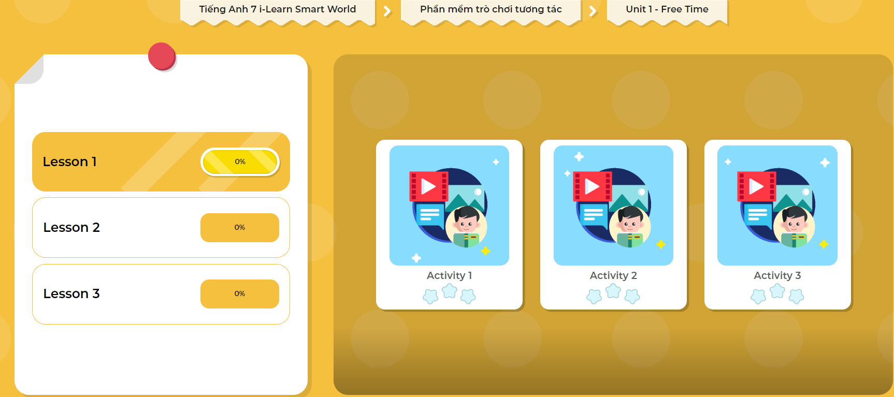
Extra Practice
DHA App
Let’s play!
Click here to play the game

Slide 24

WRAP-UP

Slide 25
Today’s lesson
Speaking:
- talk about your hobby.
- practice pronouncing sound /ei/.

Slide 26
Homework
Make 2 sentences containing some words with the sound /eɪ/, then practice saying them.
Redo the writing exercise on page 3 WB (Writing).
Prepare Lesson 2 – New words and Listening (page 7 SB).
Play the consolidation games in Tiếng Anh 7 i-Learn Smart World DHA App on www.eduhome.com.vn

Slide 27

Lesson 3
Stay positive and have a nice day!

