Slide 1
LUONG VAN CHANH SECONDARY SCHOOL
ENGLISH 7
TEACHER: TRAN MAI THAO

Slide 3
LISTENING
LESSON 7
READING

Slide 4
WARM UP

Slide 5
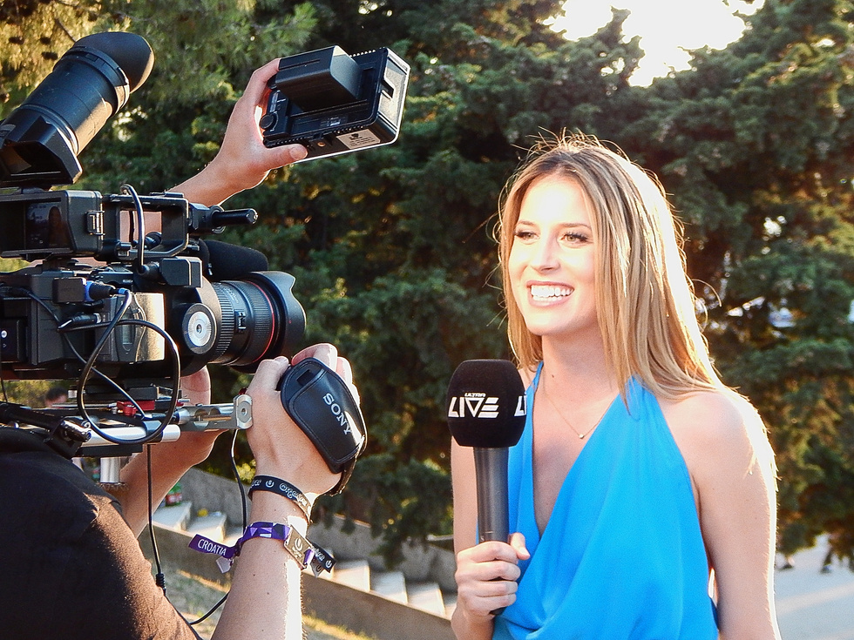
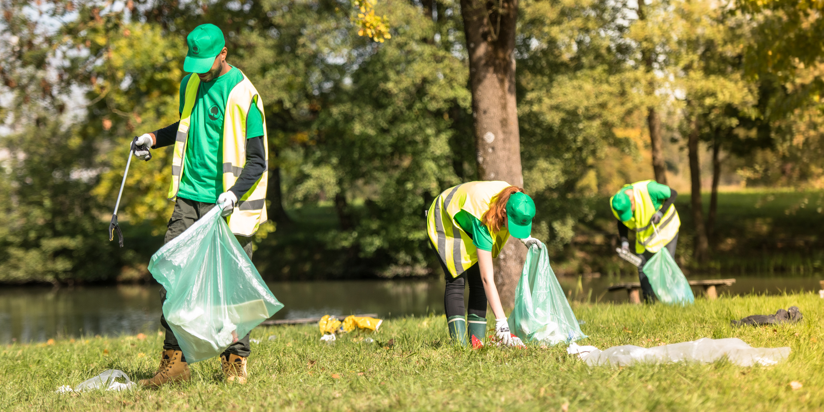
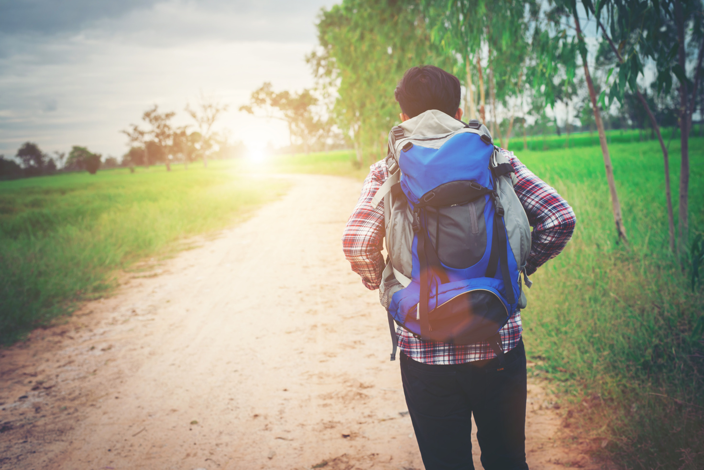
reporter
clean -up
experience

Slide 6
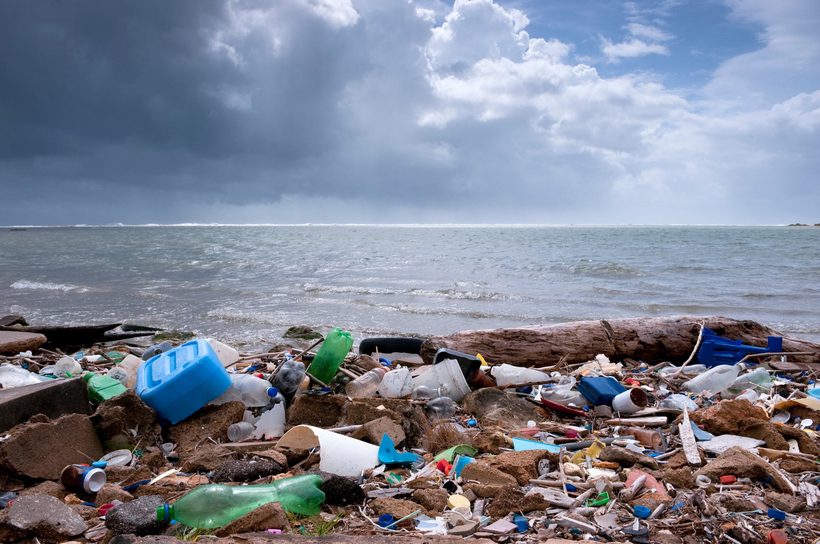
Organize (v)
trash = garbage rubbish = litter
Organizer (n)
Organization (n)

Slide 7
New words | Pronunciation | Meaning
clean-up (n)
/kliːn-ʌp/
làm sạch
reporter (n)
/rɪˈpɔːtə/
phóng viên
/ɪksˈpɪərɪəns/
kinh nghiệm, trải nghiệm
experience (n,v)
organize (v)
/ˈɔːgənaɪz/
tổ chức
organizer (n)
/ˈɔːgənaɪzə/
người tổ chức
organization (n)
/ˌɔːgənaɪˈzeɪʃən/
tổ chức
trash (n)
/træʃ/
rác thải

Slide 8
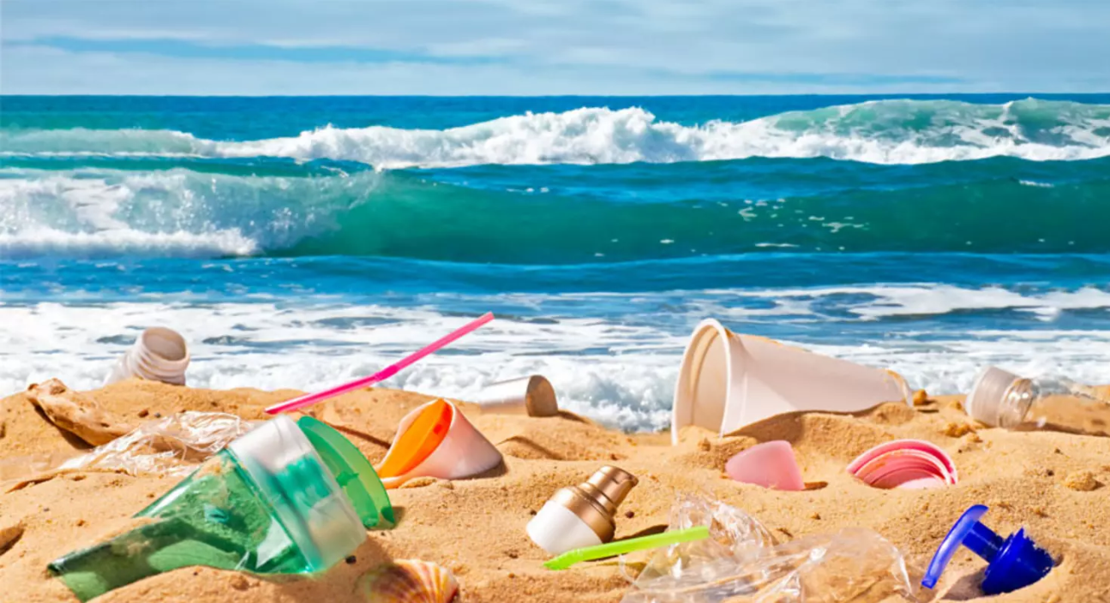
1. What can you see from the picture?
2. How do you feel about the beach?
3. What things can the people do to help the local beach?

Slide 9
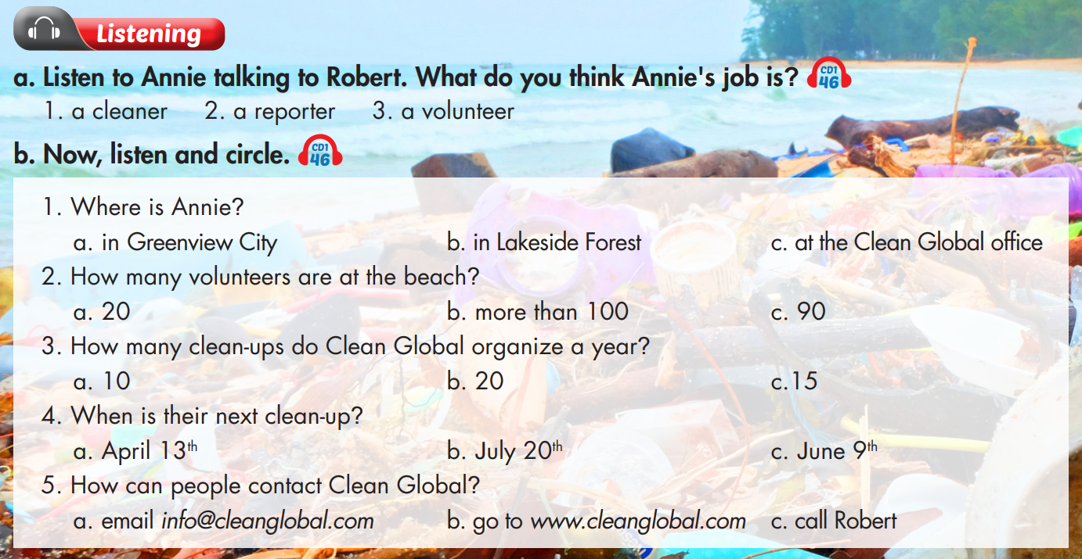

Slide 10
W: Hello. I'm Annie Jones and I'm here at Shell Beach in Greenview City. Today, Clean Global is here with over one hundred volunteers to clean up the beach.
Here I have Robert Owen, the organizer of today's event. Hi Robert!
M: Hello.
W: Tell us about your organization.
M: We're Clean Global. We organize fifteen clean-ups every year all over the country. We help keep beaches, parks, and forests clean.
W: That's great.
M: Thanks. But we need more volunteers. On Saturday, July twentieth, we are meeting at Lakeside Forest. If you want to contact us, get more information, or
join in, please visit us at www.cleanglobal.com. For every clean-up we provide trash bags, gloves, and a small lunch for all volunteers. Just remember to bring water and sunscreen!

Slide 11
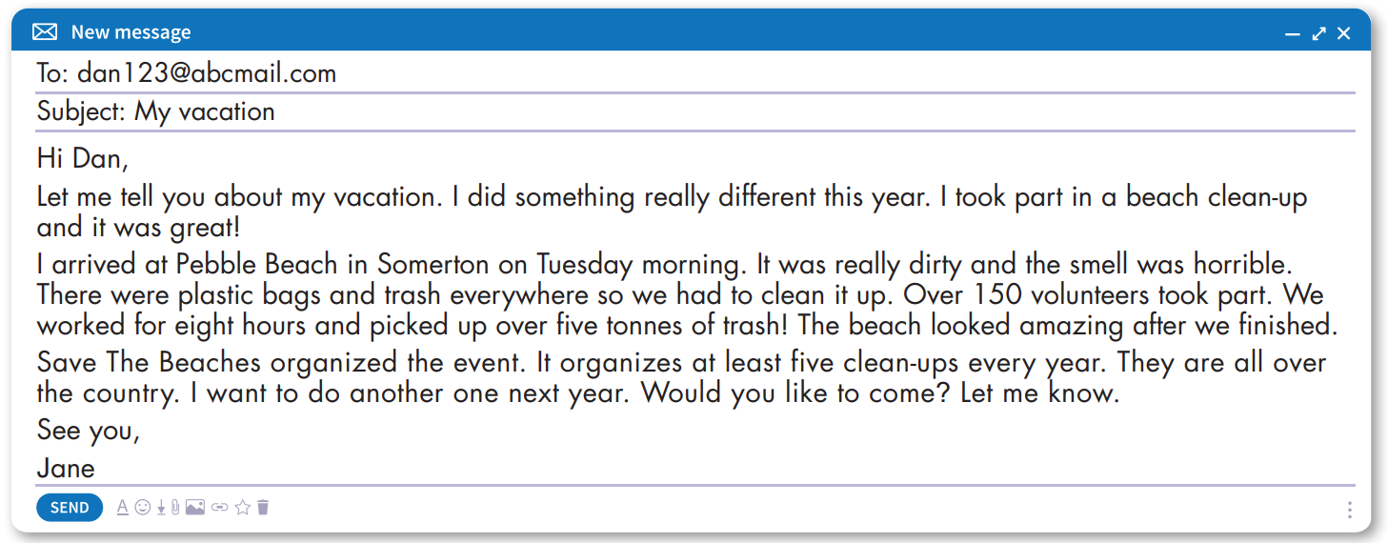

Slide 12
True
Now, read and write True or False.
False
True
False

Slide 13
New words | Pronunciation | Meaning
clean-up (n)
/kliːn-ʌp/
làm sạch
reporter (n)
/rɪˈpɔːtə/
phóng viên
/ɪksˈpɪərɪəns/
kinh nghiệm, trải nghiệm
experience (n,v)
organize (v)
/ˈɔːgənaɪz/
tổ chức
organizer (n)
/ˈɔːgənaɪzə/
người tổ chức
organization (n)
/ˌɔːgənaɪˈzeɪʃən/
tổ chức
trash (n)
/træʃ/
rác thải

Slide 14
Unit 4
COMMUNITY SERVICE
Lesson 7: Listening + reading
Listening:
- Listen for gist and comprehension.
Reading:
- Skim and scan for general and specific information
Ms Phương
Zalo: 0966765064

Slide 15
HOMEWORK
Ms Phương
Zalo: 0966765064
Do the Listening and Reading exercises on page 24 WB.
Do the exercises in Tiếng Anh 7 i-Learn Smart World Notebook on page 26.
Prepare the next lesson (page 34 SB).

