Slide 1
LUONG VAN CHANH SECONDARY SCHOOL
ENGLISH 7
TEACHER: TRAN MAI THAO

Slide 3
NEW WORDS
LESSON 4
LISTENING

Slide 4
WARM UP
VERBS
Clean up
Bake
Plant
Donate
Raise
Recycle
Wash
NOUNS
money
paper
beaches
trees
cars
food
Cookies

Slide 5
recycle
Ms Phương
Zalo: 0966765064
/ˌriːˈsaɪkəl /
(V) tái chế.
Recycling is very important to save our environment.
Tái chế rất quan trọng để bảo vệ môi trường.

Slide 6
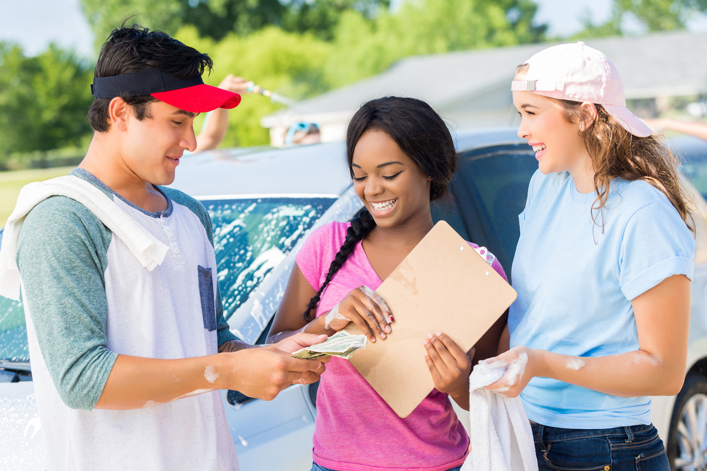
raise
Ms Phương
Zalo: 0966765064
/reɪz ˈ/
(V) gây ( quỹ), quyên góp
He often raises money for the local charity.
Anh ấy thường quyên góp tiền cho tổ chức từ thiện địa phương.

Slide 7
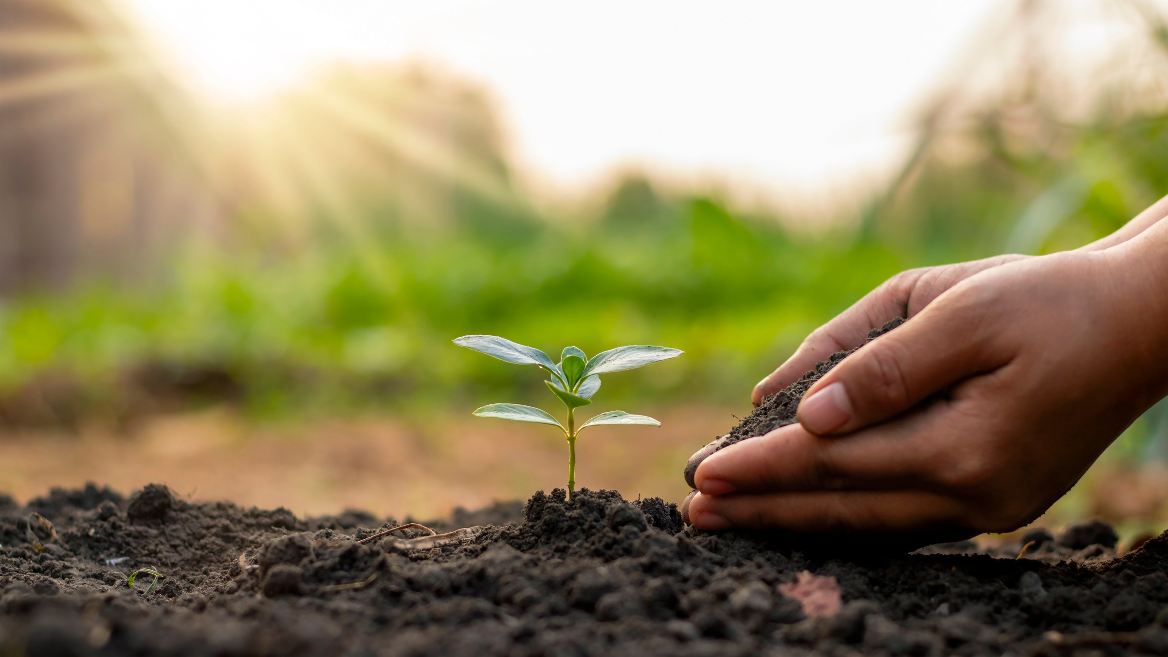
plant
Ms Phương
Zalo: 0966765064
/plænt/
(v) trồng
We should plant more trees if we want to have more fresh air.
Chúng ta nên trồng nhiều cây hơn nếu chúng ta muốn có nhiều hơn không khí trong lành.

Slide 8
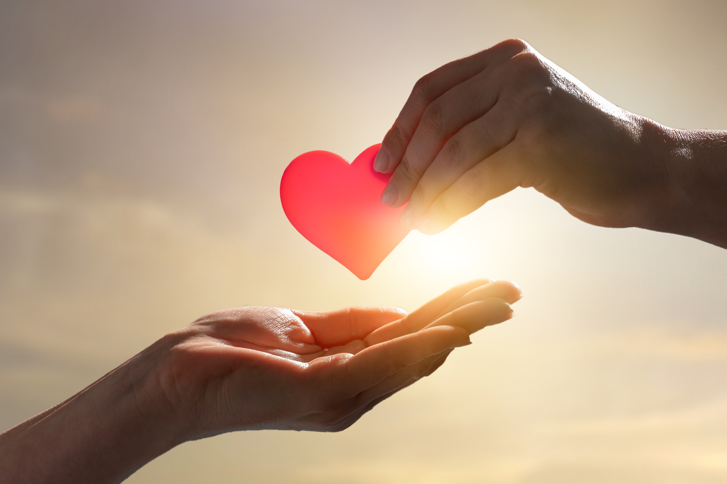
donate
Ms Phương
Zalo: 0966765064
/ˈdoʊneɪt/
(V) Hiến tặng
Last week, I donated many old books and clothes for poor children in the mountainous area.
Tuần trước tôi đã quyên góp rất nhiều sách cũ và quần áo cho trẻ em nghèo vùng núi.

Slide 9
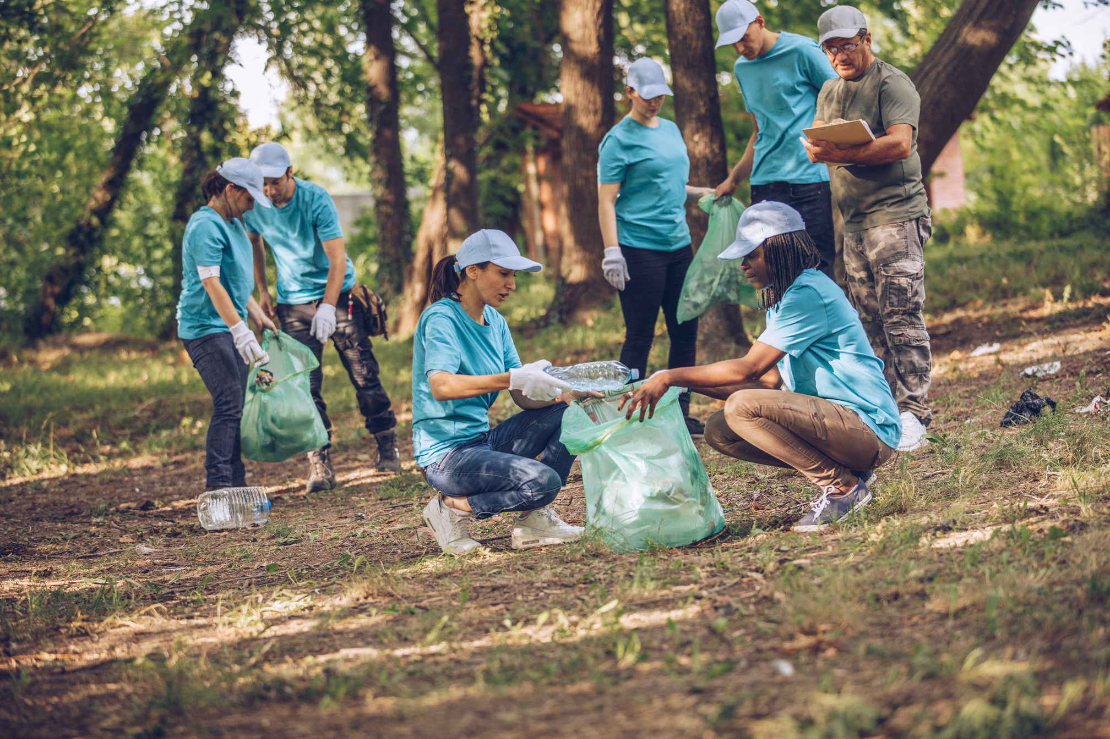
clean up
Ms Phương
Zalo: 0966765064
/kliːn ʌp/
Làm sạch
Cleaning up is a meaningful program of our community.
Làm sạch là một chương trình rất ý nghĩa của cộng đồng chúng tôi.

Slide 10
clean up
raise
recycle
donate
plant

Slide 11
Fill in the table. Listen and repeat.
recycle raise plant donate clean up
trees flowers | money | parks streets | cans bottles | books old clothes
plant
raise
clean up
recycle
donate

Slide 12
In pairs. Add more word and share your ideas with your class.
recycle
Plastic bottles
glass bottles
old newspaper
plastic bags.
raise
We can plant vegetables in our school garden.
money
money
food
plant
trees
flowers
We can donate food to homeless people.
donate
food
money
clothes
blood
clean up
street
school
neighborhood
park

Slide 13
Listen to two people talking. What is the purpose of the interview?
Listening

Slide 14
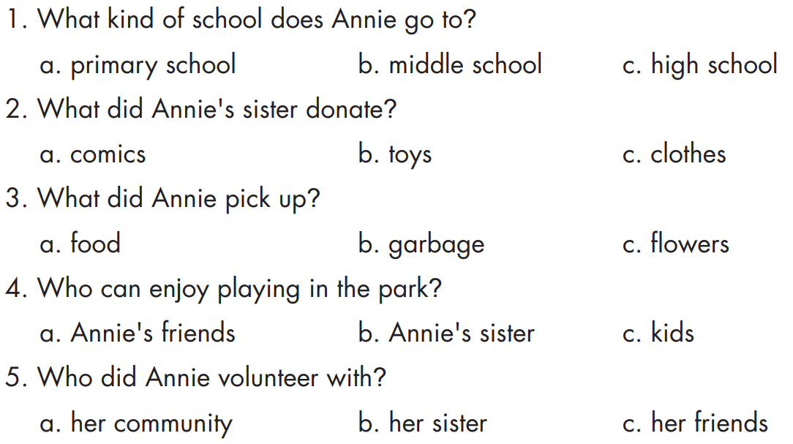
b. Now, listen again and circle a,b,c.

Slide 15
Audio - Scripts
Practice the conversation with a partner.
Ms. White: So, Annie, let's talk about what you did to help our community.
Annie: Last month, I donated warm clothes and my old toys. My sister donated some comics. They went to the poor children.
Ms. White: Great. What else did you do?
Annie: Last week, I cleaned up the park near my house. It was dirty so we picked up the garbage. We also planted flowers and trees there. Now, kids can enjoy playing in the park.
Ms. White: Fantastic. Can you tell us about your volunteer work?
Annie: Well, yesterday, my friends and I volunteered at Fair View's soup kitchen.
Ms. White: Wow! You guys did a great job to help our community.
Annie: Thank you, Ms. White.

Slide 16
James: Hi, are you Ann from Maple Falls Energy?
Ann: Yes.
James: Can I ask you some questions?
Ann: OK.
James: How much energy does Maple Falls get from coal?
Ann: Sixty percent.
James: How much energy does it get from wind power?
Ann: Just under three percent.
James: Thank you.
James: Hey Emma, Maple Falls gets less than three percent of its energy from renewable sources.
Emma: Greenwood gets fifty percent. It uses more renewable energy sources than Maple Falls.
James: So, Greenwood is greener than Maple Falls.

Slide 17
I recycle plastic bottles, cans and newspaper…
What kinds of things could you do to help your local community?
I can plant trees and pick up trash.

Slide 19
WARP - UP
e
y
e
a
e
a
u
o
a
e

Slide 20
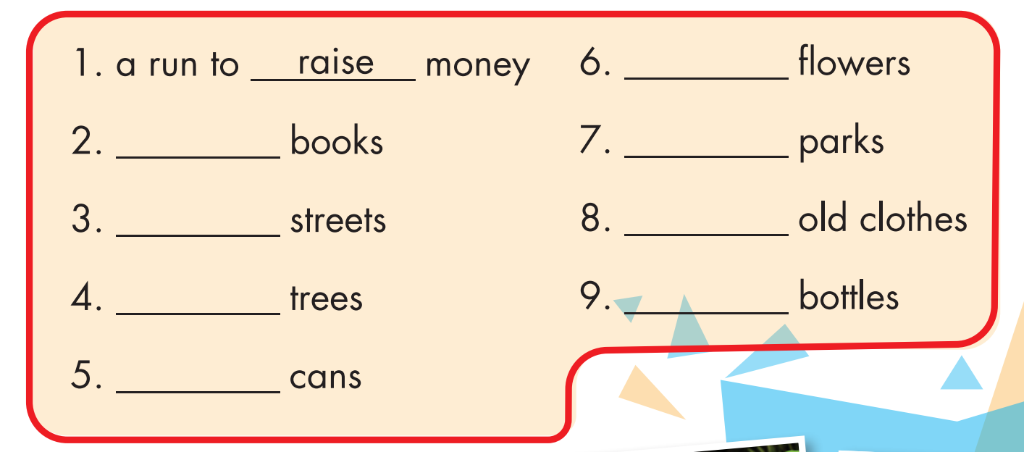
plant
donate
clean up
clean up
donate
plant
recycle
recycle

Slide 21
Unit 4: COMMUNITY SERVICE
Lesson 4: Vocabulary + listening
Ms Phương
Zalo: 0966765064
recycle (v): tái chế
raise (v): gây quỹ
donate (v): quyên góp
clean up: làm sạch
Plant : (v): trồng

Slide 22
CHECKING MEMORY
/ˌriːˈsaɪkəl /
Tái chế
1. recycle
/reɪz ˈ/
gây quỹ, quyên góp
2.raise
Ms Phương
Zalo: 0966765064
/plænt/
3. plant
trồng
/ˈdoʊneɪt/
hiến, tặng
4. donate
/kliːn ʌp/
làm sạch
5. clean up

Slide 23
HOMEWORK
Practice the vocabularies and make sentences using them.
Do the Listening exercise on page 22 WB.
Prepare the next lesson (page 32 SB).

