Slide 1
LUONG VAN CHANH SECONDARY SCHOOL
ENGLISH 7
TEACHER: TRAN MAI THAO

Slide 3
WARM UP
Work in pair. Find the mistake and correct in each sentence.
Let’s going to the zoo tonight.
How about have a barbecue in the garden?
Why don’t we buying this dress?
I think we should goes to the cinema.
Would you like drinking some tea?
go
Ms Phương
Zalo: 0966765064
having
buy
go
drink

Slide 4
PRONUNCIATION
LESSON 3
SPEAKING

Slide 5
butterfly
hotdog
watermelon
housewife
football
pancake

Slide 6
Let’s watch the video.

Slide 8
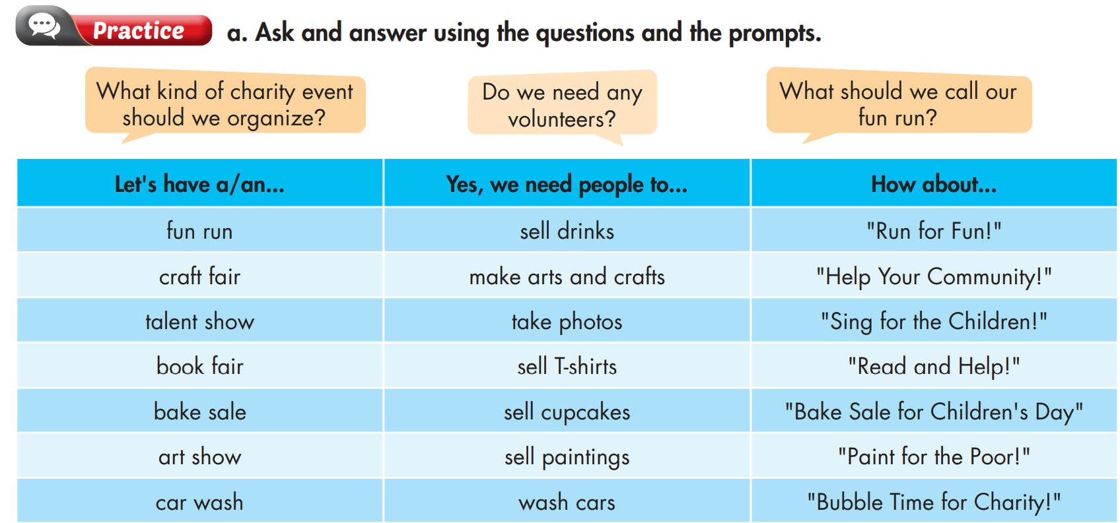

Slide 9
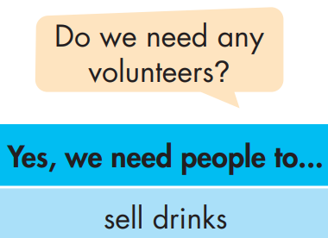
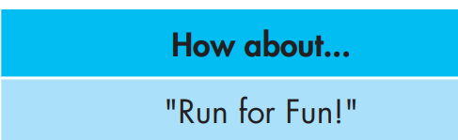
Example
What kind of charity event should we organize?
Do we need any volunteers?
What should we call our Fun run

Slide 10
Ask your partner using the prompts and then practice with your own idea.
Fun Run | Sell drinks | “Run for Fun”
Craft Fair | Make arts and crafts | “Help your Community”
Talent Show | Take photos | “Sing for the Children”
Book Fair | Sell T-shirts | “Read and Help”
Bake Sale | Sell cupcakes | “Bake Sale for Children Day”
Art Show | Sell paintings | “Pain for the Poor!”
Car Wash | Wash cars | “Bubble Time for Charity”

Slide 11
Charity event

Slide 12
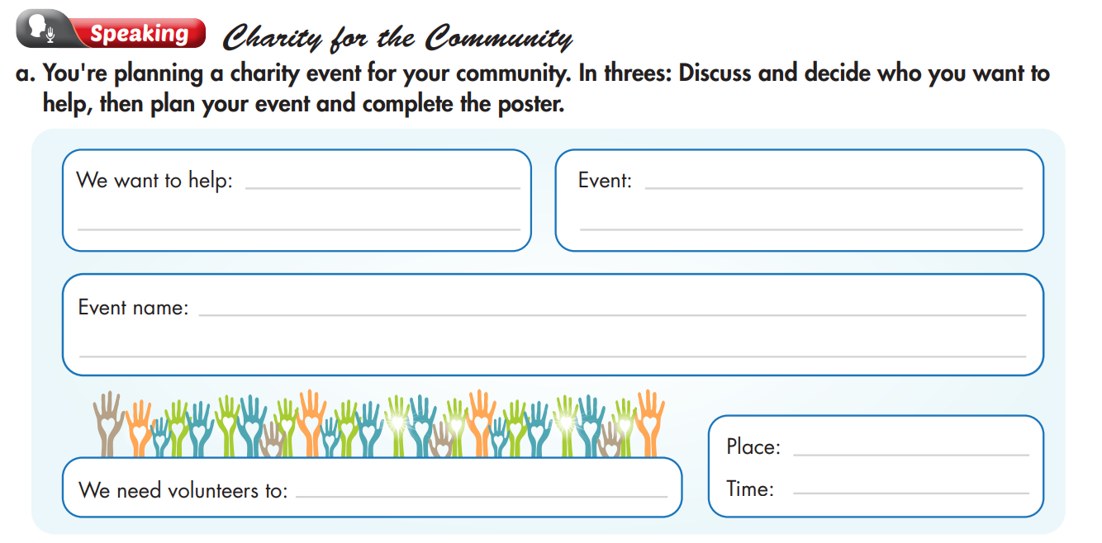

Slide 13
I think we should help our neighborhood.
Who should we help?
We want to help:___
Our neighborhood.
I think we should clean the roads and repair the unsafe road.
Event: ______
clean and repair unsafe streets.
What do you think we should do to help?
What should we call our campaign?
Event name:______
Safe streets
How about “safe streets”
Yes, we need some people to help to clean the street.
We need volunteers to :______
Clean the streets.
Do we need any volunteers?
Where and when should we have the event?
I think we should have the event in our village next Sunday.
Place: our village
Time: Next Sunday

Slide 14
Work in pairs, matching the events to the appropriate activities.
Events | Activities
Car wash | Sell paintings
Fun run | Make cupcakes
Bake sale | Sell comics
Craft fair | Wash cars
Book fair | Sell tickets
Art show | Make cards
Talent show | Sell drinks

Slide 15
Unit 4: COMMUNITY SERVICE
Lesson 3: Pronunciation + Speaking
Ms Phương
Zalo: 0966765064
Pronunciation: stress of compound nouns.
Speaking:
talk about how to organize a charity event.
practice pronouncing compound nouns.

Slide 16
HOMEWORK
Practice pronouncing compound nouns.
Redo the writing exercise on page 21 WB.
Prepare the next lesson (page 31 SB).
Review all the vocabularies and grammar in the unit.

