Slide 1
LUONG VAN CHANH SECONDARY SCHOOL
ENGLISH 7
TEACHER: TRAN MAI THAO

Slide 2


Slide 3




LESSON 2
Ms Phương
Zalo: 0966765064
GRAMMAR

Slide 4
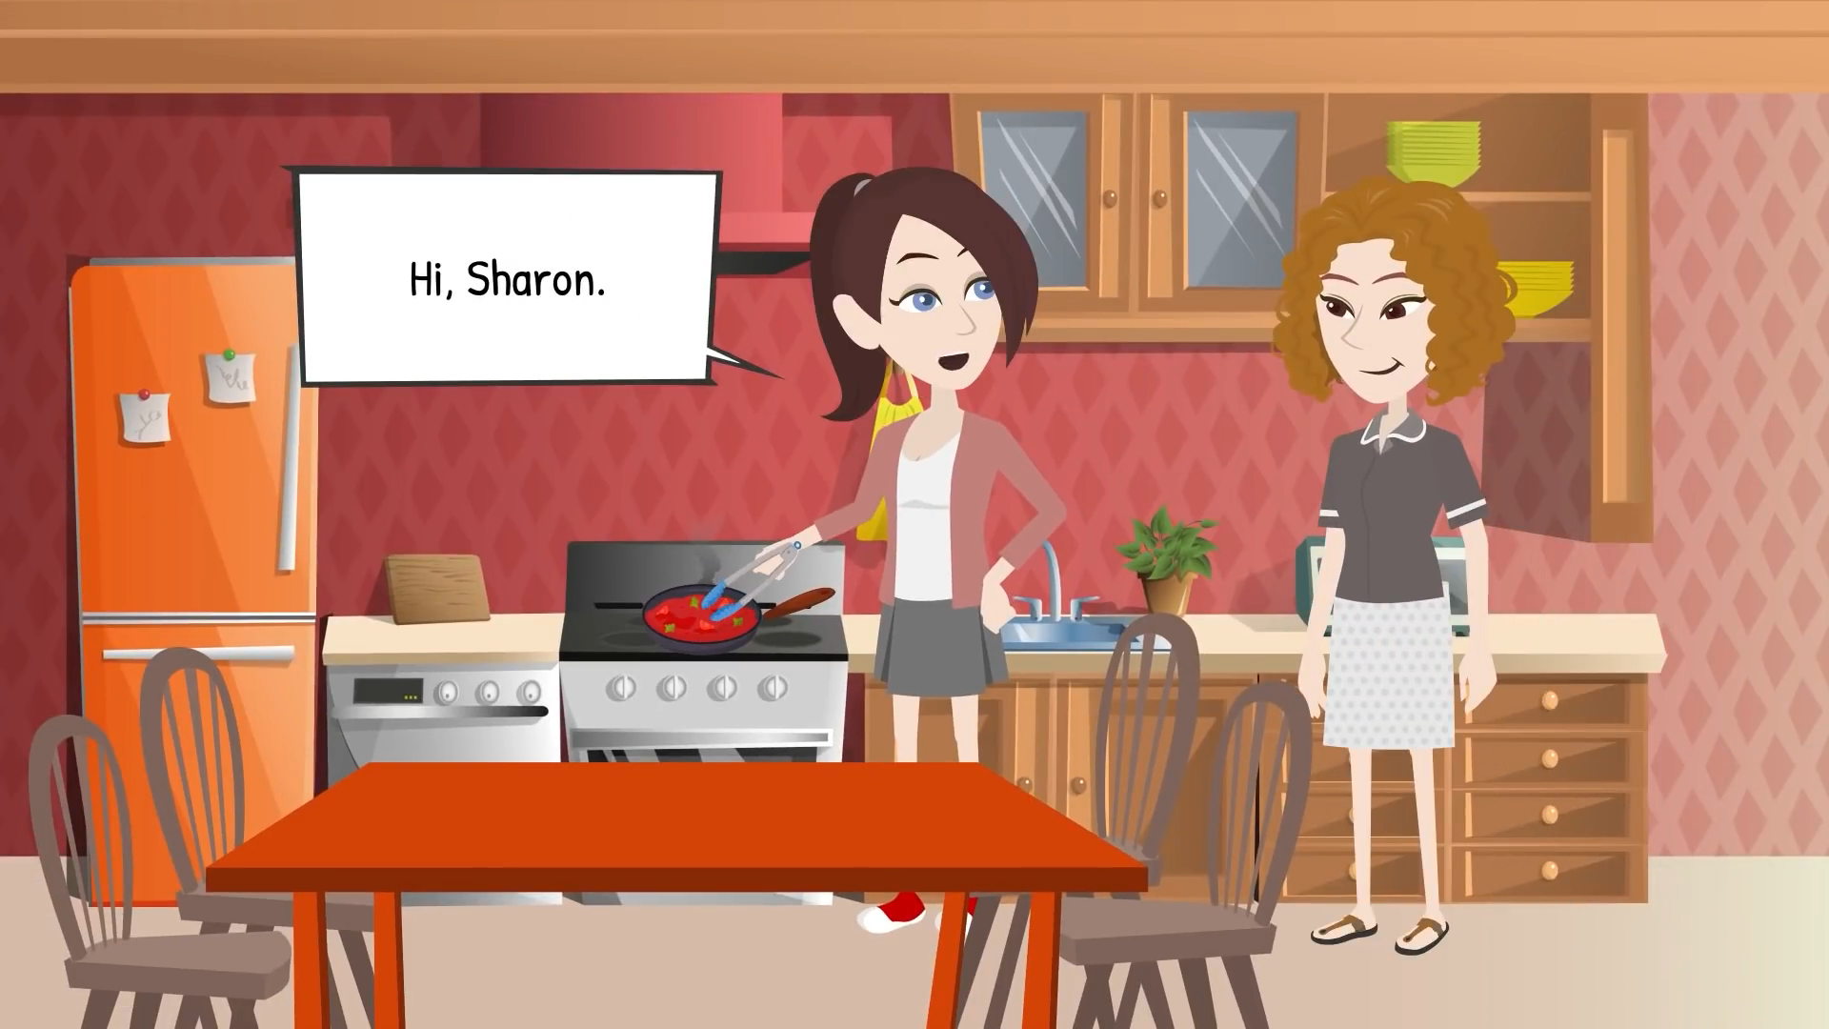
WARM UP
Making suggestions

Slide 5
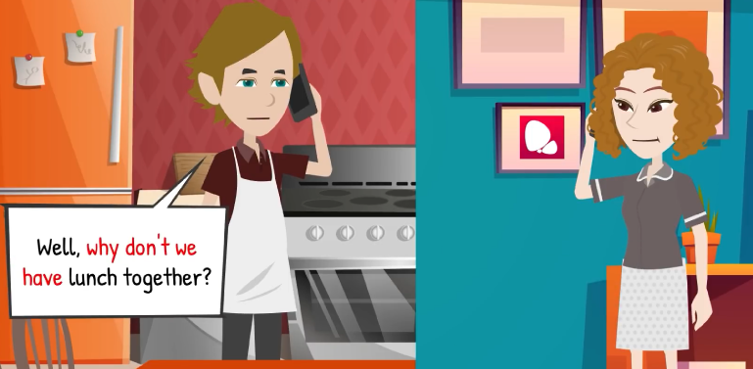
Example 1:
Why don’t we + V(o)….?

Slide 6
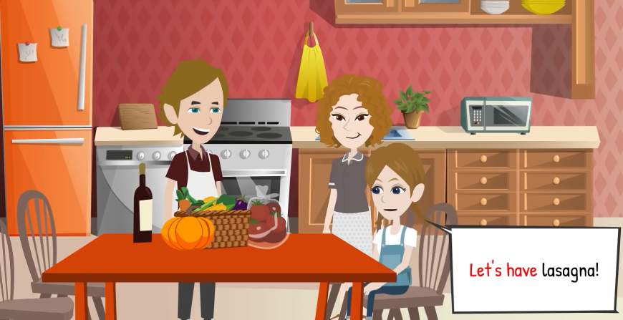
Example 2:
Let’s + V(o)….?

Slide 7
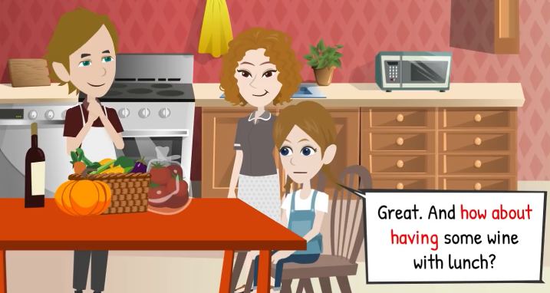
Example 3:
How about / What about + V-ing….?

Slide 8
I think we should + …
Let’s + V(o)____________.
How about + V-ing____________?
What about + V-ing___________?
Why don’t we + V(o) __________?
Making suggestions.

Slide 9
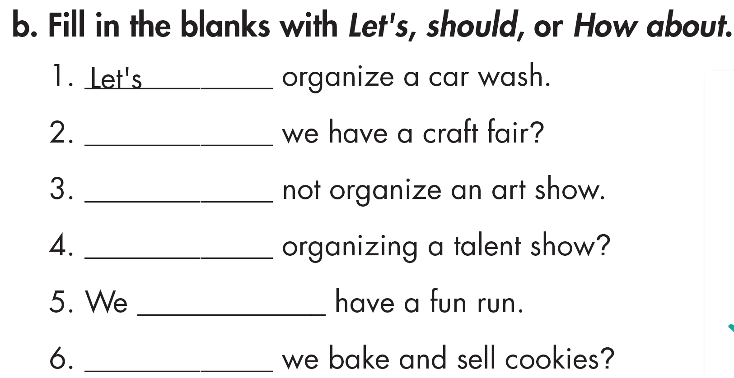
How about
Let’s
How about
should
How about

Slide 10
C. Circle the correct words.
1. A bake sale will raise more money than a craft fair. Let's/Let's not make some pies to sell this weekend.
2. We should/shouldn't charge money for the fun run. More people will come if it's free.
3. Let's/Let's not have the craft fair at the school gym. It's too small to fit a lot of people.
4. My teacher said we should/shouldn't ask our parents to donate old clothes because we don't need them.
5. The weather report said it will rain this weekend. We should/shouldn't have the event outside.
6. I'm not very good at designing posters. Let's/Let's not ask your sister to help because she's an artist.

Slide 11
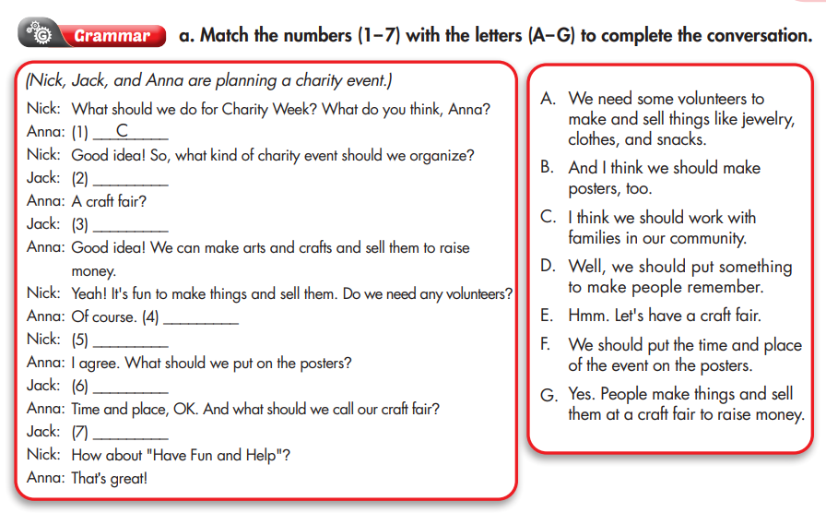
Workbook p.21
Match the numbers ( 1-7) with the letters ( A-G) to complete the conversation.
E
G
A
B
F
D

Slide 12
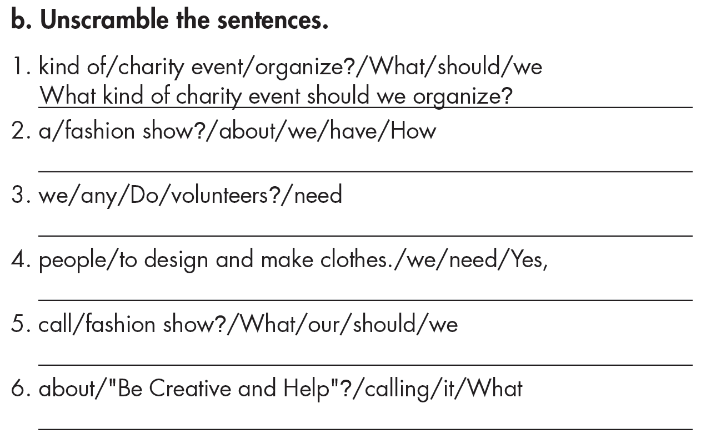
How about we have a fashion show?
Do we need volunteers?
Yes, we need people to design and make clothes.
What should we call our fashion show?
What about calling it “Be Creative and Help”?

Slide 13
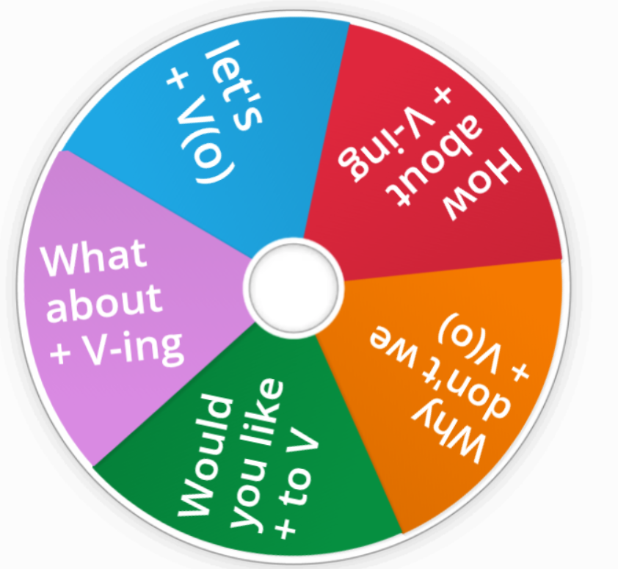

Spin the wheel and make sentences with suggestions structures.
click here.

Slide 14
Unit 4
COMMUNITY SERVICE
Lesson 2: Grammar
Ms Phương
Zalo: 0966765064
Structures for suggestions. ( Cấu trúc câu gợi ý)
Let’s + V(o)
Why don’t we + V(o)
How about + V-ing
What about + V-ing
How about + clause
I think we should + V (o)

Slide 15
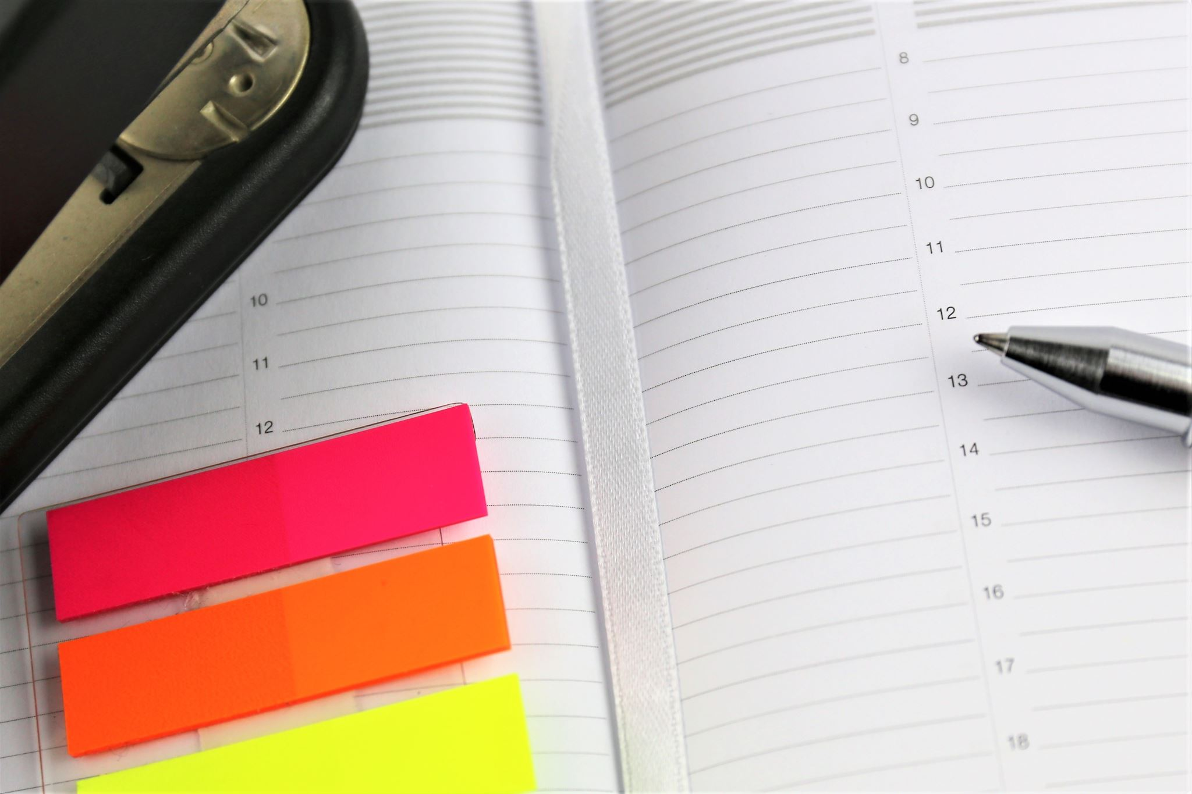
Homework
Review the grammar point and make sentences using it.
Do the exercises on page 21 WB.
Complete the grammar notes in Tiếng Anh 7 i-Learn Smart World Notebook (page 23).
Prepare the next lesson (page 30 SB).

