Slide 1
LUONG VAN CHANH SECONDARY SCHOOL
ENGLISH 7
TEACHER: TRAN MAI THAO

Slide 2
Let’s watch the video and guess the topic today.

Slide 4
NEW WORDS
LESSON 1
READING

Slide 5
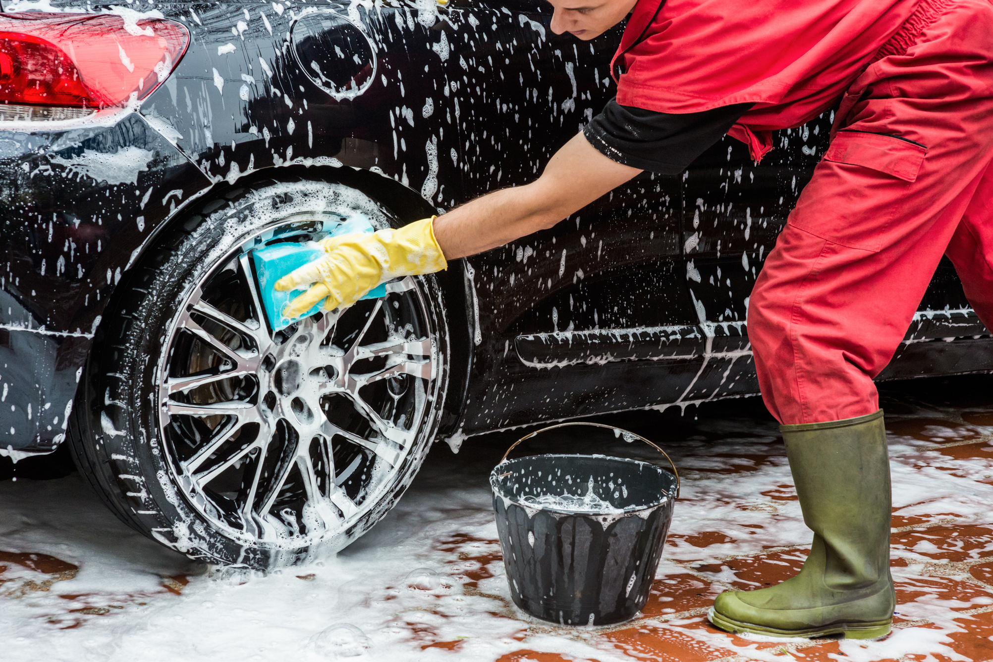
car wash
(n) /kɑːr wɑːʃ/
Ms Phương
Zalo: 0966765064
Rửa ô tô
My car is so dirty, so I am having a car wash in the afternoon.
Xe ô tô của tôi rất bẩn nên tôi sẽ rửa nó vào buổi chiều.

Slide 6
bake sale
(n) /beɪk seɪl /
Ms Phương
Zalo: 0966765064
Bán bánh
We should make a poster for the bake sale.
Chúng ta nên làm một tấm áp phích cho việc bán bánh.

Slide 7
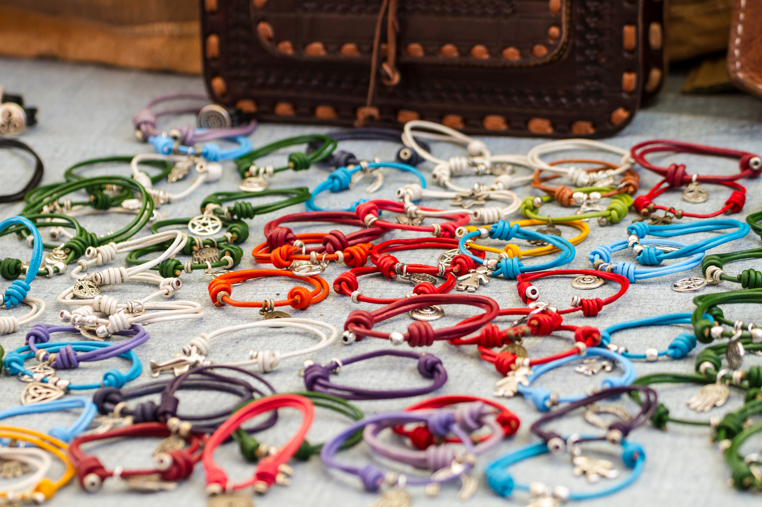
craft fair
(n) /kræft fer/
Ms Phương
Zalo: 0966765064
Hội chợ hàng thủ công
We’d like to go to craft fair when we go to Thai Lan.
Chúng tôi thích đến hội chợ hang thủ công khi đến Thái Lan.
Notes:
Would you like to go to the rock music show with me?

Slide 8
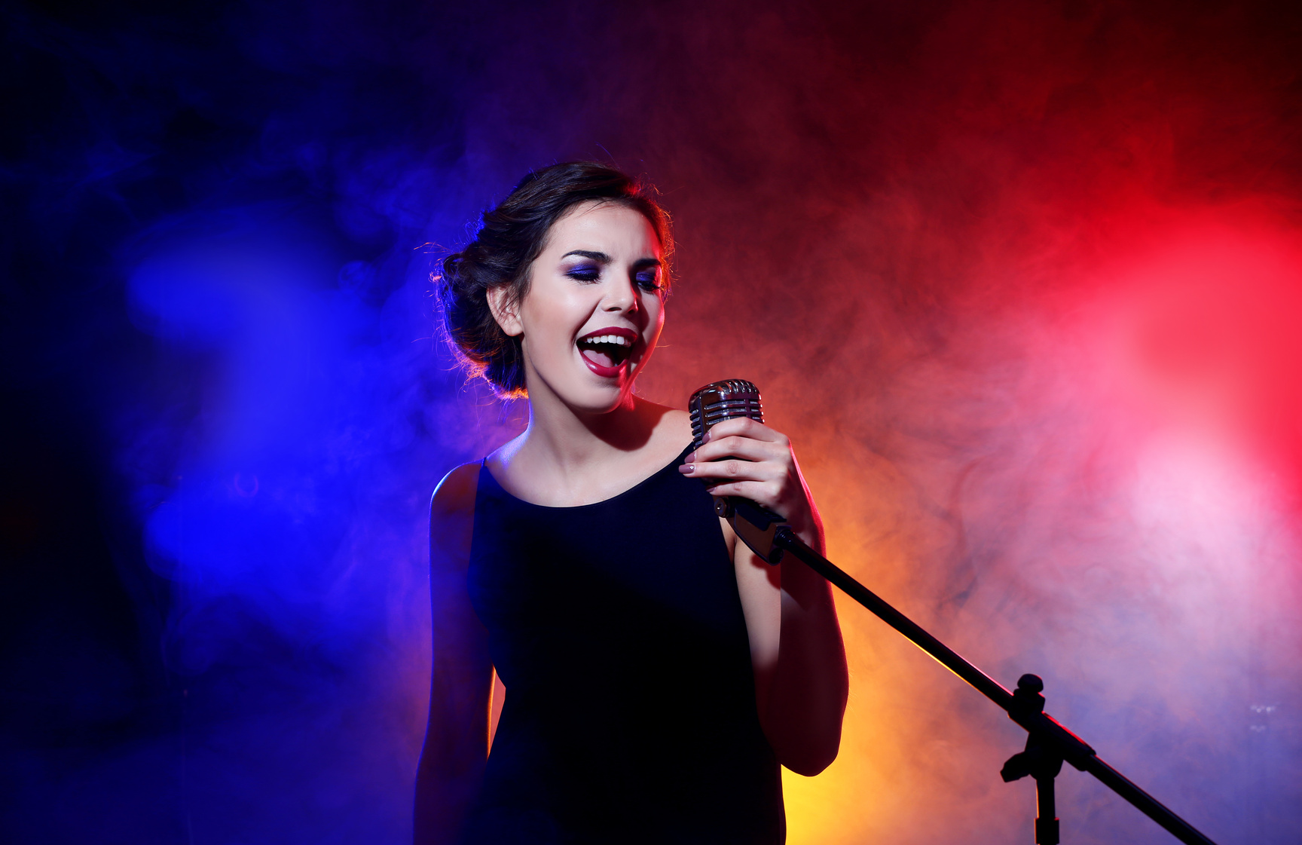
talent show
(n) / ˈtælənt ʃoʊ /
Ms Phương
Zalo: 0966765064
Biểu diễn tài năng
My sister sings very well, so she want to join a talent show.
Chị gái tôi hát rất hay vì vậy cô ấy muốn tham gia một cuộc thi tài năng.

Slide 9
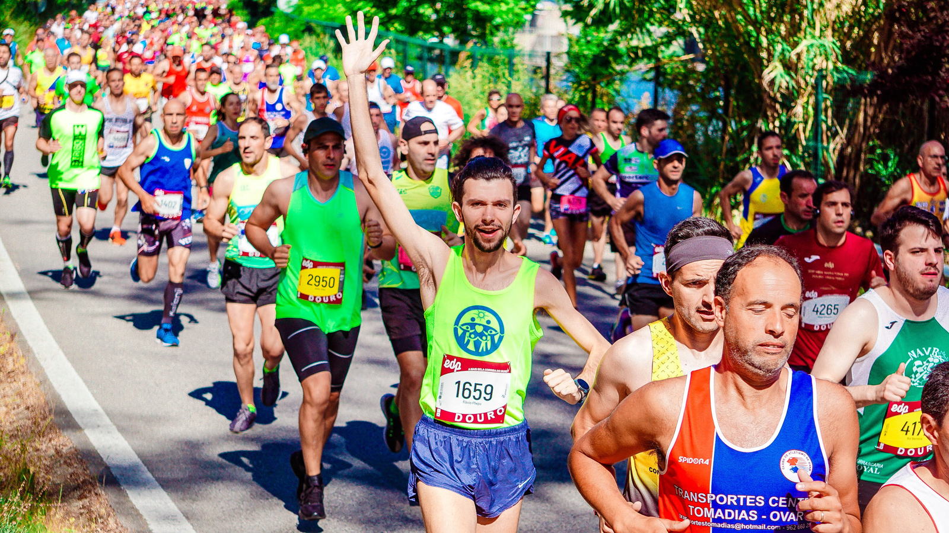
fun run
(n) /fʌn rʌn/
Ms Phương
Zalo: 0966765064
Chạy bộ
Fun run around Hoan Kiem lake is very popular activity.
Chạy bộ quanh hồ Hoàn Kiến là một hoạt động rất phổ biến.

Slide 10
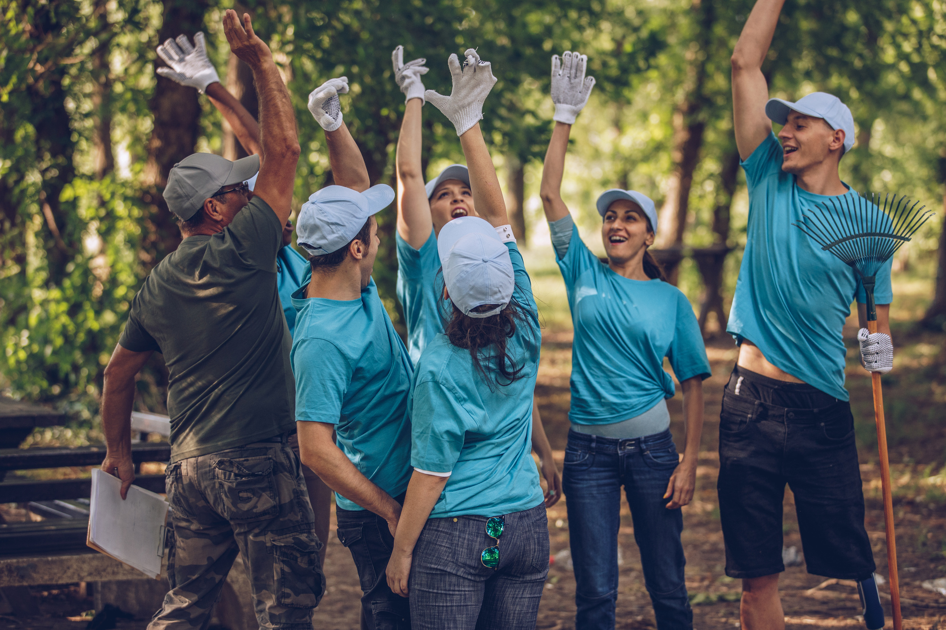
volunteer
(n) /ˌvɑːlənˈtɪr/
Ms Phương
Zalo: 0966765064
Tình nguyện viên
Our school needs some volunteers for the sport event.
Trường tôi cần một vài tình nguyện cho sự kiện thể thao.

Slide 11
charity event
(n) /ˈtʃerəti ɪˈvent/
Ms Phương
Zalo: 0966765064
Sự kiện từ thiện
If you have old books or clothes, you can bring to charity event.
Nếu bạn có sách hoặc quần áo cũ bạn có thể mang tới các sự kiện từ thiện.

Slide 12
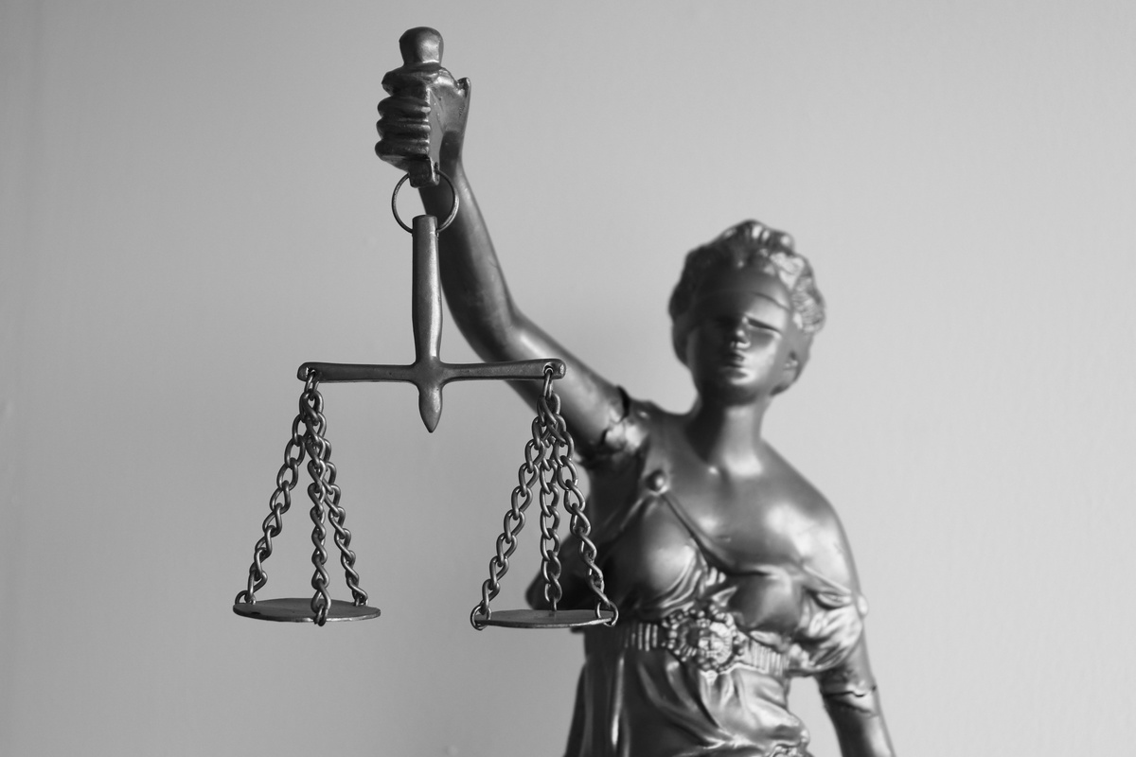
right
(n) /raɪt/
Ms Phương
Zalo: 0966765064
Quyền lợi
Every child has rights to eat, to live and to study.
Mọi đứa trẻ đều có quyền ăn, sống và học tập.

Slide 13
a
b
c
car wash
talent show
charity event
d
e
f
g
h
volunteer
right
craft fair

Slide 14
Number the pictures. Listen and repeat.
2
5
4
1

Slide 15
b. Circle the correct definitions for the underlined words. Listen and repeat.
1. My brother is a volunteer at his school. He helps teach young children after school.
A. someone who helps for free B. an activity to help people for free
2. Let's organize a charity event to support poor students in our town.
A. an outdoor activity B. an activity to help people in need
3. All children have the right to go to school. We must do everything we can to help them go to school.
A. a rule about what a person should have
B. a rule about what a person can't do

Slide 16
c. In pairs. Discuss and add more events in the box.

Slide 17
Reading
a. Read the article and choose the best headline.
1. Help Us Bring Happiness to Children!
2. Charity Event Ideas to Raise Money.
The United Nations says that all children under 18 have the right to live, be healthy and happy, and much more*, but some poor children don't have these rights. They don't have enough food and can't go to school. So, please join us in helping poor children. We are going to do these activities next month to raise money:
• Craft Fair (May 15th – 16th). Many talented artists will be there! You’ll find lots of cool things like cute stuffed animals and pretty paintings. There will also be arts and crafts workshops in the afternoons.
• Bake Sale (May 22nd – 23rd). Come buy cookies, cupcakes, pies, and more! Don't miss the cupcake decorating competition on May 23rd!
We’ll use the money from these events to buy clothes, books, and toys for children. We also need volunteers to help organize the events. Please contact brendajohnson@foreverychild.org for more information.

Slide 18
1. Every child has the same 18 rights.
2. The charity events will happen this month.
3. You can join arts and crafts workshops in the morning on May 15th.
4. You can also decorate cupcakes at the bake sale.
5. Volunteers will help organize both the craft fair and bake sale.
Doesn’t say
No
No
Yes
Yes

Slide 19
Work in pairs.
When do you like to listen to music?
I like to listen music in my free time.
.
I listen to music when I am at home alone.
I listen to my favorite music after school.
I listen to favorite music when I'm sad.

Slide 20
CHECKING MEMORY
1. car wash
Rửa xe
/kɑːr wɑːʃ/
/beɪk seɪl /
Bán bánh
2.bake sale
Ms Phương
Zalo: 0966765064
/kræft fer/
3. craft fair
Hội trợ đồ thủ công
4. talent show
/ˈtælənt ʃoʊ/
Biểu diễn tài năng
5. fun run
/fʌn rʌn/
Thi chạy
/ˌvɑːlənˈtɪr/
6.volunteer
Tình nguyện viên
7.charity event
/ˈtʃerəti ɪˈvent/
Sự kiện tình nguyện
8.right
/raɪt/
Công lý, lẽ phải.

Slide 21
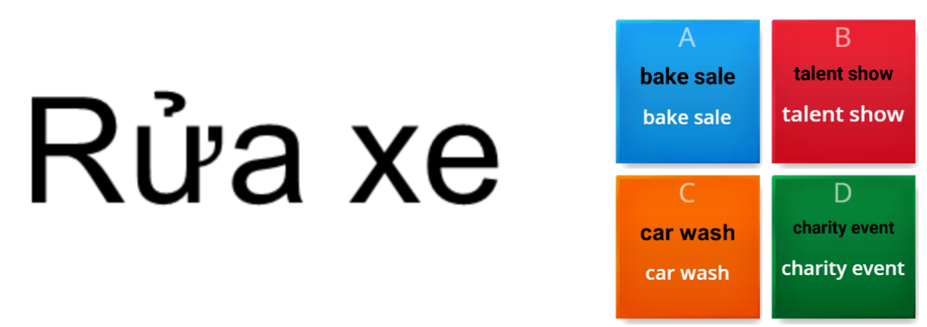
ONLINE PRACTICE

Slide 22
WARP-UP
Unit 4
COMMUNITY SERVICE
Lesson 1: New words + reading
Ms Phương
Zalo: 0966765064
Understanding instructions.
Skimming and scanning for specific information.
Speaking:
- Talking about types of music.

Slide 23
Homework
Learn by hearts vocabularies and make sentences using them.
Do the exercises on page 20 WB
Do the exercise in Tiếng Anh 7 i-Learn Smart World Notebook (page 22)
Prepare the next lesson (page 29 SB)

