Slide 12
Link xem và tải:
https://tailieugiaovien.edu.vn/subject_lesson/su-8/
https://tailieugiaovien.edu.vn/subject_lesson/dia-8/

Slide 27
Link xem và tải:
https://tailieugiaovien.edu.vn/subject_lesson/su-8/
https://tailieugiaovien.edu.vn/subject_lesson/dia-8/

Slide 39
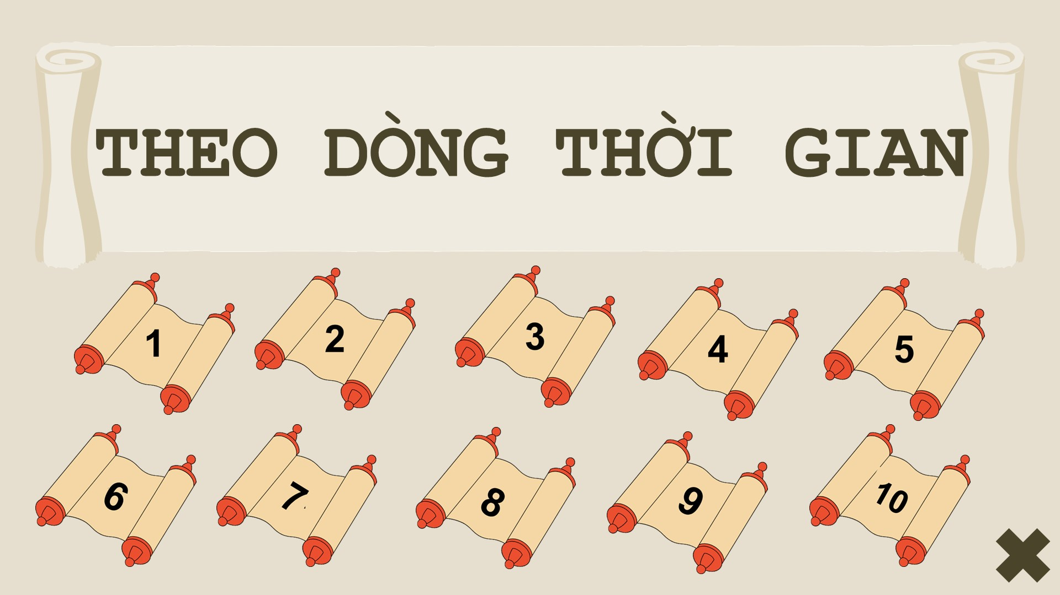

Slide 44
Link xem và tải:
https://tailieugiaovien.edu.vn/subject_lesson/su-8/
https://tailieugiaovien.edu.vn/subject_lesson/dia-8/

Slide 50
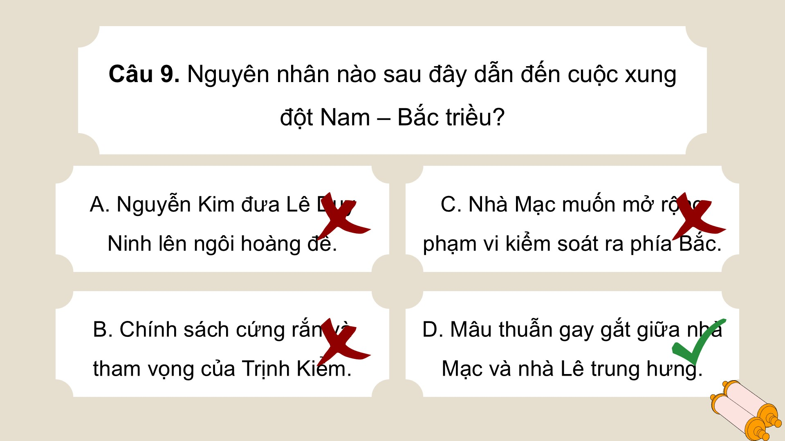

Slide 55
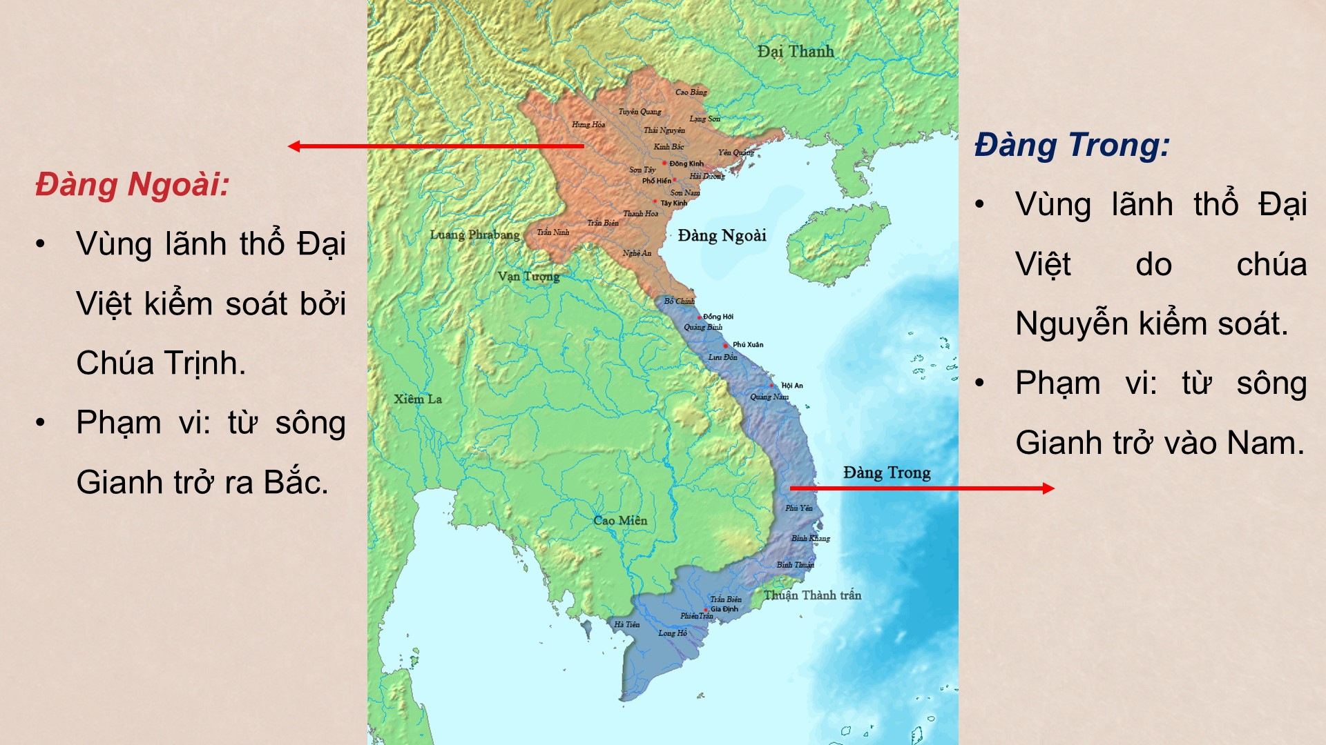

Slide 60
Link xem và tải:
https://tailieugiaovien.edu.vn/subject_lesson/su-8/
https://tailieugiaovien.edu.vn/subject_lesson/dia-8/

