Slide 8
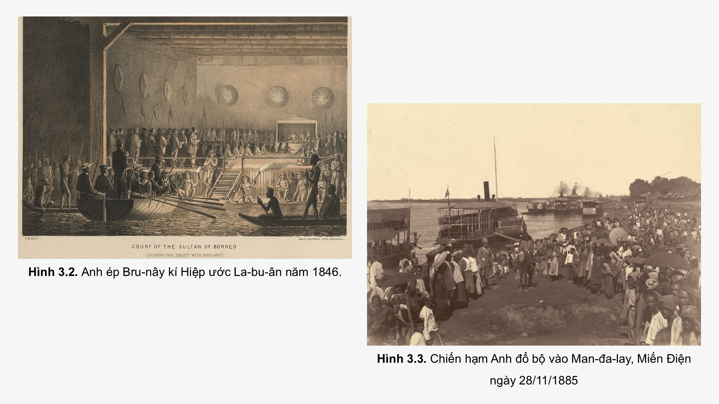

Slide 10
Link xem và tải:
https://tailieugiaovien.edu.vn/subject_lesson/su-8/
https://tailieugiaovien.edu.vn/subject_lesson/dia-8/

Slide 12
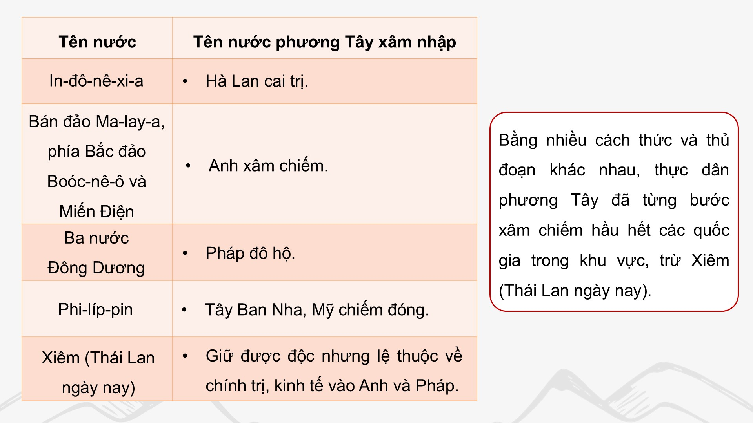

Slide 14
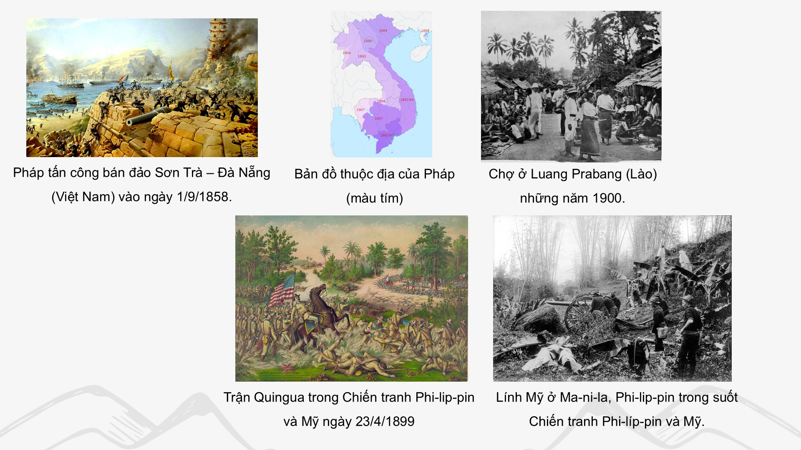

Slide 21
Link xem và tải:
https://tailieugiaovien.edu.vn/subject_lesson/su-8/
https://tailieugiaovien.edu.vn/subject_lesson/dia-8/

Slide 35
Link xem và tải:
https://tailieugiaovien.edu.vn/subject_lesson/su-8/
https://tailieugiaovien.edu.vn/subject_lesson/dia-8/

Slide 46
Link xem và tải:
https://tailieugiaovien.edu.vn/subject_lesson/su-8/
https://tailieugiaovien.edu.vn/subject_lesson/dia-8/

