Slide 10
Link xem và tải:
https://tailieugiaovien.edu.vn/subject_lesson/su-8/
https://tailieugiaovien.edu.vn/subject_lesson/dia-8/

Slide 24
Link xem và tải:
https://tailieugiaovien.edu.vn/subject_lesson/su-8/
https://tailieugiaovien.edu.vn/subject_lesson/dia-8/

Slide 42
Link xem và tải:
https://tailieugiaovien.edu.vn/subject_lesson/su-8/
https://tailieugiaovien.edu.vn/subject_lesson/dia-8/

Slide 53
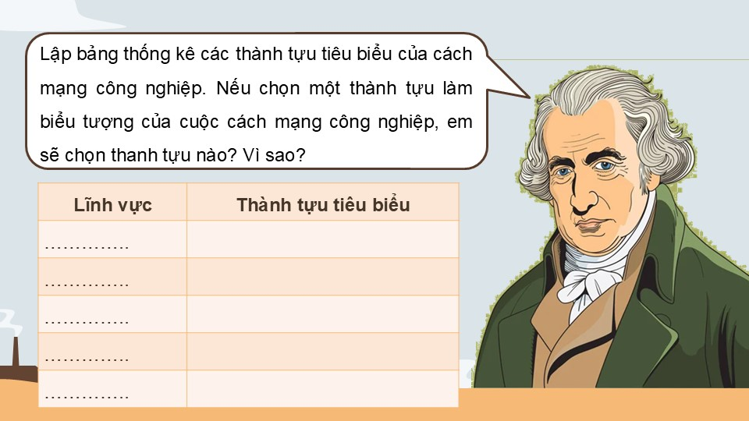

Slide 62
Link xem và tải:
https://tailieugiaovien.edu.vn/subject_lesson/su-8/
https://tailieugiaovien.edu.vn/subject_lesson/dia-8/

