Slide 3
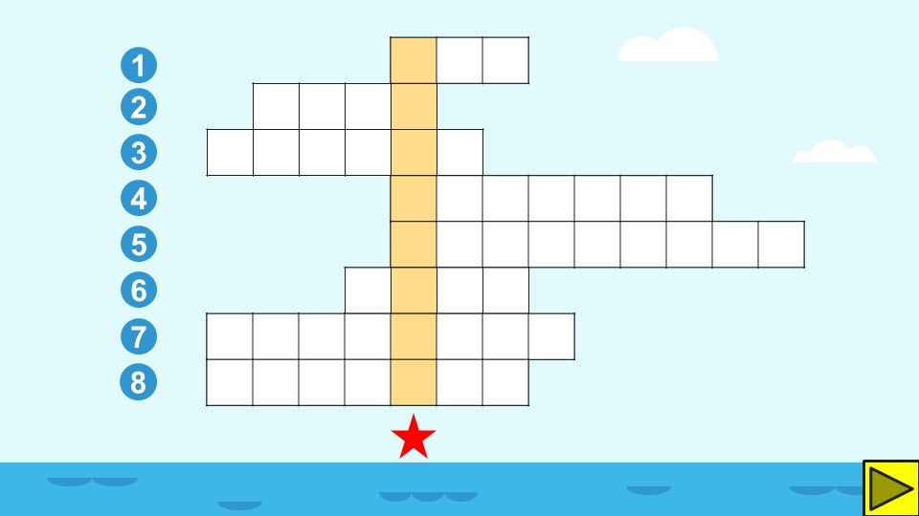

Slide 13
Link xem và tải:
https://tailieugiaovien.edu.vn/subject_lesson/su-9/
https://tailieugiaovien.edu.vn/subject_lesson/dia-9/

Slide 27
Link xem và tải:
https://tailieugiaovien.edu.vn/subject_lesson/su-9/
https://tailieugiaovien.edu.vn/subject_lesson/dia-9/

Slide 36
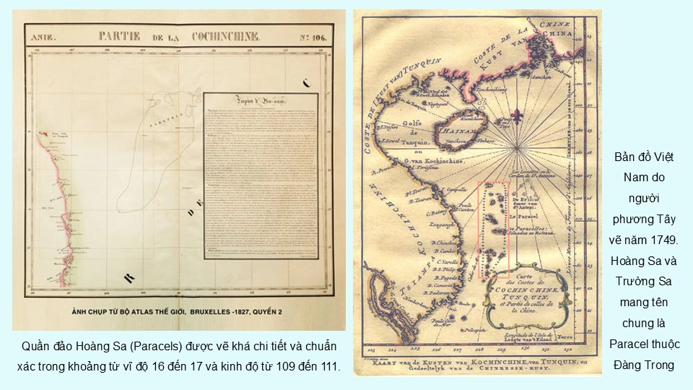

Slide 40
Link xem và tải:
https://tailieugiaovien.edu.vn/subject_lesson/su-9/
https://tailieugiaovien.edu.vn/subject_lesson/dia-9/

Slide 43
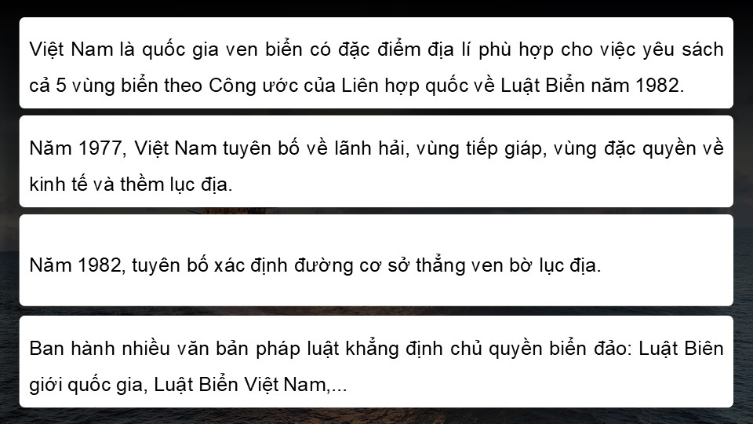

Slide 50
Link xem và tải:
https://tailieugiaovien.edu.vn/subject_lesson/su-9/
https://tailieugiaovien.edu.vn/subject_lesson/dia-9/

