Slide 13
Link xem và tải:
https://tailieugiaovien.edu.vn/subject_lesson/su-9/
https://tailieugiaovien.edu.vn/subject_lesson/dia-9/

Slide 27
Link xem và tải:
https://tailieugiaovien.edu.vn/subject_lesson/su-9/
https://tailieugiaovien.edu.vn/subject_lesson/dia-9/

Slide 37
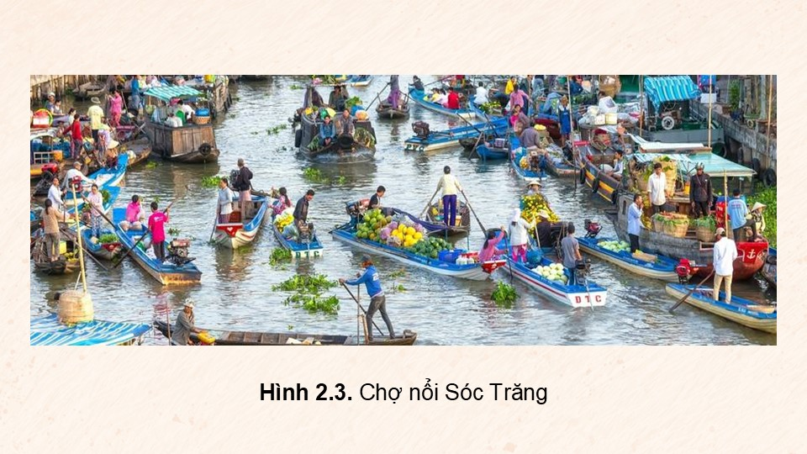

Slide 45
Link xem và tải:
https://tailieugiaovien.edu.vn/subject_lesson/su-9/
https://tailieugiaovien.edu.vn/subject_lesson/dia-9/

Slide 57
Link xem và tải:
https://tailieugiaovien.edu.vn/subject_lesson/su-9/
https://tailieugiaovien.edu.vn/subject_lesson/dia-9/

