Slide 12
Link xem và tải:
https://tailieugiaovien.edu.vn/subject_lesson/su-9/
https://tailieugiaovien.edu.vn/subject_lesson/dia-9/

Slide 22
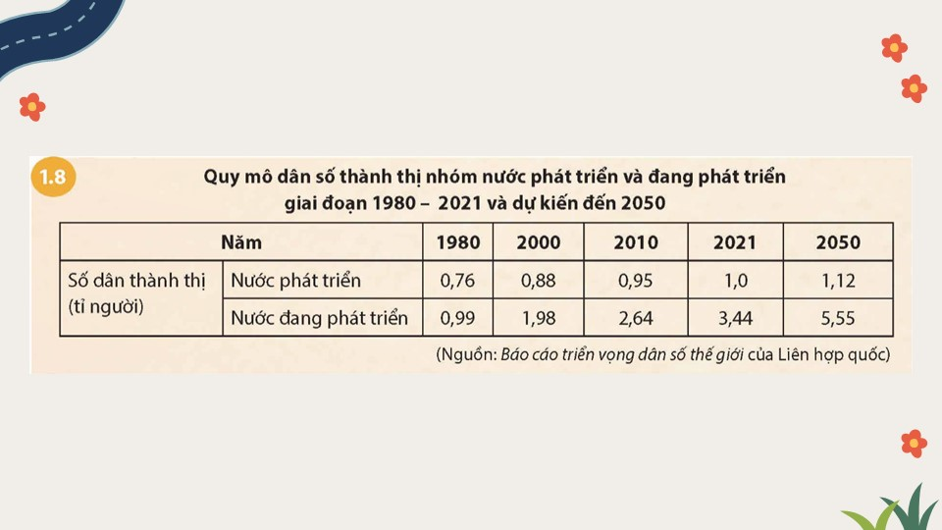

Slide 27
Link xem và tải:
https://tailieugiaovien.edu.vn/subject_lesson/su-9/
https://tailieugiaovien.edu.vn/subject_lesson/dia-9/

Slide 30
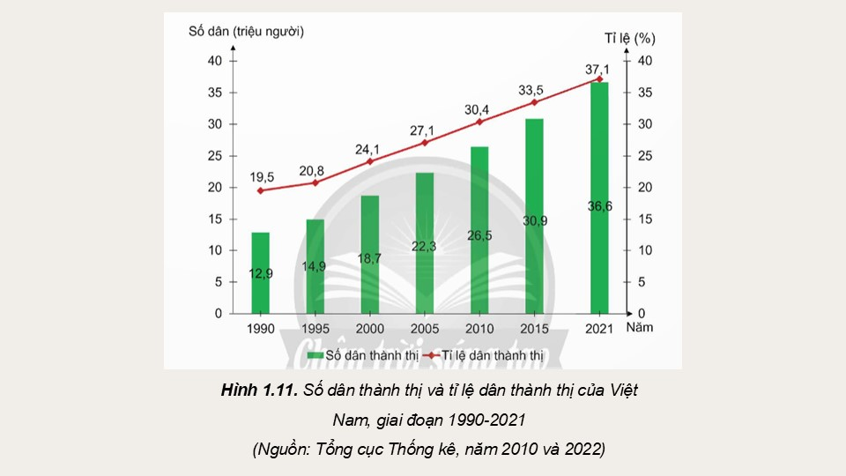

Slide 37
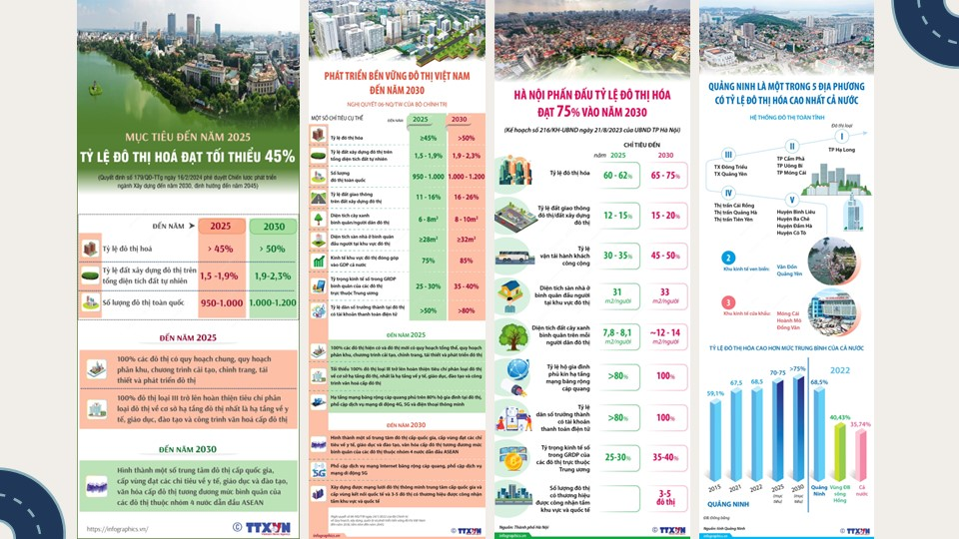

Slide 43
Link xem và tải:
https://tailieugiaovien.edu.vn/subject_lesson/su-9/
https://tailieugiaovien.edu.vn/subject_lesson/dia-9/

Slide 53
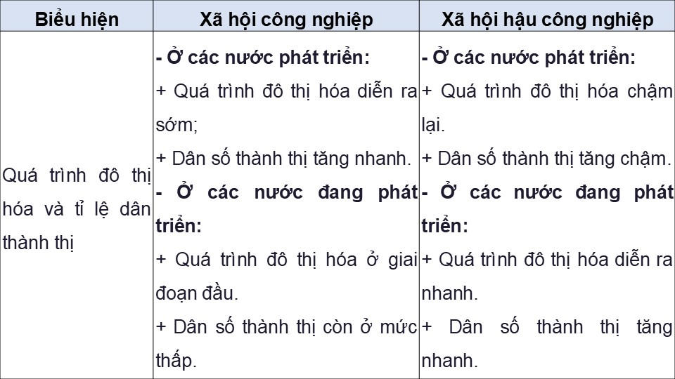

Slide 54
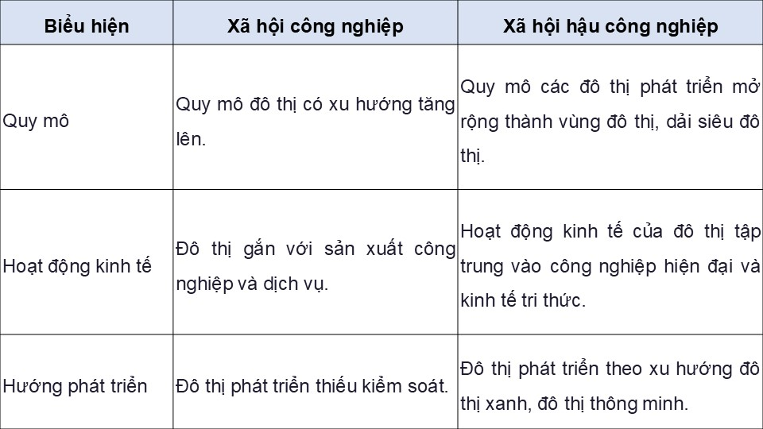

Slide 58
Link xem và tải:
https://tailieugiaovien.edu.vn/subject_lesson/su-9/
https://tailieugiaovien.edu.vn/subject_lesson/dia-9/

