Slide 8
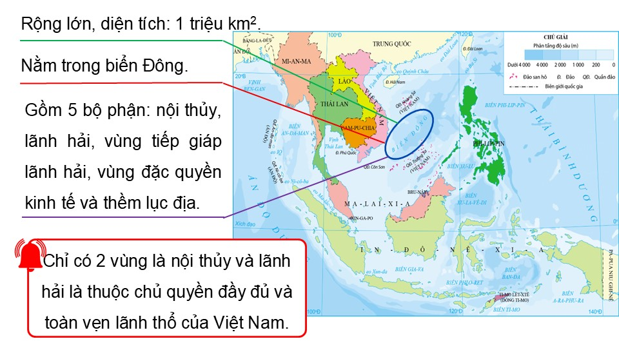

Slide 11
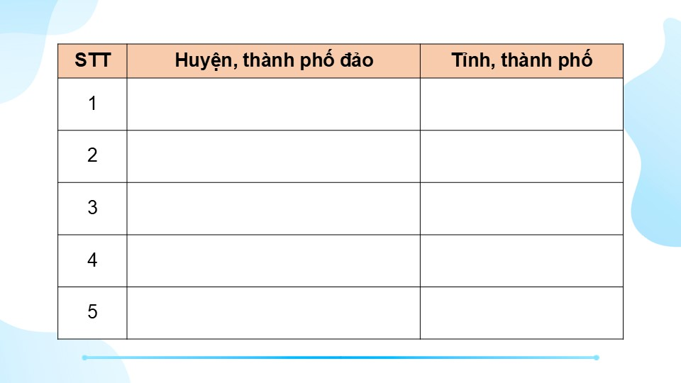

Slide 12
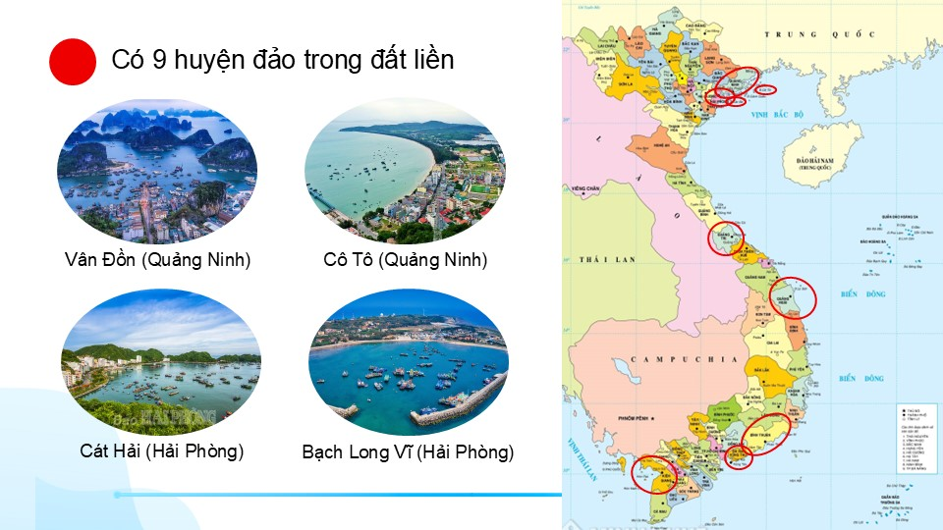

Slide 14
Link xem và tải:
https://tailieugiaovien.edu.vn/subject_lesson/su-9/
https://tailieugiaovien.edu.vn/subject_lesson/dia-9/

Slide 18
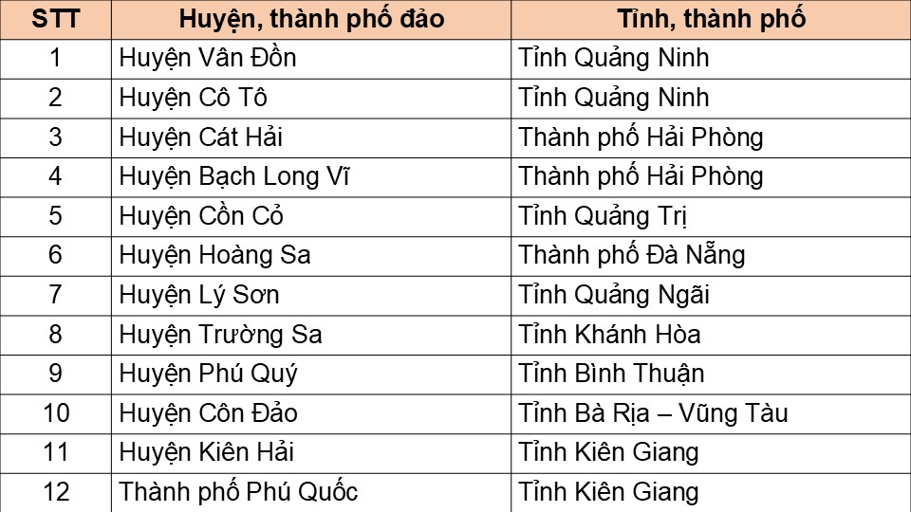

Slide 26
Link xem và tải:
https://tailieugiaovien.edu.vn/subject_lesson/su-9/
https://tailieugiaovien.edu.vn/subject_lesson/dia-9/

Slide 44
Link xem và tải:
https://tailieugiaovien.edu.vn/subject_lesson/su-9/
https://tailieugiaovien.edu.vn/subject_lesson/dia-9/

Slide 67
Link xem và tải:
https://tailieugiaovien.edu.vn/subject_lesson/su-9/
https://tailieugiaovien.edu.vn/subject_lesson/dia-9/

