Slide 7
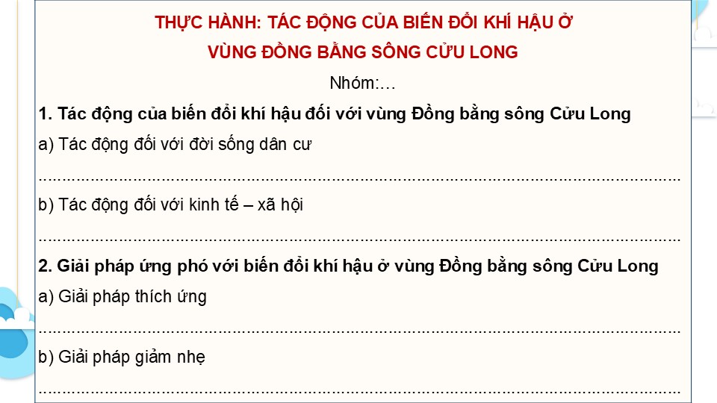

Slide 10
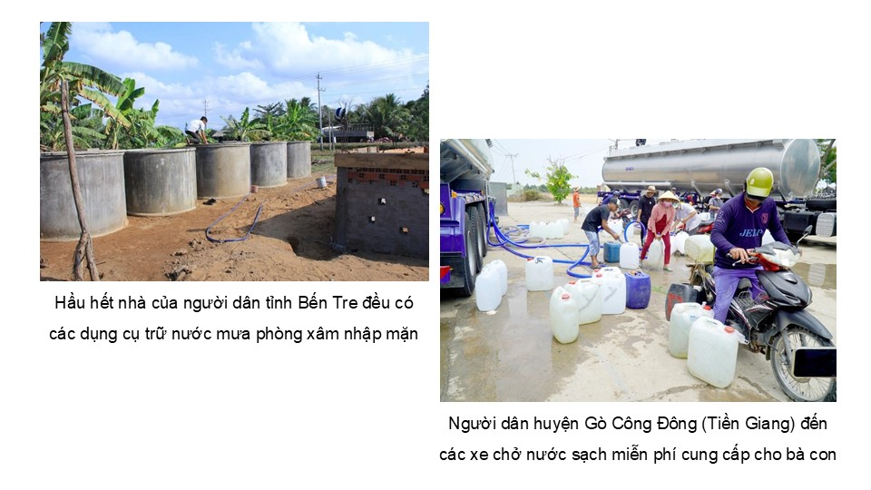

Slide 11
Link xem và tải:
https://tailieugiaovien.edu.vn/subject_lesson/su-9/
https://tailieugiaovien.edu.vn/subject_lesson/dia-9/

Slide 15
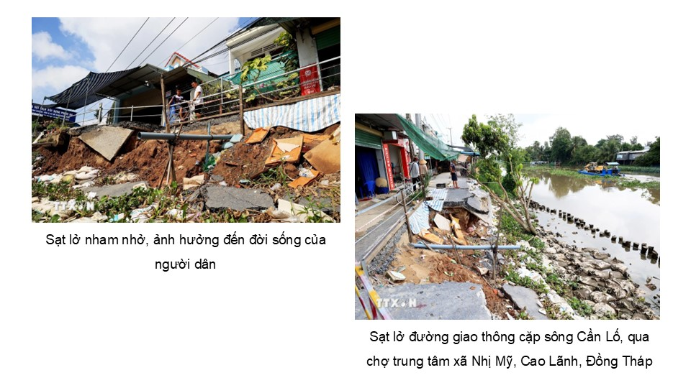

Slide 16
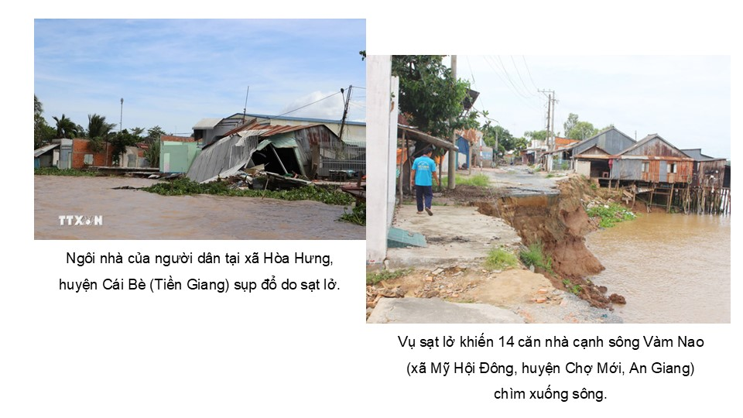

Slide 25
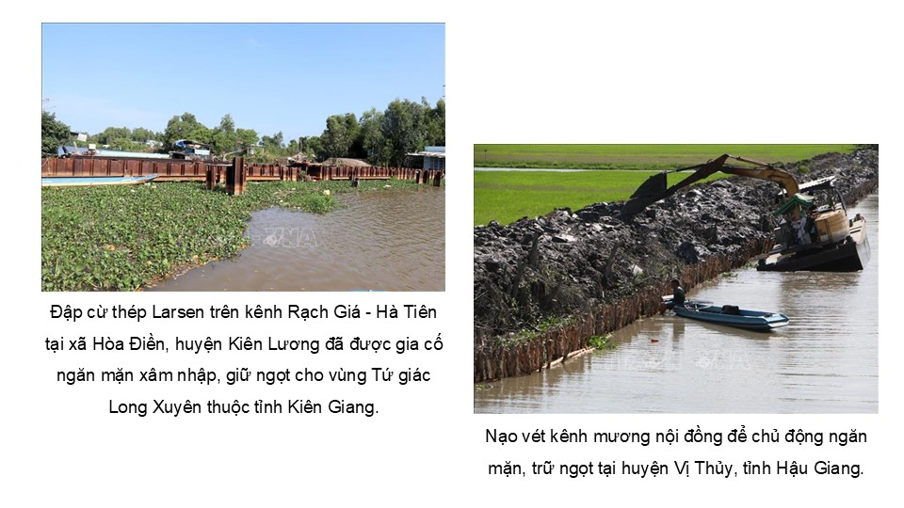

Slide 27
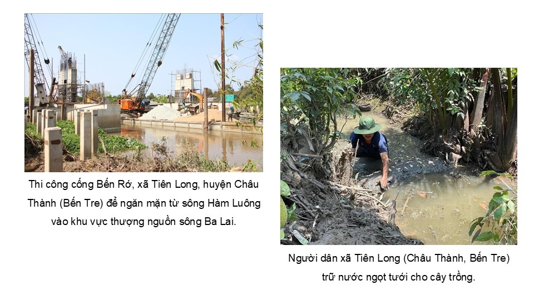

Slide 28
Link xem và tải:
https://tailieugiaovien.edu.vn/subject_lesson/su-9/
https://tailieugiaovien.edu.vn/subject_lesson/dia-9/

Slide 32
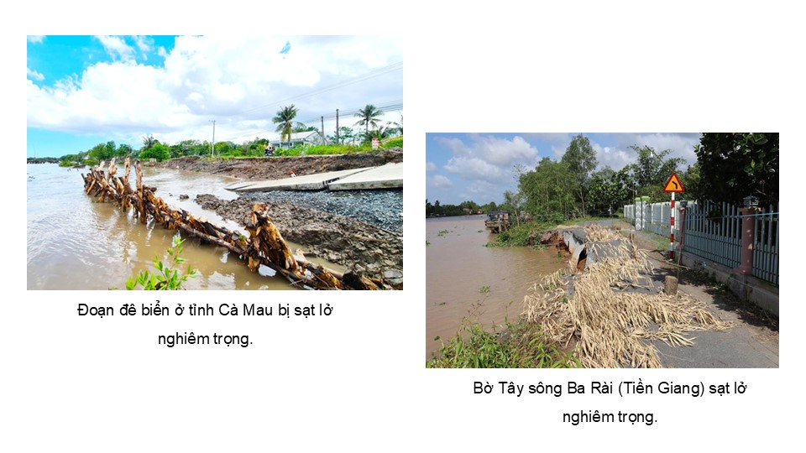

Slide 35
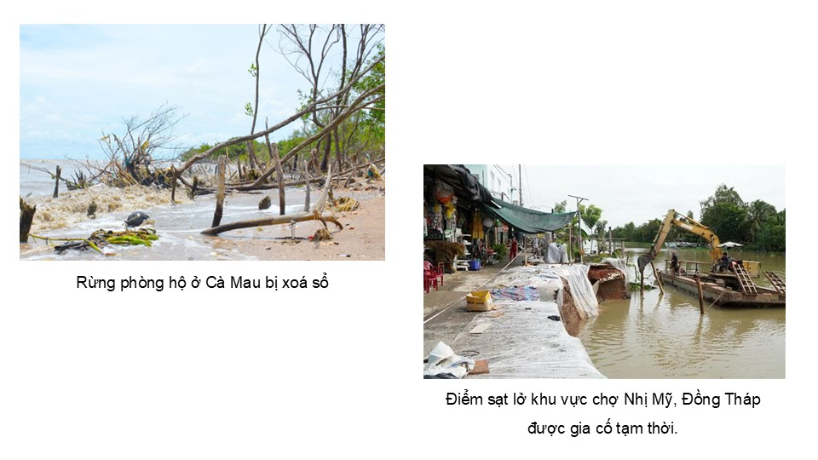

Slide 42
Link xem và tải:
https://tailieugiaovien.edu.vn/subject_lesson/su-9/
https://tailieugiaovien.edu.vn/subject_lesson/dia-9/

Slide 48
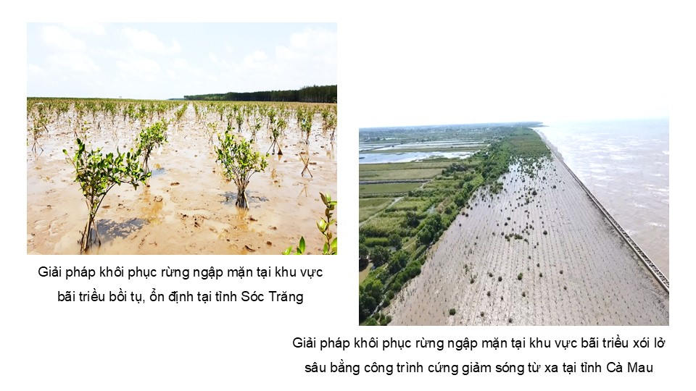

Slide 51
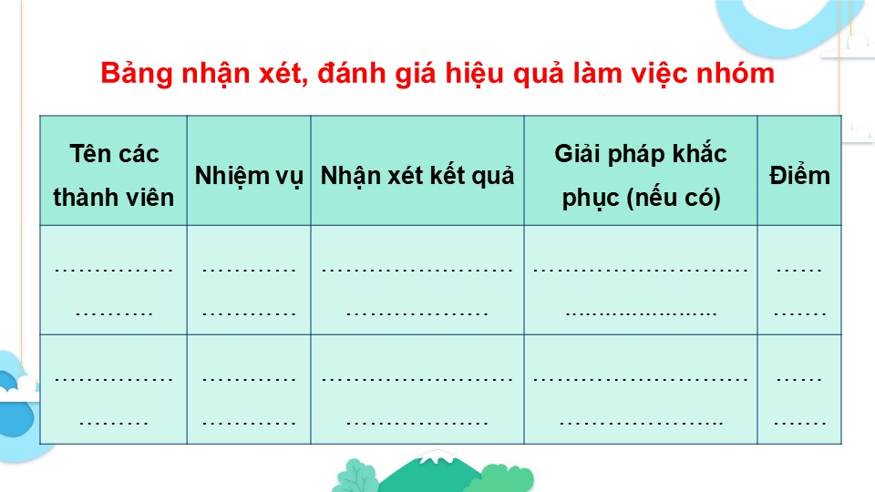

Slide 54
Link xem và tải:
https://tailieugiaovien.edu.vn/subject_lesson/su-9/
https://tailieugiaovien.edu.vn/subject_lesson/dia-9/

