Slide 13
Link xem và tải:
https://tailieugiaovien.edu.vn/subject_lesson/su-9/
https://tailieugiaovien.edu.vn/subject_lesson/dia-9/

Slide 22
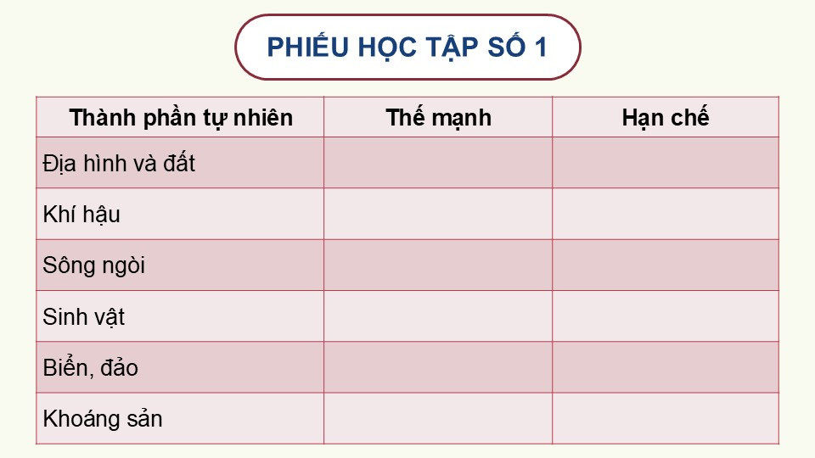

Slide 25
Link xem và tải:
https://tailieugiaovien.edu.vn/subject_lesson/su-9/
https://tailieugiaovien.edu.vn/subject_lesson/dia-9/

Slide 28
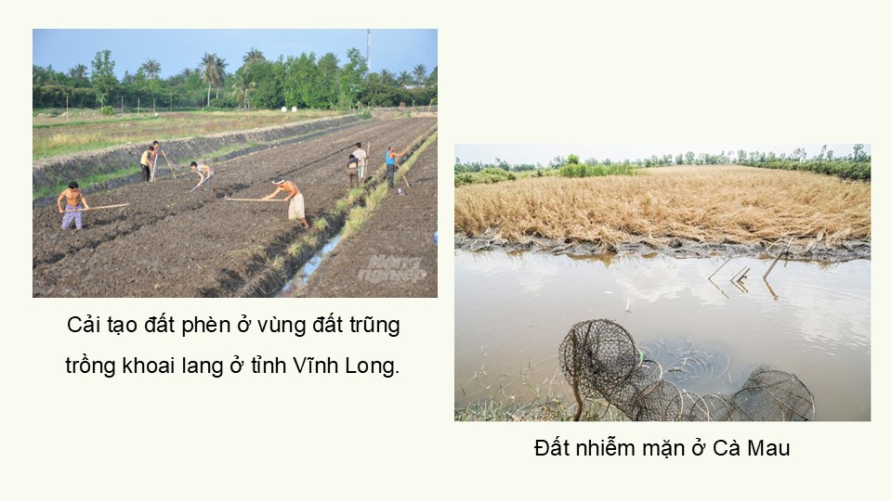

Slide 30
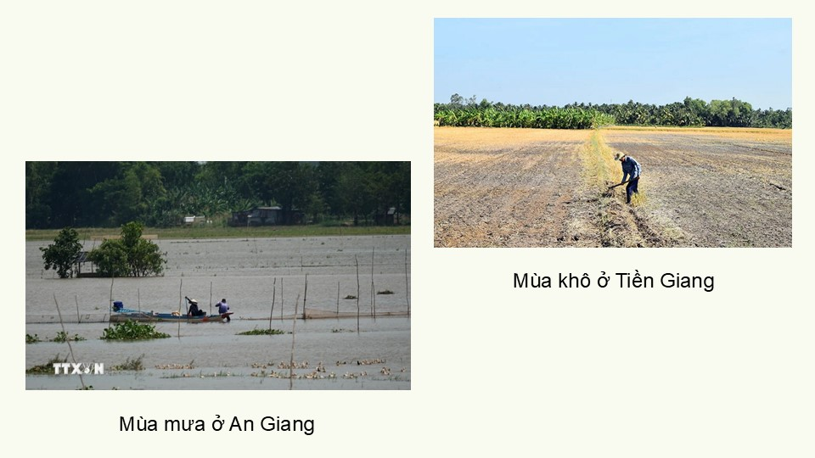

Slide 32
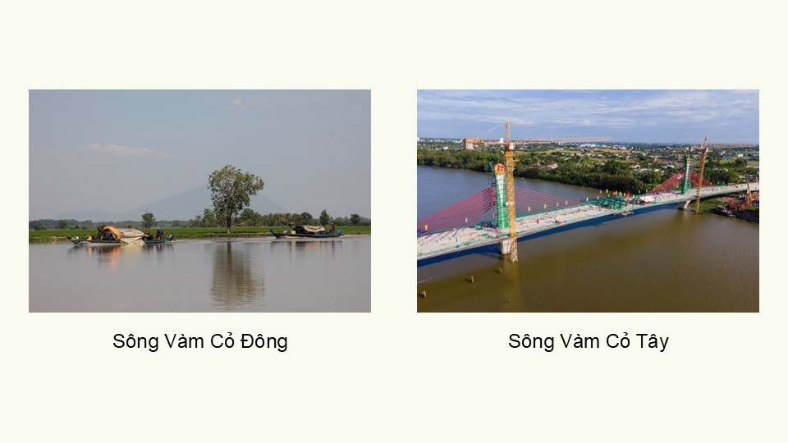

Slide 33
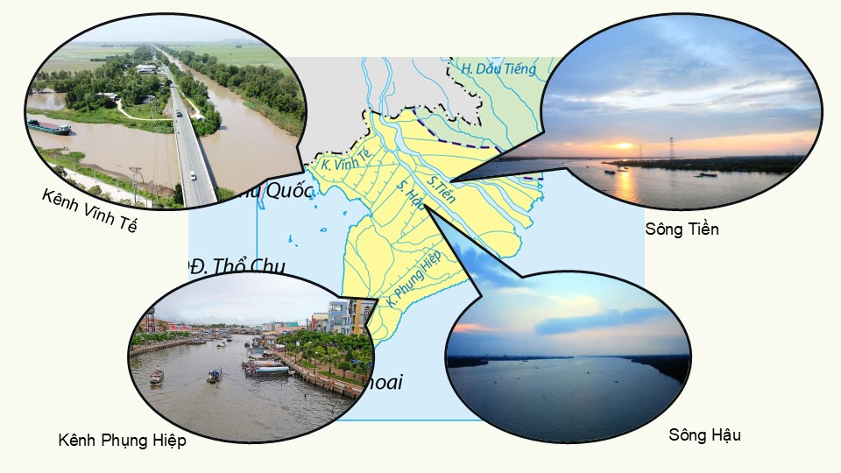

Slide 41
Link xem và tải:
https://tailieugiaovien.edu.vn/subject_lesson/su-9/
https://tailieugiaovien.edu.vn/subject_lesson/dia-9/

Slide 44
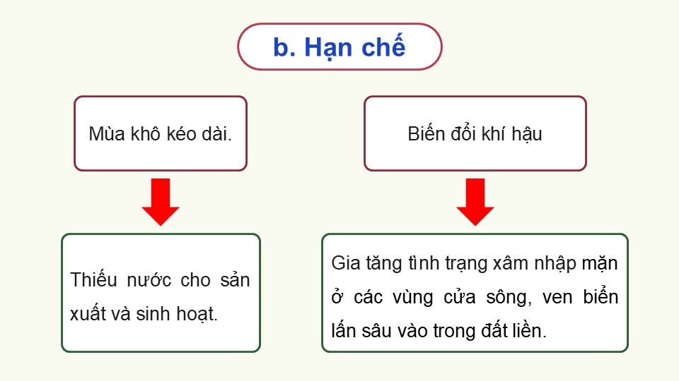

Slide 50
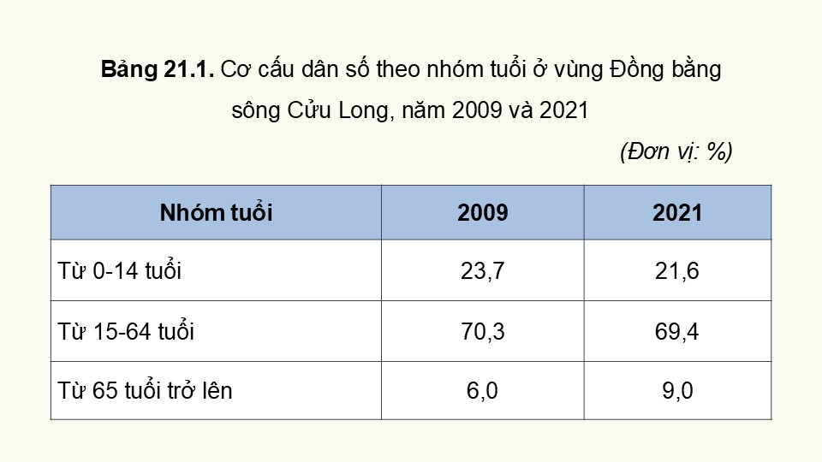

Slide 51
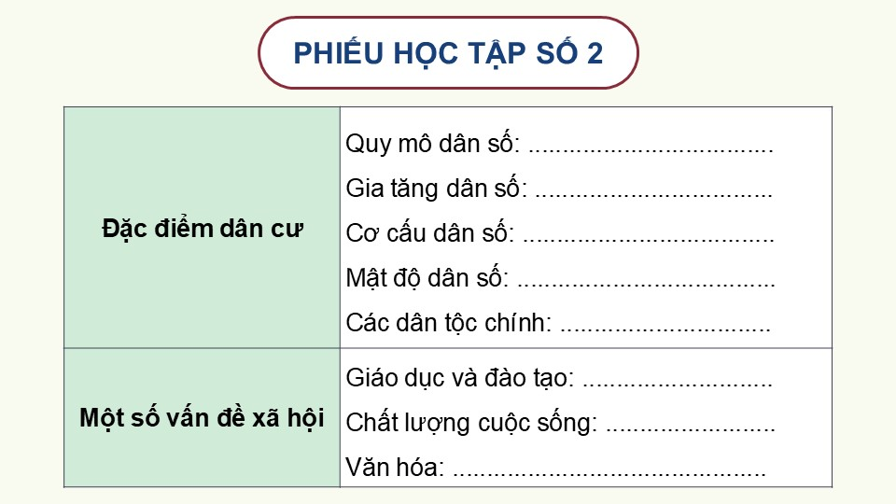

Slide 53
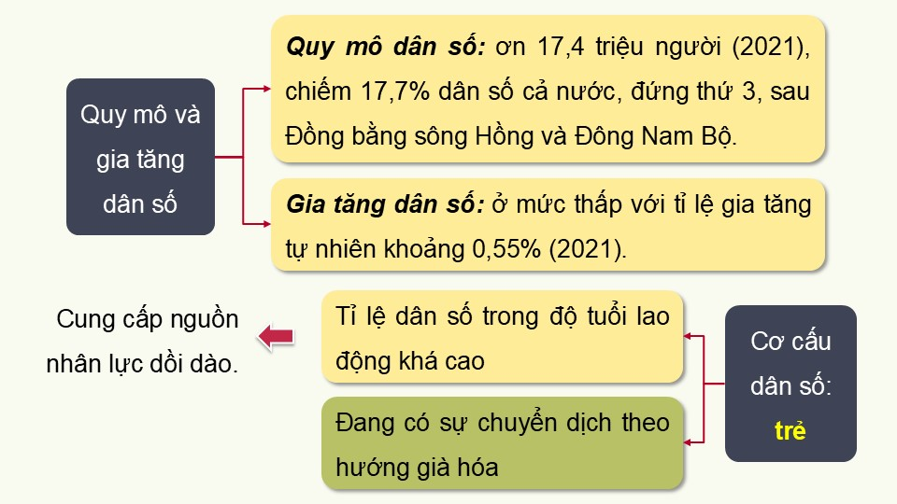

Slide 57
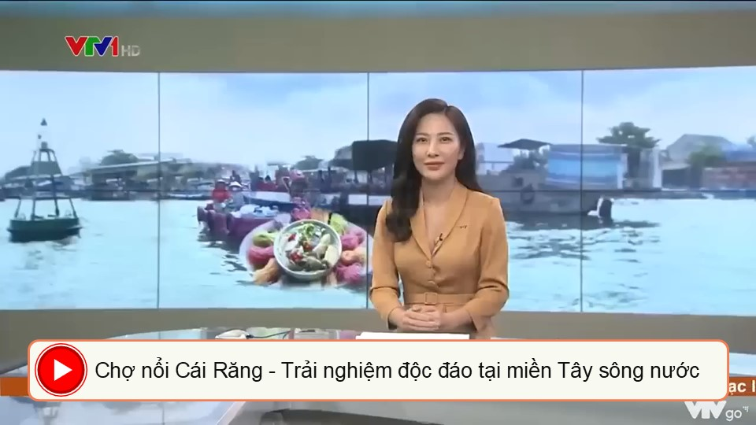

Slide 59
Link xem và tải:
https://tailieugiaovien.edu.vn/subject_lesson/su-9/
https://tailieugiaovien.edu.vn/subject_lesson/dia-9/

