Slide 7
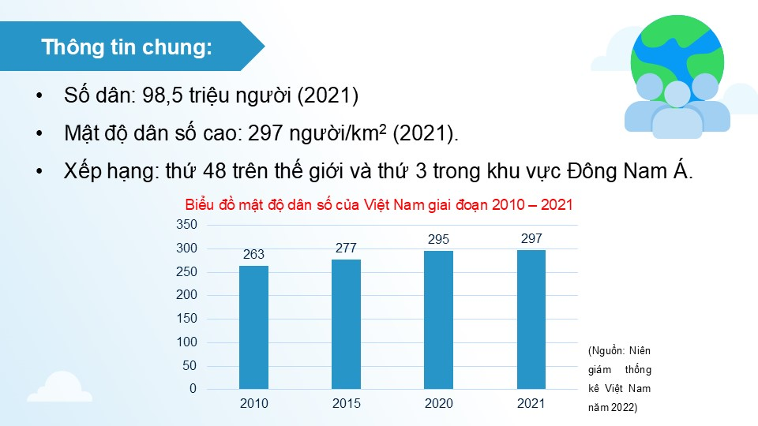

Slide 9
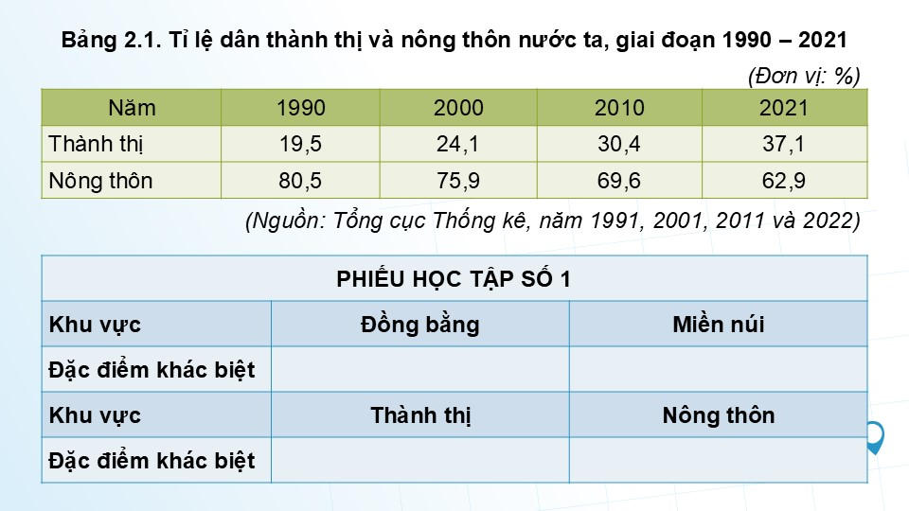

Slide 11
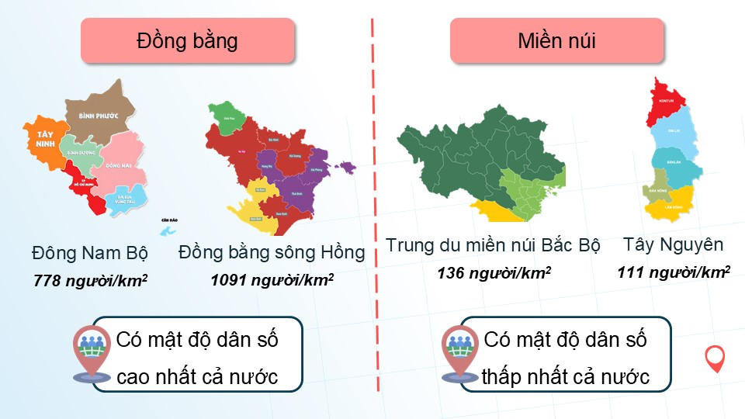

Slide 13
Link xem và tải:
https://tailieugiaovien.edu.vn/subject_lesson/su-9/
https://tailieugiaovien.edu.vn/subject_lesson/dia-9/

Slide 17
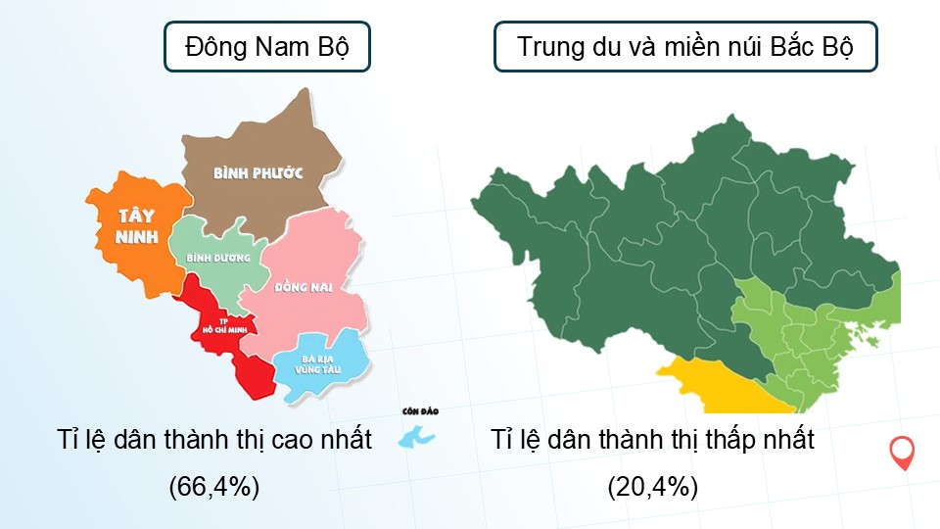

Slide 24
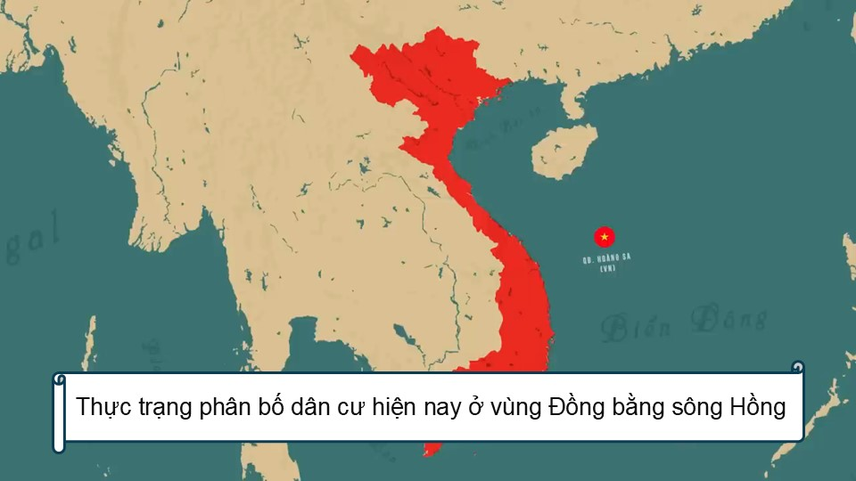

Slide 26
Link xem và tải:
https://tailieugiaovien.edu.vn/subject_lesson/su-9/
https://tailieugiaovien.edu.vn/subject_lesson/dia-9/

Slide 40
Link xem và tải:
https://tailieugiaovien.edu.vn/subject_lesson/su-9/
https://tailieugiaovien.edu.vn/subject_lesson/dia-9/

Slide 45
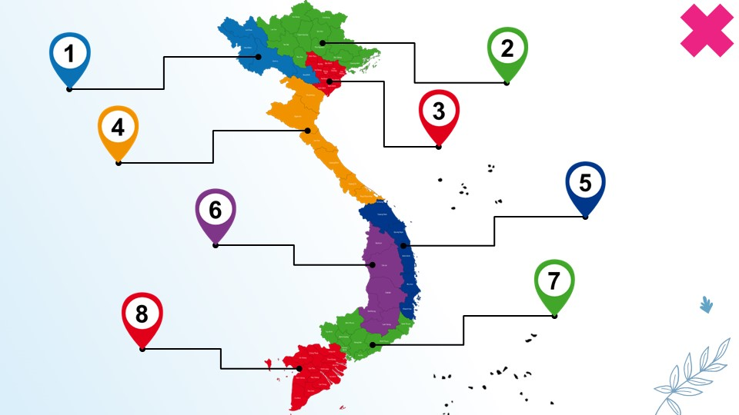

Slide 54
Link xem và tải:
https://tailieugiaovien.edu.vn/subject_lesson/su-9/
https://tailieugiaovien.edu.vn/subject_lesson/dia-9/

Slide 62
Link xem và tải:
https://tailieugiaovien.edu.vn/subject_lesson/su-9/
https://tailieugiaovien.edu.vn/subject_lesson/dia-9/

