Slide 5
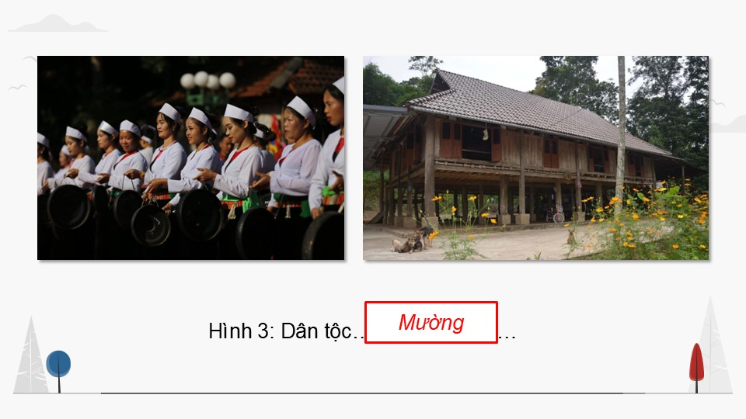

Slide 7
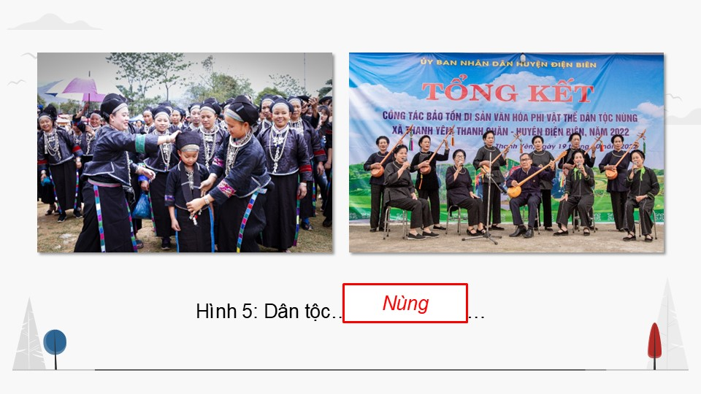

Slide 14
Link xem và tải:
https://tailieugiaovien.edu.vn/subject_lesson/su-9/
https://tailieugiaovien.edu.vn/subject_lesson/dia-9/

Slide 20
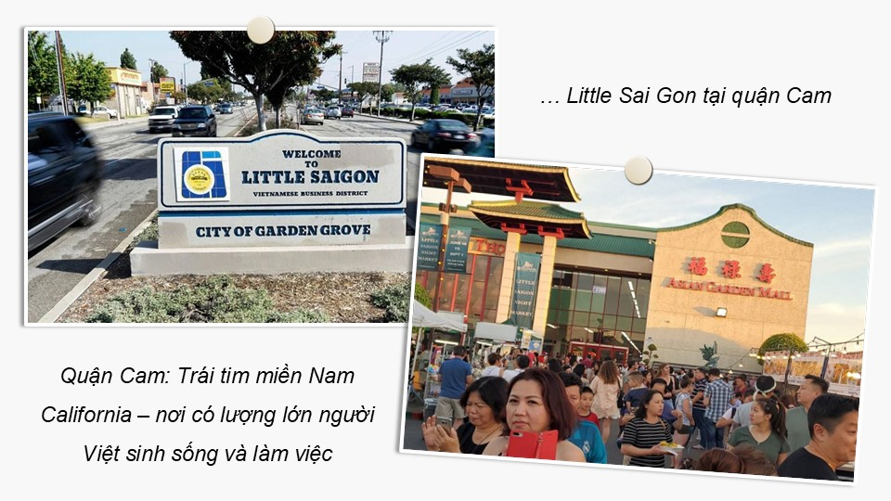

Slide 24
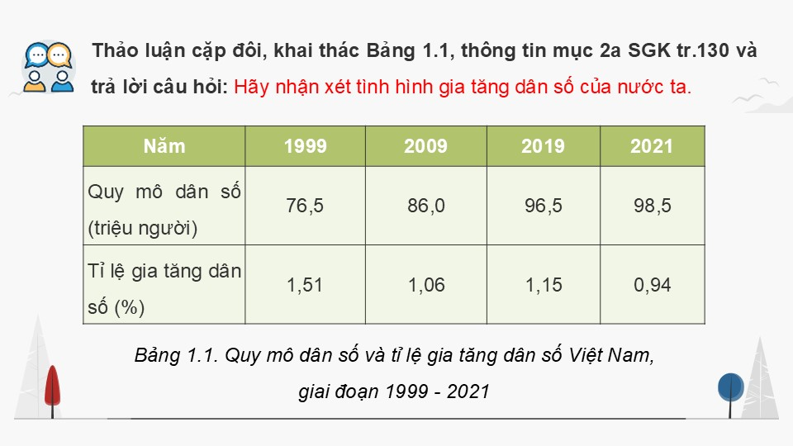

Slide 29
Link xem và tải:
https://tailieugiaovien.edu.vn/subject_lesson/su-9/
https://tailieugiaovien.edu.vn/subject_lesson/dia-9/

Slide 31
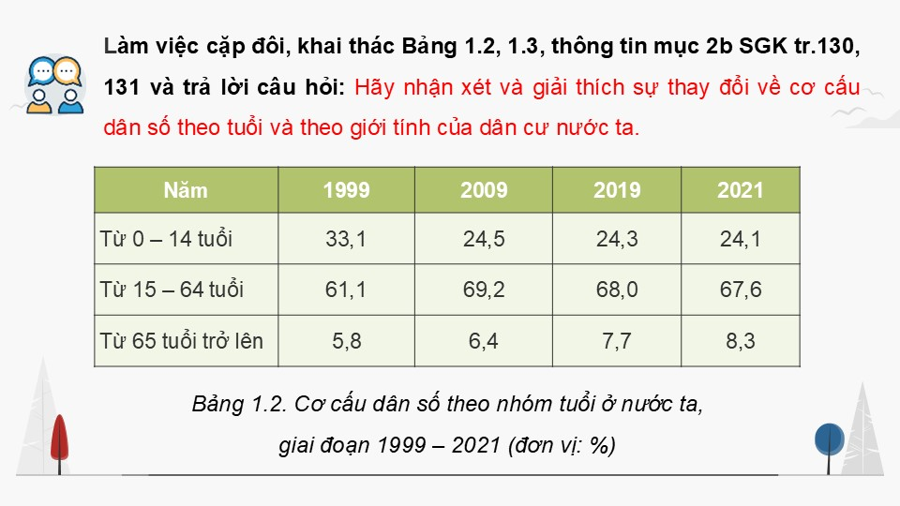

Slide 33
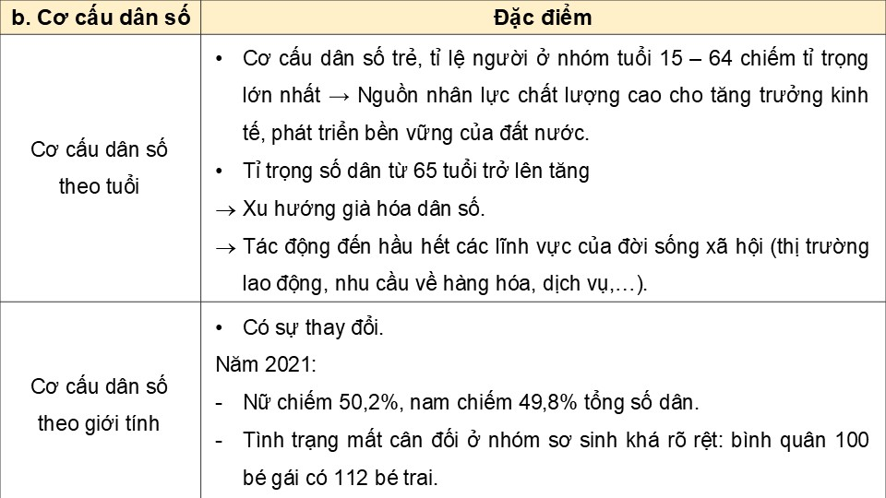

Slide 36
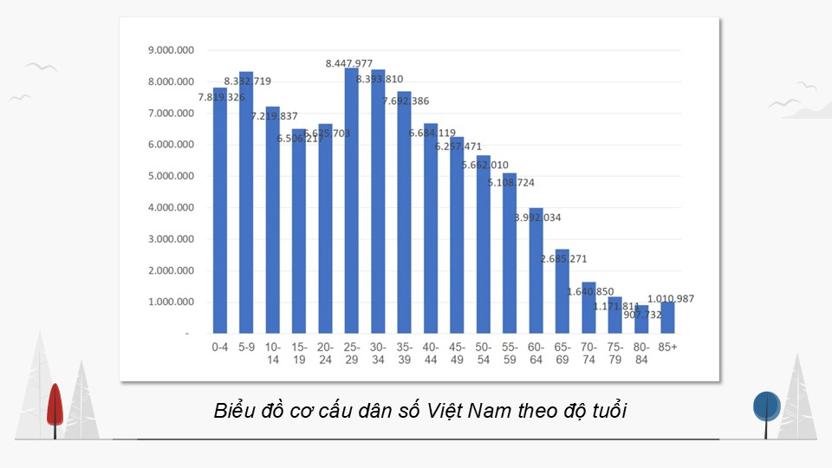

Slide 37
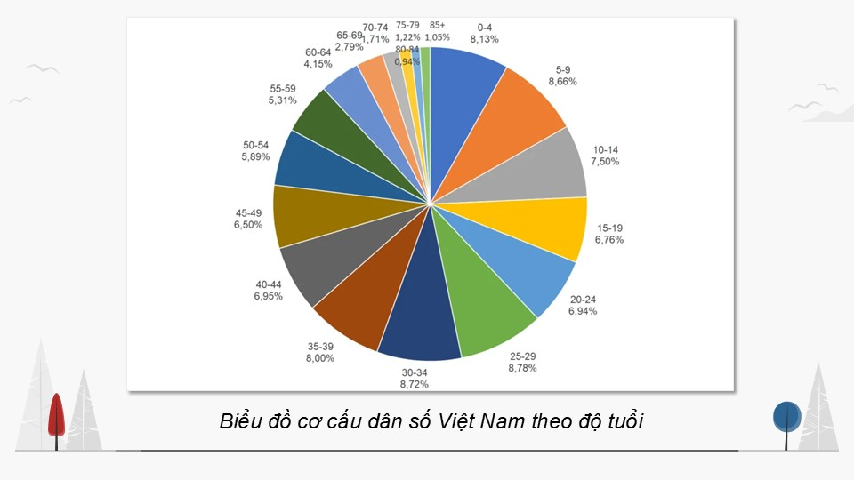

Slide 39
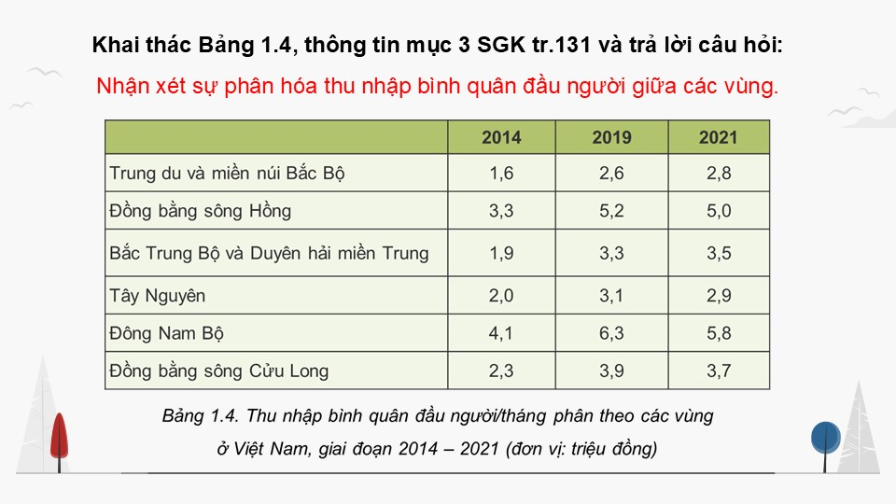

Slide 45
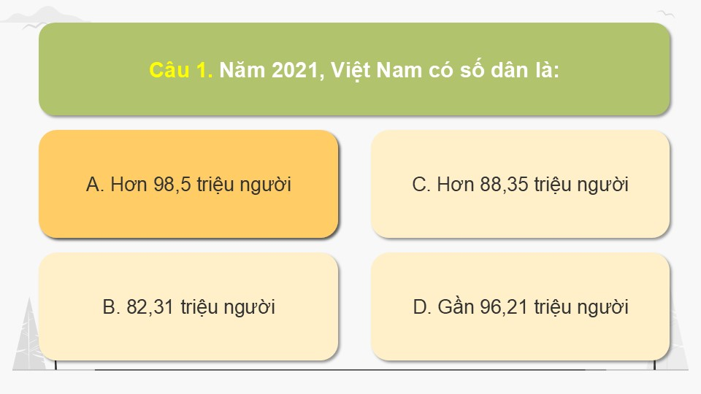

Slide 46
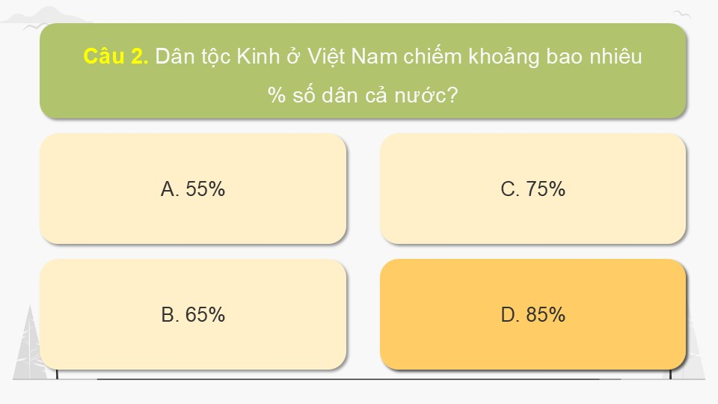

Slide 47
Link xem và tải:
https://tailieugiaovien.edu.vn/subject_lesson/su-9/
https://tailieugiaovien.edu.vn/subject_lesson/dia-9/

Slide 61
Link xem và tải:
https://tailieugiaovien.edu.vn/subject_lesson/su-9/
https://tailieugiaovien.edu.vn/subject_lesson/dia-9/

