Slide 2


Unit
7
TELEVISION
LESSON 3: A CLOSER LOOK 2
GRAMMAR
Wh-questions
Conjunctions in compound sentences
1

Slide 3
LESSON 3: A CLOSER LOOK 2
LESSON 1: GETTING STARTED
WARM-UP
Word cloud
Task 1: Read the conversation and underline the question words.
Task 2: Match each question word with the information it needs.
Task 3: Use the question words in the box to complete the conversations. Then listen and check your answers.
WH-QUESTION WORDS
CONJUNCTIONS IN COMPOUND SENTENCES
Task 4: Match the beginnings with the endings.
Task 5: Use and, but or so to complete the sentences.
CONSOLIDATION
Wrap-up
Homework

Slide 4

WARM-UP
WORD CLOUD
QUESTION WORDS
Notes:
- Teacher creates a request “Name all the question words that you know” on menti.com.
- Link: https://www.mentimeter.com/s/24c25f2cb5a01e41b5bc5cab067a17eb/6bc323ea42ce/edit

Slide 5
01
Wh-questions

Slide 6
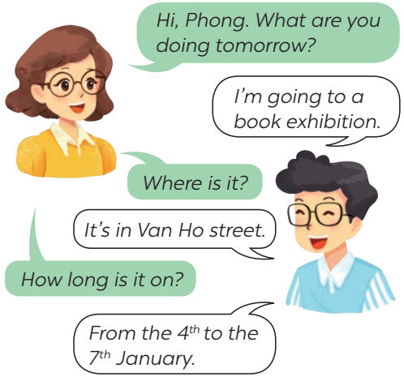
WH-QUESTIONS WORDS
1
Read the conversation and underline the question words.

Slide 7
WH-QUESTIONS WORDS
2
Match each question word with the information it needs.
person
When
thing
How many
place
How often
What
repetition
time
Where
reason
Who
number
Why

Slide 8

WH-QUESTIONS WORDS
3
Use the question words in the box to complete the conversations. Then listen and check your answers.
When Who What Where How often
Conversation 1:
﻿A: __________ do you watch TV?
B: Not very often. Two or three times a week.
A: _______ do you watch?
B: It depends. but i like talent shows the most
How often
What

Slide 9
WH-QUESTIONS WORDS
3
Use the question words in the box to complete the conversations. Then listen and check your answers.
When Who What Where How often
Conversation 2:
﻿A: ﻿_______ do you like the most in Doraemon?
B: ﻿Nobita. he’s so funny.
Who

Slide 10
WH-QUESTIONS WORDS
3
Use the question words in the box to complete the conversations. Then listen and check your answers.
When Who What Where How often
Conversation 3:
﻿﻿A: _______ do you play football?
B: Usually on Saturday or Sunday.
A: _______ do you play?
B: In the yard.
When
Where

Slide 11
02
Conjunction but, so, and

Slide 12
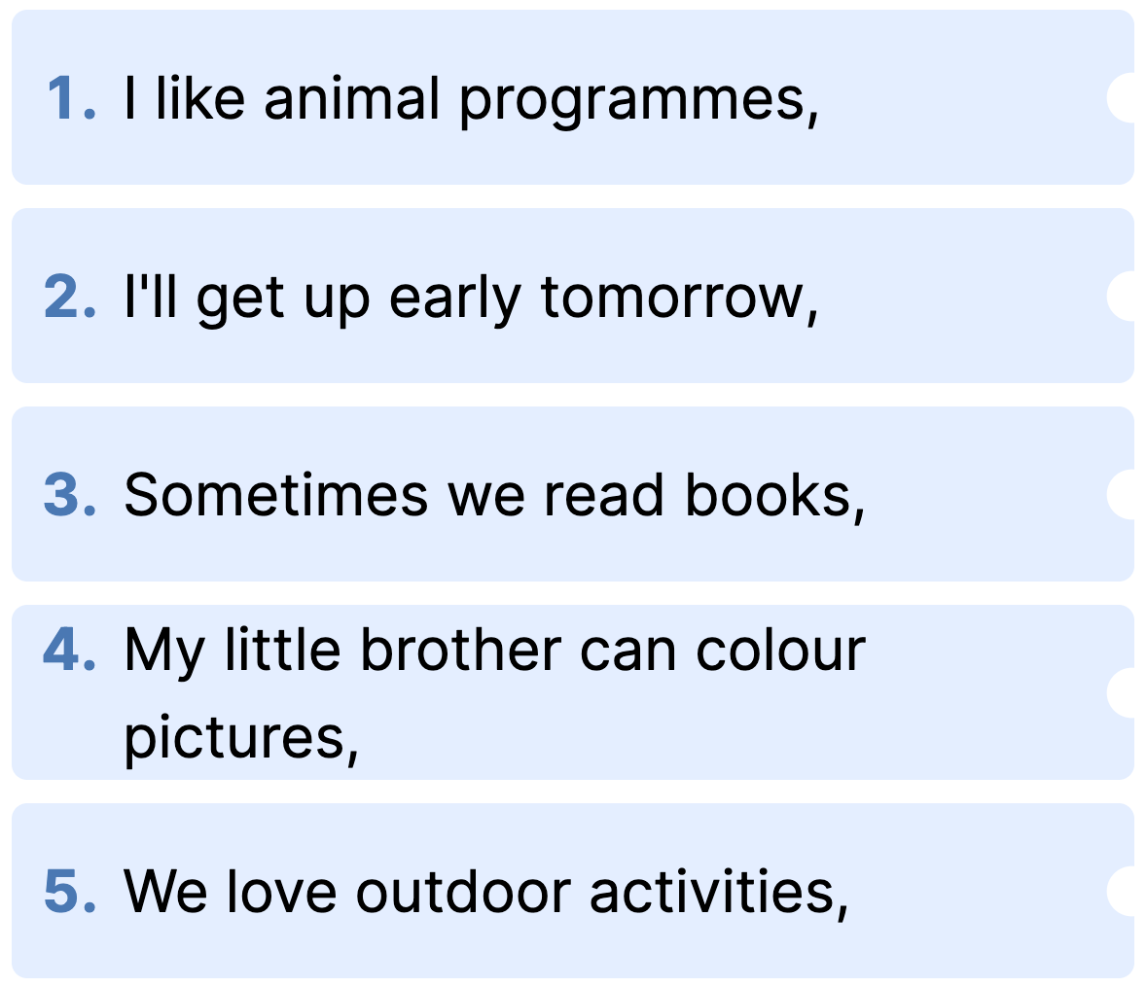
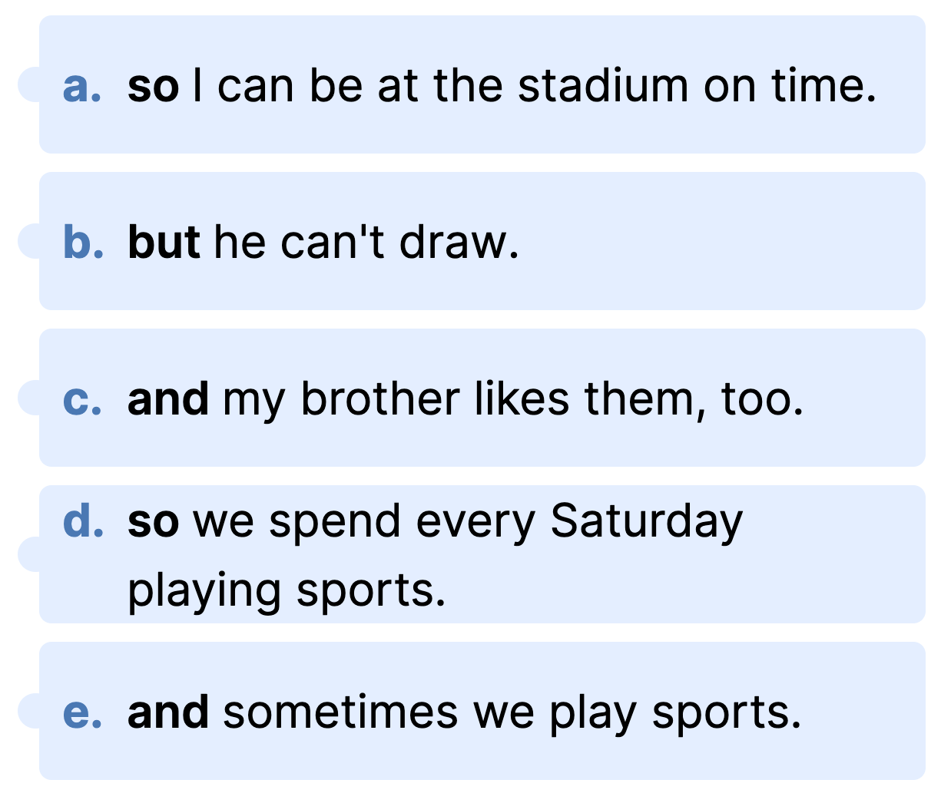
CONJUNCTIONS IN COMPOUND SENTENCES
4
Match the beginnings with the endings.

Slide 13
CONJUNCTIONS IN COMPOUND SENTENCES
4
Match the beginnings with the endings.

Slide 14
CONJUNCTIONS IN COMPOUND SENTENCES
5
Use and, but or so to complete the sentences.
﻿1. I’m tired, _______ I’ll go to bed early.
2. My sister is good at school, _______ I'm not.
3. We trained hard, _______ we won the game.
4. The programme is interesting, _______ it’s too long.
5. I'll write him some instructions, _______ I hope he’ll follow them.
so
but
so
but
and

Slide 15

CONSOLIDATION
1
Wrap-up
What have we learnt in this lesson?
Wh-questions?
Conjunctions but, and, so?

Slide 16

CONSOLIDATION
2
Homework
- Do exercises in the Workbook.
- Make 7 questions using 7 question words in Exercise 2 and answer the questions.

Slide 17






Website: hoclieu.vn
Fanpage: facebook.com/www.tienganhglobalsuccess.vn/

