Slide 2
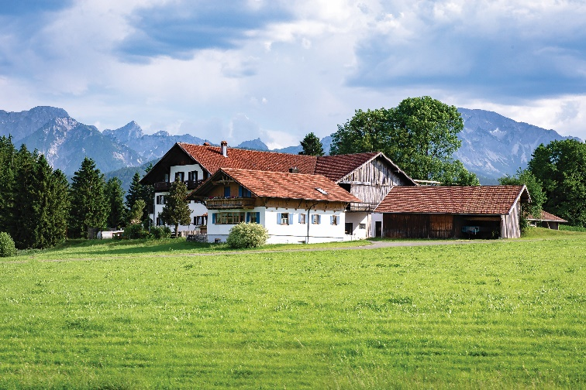
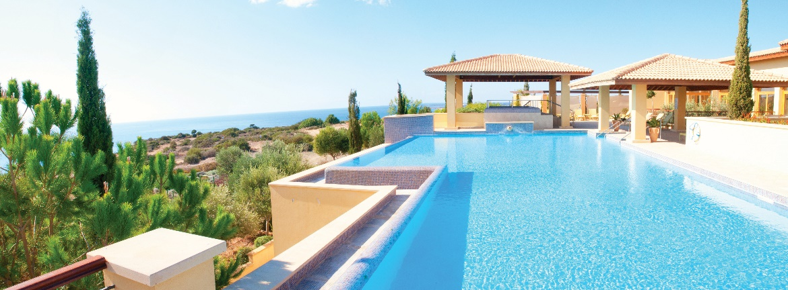
Listen to Nick and Linda talking about their dream houses. Which house would each prefer? Write their names under the correct pictures.
a
b
Nick: a flat in the city
c
Linda: a villa by the sea, with a swimming pool and a garden)
Audio script

Slide 3
AUDIO SCRIPT
Nick: Can you tell me about your dream house, Linda?
Linda: Well, it's a big villa by the sea. It has a view of the sea. It has a swimming pool and a garden.
Nick: My dream house is different.
Linda: Really? What's it like?
Nick: It's a beautiful flat in the city. It has a park view in front and a city view at the back.
Linda: Oh, sounds great!
Nick: It has a super smart TV. I can watch films from other planets.
Linda: That sounds great, too. But I think it'll be...

Slide 4
Listen to the conversation again. What is important to Linda? What is important to Nick? Tick () the columns.
 | Linda | Nick
1. park view
2. city view
3. sea view
4. swimming pool
5. garden





Audio script

Slide 5
AUDIO SCRIPT
Nick: Can you tell me about your dream house, Linda?
Linda: Well, it's a big villa by the sea. It has a view of the sea. It has a swimming pool and a garden.
Nick: My dream house is different.
Linda: Really? What's it like?
Nick: It's a beautiful flat in the city. It has a park view in front and a city view at the back.
Linda: Oh, sounds great!
Nick: It has a super smart TV. I can watch films from other planets.
Linda: That sounds great, too. But I think it'll be...

Slide 6
Listen again and answer the questions about their dream houses.
1.
What type of house does Linda have?
She has a big villa.
2.
Where is her house?
Her house / It is by the sea.
3.
What is around her house?
There’s a swimming pool and a garden around her house.
4.
What type of house does Nick have?
He has a flat.
5.
Where is it?
It’s in the city.
Audio script

Slide 7
AUDIO SCRIPT
Nick: Can you tell me about your dream house, Linda?
Linda: Well, it's a big villa by the sea. It has a view of the sea. It has a swimming pool and a garden.
Nick: My dream house is different.
Linda: Really? What's it like?
Nick: It's a beautiful flat in the city. It has a park view in front and a city view at the back.
Linda: Oh, sounds great!
Nick: It has a super smart TV. I can watch films from other planets.
Linda: That sounds great, too. But I think it'll be...

Slide 8
Writing

Slide 9
Work in pairs. Discuss your dream house, and fill the table.
Example:
A: What type of dream house is it?
B: It’s a palace.
A: Where is it?
B: It’s in the mountains
....
Types of house: | palace
Location: | in the mountains
Number of rooms: | _______________________
Appliances in the house: | _______________________

Slide 10
Use the information in 4 to write a paragraph of about 50 words about your dream house.
Example:
My dream house is a big palace. It is in the mountains. ___________________
________________________________ ________________________________ ________________________________

Slide 11
Use the information in 4 to write a paragraph of about 50 words about your dream house.
Sample paragraph
My dream house is a big palace. It is in the mountains. It is surrounded by lots of trees. It has seven rooms: three bedrooms, two bathrooms, one kitchen and one living room. There is a large swimming pool in front of it. I have some robots in the palace. They help me to clean the floor, cook meals, water flowers...
I am happy to live in my palace.

