Slide 2
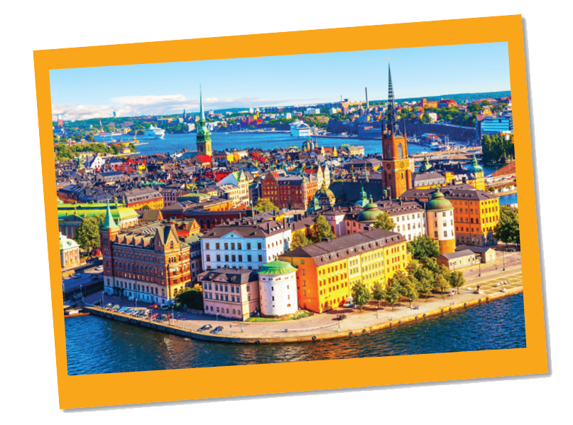
Work in groups. Look at the postcard and discuss.
Reading
Love from Sweden

Slide 3
1.
When do people write a postcard?
2.
What do they often write on a postcard?

Slide 4
Read the postcard and answer the questions.
September 6
Dear Grandpa and Grandma,
To: Grandpa & Grandma
Hoan Kiem, Ha Noi, Viet Nam
Stockholm is fantastic!
Its weather is perfect, sunny all the time! Our hotel is good. It has a swimming pool and a gym. It offers delicious breakfast. Yesterday Mum, Dad and I rented three bikes and cycled to the Old Town. My parents wore their helmets and I wore mine. We visited the Royal Palace f irst. What a beautiful place! Mum loved it. She said, “Swedish art is amazing.” After that, we had “fika”, a coffee break, in a traditional café. Everything is so wonderful!
Wish you were here!
Love,
Mai

Slide 5
Vocabolary:
rent(v)
thuê, mướn
helmet(n)
mũ bảo hiểm

Slide 6
1.
This postcard is about in Stockholm.
A.
the weather
B.
a holiday
C.
landscapes
?
2.
Guests can in the hotel.
A.
exercise
B.
cycle
C.
See Swedish art
?
3.
Mai and her parents rented bikes to .
A.
cycle around the hotel
B.
visit the old town
?
C.
go shopping
4.
“Fika” is a .
B.
palace
A.
traditional café
C.
coffee break
?

Slide 7
SUGGEST
September 6
Dear Grandpa and Grandma,
Stockholm is fantastic!
Its weather is perfect, sunny all the time! Our hotel is good. It has a swimming pool and a gym. It offers delicious breakfast. Yesterday Mum, Dad and I rented three bikes and cycled to the Old Town. My parents wore their helmets and I wore mine. We visited the Royal Palace first. What a beautiful place! Mum loved it. She said, “Swedish art is amazing.” After that, we had “fika”, a coffee break, in a traditional café. Everything is so wonderful!
Wish you were here!
Love,
Mai

Slide 8
SUGGEST
September 6
Dear Grandpa and Grandma,
Stockholm is fantastic!
Its weather is perfect, sunny all the time! Our hotel is good. It has a swimming pool and a gym. It offers delicious breakfast. Yesterday Mum, Dad and I rented three bikes and cycled to the Old Town. My parents wore their helmets and I wore mine. We visited the Royal Palace first. What a beautiful place! Mum loved it. She said, “Swedish art is amazing.” After that, we had “fika”, a coffee break, in a traditional café. Everything is so wonderful!
Wish you were here!
Love,
Mai

Slide 9
SUGGEST
September 6
Dear Grandpa and Grandma,
Stockholm is fantastic!
Its weather is perfect, sunny all the time! Our hotel is good. It has a swimming pool and a gym. It offers delicious breakfast. Yesterday Mum, Dad and I rented three bikes and cycled to the Old Town. My parents wore their helmets and I wore mine. We visited the Royal Palace first. What a beautiful place! Mum loved it. She said, “Swedish art is amazing.” After that, we had “fika”, a coffee break, in a traditional café. Everything is so wonderful!
Wish you were here!
Love,
Mai

Slide 10
SUGGEST
September 6
Dear Grandpa and Grandma,
Stockholm is fantastic!
Its weather is perfect, sunny all the time! Our hotel is good. It has a swimming pool and a gym. It offers delicious breakfast. Yesterday Mum, Dad and I rented three bikes and cycled to the Old Town. My parents wore their helmets and I wore mine. We visited the Royal Palace first. What a beautiful place! Mum loved it. She said, “Swedish art is amazing.” After that, we had “fika”, a coffee break, in a traditional café. Everything is so wonderful!
Wish you were here!
Love,
Mai

Slide 11
Read the postcard and answer the questions.
September 6
Dear Grandpa and Grandma,
To: Grandpa & Grandma
Hoan Kiem, Ha Noi, Viet Nam
Stockholm is fantastic!
Its weather is perfect, sunny all the time! Our hotel is good. It has a swimming pool and a gym. It offers delicious breakfast. Yesterday Mum, Dad and I rented three bikes and cycled to the Old Town. My parents wore their helmets and I wore mine. We visited the Royal Palace f irst. What a beautiful place! Mum loved it. She said, “Swedish art is amazing.” After that, we had “fika”, a coffee break, in a traditional café. Everything is so wonderful!
Wish you were here!
Love,
Mai

Slide 12
Read the text and match the places with the things they have.
a.
the Royal Palace
1.
The hotel in Stockholm
b.
delicious breakfast
c.
Swimming pool
2.
The Old Town
d.
‘fika’
e.
Swedish art

Slide 13
b.
delicious breakfast
c.
Swimming pool
a.
the Royal Palace
‘fika’
Swedish art
d.
e.
1.
The hotel in Stockholm
2.
The Old Town
?
?
b.
delicious breakfast
a.
the Royal Palace
c.
Swimming pool
d.
‘fika’
e.
Swedish art

Slide 14
SUGGEST
September 6
Dear Grandpa and Grandma,
Stockholm is fantastic!
Its weather is perfect, sunny all the time! Our hotel is good. It has a swimming pool and a gym. It offers delicious breakfast. Yesterday Mum, Dad and I rented three bikes and cycled to the Old Town. My parents wore their helmets and I wore mine. We visited the Royal Palace first. What a beautiful place! Mum loved it. She said, “Swedish art is amazing.” After that, we had “fika”, a coffee break, in a traditional café. Everything is so wonderful!
Wish you were here!
Love,
Mai

Slide 15
SUGGEST
September 6
Dear Grandpa and Grandma,
Stockholm is fantastic!
Its weather is perfect, sunny all the time! Our hotel is good. It has a swimming pool and a gym. It offers delicious breakfast. Yesterday Mum, Dad and I rented three bikes and cycled to the Old Town. My parents wore their helmets and I wore mine. We visited the Royal Palace first. What a beautiful place! Mum loved it. She said, “Swedish art is amazing.” After that, we had “fika”, a coffee break, in a traditional café. Everything is so wonderful!
Wish you were here!
Love,
Mai

Slide 16
Work in groups. Choose a city you know. Discuss and answer the questions below.
Speaking
What city is it?
What is it like? (the weather, the food…)
What can you see and do there?
How do you feel about it?

Slide 17
Share the information you have collected in 4 with your class.
You may start your talk with:
We’re going to tell you about …

