Slide 2
Grammar
Possessive adjectives : tính từ sở hữu
A possessive adjective is used only when there’s a noun following it. ( tính từ sở hữu được dùng khi có một danh từ sau nó)
Example: My book.
I have a pen.
This is my pen.
Đại từ sở hữu
A possessive pronoun is used alone, without a noun following it.( đại từ sở hửu được dùng không có danh từ sau nó
Ex: my book = mine

Slide 3
Subject Pronoun ( đại từ làm chủ ngữ) | Possessive Adjective( tính từ sỡ hữu) | Possessive Pronoun( đại từ sở hữu)
I | my(book) | mine
You | your | yours
He | his | his
She | her | hers
It | its | -
We | our | ours
You | your | yours
They | their | theirs

Slide 4
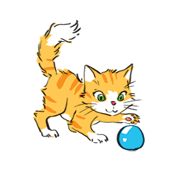
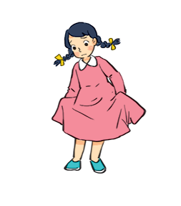
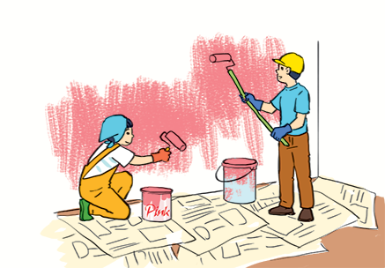
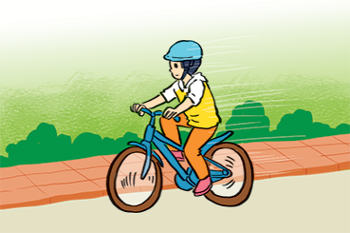
Match the sentences with the pictures, paying attention to the underlined part in each sentence.
1.
Sue doesn’t like her new dress.
1 - d
a
b
2.
Billy is riding his bicycle.
2 - f
3.
I’ll write my name in red. Could you write
your name in blue?
d
c
3 - e
4.
The cat is playing with its ball.
4 - b
5.
We love our school.
5 - a
e
f
6.
They are painting their room pink.
6 - c

Slide 5
Complete the sentences with the correct possessive adjectives.
1.
My favourite cartoon is Dragon Balls.
I love cartoons.
________ favourite cartoon is Dragon Balls.
This book has your name on it. Is it
_______ book?
2.
your book?
The lion has three cubs.
Its cubs are playing under a big tree.
3.
_______ cubs are playing under a big tree.
4.
Do you know my friend Anna?
_______ house is close to the park.
Her house is close to the park.
We are from Switzerland.
________ country is famous
5.
Our country is famous for chocolate.
for chocolate.

Slide 6
Complete the sentences with the correct possessive pronouns.
1.
I have a new bike. The bike is .
mine
These are Mai’s and Lan’s maps. These maps are .
2.
theirs
3.
This is a present for you. It’s .
yours
4.
My father has new shoes. They’re .
his
5.
This is our new house. The house is .
ours

Slide 7
Underline the correct word in brackets to complete each sentence.
1.
Australia is a strange country. All of (it’s / its) big cities are along the coast.
2.
Our city is very crowded. How about (your / yours)?
3.
I love my football club. Does phong like (his / him)?
4.
(Our / Ours) street is short and narrow.
5.
They cannot f ind (their / theirs) city map anywhere.

Slide 8
Choose the correct word to complete the sentences.
1.
The book is (my / mine / yours), but you are welcome to read it.
2.
( Your / Yours / You) bike is dirty, and I can’t tell what colour it is.
3.
Your country is much bigger than (our / ours / their).
4.
(They / Their / Theirs) dog is so friendly. It never barks.
5.
(It / It’s / Its) not easy to find your way in a strange city.

