Slide 2
Vocabulary:
delicious/ tasty ( adj)
ngon
helpful( adj)
sẵn sàng giúp đỡ
floating market( n)
chợ nổi
street food( n)
đồ ăn bán ở đường phố
Palace( n)
cung điện
Stall( n)
gian hàng

Slide 3
Fill each box with an adjective.
Vocabulary
rainy
old
exciting
old
city
delicious
delicious
tasty
friendly
food
exciting
friendly
helpful
sunny
people
tasty
rainy
sunny
helpful
weather

Slide 4
Complete the sentences with the words in 1.
Vocabulary
1.
- What’s the weather like in Sydney in summer?
sunny
- It’s and dry.
I love the buildings in Edinburgh. I feel that they can tell stories.
2.
old
There are so many things to do in New York. It’s very .
3.
exciting
4.
The people in my city are and helpful.
friendly
5.
Ha Noi is famous for its street food.
delicious / tasty

Slide 5
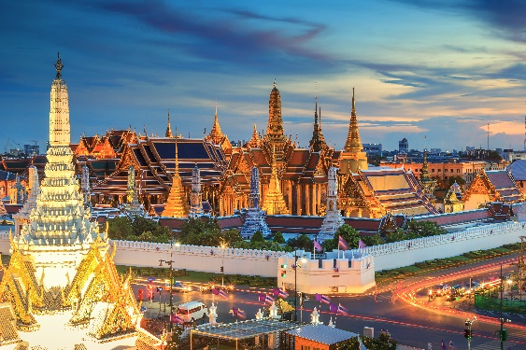
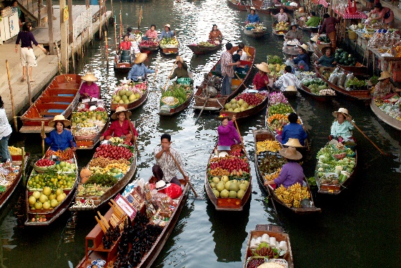
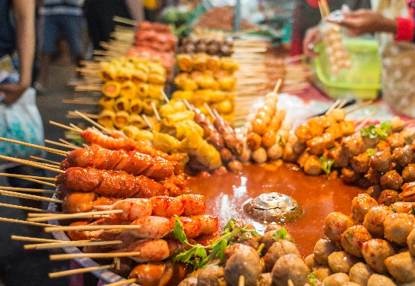
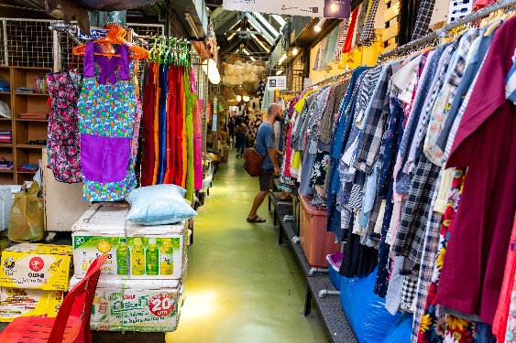
Write the words / phrases below under the correct pictures.
Vocabulary
stall
street food
palace
floating market
1.
palace
2.
floating market
3.
street food
4.
stall

Slide 6
Listen and write the words in the correct column. Then listen and repeat.
Pronunciation
/əʊ/ and /aʊ/
boat
house
town
tower
postcard
crowded
coast
pagoda
/əʊ/
/aʊ/
boat
house
postcard
crowded
coast
town
pagoda
tower

Slide 7
Listen and repeat. Pay attention to the underlined words.
Pronunciation
/əʊ/ and /aʊ/
1.
The town is crowded at the weekend.
2.
There’s lots of snow in Tokyo in winter.
3.
It’s very cold on the boat.
4.
He’s running aroud the house.

Slide 8
