Slide 2
Vocabulary
racket( n)
Cái vợt cầu lông
Goggles(n)
Kính bơi
competition(n)
cuộc thi
marathon(n)
cuộc đua ma-ra tông

Slide 3
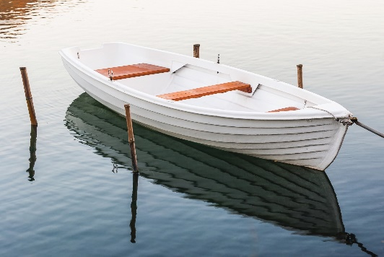
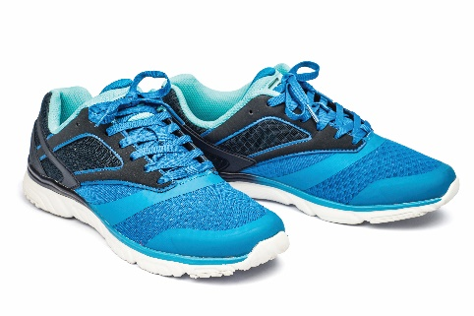
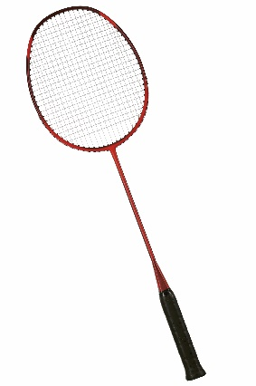
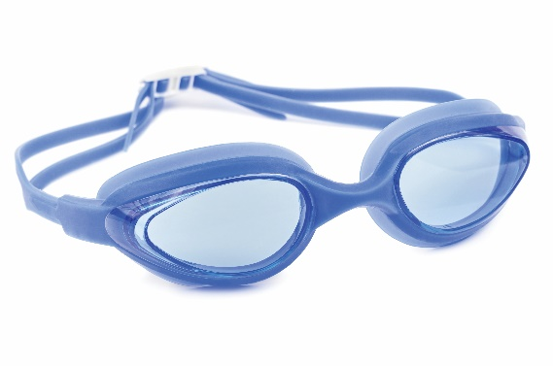
Write the right words under the pictures.
ball
racket
sports shoes
boat
goggles
1. ball
2. sports shoes
3.
1.
2.
3. boat
4. racket
5. goggles
4.
5.

Slide 4
What sports are these things for? Match each thing in column A with a sport in column B.
A
B
c.
1.
a.
cycling
bicycle
boating
d.
2.
b.
ball games
ball
swimming
c.
a.
cycling
3.
boat
boating
b.
swimming
4.
goggles
d.
ball games
e.
e.
badminton
5.
racket
badminton

Slide 5
Fill each blank with one of the words from the box.
champion
competition
sporty
marathon
congratulations
competition.
1.
She won an international sports
_______.
champion when he was very young.
2.
He became the world tennis
_______ when he was very young.
congratulations to the winner of the contest?”
3.
“Can you send my
_______ to the winner of the contest?”
_______. He does exercise every day.
4.
My friend David is very
sporty. He does exercise every day.
5.
The first
marathon took place in 1896.
_______ took place in 1896.

Slide 6
Pronunciation
/e/ and /æ/

Slide 7
Listen and repeat the words. Pay attention to the sounds /e/ and /æ/.
/e/ | /æ/
chess tennis exerise contest | racket match marathon active

Slide 8
Listen and repeat. Underline the words having the sounds /e/ and /æ/.
1.
They cannot take part in this contest.
2.
They began the match very late.
3.
Please get the racket for me.
4.
We play chess every Saturday.
5.
My grandpa is old, but he’s active.

Slide 9
Homework:
Prepare a closer look 2

