Slide 2
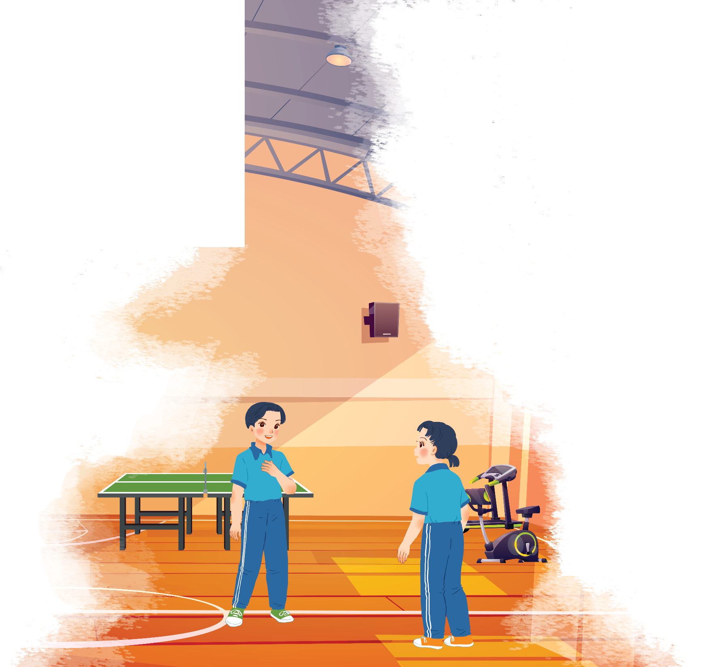
Listen and read.
At the gym

Slide 3
At the gym
Duong: Wow! This gym is big!
Mai: Yeah. The equipment is great. What sports do you do, Duong?
Duong: Well, I do karate, and I play table tennis. Yesterday I played with Duy, and I won!
Mai: Congratulations! You look f it! I’m not good at sports.
Duong: I have an idea – you can go to the karate club with me.
Mai: No, I can’t do karate.
Duong: But you can learn! You’ll love it.
Mai: Well ... OK.
Duong: Great! I’ll meet you there at 10 a.m. on Sunday.
Mai: Where’s the club?
Duong: It’s Superfit Club, in Pham Hung Road. You can cycle there.
Mai: OK. See you then.

Slide 4
Vocabulary:
gym ( n)
trung tâm thể dục thể thao
equipment (n)
thiết bị , dụng cụ
karate(n)
môn võ ka-ra- tê
Congratulations(n)
lời chúc mừng
Sporty( n)
khỏe mạnh, dáng thể thao

Slide 5
At the gym
Duong: Wow! This gym is big!
Mai: Yeah. The equipment is great. What sports do you do, Duong?
Duong: Well, I do karate, and I play table tennis. Yesterday I played with Duy, and I won!
Mai: Congratulations! You look f it! I’m not good at sports.
Duong: I have an idea – you can go to the karate club with me.
Mai: No, I can’t do karate.
Duong: But you can learn! You’ll love it.
Mai: Well ... OK.
Duong: Great! I’ll meet you there at 10 a.m. on Sunday.
Mai: Where’s the club?
Duong: It’s Superfit Club, in Pham Hung Road. You can cycle there.
Mai: OK. See you then.

Slide 6
Put a word from the conversation in each gap.
Duong looks
_______. He often does karate.
1.
fit. He often does karate.
2.
gym. The equipment there is great.
Mai likes coming to the
_______. The equipment there is great.
table tennis with Duy yesterday, and he won.
3.
Duong played
_______ with Duy yesterday, and he won.
Mai and Duong will meet at Superf it
Club on Sunday.
4.
_______ on Sunday.
5.
Mai will
cycle to Superf it Club.
_______ to Superf it Club.

Slide 7
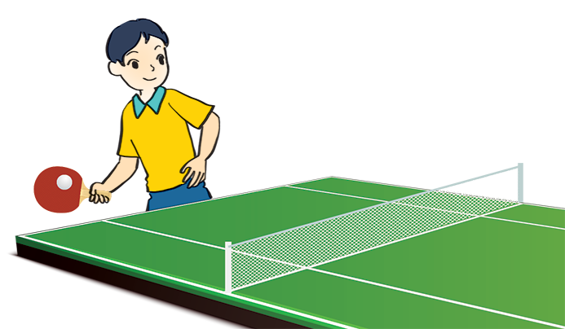
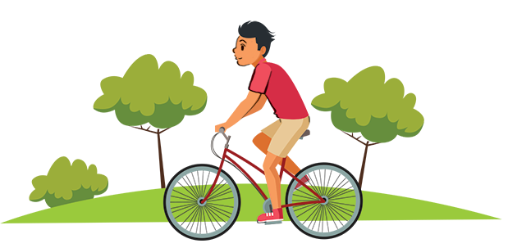
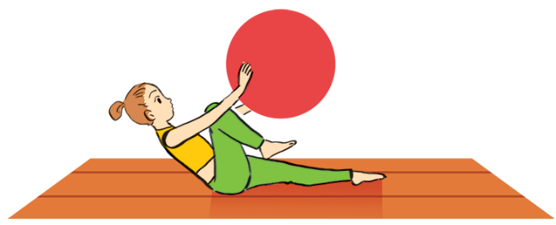
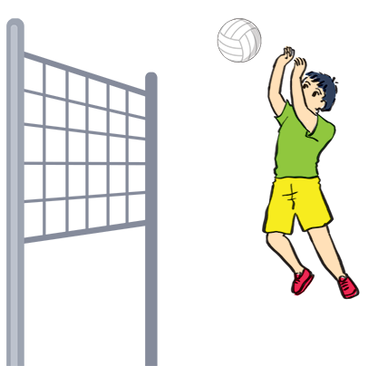
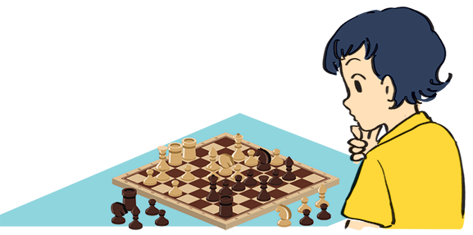
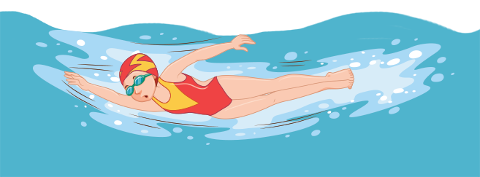
Name these sports and games, using the words from the box.
chess
cycling
aerobics
swimming
table tennis
volleyball
cycling
aerobics
3. table tennis
1.
2.
3.
swimming
5.
chess
6.
volleyball
4.

Slide 8
What is the diﬀerence between a sport and a game?

Slide 9
Work in pairs. Ask your partner these questions to find out how sporty they are.
1.
Can you swim?
If your answers to the questions are mostly “A”, you are sporty. If they are mostly “B”, do more sport and try to be more active.
A.
Yes.
B.
No.
2.
Do you play outdoors every day?
A.
Yes.
B.
No.
3.
Do you usually do morning excerise?
A.
Yes.
B.
No.
4.
What do you usually do at break time at school?
A.
Play in the school yard.
B.
Sit in the classroom.
5.
What do you think of sports and games?
A.
Very good.
B.
Not useful.

