Slide 2
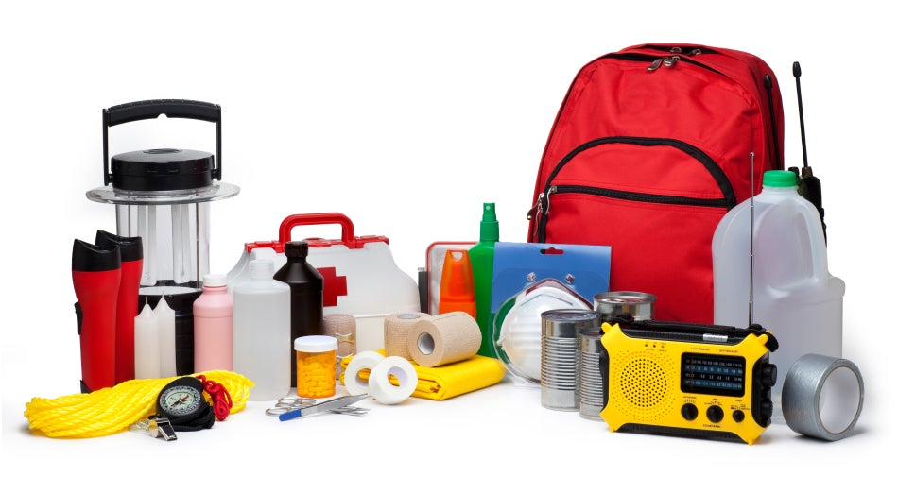
Unit
9
NATURAL DISASTERS
Unit
ETHNIC GROUPS OF VIET NAM
LESSON 6: SKILLS 2
LESSON 3: A CLOSER LOOK 2
Unit
HOBBIES

Slide 3
OBJECTIVES
By the end of the lesson, you will be able to:
Use the lexical items related to the topic of the listening text.
Develop the skills of listening for specific information.
Write instructions about things to do before, during, and after a flood.

Slide 4
LESSON 6: SKILLS 2
WARM-UP
Chatting: What should people do before, during and after a storm?
* Vocabulary
Task 1: Work in pairs. Look at the picture and answer the questions.
Task 2: Listen to a broadcast. Put the activities (1 – 6) in the correct column.
Task 3: Listen again and tick (√) T (True) or F (False) for each sentence.
LISTENING
Task 4: Work in pairs. Discuss what you should do before, during, and after a flood. Write your ideas in the columns.
Task 5: Write instructions (80 - 100 words) about things to do before, during, and after a flood.
WRITING
CONSOLIDATION
Wrap-up
Homework

Slide 5
LESSON 5: SKILLS 1
WARM-UP
Chatting: What should people do before, during and after a storm?

Slide 6
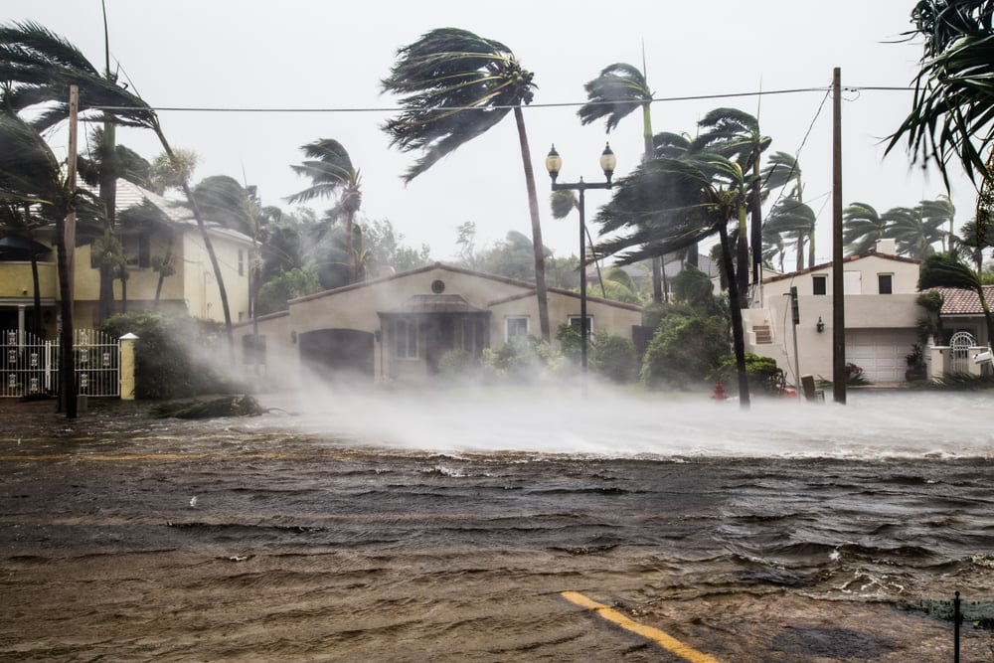
WARM-UP
Buy candles
What should people do before, during and after a storm?

Slide 7
LESSON 6: SKILLS 2
WARM-UP
Chatting: What should people do before, during and after a storm?
* Vocabulary
Task 1: Work in pairs. Look at the picture and answer the questions.
Task 2: Listen to a broadcast. Put the activities (1 – 6) in the correct column.
Task 3: Listen again and tick (√) T (True) or F (False) for each sentence.
LISTENING
Aims of the stage:
To introduce the new words related to natural disasters..
To help Ss develop the skill of listening for specific information.

Slide 8
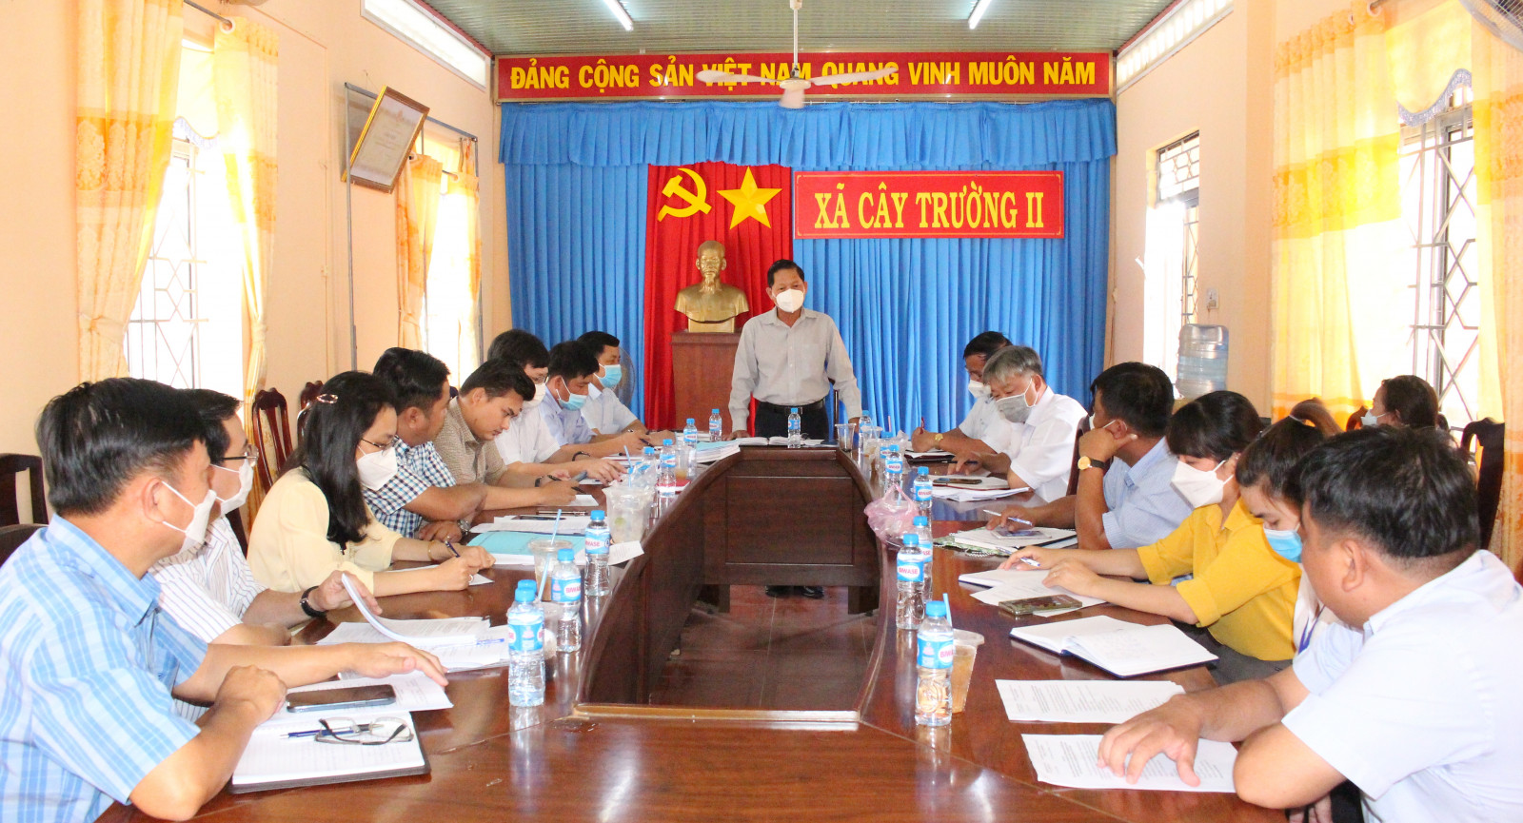
VOCABULARY
Authority (n)
/ɔːˈθɒrəti/
Chính quyền

Slide 9
VOCABULARY
Warn (v)
/wɔːn/
Cảnh báo

Slide 10
VOCABULARY
Avoid (v)
/əˈvɔɪd/
Tránh, tránh xa

Slide 11
VOCABULARY
New words | Pronunciation | Meaning
1. Authority (n) | /ɔːˈθɒrəti/ | Chính quyền
2. Warn (v) | /wɔːn/ | Cảnh báo
3. Avoid (v) | /əˈvɔɪd/ | Tránh, tránh xa

Slide 12
VOCABULARY
New words |  | Meaning
1. Authority (n)
2. Warn (v)
3. Avoid (v)
Cảnh báo
Tránh, tránh xa
Chính quyền

Slide 13
LISTENING
1
Work in pairs. Look at the picture and answer the questions.
What can you see in the picture?
2. When do we need these things?

Slide 14
LISTENING
2
Listen to a broadcast. Put the activities (1 – 6) in the correct column.
Before a storm | During a storm | After a storm
2,6
3,5
1,4
Listen to instructions from local authorities
2. Prepare an emergency kit
3. Stay inside the house
4. Keep away from dangerous areas
5. Avoid windows and glass doors
6. Strengthen houses

Slide 15
LISTENING
3
Listen again and tick (√) T (True) or F (False) for each sentence.
 | T | F
1. The broadcast is on TV.
2. You should bring flowerpots and rubbish bins into the house.
3. Right after the storm, you can leave your home.
4. The local authority may warn you about dangerous places.

Slide 16
LESSON 6: SKILLS 2
WARM-UP
Chatting: What should people do before, during and after a storm?
* Vocabulary
Task 1: Work in pairs. Look at the picture and answer the questions.
Task 2: Listen to a broadcast. Put the activities (1 – 6) in the correct column.
Task 3: Listen again and tick (√) T (True) or F (False) for each sentence.
LISTENING
Task 4: Work in pairs. Discuss what you should do before, during, and after a flood. Write your ideas in the columns.
Task 5: Write instructions (80 - 100 words) about things to do before, during, and after a flood.
WRITING

Slide 17
WRITING
4
Work in pairs. Discuss what you should do before, during, and after a flood. Write your ideas in the columns.
Before a storm | During a storm | After a storm
-Prepare an emergency
kit.
.........
-Stay inside a safe and high place.
…….
-Avoid moving water.
……..

Slide 18
WRITING
5
Write instructions (80 - 100 words) about things to do before, during, and after a flood.

Slide 19
LESSON 6: SKILLS 2
WARM-UP
Chatting: What should people do before, during and after a storm?
* Vocabulary
Task 1: Work in pairs. Look at the picture and answer the questions.
Task 2: Listen to a broadcast. Put the activities (1 – 6) in the correct column.
Task 3: Listen again and tick (√) T (True) or F (False) for each sentence.
LISTENING
Task 4: Work in pairs. Discuss what you should do before, during, and after a flood. Write your ideas in the columns.
Task 5: Write instructions (80 - 100 words) about things to do before, during, and after a flood.
WRITING
CONSOLIDATION
Wrap-up
Homework

Slide 20
CONSOLIDATION
1
WRAP-UP
In this lesson, you have:
learnt new words related to natural disasters.
known more about things to do before, during, and after a storm.
Written instructions about things to do before, during, and after a flood.

Slide 21
CONSOLIDATION
2
HOMEWORK
Learn by heart all the words.
Do exercises in the workbook.
Prepare for Lesson 7 – Looking back + project.

Slide 22
Website: hoclieu.vn
Fanpage: facebook.com/sachmem.vn/

