Slide 1


Slide 2


Unit
9
NATURAL DISASTERS
Unit
ETHNIC GROUPS OF VIET NAM
LESSON 3: A CLOSER LOOK 2
LESSON 3: A CLOSER LOOK 2
Unit
HOBBIES

Slide 3

OBJECTIVES
By the end of the lesson, students will be able to know how to use “The past continuous” in different situations.

Slide 4
LESSON 3: A CLOSER LOOK 2
WARM-UP
Questions and answers.
PRESENTATION
Introduce the form and use of the past continuous.
Task 1: Complete the sentences by putting the verbs in brackets into the past continuous.
Task 2: Circle the correct answer to complete each sentence.
Task 3: Look at the picture and write what each person in Lan’s family was doing when the earthquake happened. Use the given word and phrases from the box.
Task 4: Form questions using the past continuous. Then in pairs, ask and answer the questions.
PRACTICE
PRODUCTION
Task 5: Work in groups, think of six nouns related to each of the following topics “Leisure time, living in the mountains”.
CONSOLIDATION
Wrap-up
Homework

Slide 5

LESSON 3: A CLOSER LOOK 2
WARM-UP
Questions and answers.
Aims of the stage:
To create an active atmosphere in the class before the lesson.
To lead into the new lesson.

Slide 6
Questions and answers
I was watching TV at
8 pm yesterday.
What were you doing?

Slide 7
LESSON 3: A CLOSER LOOK 2
WARM-UP
Questions and answers.
PRESENTATION
Introduce the form and use of the past continuous.

Slide 8
PRESENTATION
Form of the past continuous:
Affirmative sentences: S + was/ were + V_ing…
Negative sentences: S + was/ were not + V_ing…
Questions: Was/ were + S + V_ing…?

Slide 9
PRESENTATION
The use of the past continuous:
We use the past continuous to describe:
+) an action that was happening at a particular time in the past.
+) a past action that was happening when another action interrupted it. We use the past simple for the action that interrupted it.
Notes:
+) We can use when or while before the past continuous.
+) We can only use when before the past simple.

Slide 10
LESSON 3: A CLOSER LOOK 2
WARM-UP
Questions and answers.
PRESENTATION
Introduce the form and use of the past continuous.
Task 1: Complete the sentences by putting the verbs in brackets into the past continuous.
Task 2: Circle the correct answer to complete each sentence.
Task 3: Look at the picture and write what each person in Lan’s family was doing when the earthquake happened. Use the given word and phrases from the box.
Task 4: Form questions using the past continuous. Then in pairs, ask and answer the questions.
PRACTICE

Slide 11
PRACTICE
1
Complete the sentences by putting the verbs in brackets into the past continuous.
1. They (help) _____________ the flood victims at 10 o’clock last night.
2. It (not snow) _______________ when I left home this afternoon.
3. While she (work) ____________ in the field, the tornado came.
4. – What you (do) ______________ at 9 o’clock yesterday morning? – I (watch) ____________ the news about a volcanic eruption.
5. – you (cry) _______________ when I saw you two days ago? – No, I wasn’t.
were helping
wasn’t snowing
was working
were you doing
was watching
were you crying

Slide 12
PRACTICE
2
Circle the correct answer to complete each sentence.
1. We donated / were donating money to help the earthquake victims last month.
2. – What did you do / were you doing when the volcano erupted? – I slept / was sleeping in my bed.
3. While they camped / were camping near the river, the flood was coming / came suddenly.
4. After Tom ran / was running out of his house, he moved / was moving quickly to a safer place.
5. I didn’t read / wasn’t reading a newspaper at 9 a.m. yesterday, but I watched / was watching the news about the tornado.

Slide 13
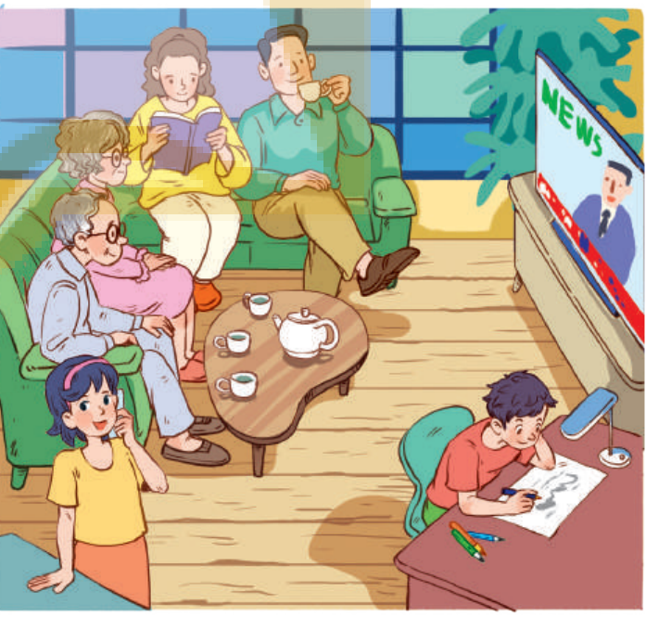
PRACTICE
3
Look at the picture and write what each person in Lan’s family was doing when the earthquake happened. Use the given word and phrases from the box.
1. Lan’s grandparents were watching TV.
2. Lan’s/ Her mother was reading a book.
3. Lan’s/ Her father was drinking tea.
4. Lan was talking on the phone.
5. Lan’s/ Her brother was drawing.
watch TV
read a book
drink tea
talk on the phone
draw

Slide 14
PRACTICE
4
Form questions using the past continuous. Then in pairs, ask and answer the questions.
Example: you / play / football / 5 o’clock yesterday afternoon?
Were you playing football at 5 o’clock yesterday afternoon?
Yes, I was. / No, I wasn’t. I was doing my homework

Slide 15
PRACTICE
4
Form questions using the past continuous. Then in pairs, ask and answer the questions.
1. you / have dinner / 7 o’clock yesterday evening?
=> Were you having dinner at 7 o’clock yesterday evening?
2. you / do / homework / 8 o’clock yesterday evening?
=> Were you doing your homework at 8 o’clock yesterday evening?
3. you / watch / film / 9 o’clock yesterday evening?
=> Were you watching a film at 9 o’clock yesterday evening?

Slide 16
LESSON 3: A CLOSER LOOK 2
WARM-UP
Questions and answers.
PRESENTATION
Introduce the form and use of the past continuous.
Task 1: Complete the sentences by putting the verbs in brackets into the past continuous.
Task 2: Circle the correct answer to complete each sentence.
Task 3: Look at the picture and write what each person in Lan’s family was doing when the earthquake happened. Use the given word and phrases from the box.
Task 4: Form questions using the past continuous. Then in pairs, ask and answer the questions.
PRACTICE
PRODUCTION
Task 5: Work in groups, think of six nouns related to each of the following topics “Leisure time, living in the mountains”.

Slide 17
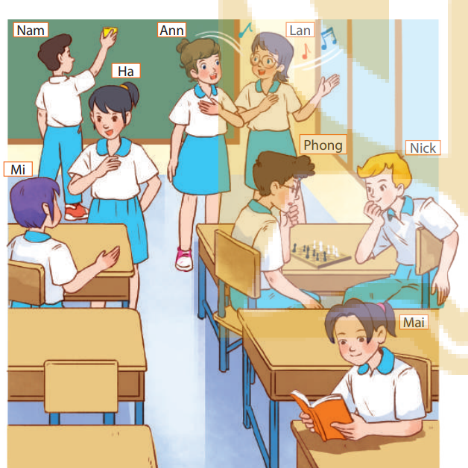
PRODUCTION
5
Work in groups. Take turns to say a sentence that describes what each person in the picture was doing
- Mai was reading.
- Phong and Nick were playing chess.
- Lan and Ann were singing.
- Nam was cleaning the board.
- Mi and Ha were talking.

Slide 18
LESSON 3: A CLOSER LOOK 2
WARM-UP
Questions and answers.
PRESENTATION
Introduce the form and use of the past continuous.
Task 1: Complete the sentences by putting the verbs in brackets into the past continuous.
Task 2: Circle the correct answer to complete each sentence.
Task 3: Look at the picture and write what each person in Lan’s family was doing when the earthquake happened. Use the given word and phrases from the box.
Task 4: Form questions using the past continuous. Then in pairs, ask and answer the questions.
PRACTICE
PRODUCTION
Task 5: Work in groups, think of six nouns related to each of the following topics “Leisure time, living in the mountains”.
CONSOLIDATION
Wrap-up
Homework

Slide 19
CONSOLIDATION
1
WRAP-UP
Structures:
Affirmative sentences: S + was/ were + V_ing ….
Negative sentences: S + was/ were not + V_ing …
Questions: Was/ were + S + V_ing …?

Slide 20

CONSOLIDATION
2
HOMEWORK
- Remember the structures and the use of the past continuous.
- Do exercises in the workbook.
- Prepare for Lesson 4 - Communication

Slide 21

Website: hoclieu.vn
Fanpage: facebook.com/sachmem.vn/

