Slide 1


Slide 2

Unit
9
NATURAL DISASTERS
LESSON 2: A CLOSER LOOK 1
VOCABULARY
PRONUNCIATION
Unit
HOBBIES

Slide 3

OBJECTIVES
By the end of the lesson, you will be able to gain:
- Vocabulary:
The lexical items related to natural disasters.
- Pronunciation:
Stress in words ending in -al and -ous.

Slide 4
LESSON 2: A CLOSER LOOK 1
WARM-UP
Game: Kim’s game
* Vocabulary
Task 1: In column B, write the noun forms of the verbs in column A.
Task 2: Write a word or phrase from the box under the correct picture.
Task 3: Fill in each blank with a word or phrase from the box.
VOCABULARY
PRONUNCIATION
Task 4: Listen and repeat the words. Pay attention to the word stress.
Task 5: Listen and repeat the sentences. Mark the stress in the underlined words.
CONSOLIDATION
Wrap-up
Homework

Slide 5
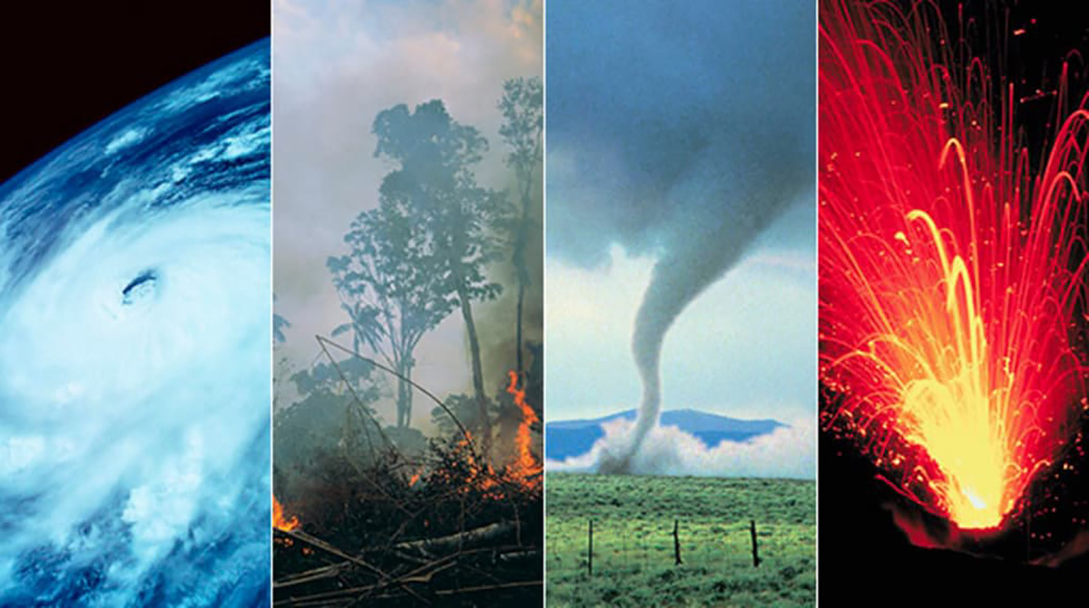
LESSON 2: A CLOSER LOOK 1
WARM-UP
Game: Kim’s game
Aims of the stage:
To activate students’ prior knowledge and vocabulary related to natural disasters.

Slide 6
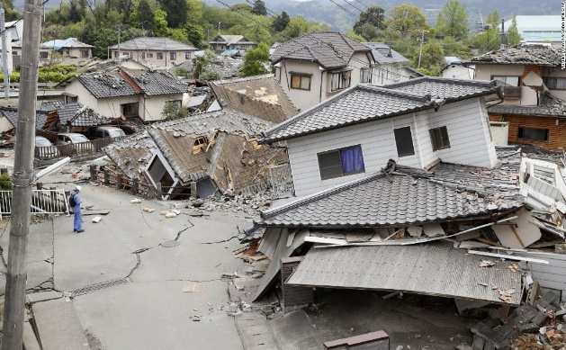
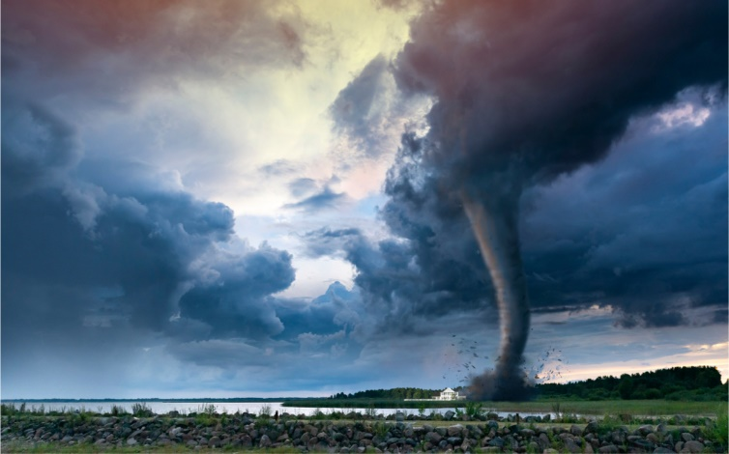
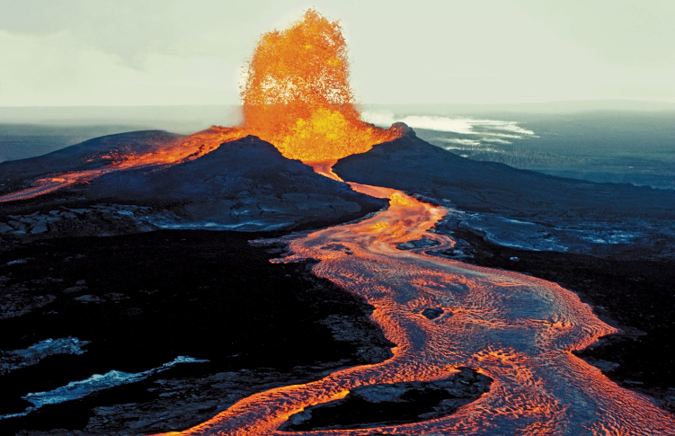
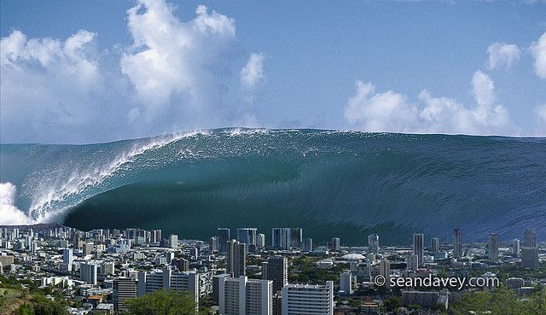
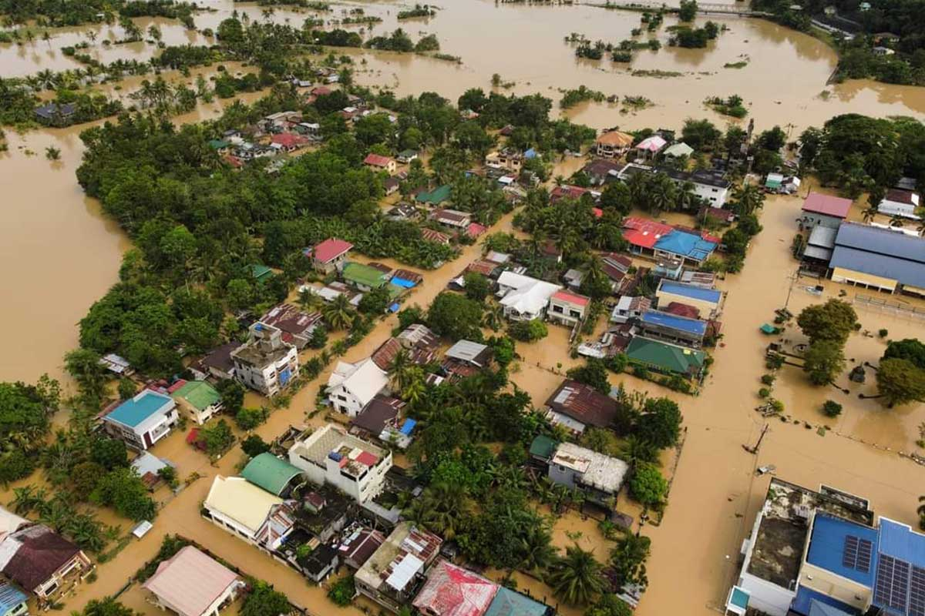
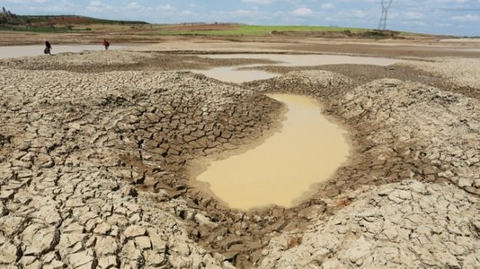
WARM-UP

Slide 7


WARM-UP
Earthquake
Tornado
Volcano
Tidal wave/ tsunami
Flood
Drought

Slide 8

LESSON 2: A CLOSER LOOK 1
LESSON 2: A CLOSER LOOK 1
WARM-UP
Game: Kim’s game
* Vocabulary
Task 1: In column B, write the noun forms of the verbs in column A.
Task 2: Write a word or phrase from the box under the correct picture.
Task 3: Fill in each blank with a word or phrase from the box.
VOCABULARY
Aims of the stage:
To introduce some new words related to natural disasters.

Slide 9
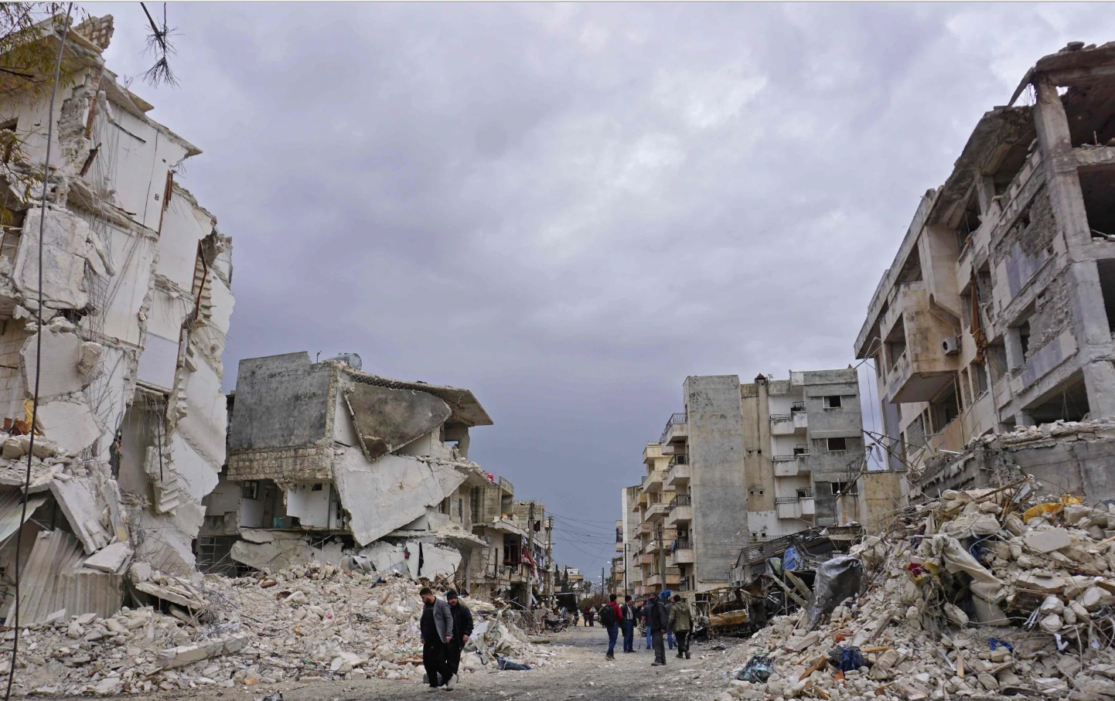
VOCABULARY
Destroy (v)
/dɪˈstrɔɪ/
Phá hủy

Slide 10
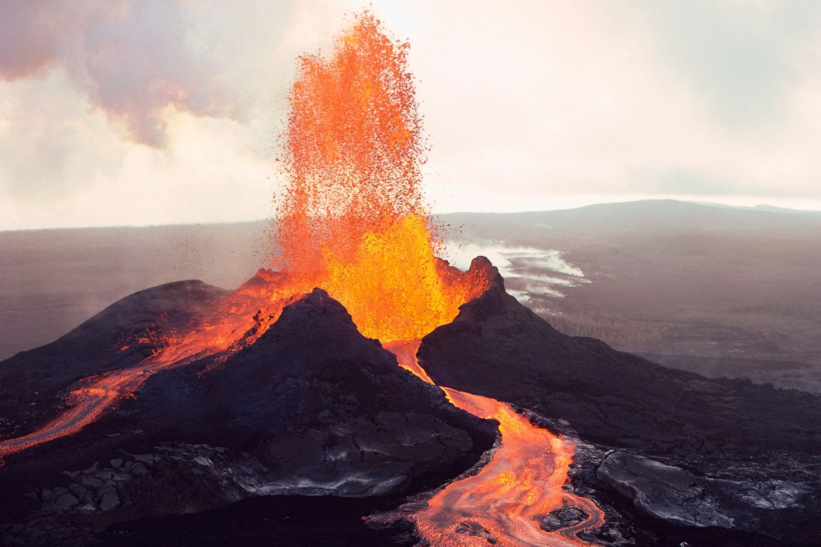
VOCABULARY
Erupt (v)
/ɪˈrʌpt/
Phun trào

Slide 11

VOCABULARY
Predict (v)
/prɪˈdɪkt/
Dự đoán

Slide 12
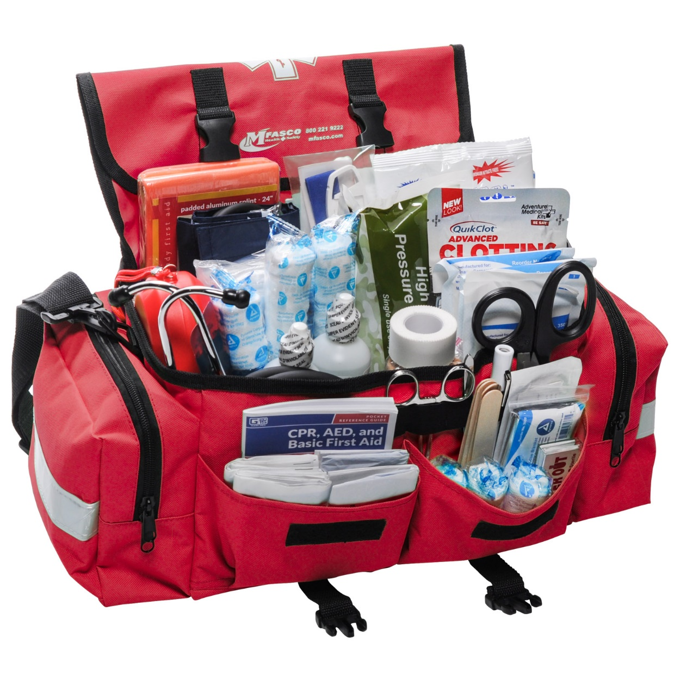
VOCABULARY
Emergency kit (n)
/ɪˈmɜːdʒənsikit/
Bộ dụng cụ dùng trong trường hợp khẩn cấp

Slide 13
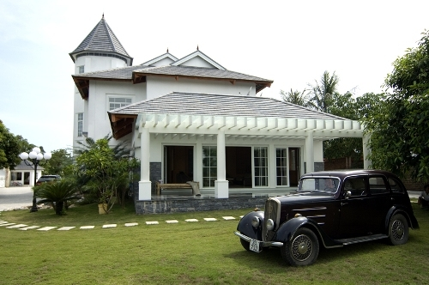
VOCABULARY
Property (n)
/ˈprɒpəti/
Của cải, nhà cửa

Slide 14
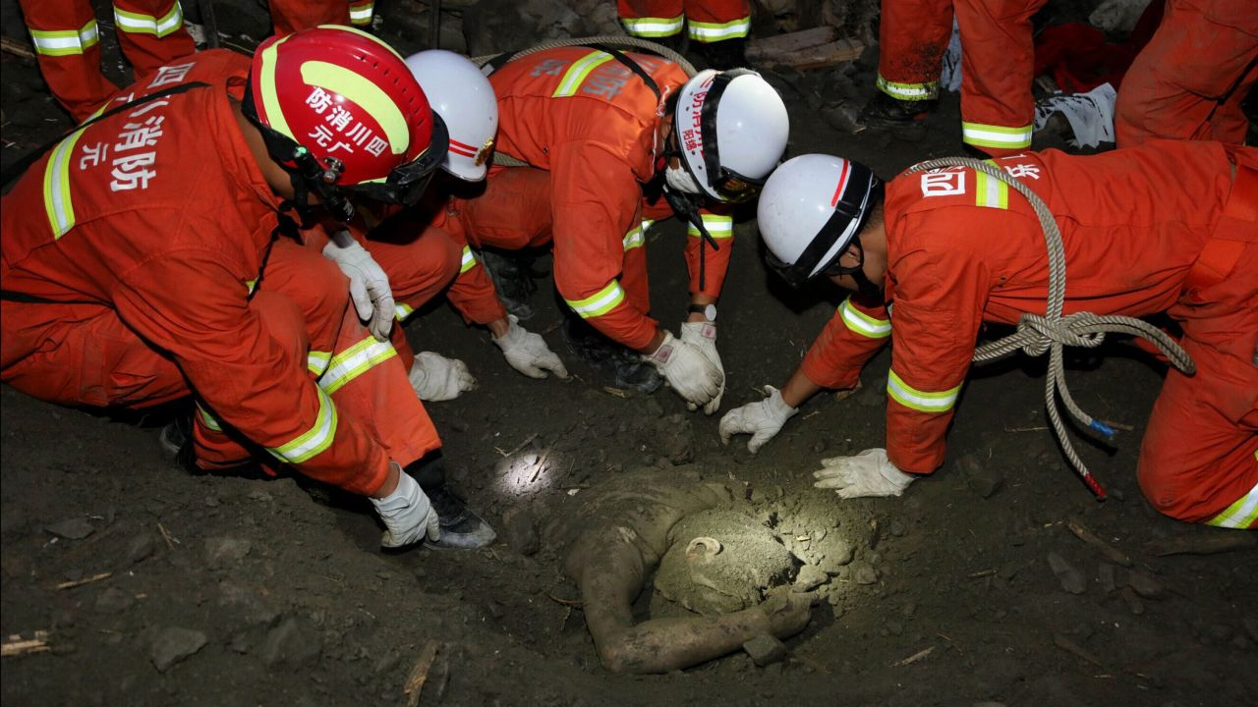
VOCABULARY
Rescue worker(n)
/ˈreskjuːˈwɜːkər /
Nhân viên cứu hộ

Slide 15
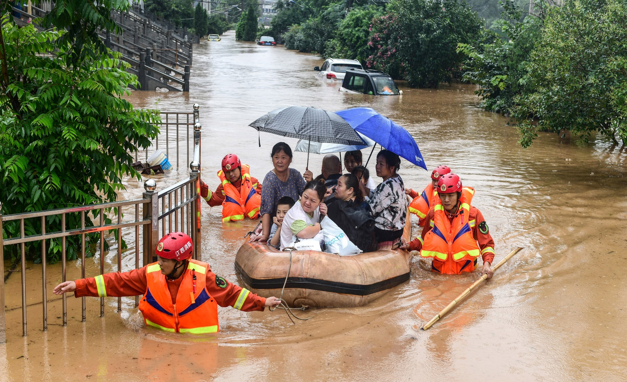
VOCABULARY
Victim (n)
/ˈvɪktəm/
Nạn nhân

Slide 16
VOCABULARY
New words | Pronunciation | Meaning
1. Destroy (v) | /dɪˈstrɔɪ/ | Phá hủy
2. Erupt (v) | /ɪˈrʌpt/ | Phun trào
3. Predict (v) | /prɪˈdɪkt/ | Dự đoán
4. Emergency kit | /ɪˈmɜːdʒənsikit/ | Bộ dụng cụ dùng trong trường hợp khẩn cấp
5. Property (n) | /ˈprɒpəti/ | Của cải, nhà cửa
6. Rescue worker | /ˈreskjuːˈwɜːkər / | Nhân viên cứu hộ
7. Victim (n) | /ˈvɪktəm/ | Nạn nhân

Slide 17
VOCABULARY
1
In column B, write the noun forms of the verbs in column A.
A | B
1. destroy
2. erupt
3. warn
4. predict
5. damage
destruction
eruption
warning
prediction
damage

Slide 18
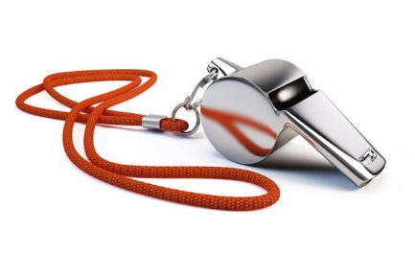

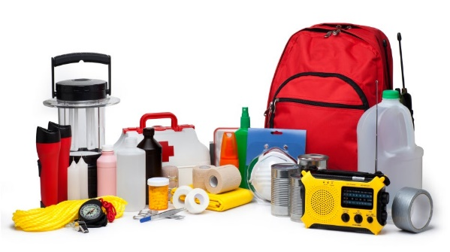
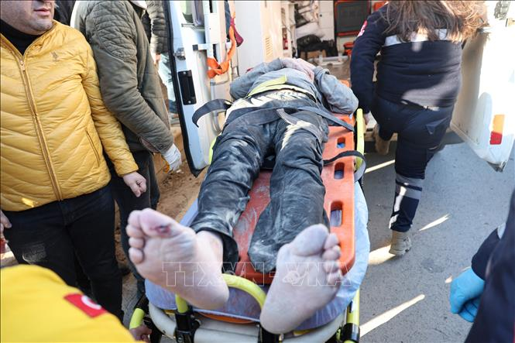
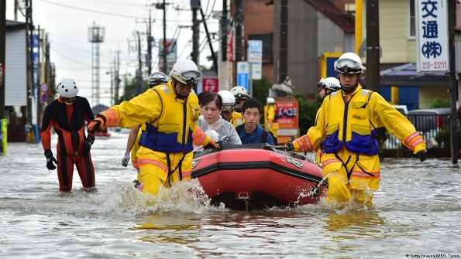
VOCABULARY
2
Write a word or phrase from the box under the correct picture
emergency kit victim rescue worker property whistle
whistle
property
emergency kit
1. ____________
2. _____________
3. _____________
victim
4. _____________
5. _____________
rescue worker

Slide 19
VOCABULARY
3
Fill in each blank with a word or phrase from the box.
warning predict property damage emergency kit
1. Natural disasters can cause serious ________ to human life.
2. Local authorities gave a flood ________ yesterday, so today people are moving to safer places.
3. To prepare for a natural disaster, we should make a(n) _____________.
4. It’s hard to believe that we cannot _______ when earthquakes will happen.
5. They lost all of their ________ because of the volcanic eruption.
damage
warning
emergency kit
predict
property

Slide 20
LESSON 2: A CLOSER LOOK 1
WARM-UP
Game: Kim’s game
* Vocabulary
Task 1: In column B, write the noun forms of the verbs in column A.
Task 2: Write a word or phrase from the box under the correct picture.
Task 3: Fill in each blank with a word or phrase from the box.
VOCABULARY
PRONUNCIATION
Task 4: Listen and repeat the words. Pay attention to the word stress.
Task 5: Listen and repeat the sentences. Mark the stress in the underlined words.

Slide 21

PRONUNCIATION
Aims of the stage:
To help students identify the stress in words ending in -al and -ous

Slide 22

PRONUNCIATION
Stress in words ending in -al and -ous

Slide 23

PRONUNCIATION
4
Listen and repeat the words. Pay attention to the word stress
musical dangerous
humorous national
practical poisonous
personal marvellous

Slide 24

PRONUNCIATION
5
Listen and repeat the sentences. Mark the stress in the underlined words.
1. The flood victims are collecting their personal property.
2. Avoid dangerous places, such as windows or bookcases, during an earthquake.
3. There are numerous tropical storms in this area every year.
4. Some natural disasters, such as landslides, usually happen in mountainous areas.
5. She gave us practical tips about treating poisonous wastes.
-al/ -ous
‘
‘
‘
‘
‘
‘
‘
‘

Slide 25
LESSON 2: A CLOSER LOOK 1
WARM-UP
Game: Kim’s game
* Vocabulary
Task 1: In column B, write the noun forms of the verbs in column A.
Task 2: Write a word or phrase from the box under the correct picture.
Task 3: Fill in each blank with a word or phrase from the box.
VOCABULARY
PRONUNCIATION
Task 4: Listen and repeat the words. Pay attention to the word stress.
Task 5: Listen and repeat the sentences. Mark the stress in the underlined words.
CONSOLIDATION
Wrap-up
Homework

Slide 26
CONSOLIDATION
1
WRAP-UP
VOCABULARY
PRONUNCIATION

Slide 27

CONSOLIDATION
2
HOMEWORK
- Learn by heart all the words that you have just learnt.
- Do exercises in the workbook.
- Prepare for Lesson 3 - A closer look 2.

Slide 28

Website: hoclieu.vn
Fanpage: facebook.com/sachmem.vn/

